Slide 1
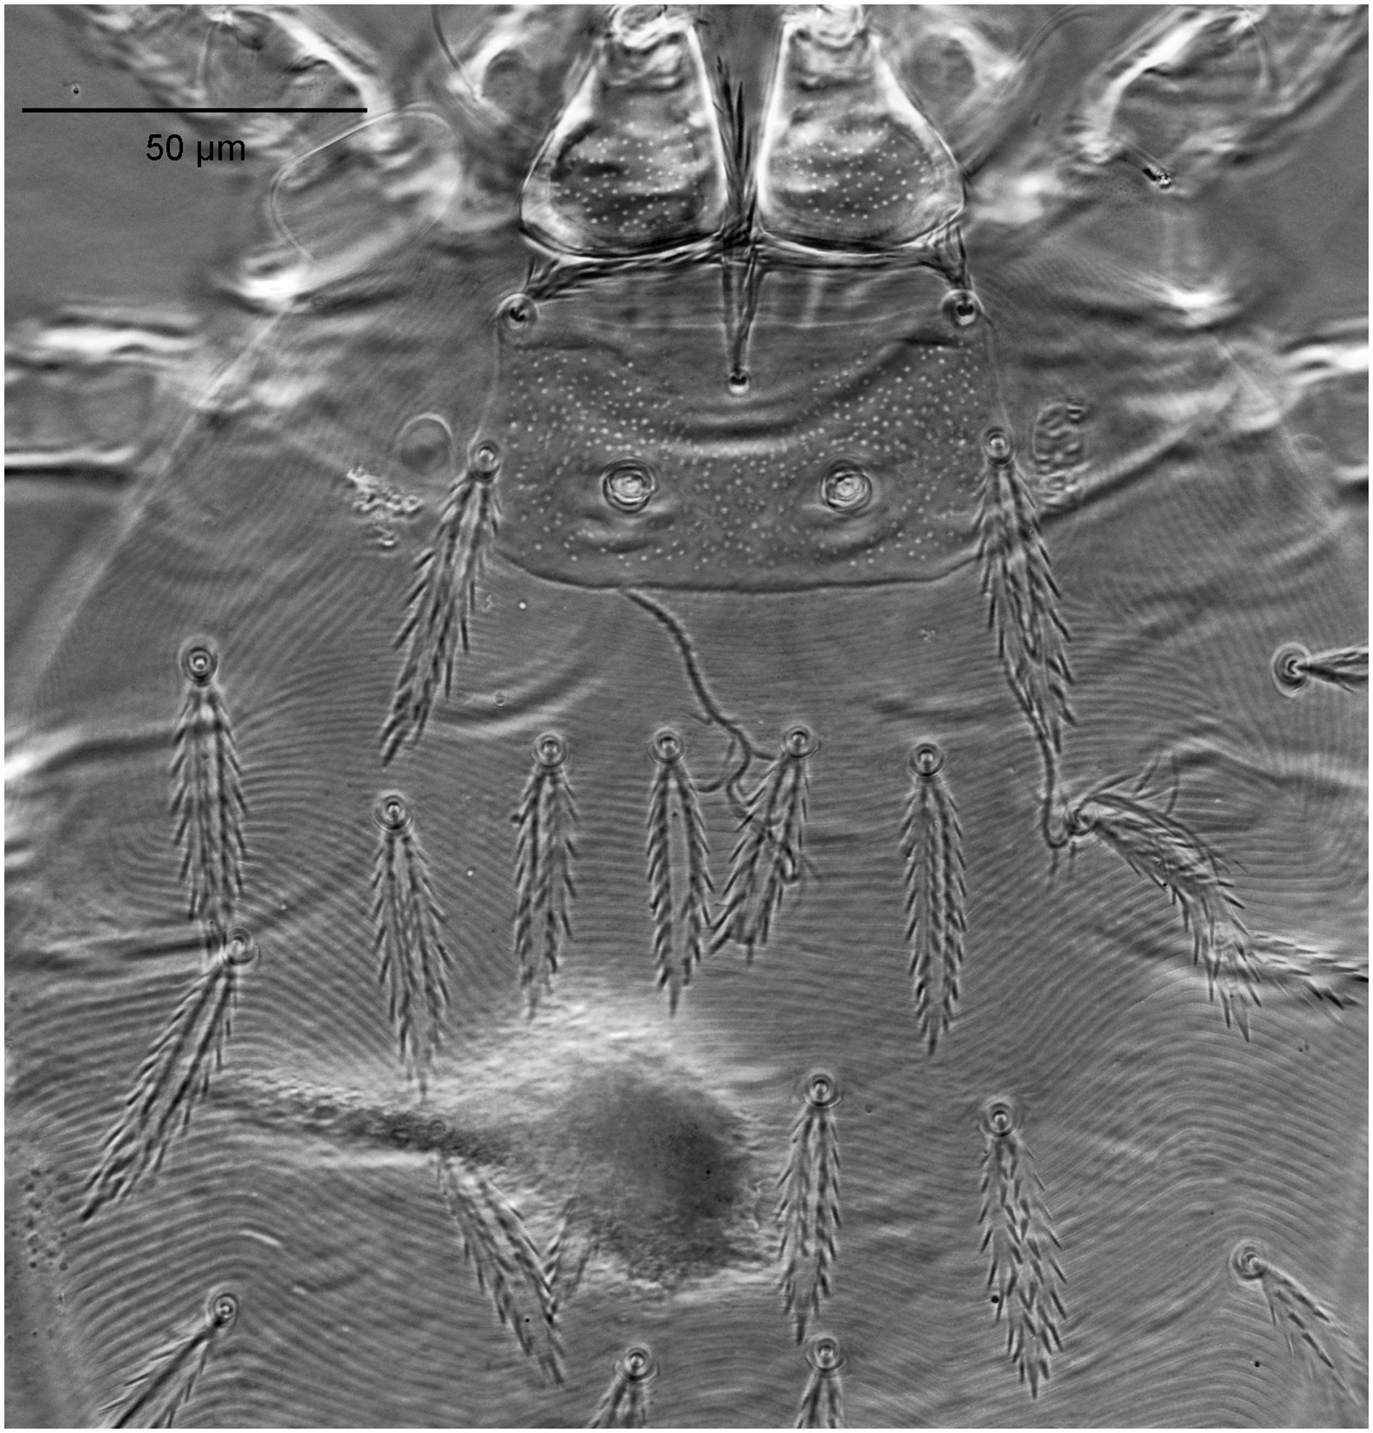
Fig. 1. Trombiculindus kosapani sp. nov. (holotype), scutum and dorsal idiosomal setae.
Notes:
Fig. 1. Trombiculindus kosapani sp. nov. (holotype), scutum and dorsal idiosomal setae.
Unless provided in the caption above, the following copyright applies to the content of this slide: © The Authors 2016. Published by Oxford University Press on behalf of Entomological Society of America. All rights reserved. For Permissions, please email: journals.permissions@oup.com

Slide 2
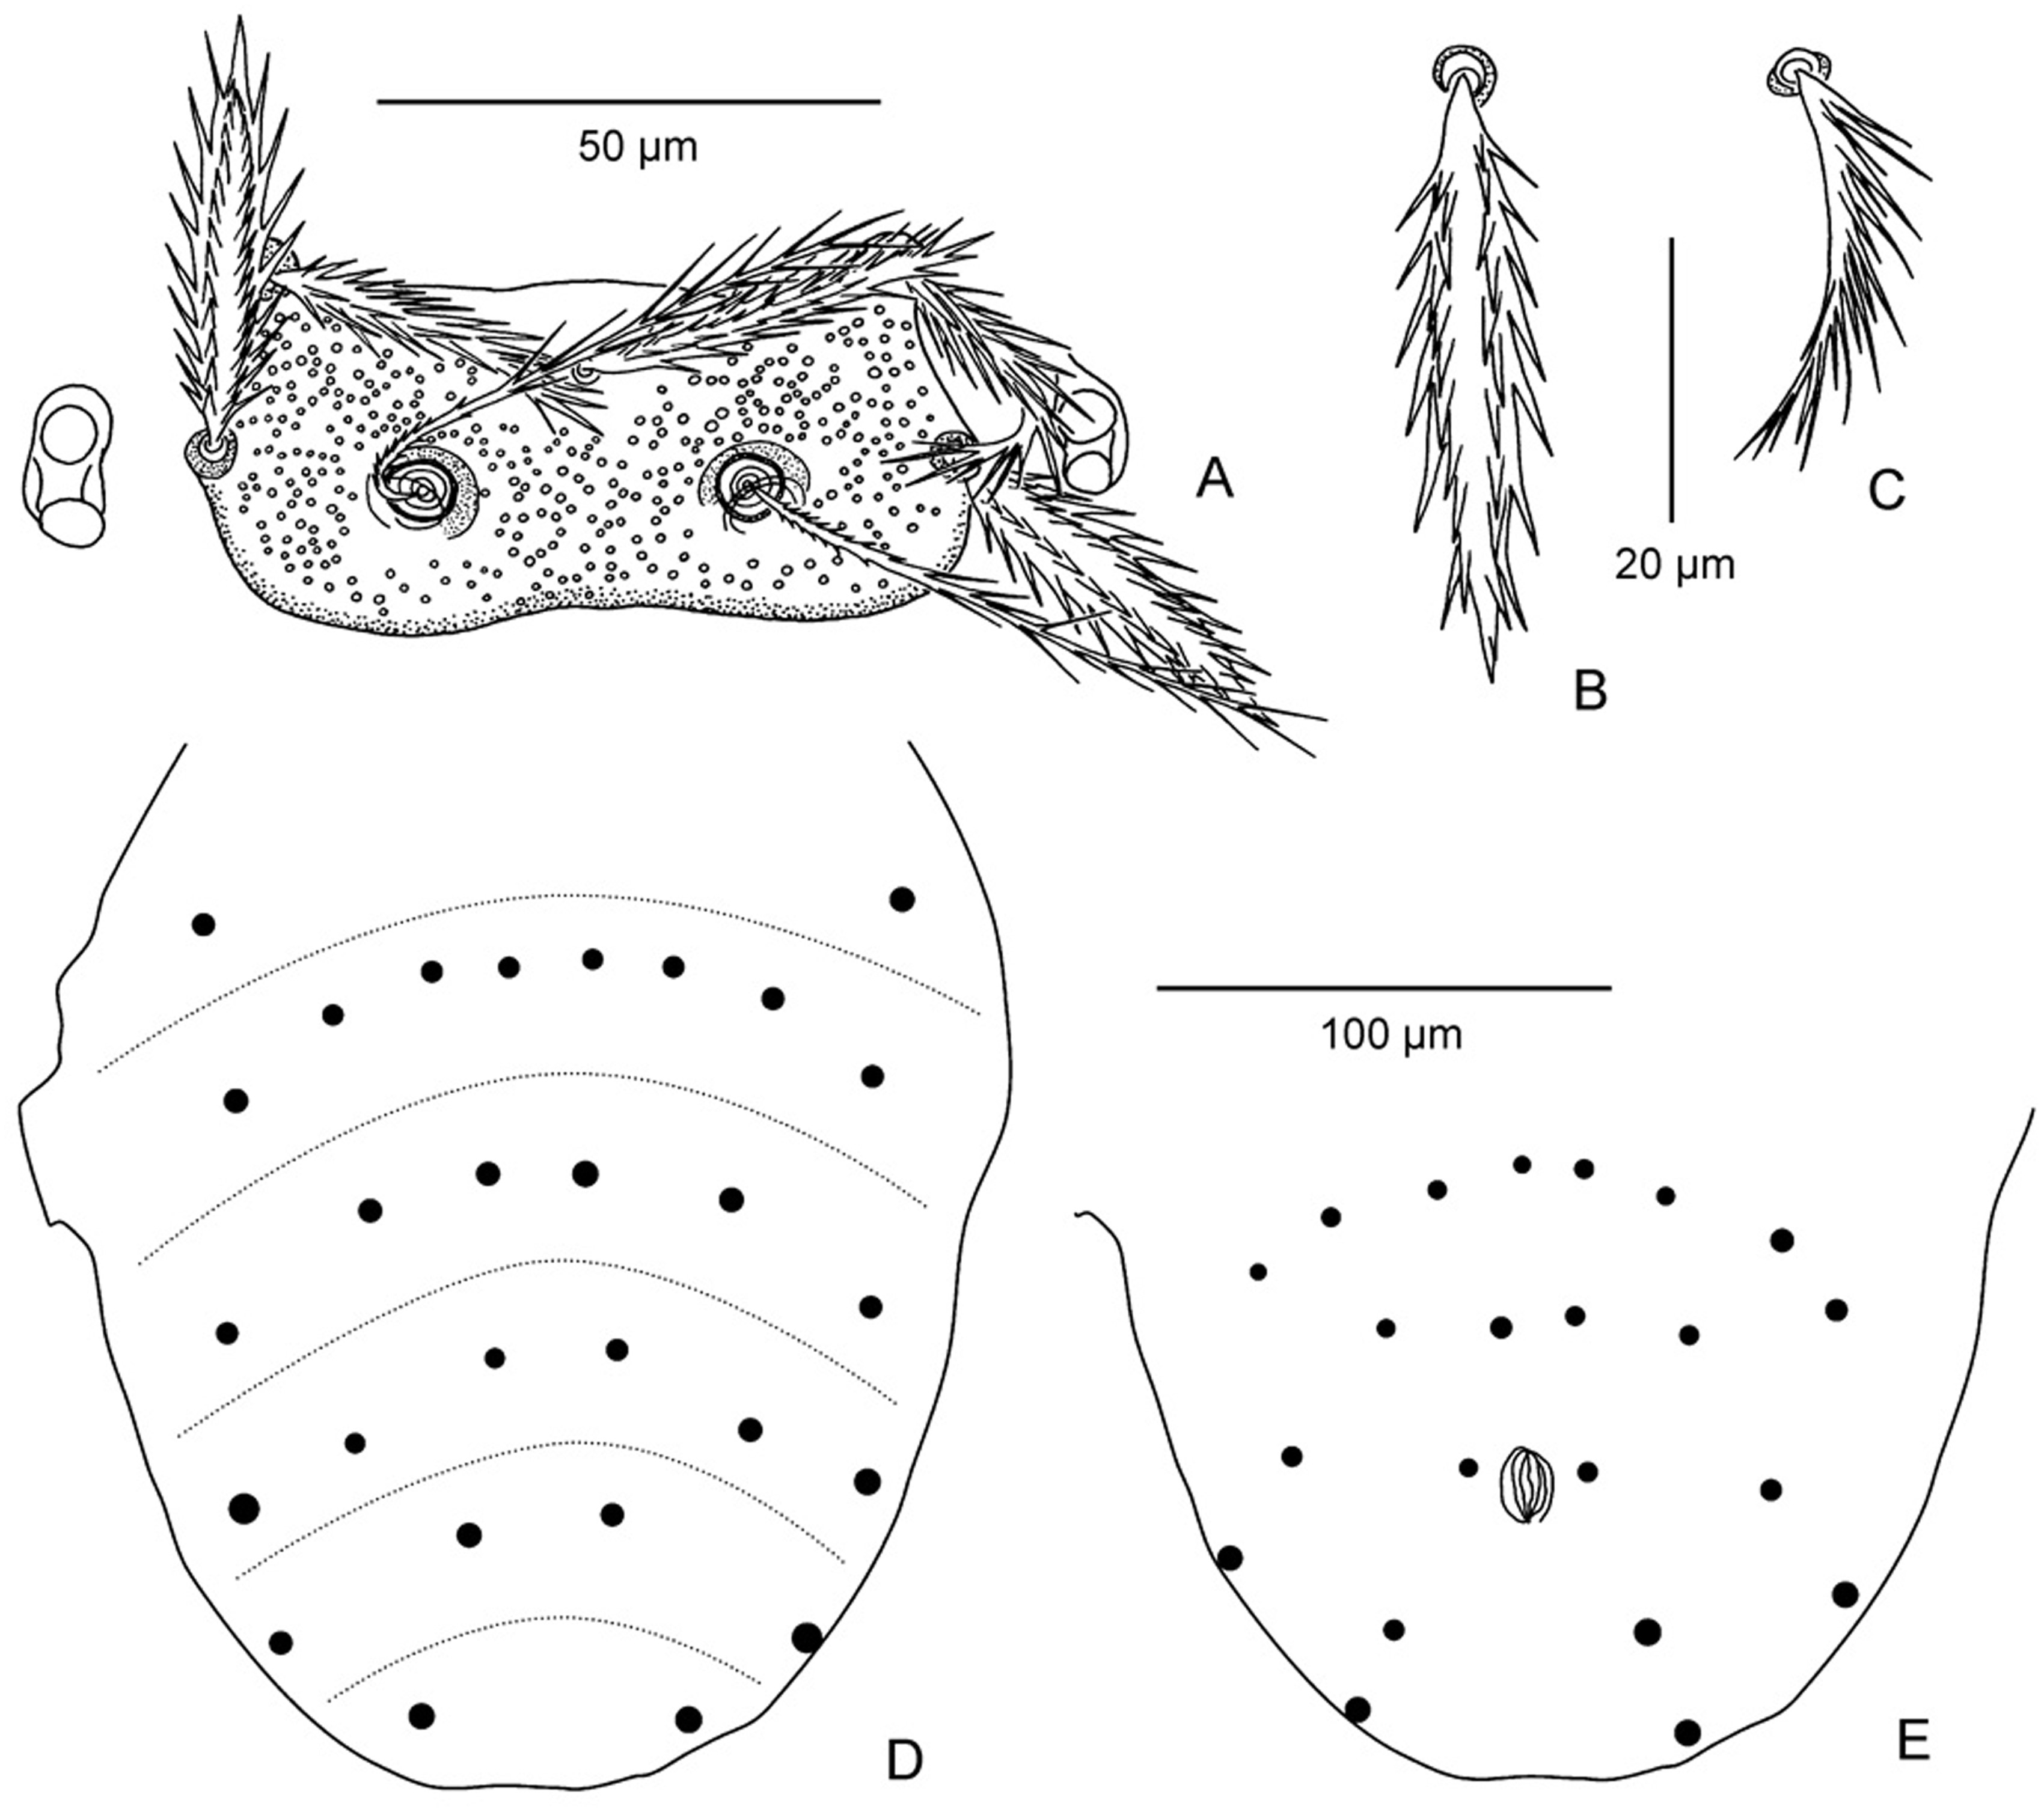
Fig. 2. Trombiculindus kosapani sp. nov. (paratype). ( A ) Scutum and eyes. ( B ) Marginal dorsal idiosomal seta of ...
Notes:
Fig. 2. Trombiculindus kosapani sp. nov. (paratype). ( A ) Scutum and eyes. ( B ) Marginal dorsal idiosomal seta of first row. ( C ) Preanal ventral idiosomal seta. ( D ) Arrangement of dorsal idiosomal setae. ( E ) Arrangement of ventral idiosomal setae. Scale bars: 50 μm (A), 20 μm (B, C), 100 μm (D, E).
Unless provided in the caption above, the following copyright applies to the content of this slide: © The Authors 2016. Published by Oxford University Press on behalf of Entomological Society of America. All rights reserved. For Permissions, please email: journals.permissions@oup.com

Slide 3
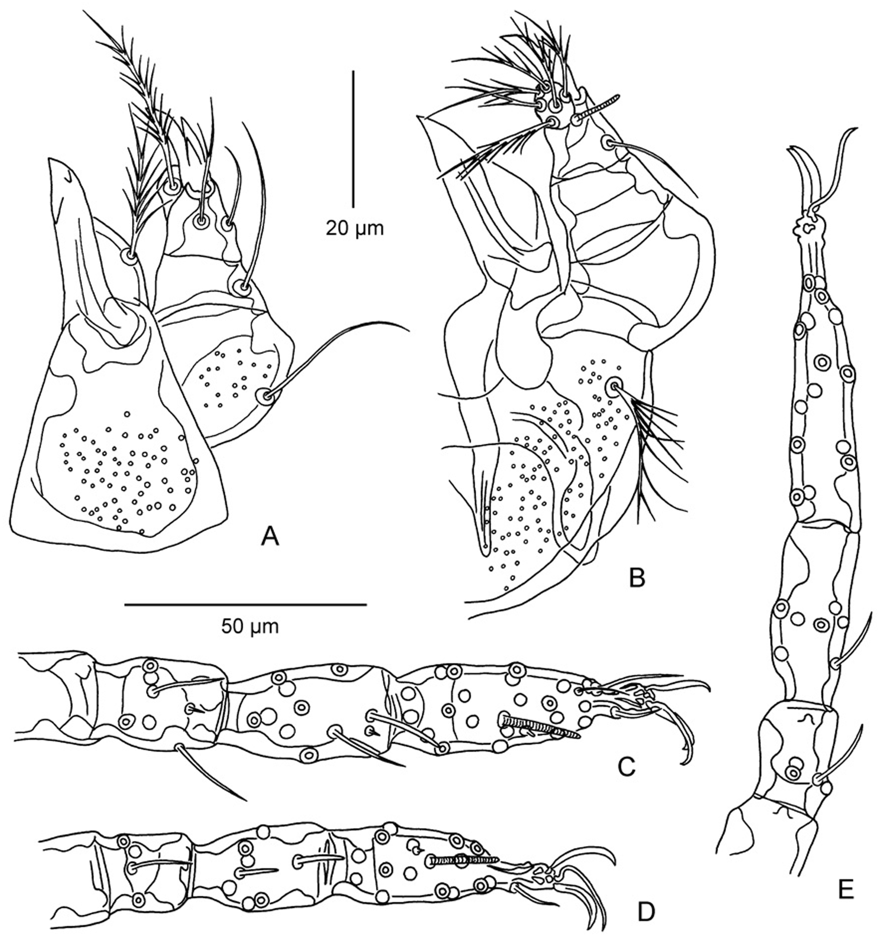
Fig. 3. Trombiculindus kosapani sp. nov. (holotype). ( A ) Dorsal aspect of gnathosoma. ( B ) Ventral aspect of ...
Notes:
Fig. 3. Trombiculindus kosapani sp. nov. (holotype). ( A ) Dorsal aspect of gnathosoma. ( B ) Ventral aspect of gnathosoma. ( C ) Tarsus, tibia, and genu of leg I. ( D ) Tarsus, tibia, and genu of leg II. ( E ) Tarsus, tibia, and genu of leg III. Scale bars: 20 μm (A, B), 50 μm (C–E).
Unless provided in the caption above, the following copyright applies to the content of this slide: © The Authors 2016. Published by Oxford University Press on behalf of Entomological Society of America. All rights reserved. For Permissions, please email: journals.permissions@oup.com

Slide 4
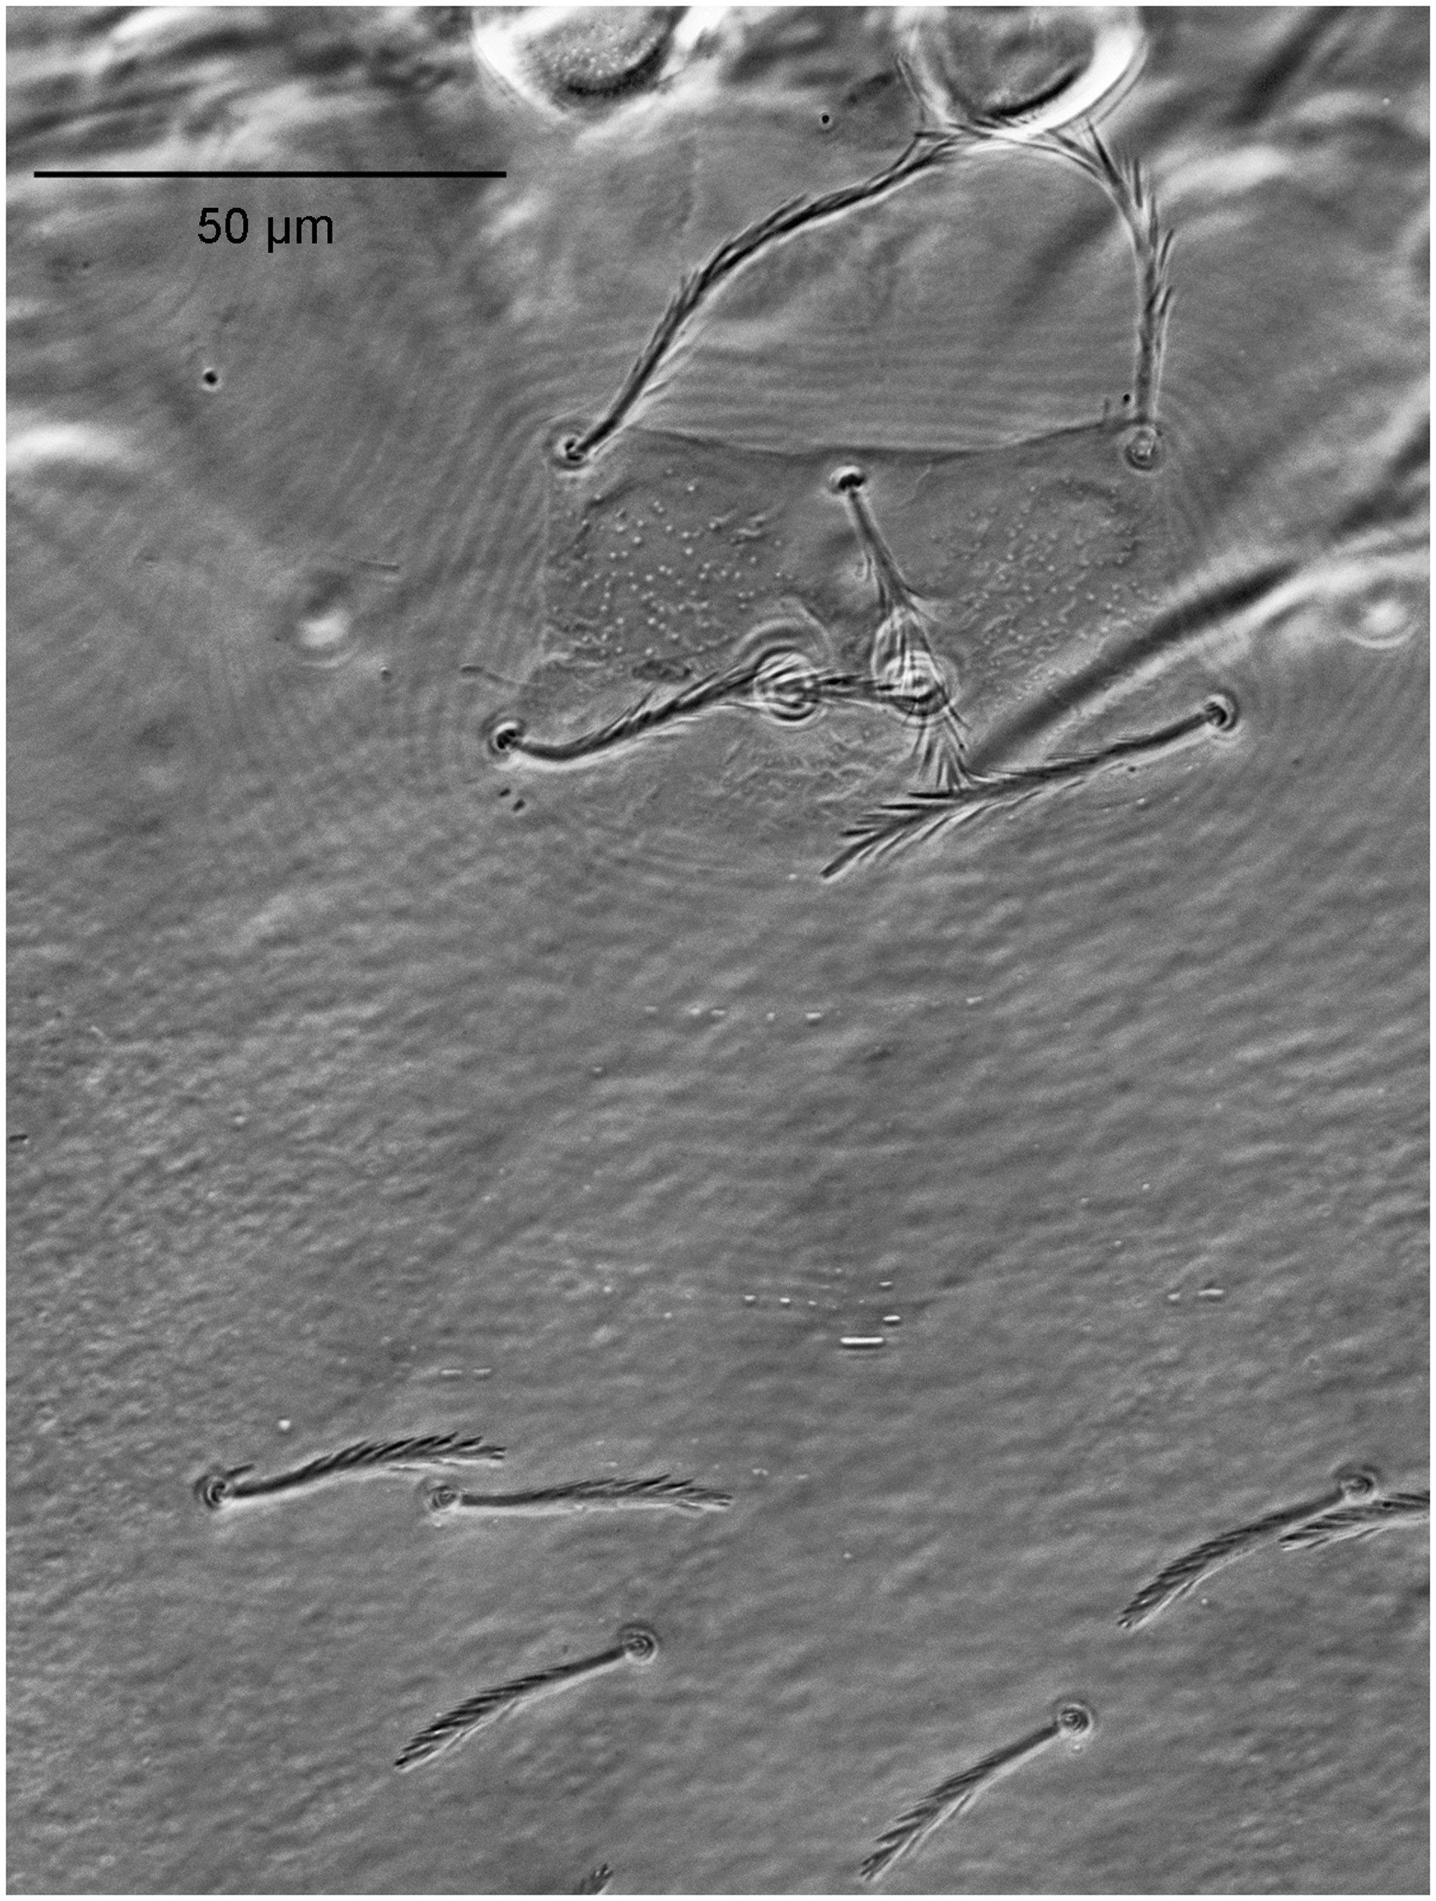
Fig. 4. Helenicula naresuani sp. nov. (paratype), scutum and dorsal idiosomal setae.
Notes:
Fig. 4. Helenicula naresuani sp. nov. (paratype), scutum and dorsal idiosomal setae.
Unless provided in the caption above, the following copyright applies to the content of this slide: © The Authors 2016. Published by Oxford University Press on behalf of Entomological Society of America. All rights reserved. For Permissions, please email: journals.permissions@oup.com

Slide 5
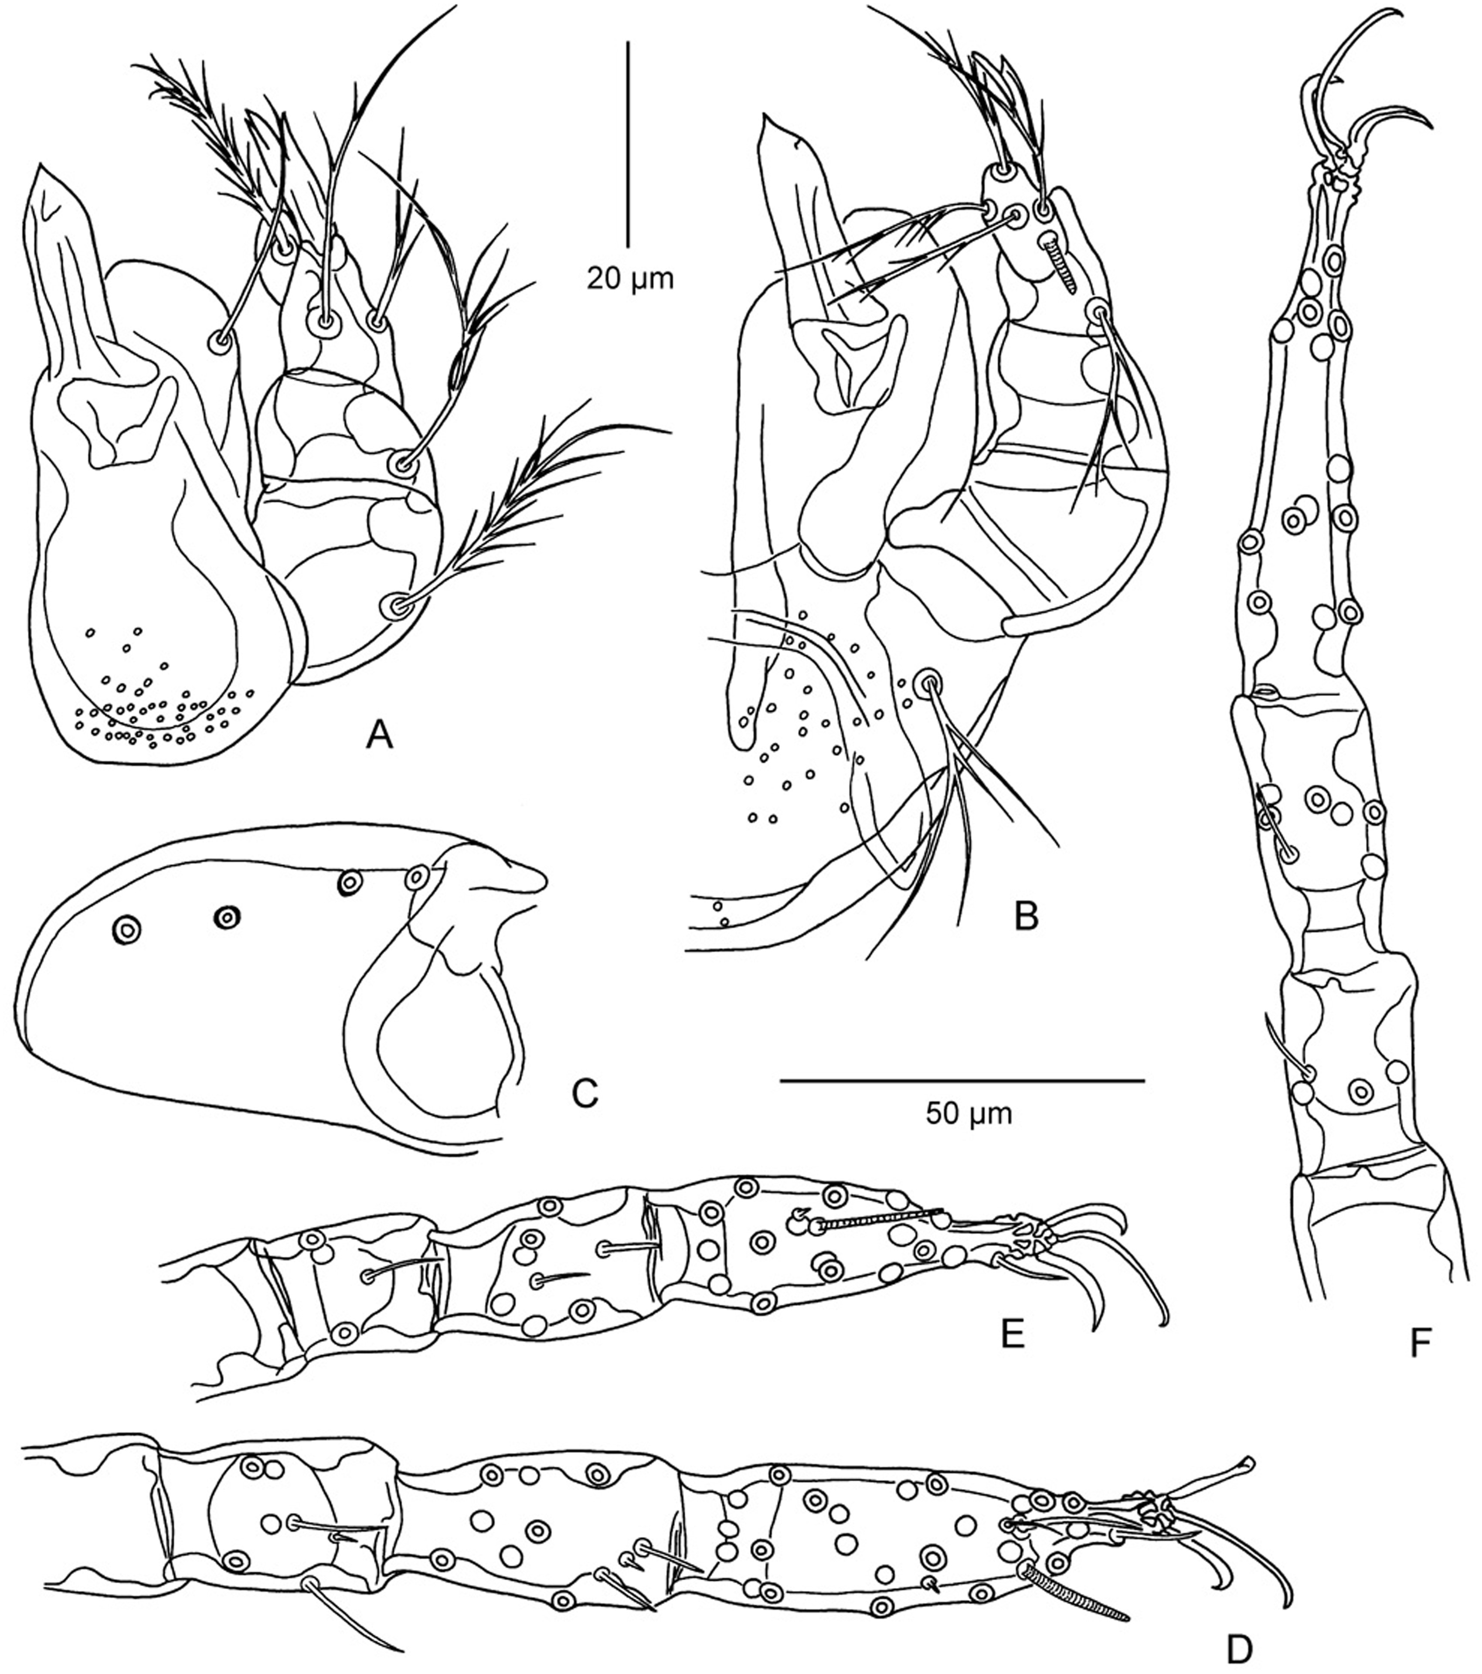
Fig. 6. Helenicula naresuani sp. nov. (holotype). ( A ) Dorsal aspect of gnathosoma. ( B ) Ventral aspect of ...
Notes:
Fig. 6. Helenicula naresuani sp. nov. (holotype). ( A ) Dorsal aspect of gnathosoma. ( B ) Ventral aspect of gnathosoma. ( C ) Coxa of leg III. ( D ) Tarsus, tibia, and genu of leg I. ( E ) Tarsus, tibia, and genu of leg II. ( F ) Tarsus, tibia, and genu of leg III. Scale bars: 20 μm (A, B), 50 μm (C–F).
Unless provided in the caption above, the following copyright applies to the content of this slide: © The Authors 2016. Published by Oxford University Press on behalf of Entomological Society of America. All rights reserved. For Permissions, please email: journals.permissions@oup.com

Slide 6
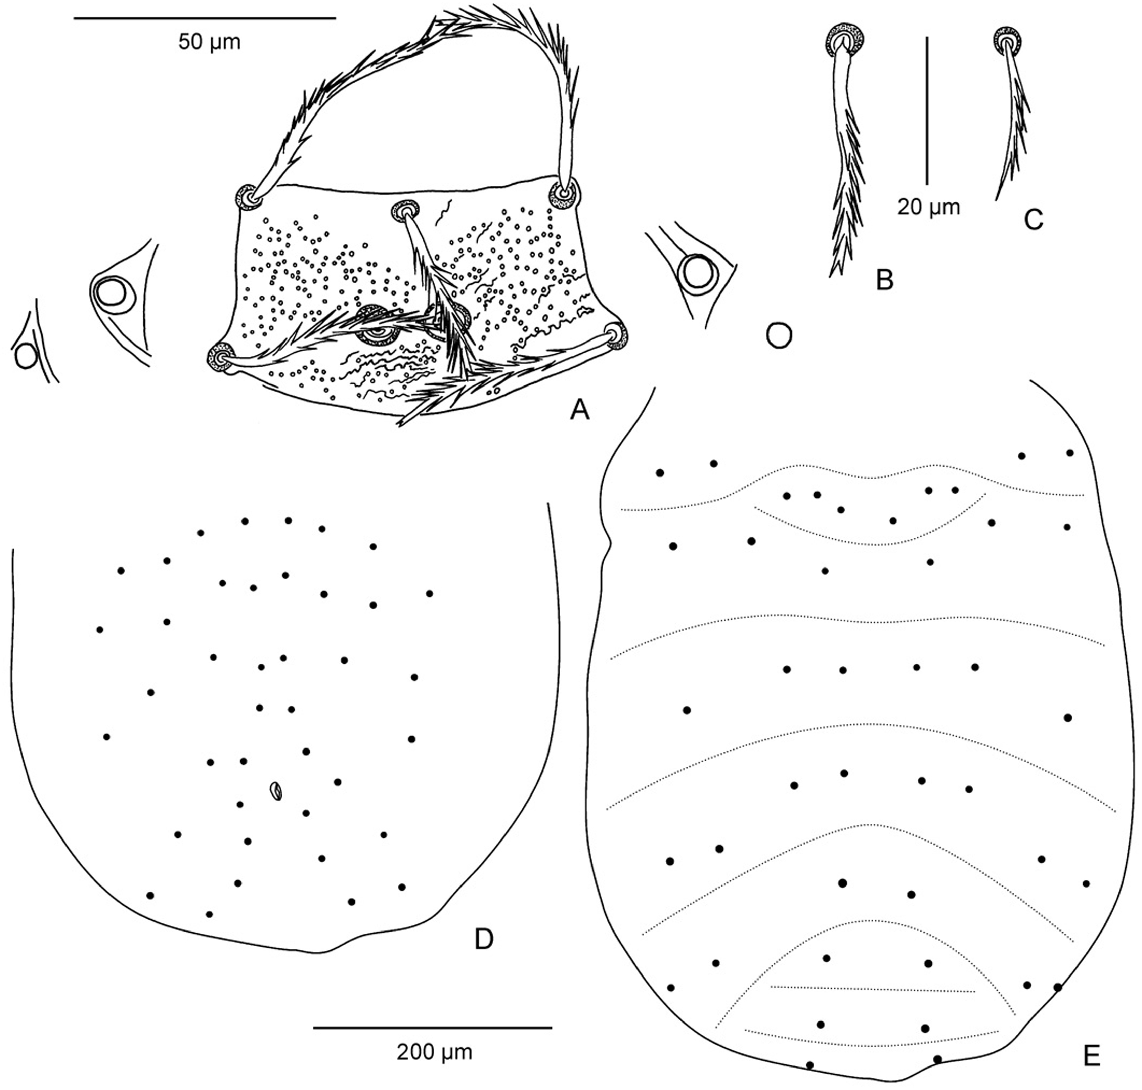
Fig. 5. Helenicula naresuani sp. nov. (paratype). ( A ) Scutum and eyes. ( B ) Dorsal idiosomal seta of first row. ( ...
Notes:
Fig. 5. Helenicula naresuani sp. nov. (paratype). ( A ) Scutum and eyes. ( B ) Dorsal idiosomal seta of first row. ( C ) Preanal ventral idiosomal seta. ( D ) Arrangement of ventral idiosomal setae. ( E ) Arrangement of dorsal idiosomal setae. Scale bars: 50 μm (A), 20 μm (B, C), 200 μm (D, E).
Unless provided in the caption above, the following copyright applies to the content of this slide: © The Authors 2016. Published by Oxford University Press on behalf of Entomological Society of America. All rights reserved. For Permissions, please email: journals.permissions@oup.com

Slide 7
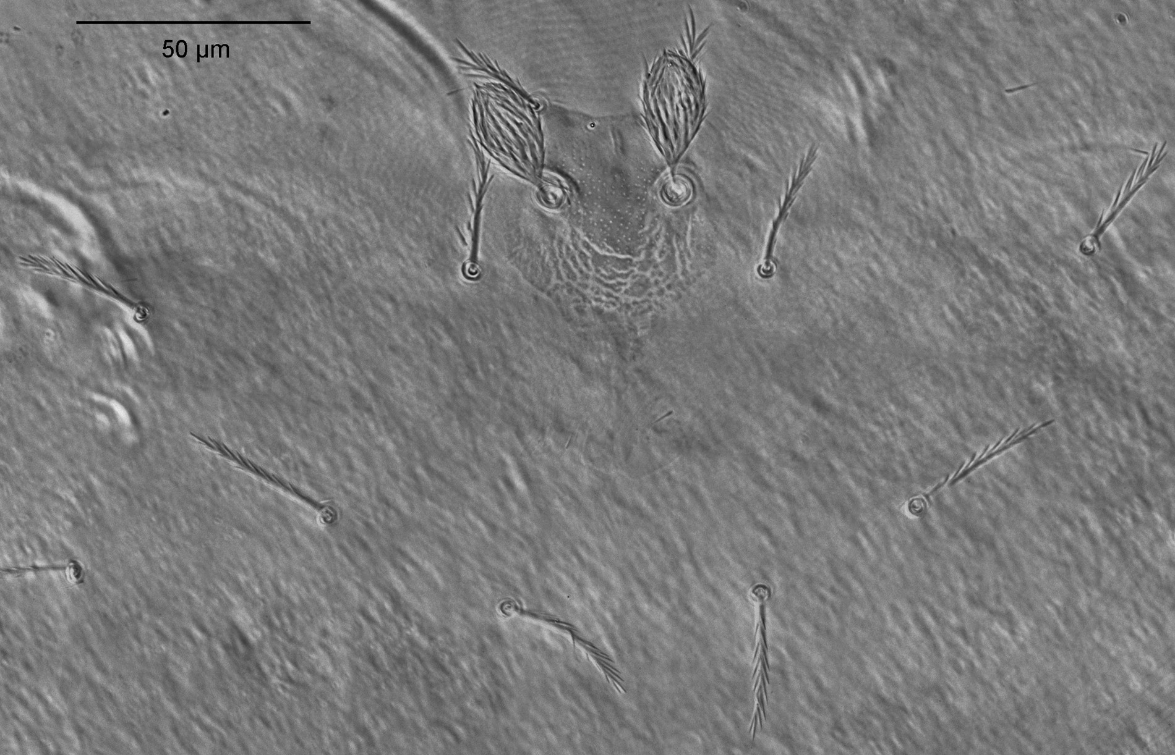
Fig. 7. Walchia chavali sp. nov. (paratype no. 9861), scutum and dorsal idiosomal setae.
Notes:
Fig. 7. Walchia chavali sp. nov. (paratype no. 9861), scutum and dorsal idiosomal setae.
Unless provided in the caption above, the following copyright applies to the content of this slide: © The Authors 2016. Published by Oxford University Press on behalf of Entomological Society of America. All rights reserved. For Permissions, please email: journals.permissions@oup.com

Slide 8
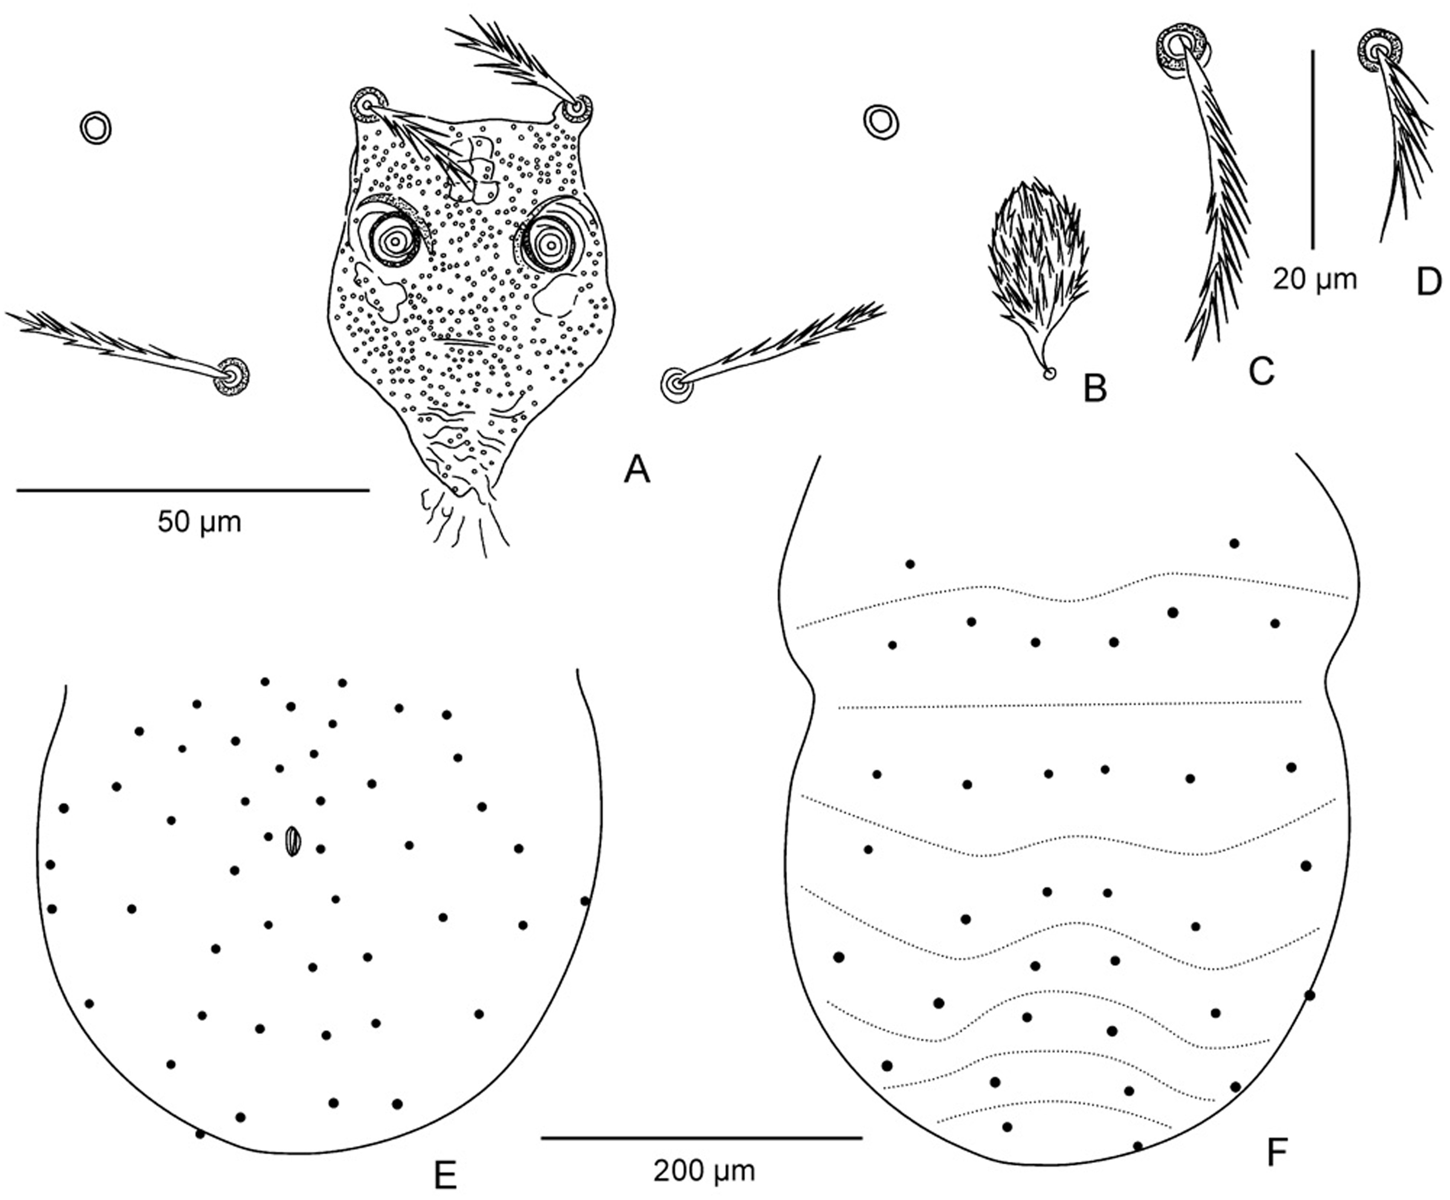
Fig. 8. Walchia chavali sp. nov. ( A ) Scutum and eyes. ( B ) Sensillum. ( C ) Dorsal idiosomal seta of first row. ( ...
Notes:
Fig. 8. Walchia chavali sp. nov. ( A ) Scutum and eyes. ( B ) Sensillum. ( C ) Dorsal idiosomal seta of first row. ( D ) Preanal ventral idiosomal seta. ( E ) Arrangement of ventral idiosomal setae (holotype). ( F ) Arrangement of dorsal idiosomal setae (holotype). Scale bars: 50 μm (A, B), 20 μm (C, D), 200 μm (E, F).
Unless provided in the caption above, the following copyright applies to the content of this slide: © The Authors 2016. Published by Oxford University Press on behalf of Entomological Society of America. All rights reserved. For Permissions, please email: journals.permissions@oup.com

Slide 9
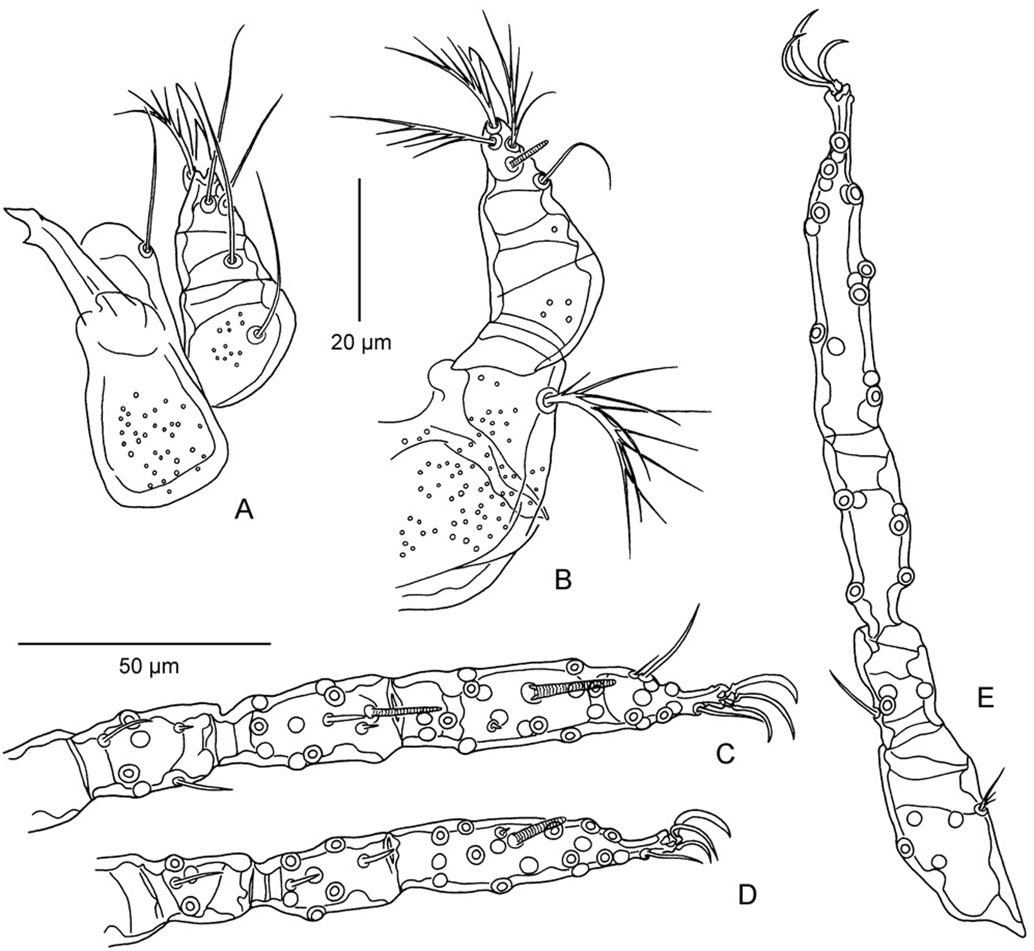
Fig. 9. Walchia chavali sp. nov. ( A ) Dorsal aspect of gnathosoma. ( B ) Ventral aspect of gnathosoma. ( C ) Tarsus, ...
Notes:
Fig. 9. Walchia chavali sp. nov. ( A ) Dorsal aspect of gnathosoma. ( B ) Ventral aspect of gnathosoma. ( C ) Tarsus, tibia, and genu of leg I. ( D ) Tarsus, tibia, and genu of leg II. ( E ) Tarsus, tibia, genu, and femur of leg III. Scale bars: 20 μm (A, B), 50 μm (C–E).
Unless provided in the caption above, the following copyright applies to the content of this slide: © The Authors 2016. Published by Oxford University Press on behalf of Entomological Society of America. All rights reserved. For Permissions, please email: journals.permissions@oup.com

Slide 10
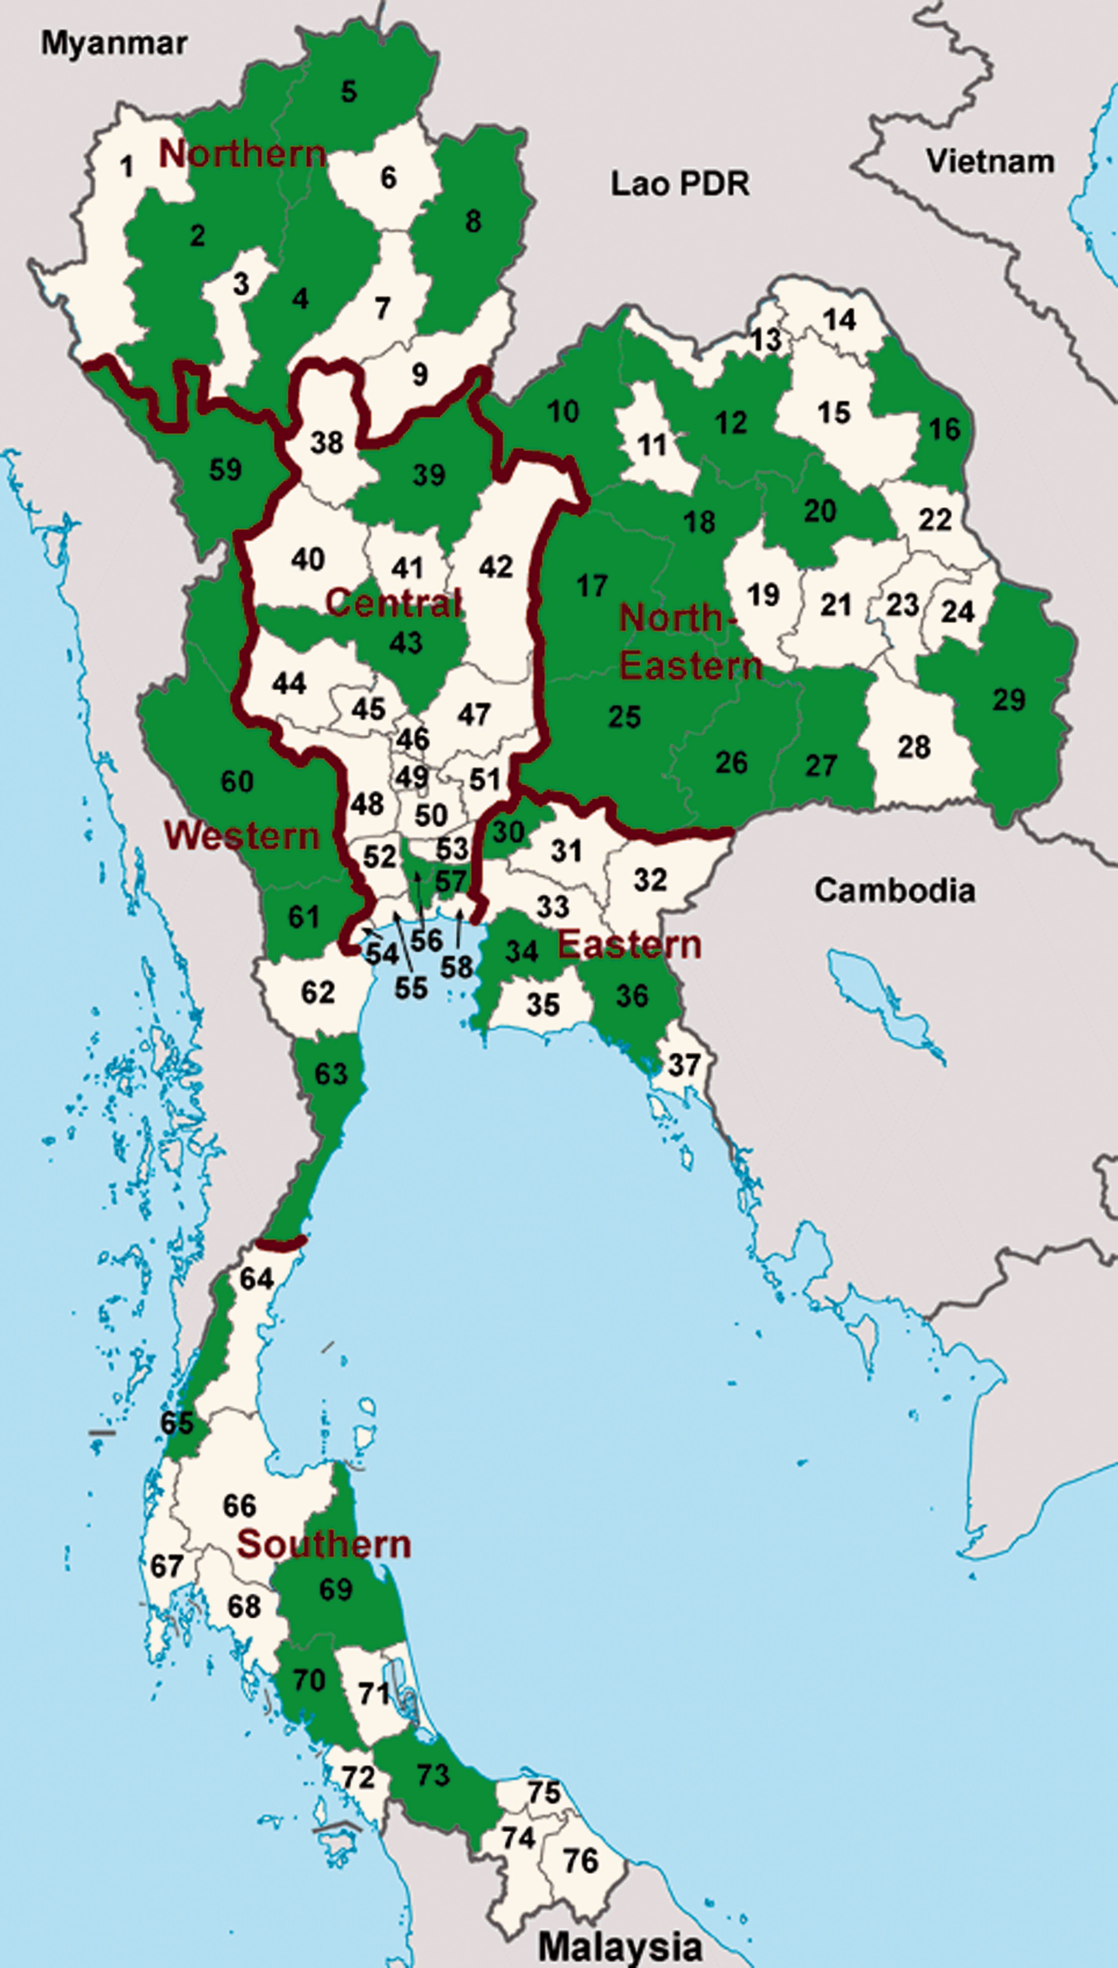
Fig. 10. Map of Thailand. Provinces with records of chigger species are highlighted in green. Provinces: (1) Mae Hong ...
Notes:
Fig. 10. Map of Thailand. Provinces with records of chigger species are highlighted in green. Provinces: (1) Mae Hong Son. (2) Chiang Mai. (3) Lamphun. (4) Lampang. (5) Chiang Rai. (6) Phayao. (7) Phrae. (8) Nan. (9) Uttaradit. (10) Loei. (11) Nong Bua Lamphu. (12) Udon Thani. (13) Nong Khai. (14) Bueng Kan. (15) Sakon Nakhon. (16) Nakhon Phanom. (17) Chaiyaphum. (18) Khon Kaen. (19) Maha Sarakham. (20) Kalasin. (21) Roi Et. (22) Mukdahan. (23) Yasothon. (24) Amnat Charoen. (25) Nakhon Ratchasima. (26) Buriram. (27) Surin. (28) Sisaket. (29) Ubon Ratchathani. (30) Nakhon Nayok. (31) Prachinburi. (32) Sa Kaew. (33) Chachoengsao. (34) Chonburi. (35) Rayong. (36) Chanthaburi. (37) Trat. (38) Sukhothai. (39) Phitsanulok. (40) Kamphaeng Phet. (41) Phichit. (42) Phetchabun. (43) Nakhon Sawan. (44) Uthaithani. (45) Chainat. (46) Singburi. (47) Lopburi. (48) Suphanburi. (49) Ang Thong. (50) Ayutthaya. (51) Saraburi. (52) Nakhon Pathom. (53) Pathum Thani. (54) Samut Songkhram. (55) Samut Sakhon. (56) Nonthaburi. (57) Bangkok. (58) Samut Prakan. (59) Tak. (60) Kanchanaburi. (61) Ratchaburi. (62) Phetchaburi. (63) Prachuap Khiri Khan. (64) Chumphon. (65) Phang Nga. (66) Surat Thani. (67) Phuket. (68) Krabi. (69) Nakhon Si Thammarat. (70) Trang. (71) Phatthalung. (72) Satun. (73) Songkhla. (74) Yala. (75) Pattani. (76) Narathiwat.
Unless provided in the caption above, the following copyright applies to the content of this slide: © The Authors 2016. Published by Oxford University Press on behalf of Entomological Society of America. All rights reserved. For Permissions, please email: journals.permissions@oup.com

