Slide 1
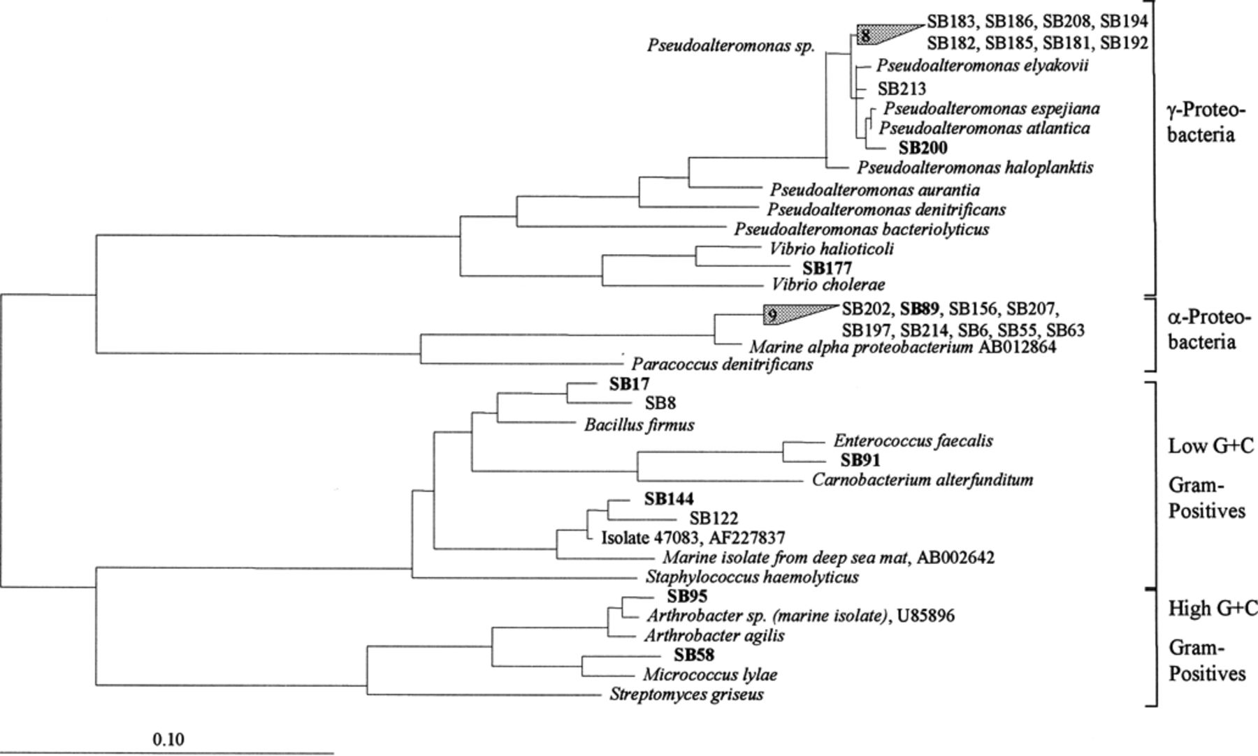
1 Phylogenetic dendrogram calculated with almost full length 16S rRNA sequences of the isolates obtained using ...
Notes:
1 Phylogenetic dendrogram calculated with almost full length 16S rRNA sequences of the isolates obtained using maximum likelihood approach included in the ARB software package (TU München). The scale bar indicates 10% sequence divergence. One representative strain for each phylogenetic cluster is highlighted in bold (see Table 1).
Unless provided in the caption above, the following copyright applies to the content of this slide: © 2001 Federation of European Microbiological Societies. Published by Elsevier Science B.V. All rights reserved.

