Slide 1
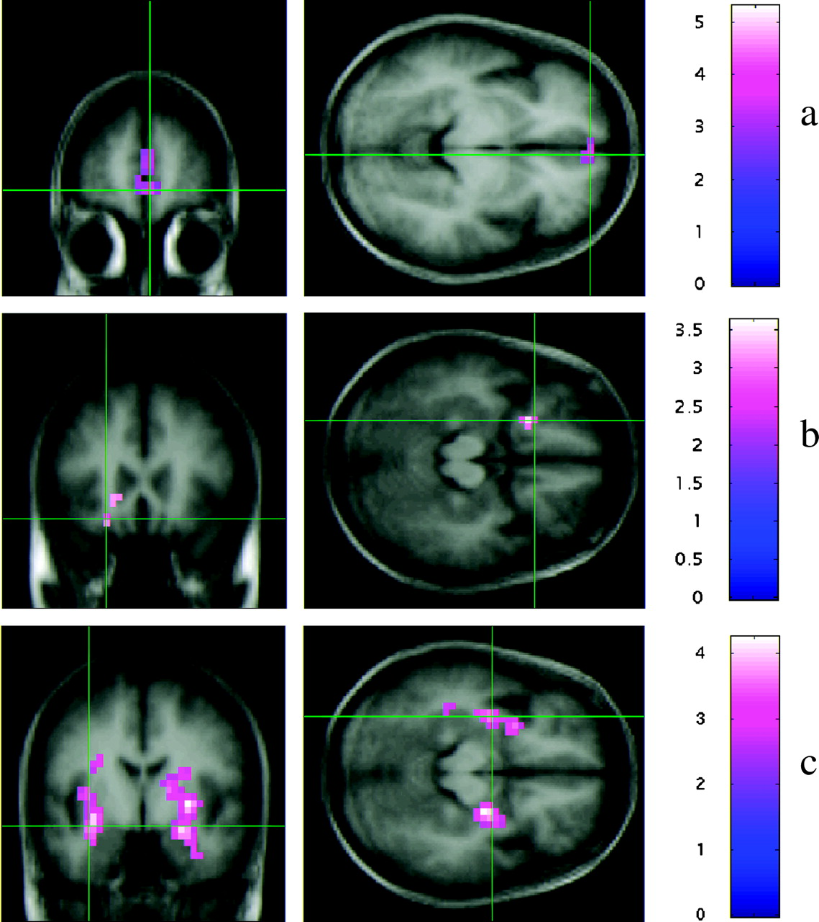
Figure 1. Activation associated with each dimension: (a) medial PFC activation associated with the experience ...
Notes:
Figure 1. Activation associated with each dimension: (a) medial PFC activation associated with the experience dimension, (b) left orbitofrontal activation associated with the engagement dimension, and (c) amygdala activation associated with the social valence dimension.
Unless provided in the caption above, the following copyright applies to the content of this slide: © Oxford University Press 2004; all rights reserved

Slide 2
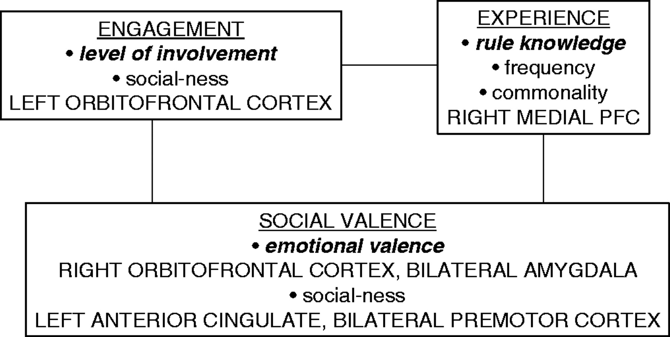
Figure 2. Summary of the event knowledge structure identified in the present study (bold italic indicates the variables ...
Notes:
Figure 2. Summary of the event knowledge structure identified in the present study (bold italic indicates the variables identified by Forgas).
Unless provided in the caption above, the following copyright applies to the content of this slide: © Oxford University Press 2004; all rights reserved

