Slide 1
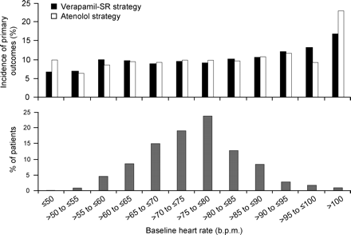
Figure 1 Top panel: incidence of adverse outcomes (time to first event of all-cause death, non-fatal myocardial ...
Notes:
Figure 1 Top panel: incidence of adverse outcomes (time to first event of all-cause death, non-fatal myocardial infarction, or non-fatal stroke) among randomized patients without an electronic pacemaker for each treatment strategy by resting heart rate at baseline. Bottom panel: distribution of patients by baseline resting heart rate
Unless provided in the caption above, the following copyright applies to the content of this slide: Published on behalf of the European Society of Cardiology. All rights reserved. © The Author 2008. For permissions please email: journals.permissions@oxfordjournals.org

Slide 2
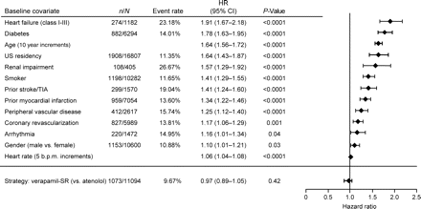
Figure 2 Conditions present at baseline that were associated with risk for adverse outcomes from a stepwise Cox ...
Notes:
Figure 2 Conditions present at baseline that were associated with risk for adverse outcomes from a stepwise Cox proportional hazards model; n, number of patients with adverse outcome; N, number patients with baseline condition; event rate, adverse outcome incidence; HR, hazard ratio; CI, confidence interval; TIA, transient ischaemic attack; b.p.m., beats per minute; strategy, randomized treatment strategy
Unless provided in the caption above, the following copyright applies to the content of this slide: Published on behalf of the European Society of Cardiology. All rights reserved. © The Author 2008. For permissions please email: journals.permissions@oxfordjournals.org

Slide 3
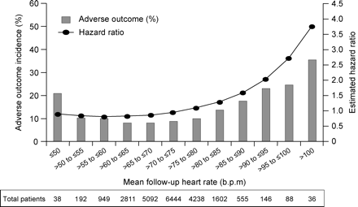
Figure 3 Relationship between follow-up resting heart rate for all patients and incidence of adverse outcomes (left ...
Notes:
Figure 3 Relationship between follow-up resting heart rate for all patients and incidence of adverse outcomes (left axis, bars) and risk (right axis –•–, hazard ratio) derived from a stepwise Cox proportional hazards model. Among all patients, the nadir for follow-up resting heart rate was 59 b.p.m
Unless provided in the caption above, the following copyright applies to the content of this slide: Published on behalf of the European Society of Cardiology. All rights reserved. © The Author 2008. For permissions please email: journals.permissions@oxfordjournals.org

Slide 4
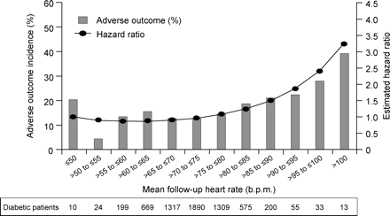
Figure 4 Relationship between follow-up resting heart rate among patients with diabetes and incidence of adverse ...
Notes:
Figure 4 Relationship between follow-up resting heart rate among patients with diabetes and incidence of adverse outcomes (left axis, bars) and risk (right axis –•–, hazard ratio) derived from a stepwise Cox proportional hazards model
Unless provided in the caption above, the following copyright applies to the content of this slide: Published on behalf of the European Society of Cardiology. All rights reserved. © The Author 2008. For permissions please email: journals.permissions@oxfordjournals.org

Slide 5
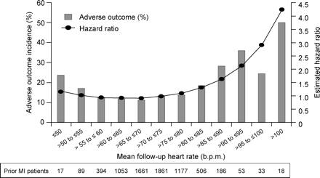
Figure 5 Relationship between follow-up resting heart rate among patients with prior myocardial infarction and ...
Notes:
Figure 5 Relationship between follow-up resting heart rate among patients with prior myocardial infarction and incidence of adverse outcomes (left axis, bars) and risk (right axis –•–, hazard ratio) derived from a stepwise Cox proportional hazards model. MI, myocardial infarction
Unless provided in the caption above, the following copyright applies to the content of this slide: Published on behalf of the European Society of Cardiology. All rights reserved. © The Author 2008. For permissions please email: journals.permissions@oxfordjournals.org

