Slide 1
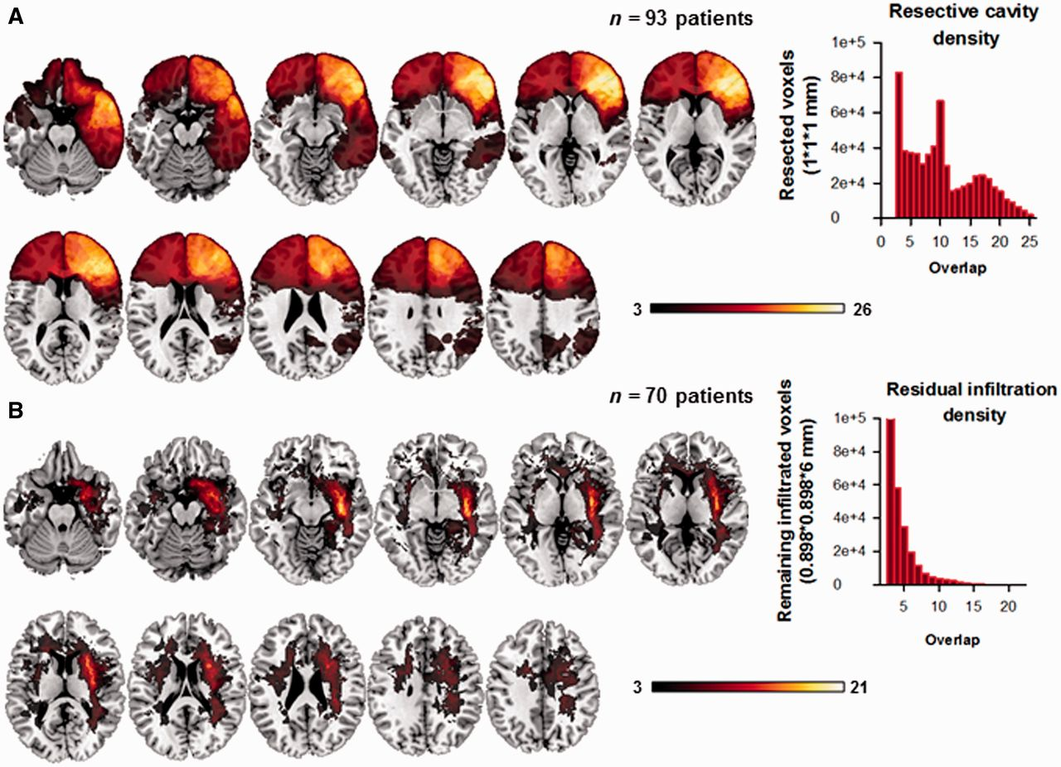
Figure 1 Lesion overlap maps for all patients. (A) Resection cavity overlaps (n = 93). The pars triangularis of the ...
Notes:
Figure 1 Lesion overlap maps for all patients. (A) Resection cavity overlaps (n = 93). The pars triangularis of the right frontal gyrus was the region with the greatest overlap (n = 26). (B) Residual lesion infiltration overlaps (n = 70). As expected, the residual infiltrations were located on the trajectory of the associative white matter fasciculi. The greatest degree of overlap occurred in the white matter fibres of the right inferior occipito-frontal fasciculus (n = 21). Histograms represent lesion density plots (i.e. the number of overlapping voxels).
Unless provided in the caption above, the following copyright applies to the content of this slide: © The Author (2014). Published by Oxford University Press on behalf of the Guarantors of Brain. All rights reserved. For Permissions, please email: journals.permissions@oup.com

Slide 2
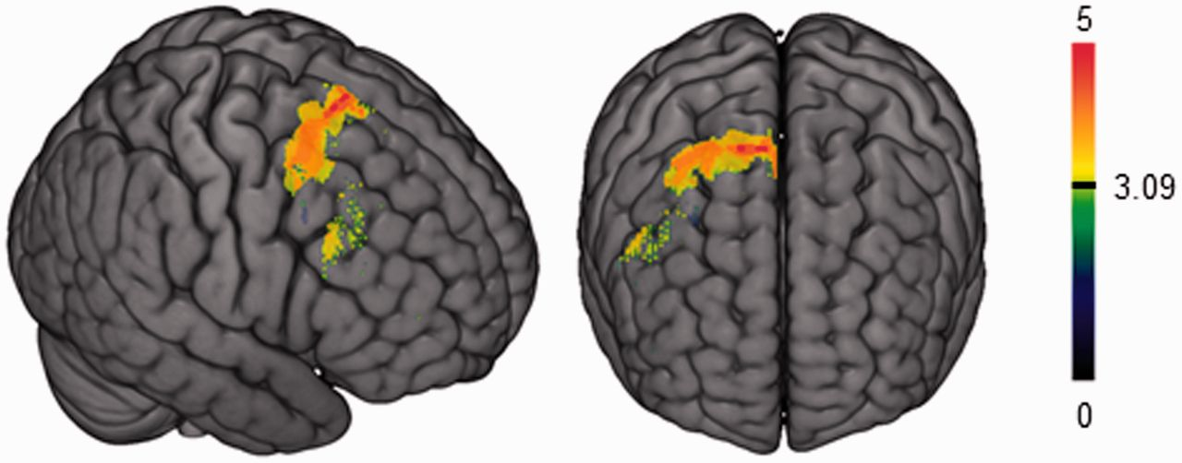
Figure 2 Damage to the supplementary motor area and dorsal premotor cortex is associated with impaired accuracy in ...
Notes:
Figure 2 Damage to the supplementary motor area and dorsal premotor cortex is associated with impaired accuracy in inference-based mentalizing. The statistical map is thresholded at P < 0.001 uncorrected and rendered in three dimensions. Only significant voxels are shown. This lesion-symptom analysis was performed on the difference in error rate between the mentalizing condition (intention attribution) and the control condition (physical causality), after removing unwanted variance associated with nuisance variables (age, premorbid IQ, lesion volume and time since surgery).
Unless provided in the caption above, the following copyright applies to the content of this slide: © The Author (2014). Published by Oxford University Press on behalf of the Guarantors of Brain. All rights reserved. For Permissions, please email: journals.permissions@oup.com

Slide 3
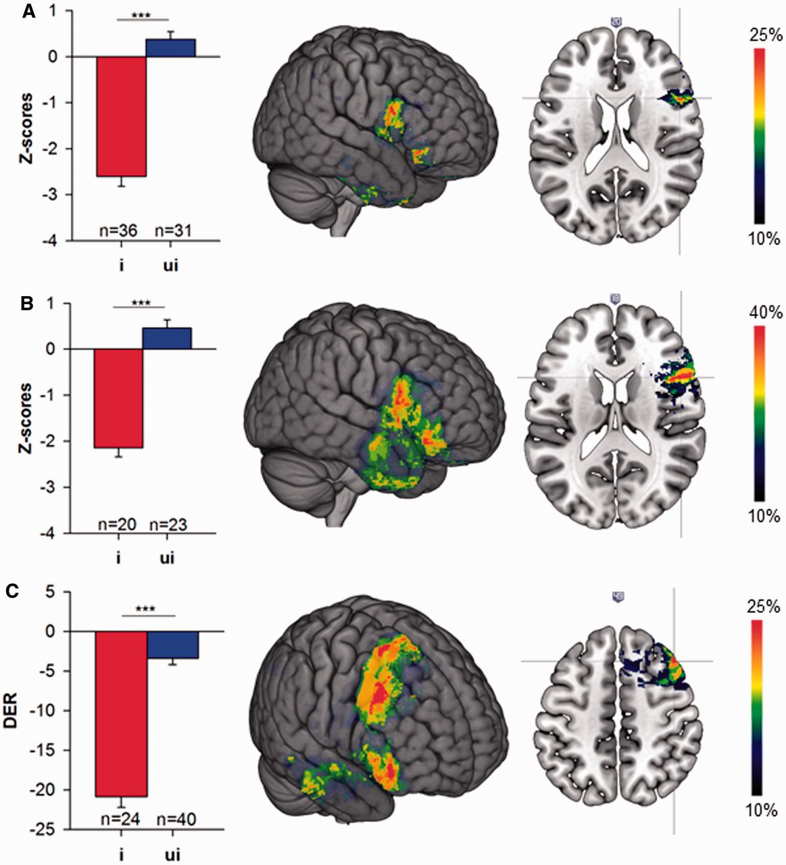
Figure 3 The most frequently damaged brain regions in patients with impaired (i) mentalizing accuracy. (A) Low-level ...
Notes:
Figure 3 The most frequently damaged brain regions in patients with impaired (i) mentalizing accuracy. (A) Low-level mentalizing task, all right-lesion patients. (B) Low-level mentalizing task, only frontal right-lesion patients. (C) High-level mentalizing task, all right-lesion patients. The colour bar indicates increasing frequency. Only brain regions that overlapped in at least 10% of patients are shown. The left-hand plots depict accuracy scores for the two patient subgroups. ***P < 10−6. DER = differential error rate; ui = unimpaired.
Unless provided in the caption above, the following copyright applies to the content of this slide: © The Author (2014). Published by Oxford University Press on behalf of the Guarantors of Brain. All rights reserved. For Permissions, please email: journals.permissions@oup.com

Slide 4
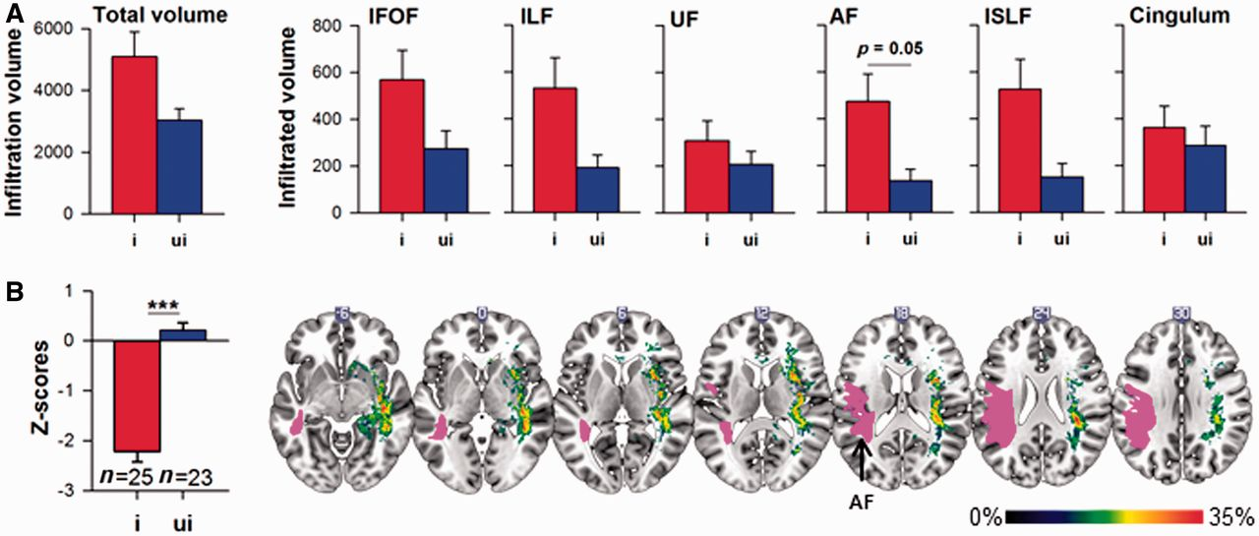
Figure 4 Damage to the right arcuate fasciculus is specifically associated with decreased low-level mentalizing ...
Notes:
Figure 4 Damage to the right arcuate fasciculus is specifically associated with decreased low-level mentalizing accuracy. (A) Group analyses: the residual lesion volumes in each associative pathway were compared in patients with impaired (i) and without impaired (ui) mentalizing performance. Only the arcuate fasciculus showed a group effect (Z = 1.95, P = 0.05). All other comparisons were non-significant (P > 0.1, see also Table 2). (B) Subtraction plots: patients with impaired performance were more likely to have infiltration in the arcuate fasciculus. The bar indicates increasing frequency. Only brain regions that overlapped in at least 10% of patients are shown. The left arcuate fasciculus is plotted as a visual point of reference. IFOF = inferior fronto-occipital fasciculus; ILF = inferior longitudinal fasciculus; UF = uncinate fasciculus; AF = arcuate fasciculus; lSLF = lateral superior longitudinal fasciculus.
Unless provided in the caption above, the following copyright applies to the content of this slide: © The Author (2014). Published by Oxford University Press on behalf of the Guarantors of Brain. All rights reserved. For Permissions, please email: journals.permissions@oup.com

Slide 5
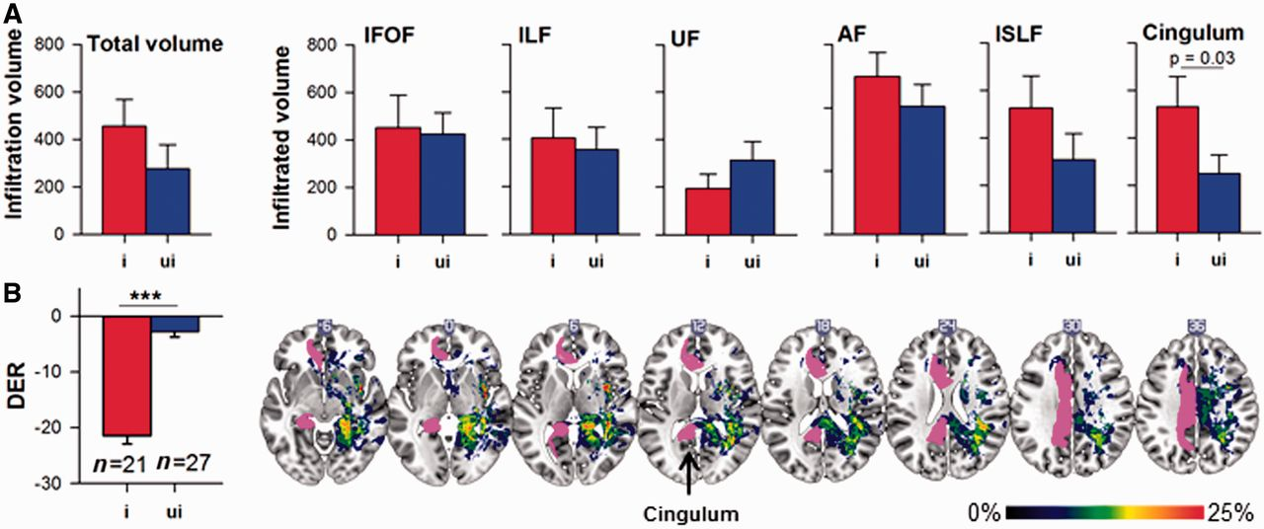
Figure 5 Damage to the right cingulum is specifically associated with decreased high-level mentalizing accuracy. (A) ...
Notes:
Figure 5 Damage to the right cingulum is specifically associated with decreased high-level mentalizing accuracy. (A) Patients with an impaired differential error rate were more likely to have infiltration in the right cingulum than patients with a normal differential error rate (P = 0.03, see also Table 2). Subtraction plot: patients with impaired performance were more likely to have infiltration in the cingulum and in white matters fibres constituting the temporo-parieto-occipital junction. The bar indicates increasing frequency. The left cingulum is plotted as a visual point of reference. IFOF = inferior fronto-occipital fasciculus; ILF = inferior longitudinal fasciculus; UF = uncinate fasciculus; AF = arcuate fasciculus; lSLF = lateral superior longitudinal fasciculus.
Unless provided in the caption above, the following copyright applies to the content of this slide: © The Author (2014). Published by Oxford University Press on behalf of the Guarantors of Brain. All rights reserved. For Permissions, please email: journals.permissions@oup.com

