Slide 1
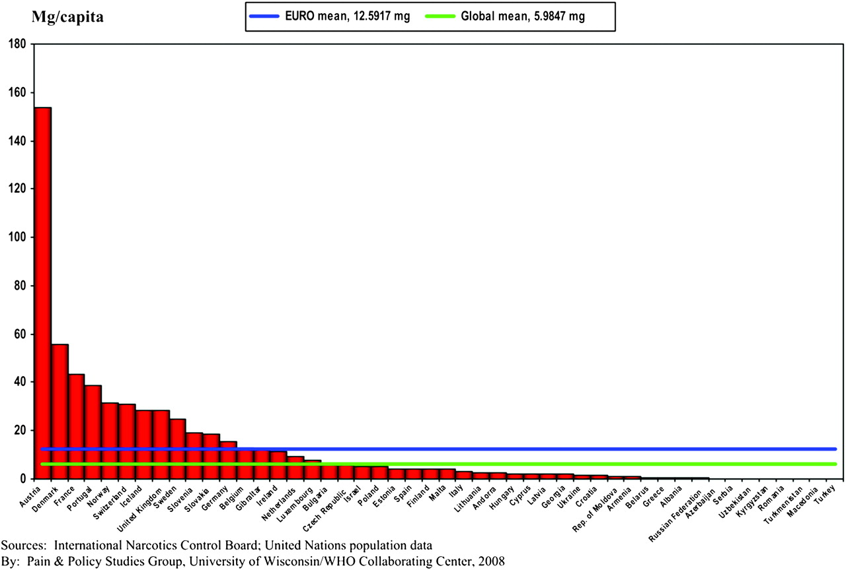
Figure 1. European consumption of morphine, 2006.
Notes:
Figure 1. European consumption of morphine, 2006.
Unless provided in the caption above, the following copyright applies to the content of this slide: © The Author 2010. Published by Oxford University Press on behalf of the European Society for Medical Oncology. All rights reserved. For permissions, please email: journals.permissions@oxfordjournals.org

Slide 2
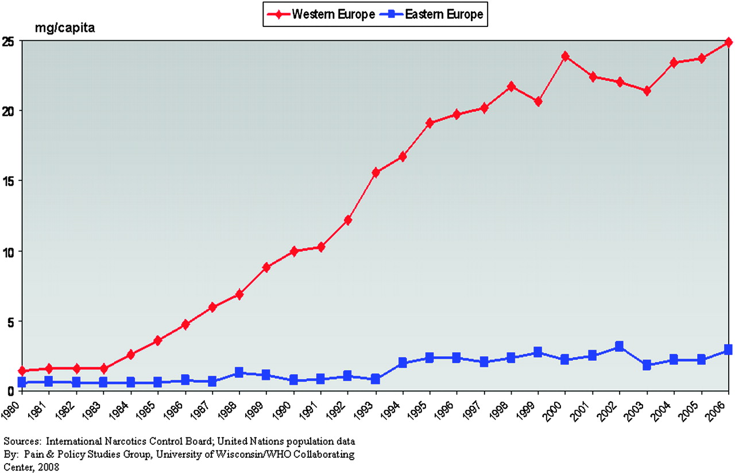
Figure 2. East versus West Europe: morphine consumption, average milligram per capita*, 1980–2006. *Average milligram ...
Notes:
Figure 2. East versus West Europe: morphine consumption, average milligram per capita*, 1980–2006. *Average milligram per capita calculated by adding milligram per capita statistic for each country and dividing by the total number of countries.
Unless provided in the caption above, the following copyright applies to the content of this slide: © The Author 2010. Published by Oxford University Press on behalf of the European Society for Medical Oncology. All rights reserved. For permissions, please email: journals.permissions@oxfordjournals.org

Slide 3
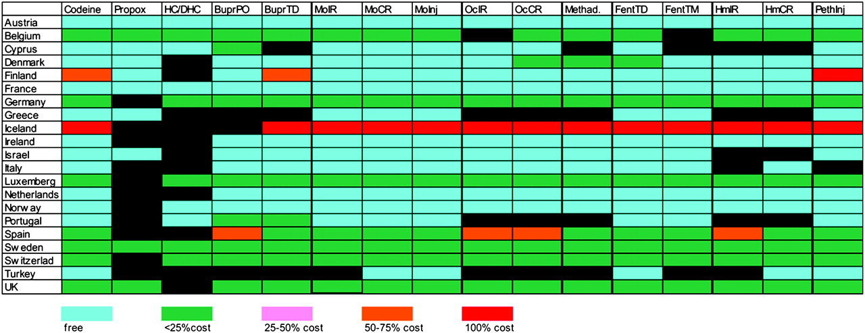
Figure 3. Opioid availability in Western European countries. Propox, propoxyphene; NC, hydrocodone; DHC, ...
Notes:
Figure 3. Opioid availability in Western European countries. Propox, propoxyphene; NC, hydrocodone; DHC, dihydrocodeine; Bupr, buprenorphine; Mo, morphine; Oc, oxycodone; Methad, methadone; Fent, fentanyl; Hm, hydromorphone; Peth, pethidine; PO, oral; Propox, propoxyphene; TD, transdermal; TM, transmucosal; Inj, injectable; IR, immediate release; CR, controlled release.
Unless provided in the caption above, the following copyright applies to the content of this slide: © The Author 2010. Published by Oxford University Press on behalf of the European Society for Medical Oncology. All rights reserved. For permissions, please email: journals.permissions@oxfordjournals.org

Slide 4
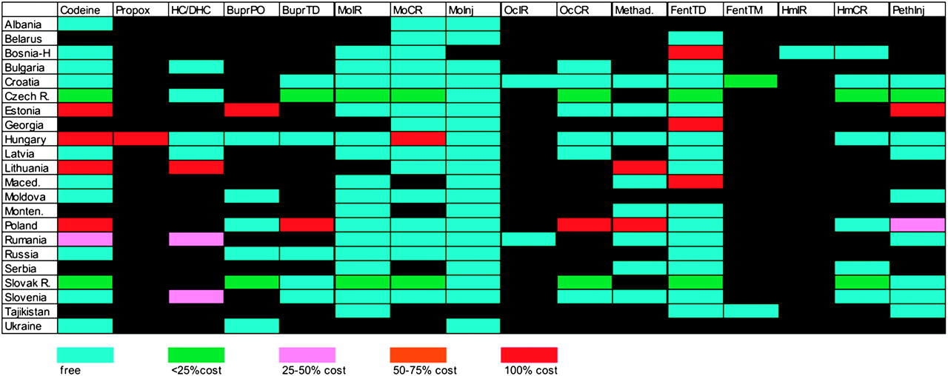
Figure 4. Opioid availability in Eastern European countries. Propox, propoxyphene; NC, hydrocodone; DHC, ...
Notes:
Figure 4. Opioid availability in Eastern European countries. Propox, propoxyphene; NC, hydrocodone; DHC, dihydrocodeine; Bupr, buprenorphine; Mo, morphine; Oc, oxycodone; Methad, methadone; Fent, fentanyl; Hm, hydromorphone; Peth, pethidine; PO, oral; TD, transdermal; TM, transmucosal; Inj, injectable; IR, immediate release; CR, controlled release.
Unless provided in the caption above, the following copyright applies to the content of this slide: © The Author 2010. Published by Oxford University Press on behalf of the European Society for Medical Oncology. All rights reserved. For permissions, please email: journals.permissions@oxfordjournals.org

Slide 5
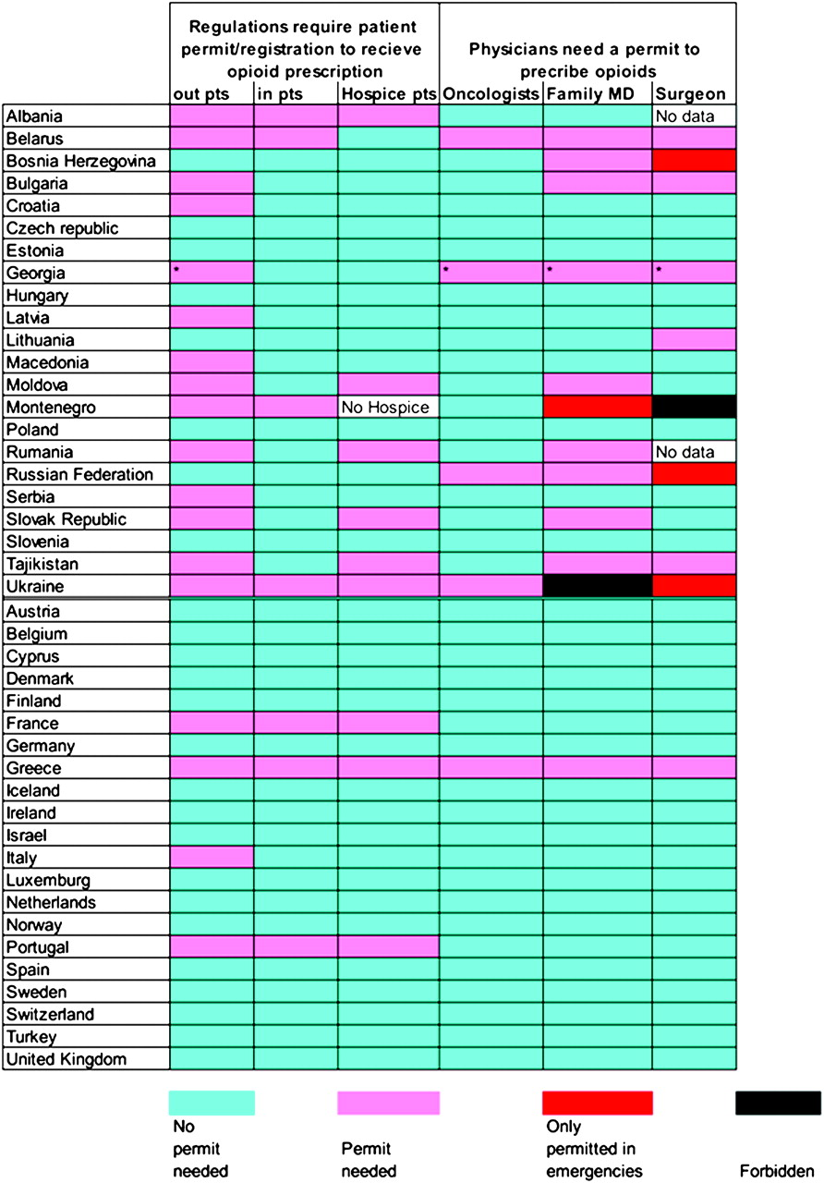
Figure 5. Requirement for authority to receive and prescribe opioids. *Only physicians who have applied for and ...
Notes:
Figure 5. Requirement for authority to receive and prescribe opioids. *Only physicians who have applied for and received special prescription forms.
Unless provided in the caption above, the following copyright applies to the content of this slide: © The Author 2010. Published by Oxford University Press on behalf of the European Society for Medical Oncology. All rights reserved. For permissions, please email: journals.permissions@oxfordjournals.org

Slide 6
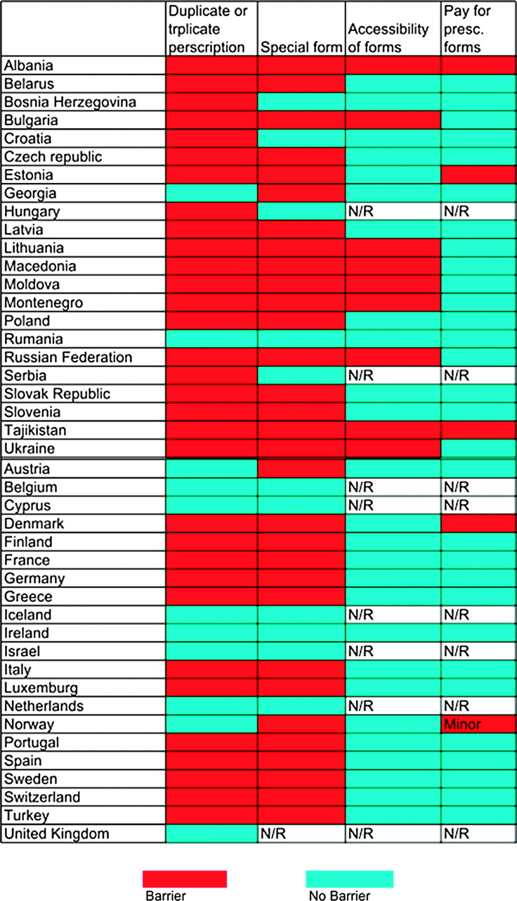
Figure 6. Requirement that opioids be prescribed in multiple copies or on special prescription. N/R, not relevant.
Notes:
Figure 6. Requirement that opioids be prescribed in multiple copies or on special prescription. N/R, not relevant.
Unless provided in the caption above, the following copyright applies to the content of this slide: © The Author 2010. Published by Oxford University Press on behalf of the European Society for Medical Oncology. All rights reserved. For permissions, please email: journals.permissions@oxfordjournals.org

Slide 7
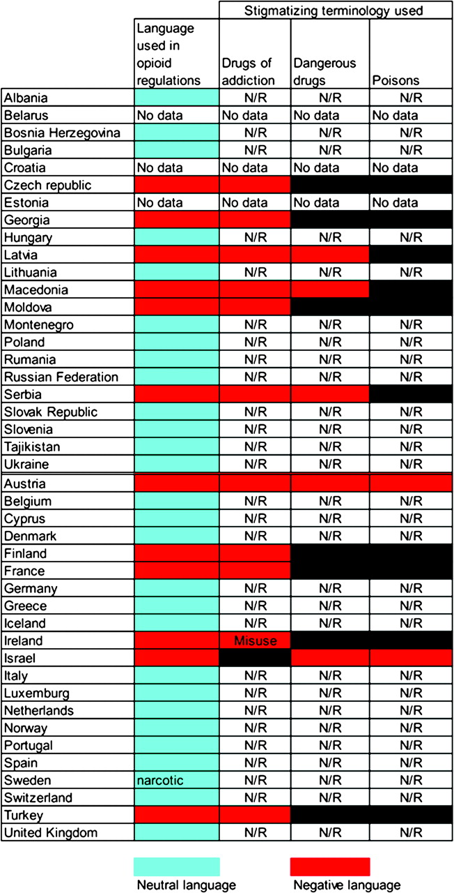
Figure 10. Stigmatizing language in regulations. N/R, not relevant.
Notes:
Figure 10. Stigmatizing language in regulations. N/R, not relevant.
Unless provided in the caption above, the following copyright applies to the content of this slide: © The Author 2010. Published by Oxford University Press on behalf of the European Society for Medical Oncology. All rights reserved. For permissions, please email: journals.permissions@oxfordjournals.org

Slide 8
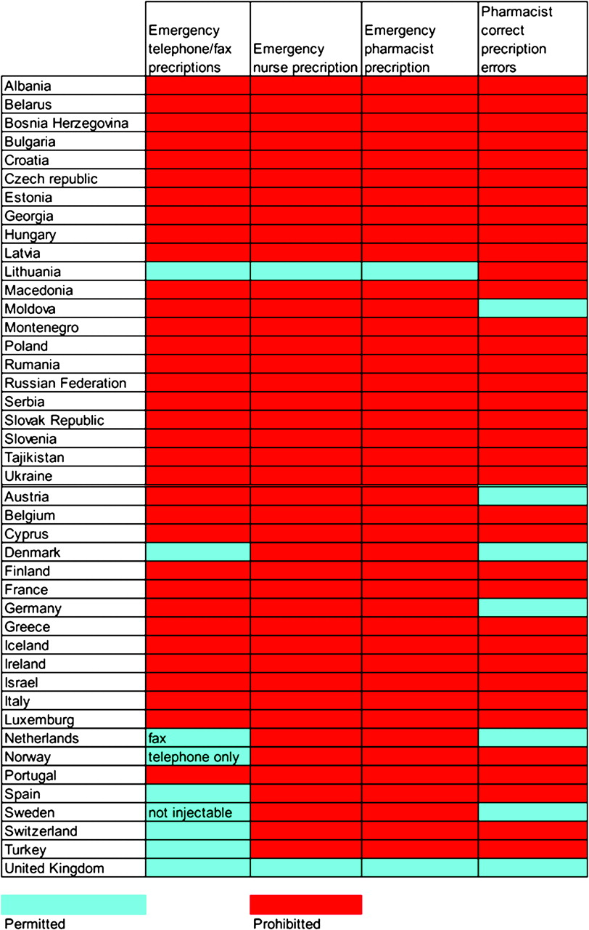
Figure 9. Emergency provisions.
Notes:
Figure 9. Emergency provisions.
Unless provided in the caption above, the following copyright applies to the content of this slide: © The Author 2010. Published by Oxford University Press on behalf of the European Society for Medical Oncology. All rights reserved. For permissions, please email: journals.permissions@oxfordjournals.org

Slide 9
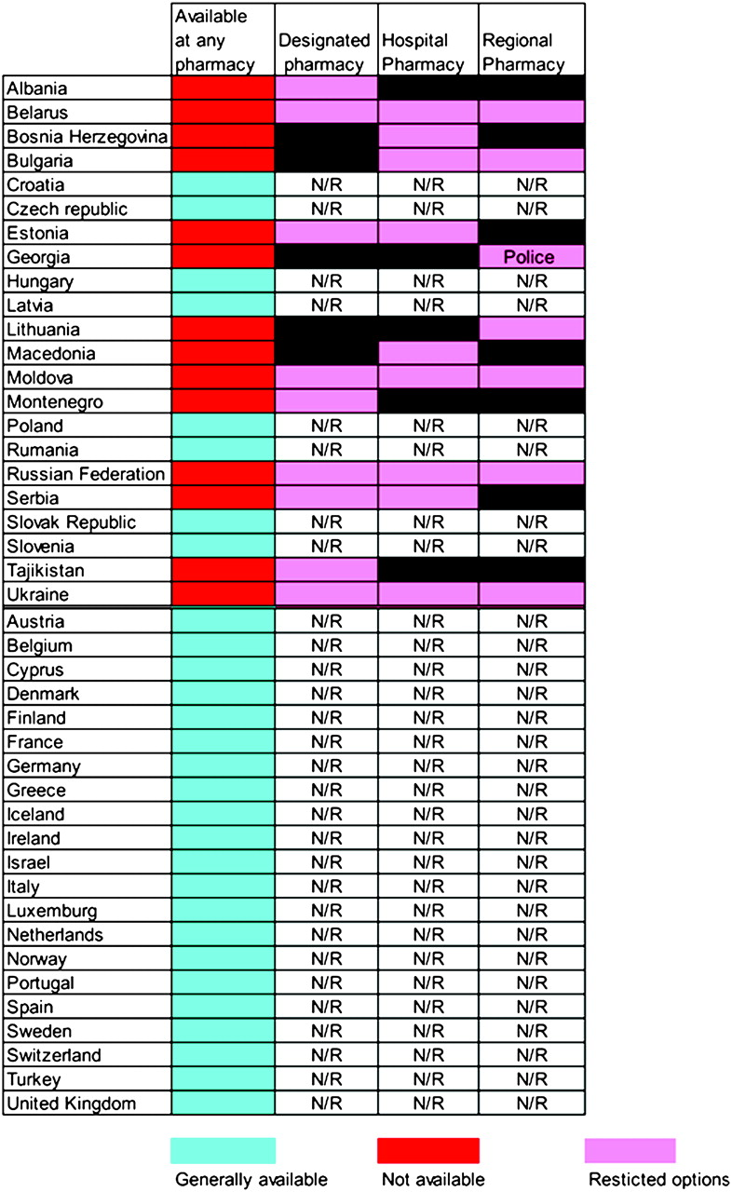
Figure 8. Limitations on dispensing privileges. N/R, not relevant.
Notes:
Figure 8. Limitations on dispensing privileges. N/R, not relevant.
Unless provided in the caption above, the following copyright applies to the content of this slide: © The Author 2010. Published by Oxford University Press on behalf of the European Society for Medical Oncology. All rights reserved. For permissions, please email: journals.permissions@oxfordjournals.org

Slide 10
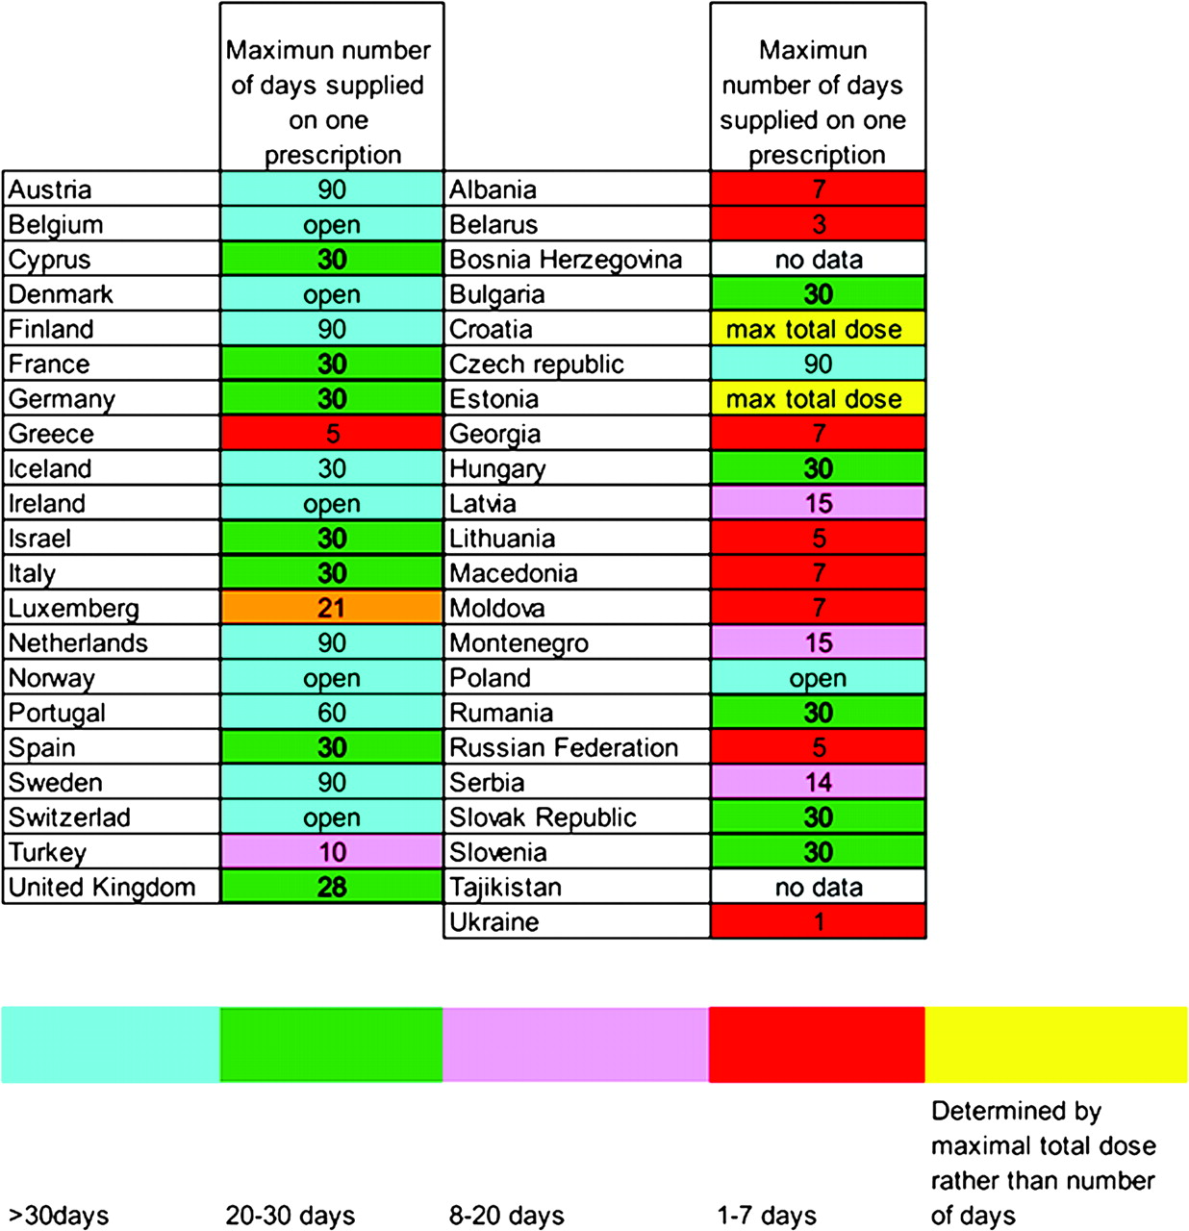
Figure 7. Prescription limits (days).
Notes:
Figure 7. Prescription limits (days).
Unless provided in the caption above, the following copyright applies to the content of this slide: © The Author 2010. Published by Oxford University Press on behalf of the European Society for Medical Oncology. All rights reserved. For permissions, please email: journals.permissions@oxfordjournals.org

