Slide 1
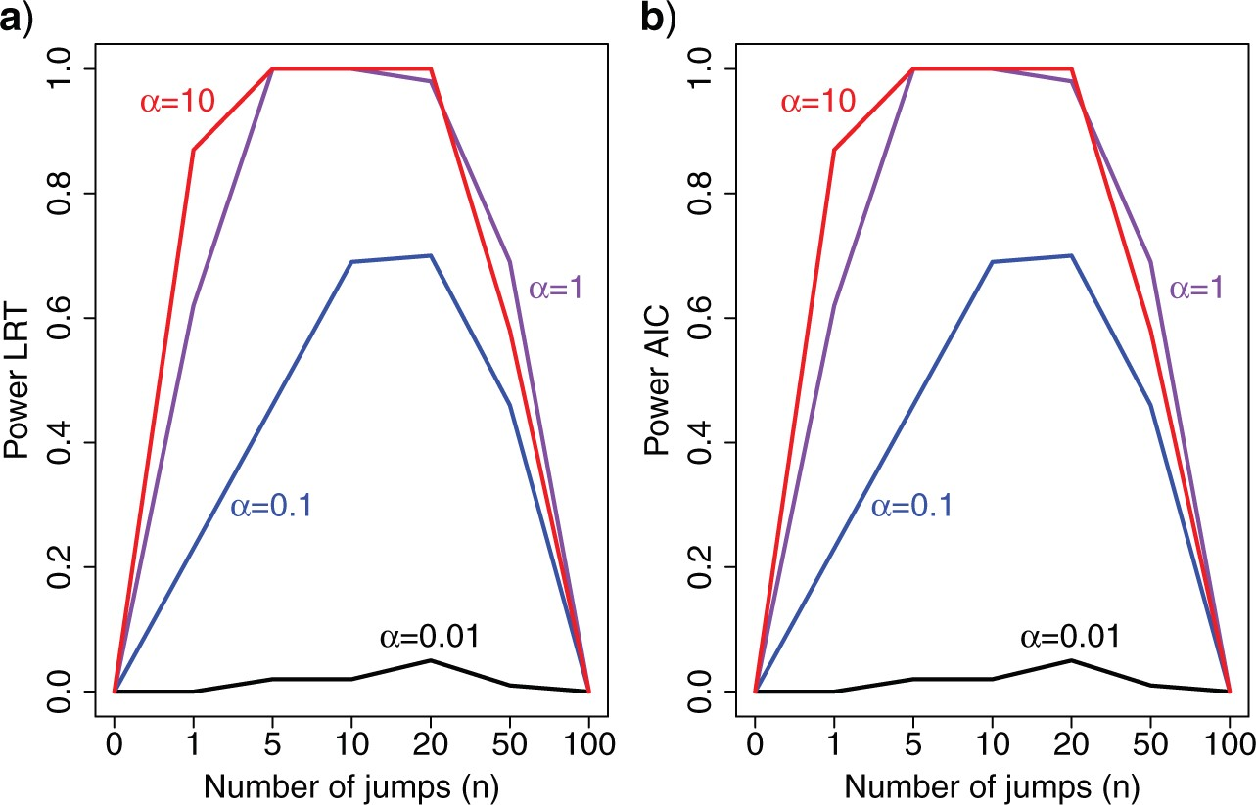
Figure. 1. Power to reject the null model (Brownian motion) using a likelihood ratio test (LRT) a), or the Akaike ...
Notes:
Figure. 1. Power to reject the null model (Brownian motion) using a likelihood ratio test (LRT) a), or the Akaike information criterion (AIC); b) as a function of the number of simulated jumps $n$ and the jump strengths $\alpha$.
Unless provided in the caption above, the following copyright applies to the content of this slide: The Author(s) 2017. Published by Oxford University Press, on behalf of the Society of Systematic Biologists.This is an Open Access article distributed under the terms of the Creative Commons Attribution Non-Commercial License (http://creativecommons.org/licenses/by-nc/4.0/), which permits non-commercial re-use, distribution, and reproduction in any medium, provided the original work is properly cited. For commercial re-use, please contact journals.permissions@oup.com

Slide 2
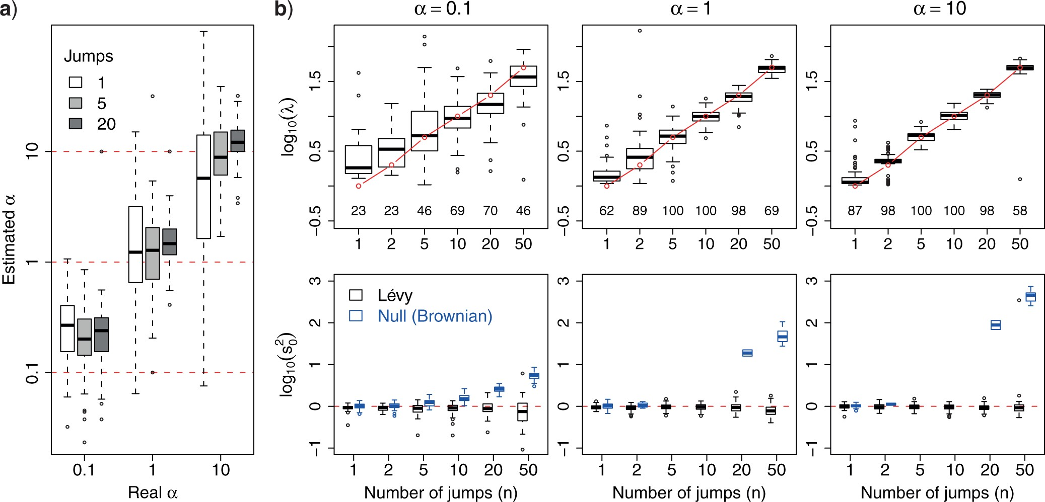
Figure. 2. Accuracy in inferring Lévy parameters. Each boxplot represents the distribution of inferred values across 100 ...
Notes:
Figure. 2. Accuracy in inferring Lévy parameters. Each boxplot represents the distribution of inferred values across 100 replicates simulated as described in the text for different combinations of jump strengths $\alpha$ and number of simulated jumps $n$. a) Accuracy in inferring factor $\alpha$. The true $\alpha$ values used in the simulations are indicated with red dashed lines. b) Top row: distributions of inferred jump rate $\lambda$. Connected red open circles represent the true values. The numbers printed below the boxplots indicate the percentage of simulations for which the Brownian model was rejected and are hence included here. Bottom row: distributions of inferred Brownian background rates $s_0^2$ for simulations in which the Brownian null model was rejected (black) or not rejected (blue).
Unless provided in the caption above, the following copyright applies to the content of this slide: The Author(s) 2017. Published by Oxford University Press, on behalf of the Society of Systematic Biologists.This is an Open Access article distributed under the terms of the Creative Commons Attribution Non-Commercial License (http://creativecommons.org/licenses/by-nc/4.0/), which permits non-commercial re-use, distribution, and reproduction in any medium, provided the original work is properly cited. For commercial re-use, please contact journals.permissions@oup.com

Slide 3
Figure. 3. Power to detect individual jumps. a) Cumulative distribution of jump posterior probabilities on all branches ...
Notes:
Figure. 3. Power to detect individual jumps. a) Cumulative distribution of jump posterior probabilities on all branches with (solid lines) and without (dashed lines) simulated jumps. Notice that branches with jumps have posterior probabilities that accumulate at 1, whereas branches without jumps accumulate at 0. b) Distribution of the absolute strengths of individual jumps that were either detected (white) or not detected (gray). c) Same as (a) but for trees with 1000 leaves. d) Same as (b) but for trees with 1000 leaves.
Unless provided in the caption above, the following copyright applies to the content of this slide: The Author(s) 2017. Published by Oxford University Press, on behalf of the Society of Systematic Biologists.This is an Open Access article distributed under the terms of the Creative Commons Attribution Non-Commercial License (http://creativecommons.org/licenses/by-nc/4.0/), which permits non-commercial re-use, distribution, and reproduction in any medium, provided the original work is properly cited. For commercial re-use, please contact journals.permissions@oup.com

Slide 4
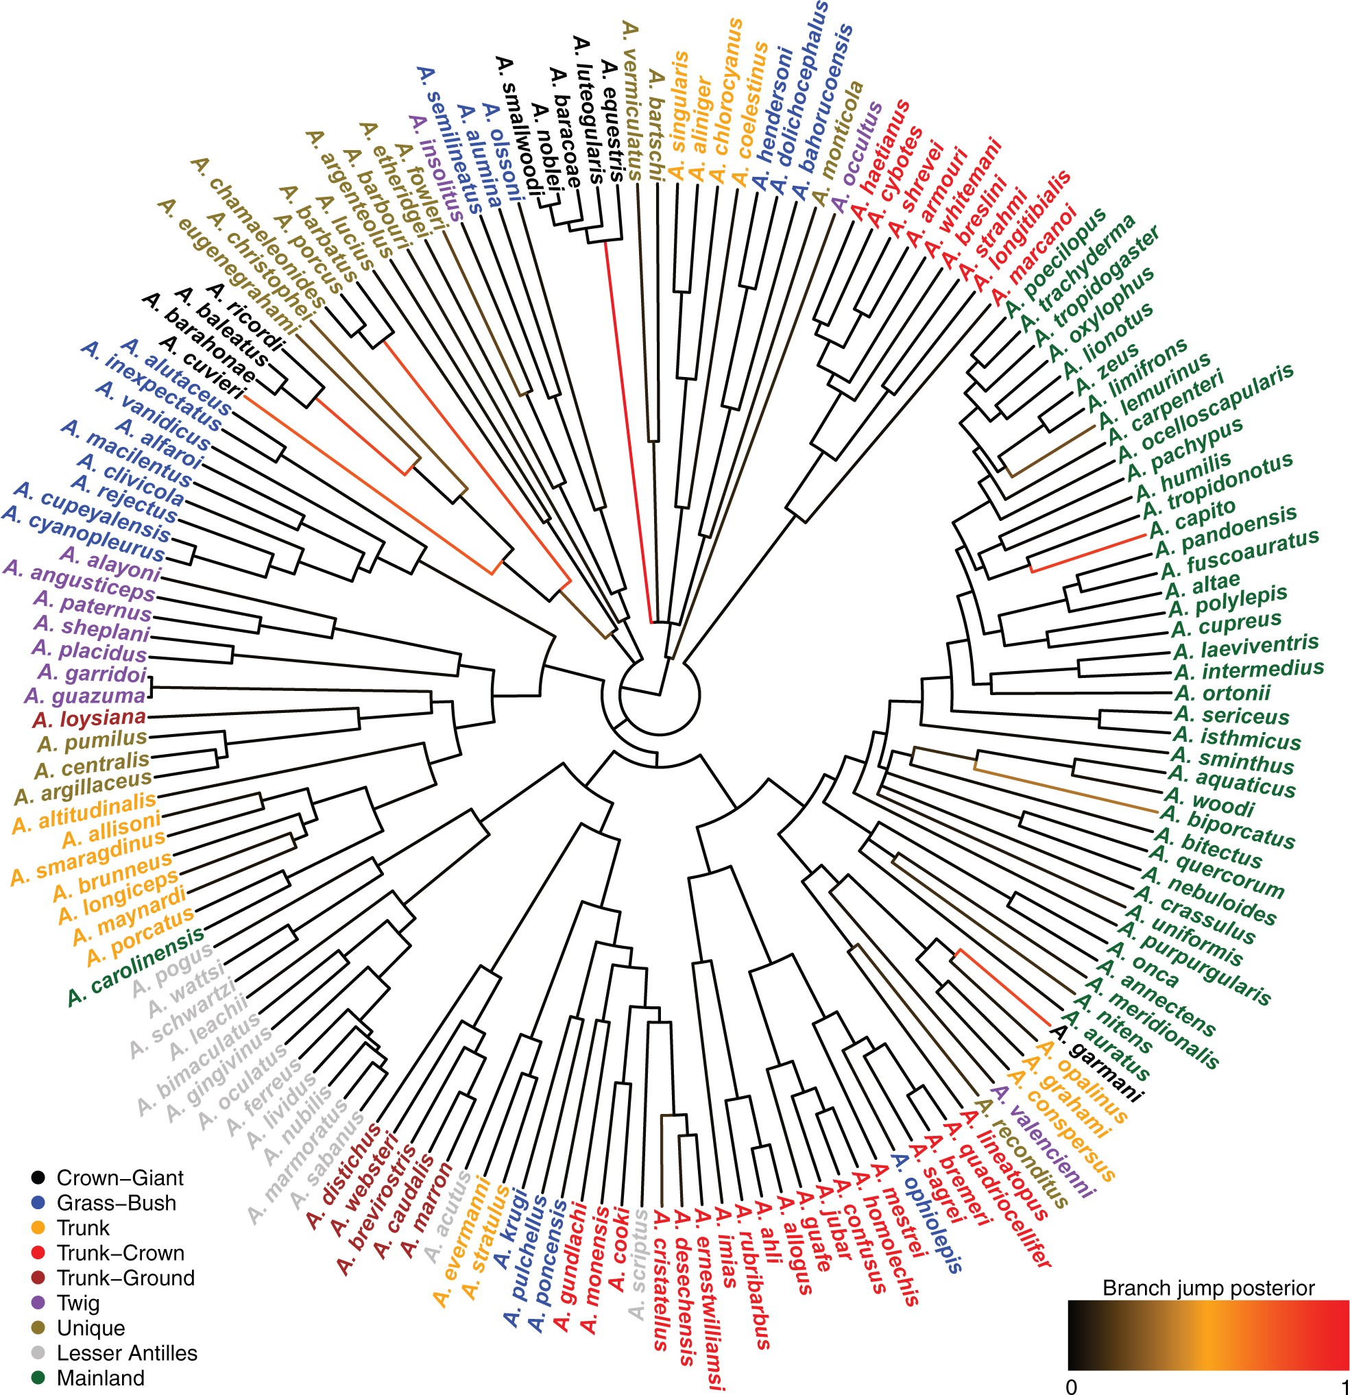
Figure. 4. Inferred jumps for female body-size evolution on the anoles’ tree. The trait measured was the snout-to-vent ...
Notes:
Figure. 4. Inferred jumps for female body-size evolution on the anoles’ tree. The trait measured was the snout-to-vent length (SVL). Branches are colored according to their inferred jump posterior probability (black to red scale going from posterior probability 0 to 1, respectively). Tips are colored according to ecomorphs as defined by Thomas et al. (2009).
Unless provided in the caption above, the following copyright applies to the content of this slide: The Author(s) 2017. Published by Oxford University Press, on behalf of the Society of Systematic Biologists.This is an Open Access article distributed under the terms of the Creative Commons Attribution Non-Commercial License (http://creativecommons.org/licenses/by-nc/4.0/), which permits non-commercial re-use, distribution, and reproduction in any medium, provided the original work is properly cited. For commercial re-use, please contact journals.permissions@oup.com

Slide 5
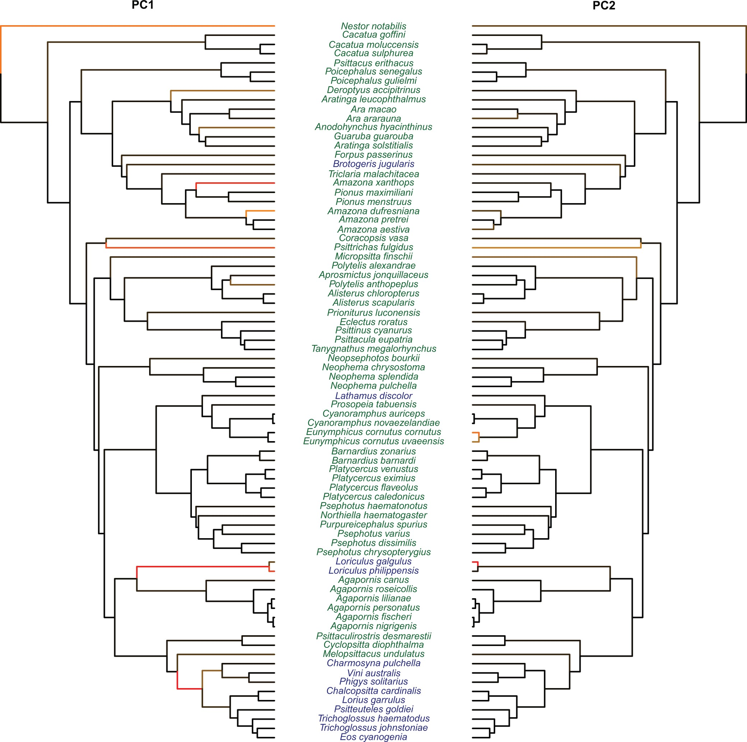
Figure. 5. Evolutionary jumps in the morphology of the digestive tract in parrots. Results for PC1 are shown on the left ...
Notes:
Figure. 5. Evolutionary jumps in the morphology of the digestive tract in parrots. Results for PC1 are shown on the left phylogeny, and results for PC2 on the right phylogeny. Branches are colored according to their inferred jump posterior probability (black to red scale going from posterior probability 0 to 1, respectively). Species names are colored according to their diet: nectarivorous (blue) and nonnectarivorous (green).
Unless provided in the caption above, the following copyright applies to the content of this slide: The Author(s) 2017. Published by Oxford University Press, on behalf of the Society of Systematic Biologists.This is an Open Access article distributed under the terms of the Creative Commons Attribution Non-Commercial License (http://creativecommons.org/licenses/by-nc/4.0/), which permits non-commercial re-use, distribution, and reproduction in any medium, provided the original work is properly cited. For commercial re-use, please contact journals.permissions@oup.com

