Slide 1
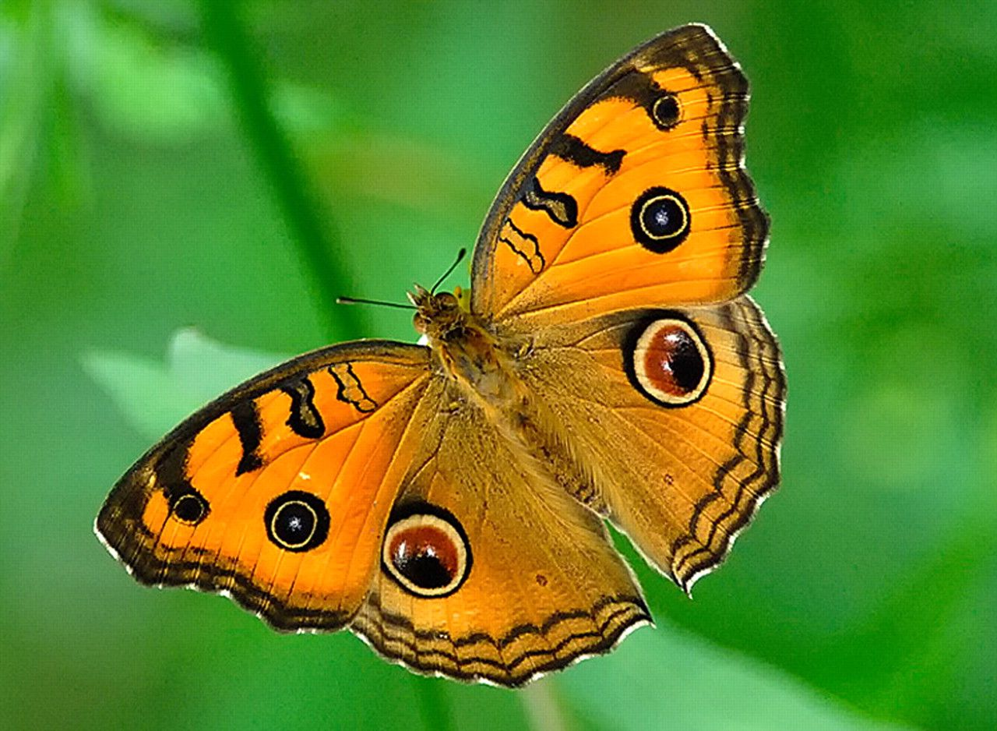
Figure 1 Isolated-large eyespots on the dorsal wing surface of Junonia almana.
Notes:
Figure 1 Isolated-large eyespots on the dorsal wing surface of Junonia almana.
Unless provided in the caption above, the following copyright applies to the content of this slide: © The Author 2011. Published by Oxford University Press on behalf of the International Society for Behavioral Ecology. All rights reserved. For permissions, please e-mail: journals.permissions@oup.com

Slide 2
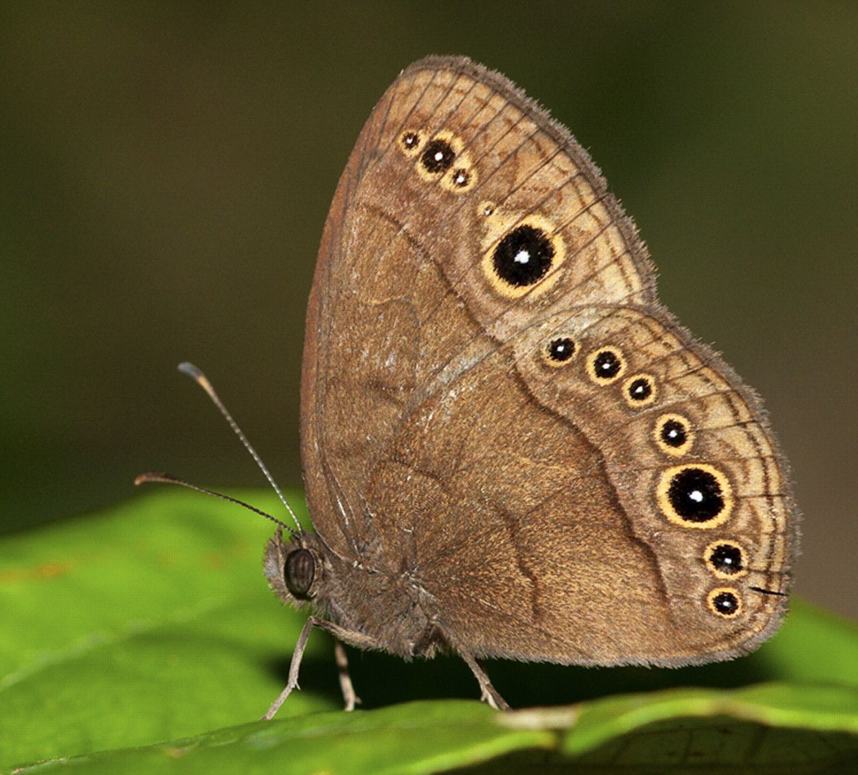
Figure 2 Putative deflective marginal eyespots on the ventral wing surface of Bicyclus madetes.
Notes:
Figure 2 Putative deflective marginal eyespots on the ventral wing surface of Bicyclus madetes.
Unless provided in the caption above, the following copyright applies to the content of this slide: © The Author 2011. Published by Oxford University Press on behalf of the International Society for Behavioral Ecology. All rights reserved. For permissions, please e-mail: journals.permissions@oup.com

Slide 3
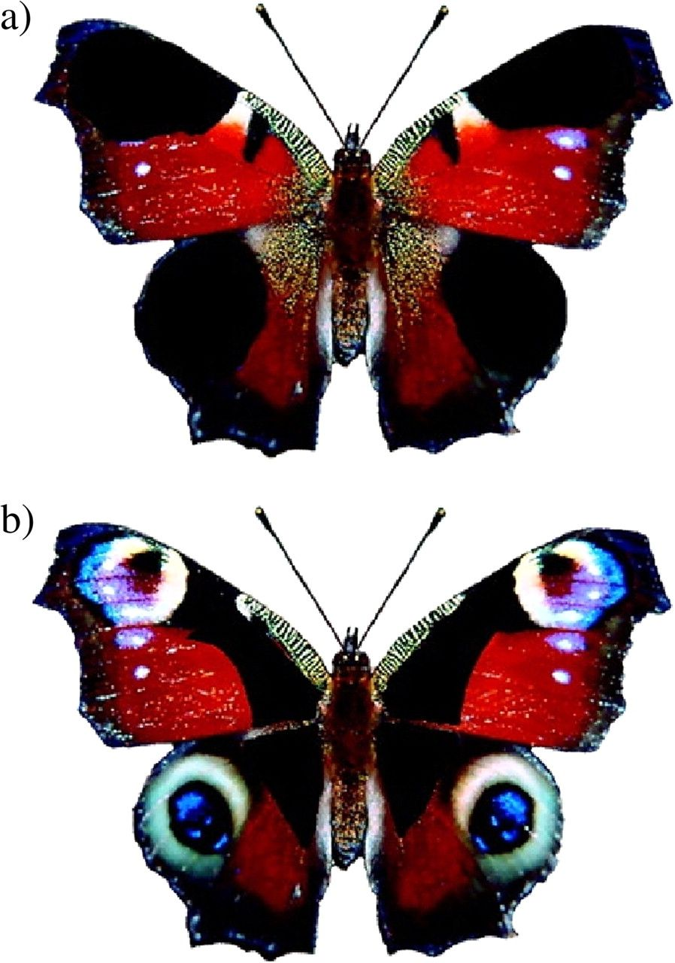
Figure 3 Two treatments used in Vallin et al. (2005) where live peacock butterflies (Inachis io) were manipulated to ...
Notes:
Figure 3 Two treatments used in Vallin et al. (2005) where live peacock butterflies (Inachis io) were manipulated to test the effect of eyespots on survival in the face of predation by Blue Tits (Cyanistes caeruleus) (a) Treatment where eyespots were painted over using a black marker pen (b) Control, where wings were painted such that the eyespots were visible. Butterflies with visible eyespots survived much better than those with eyespots painted over. Adapted from Figure 1 of Vallin et al. (2005).
Unless provided in the caption above, the following copyright applies to the content of this slide: © The Author 2011. Published by Oxford University Press on behalf of the International Society for Behavioral Ecology. All rights reserved. For permissions, please e-mail: journals.permissions@oup.com

Slide 4
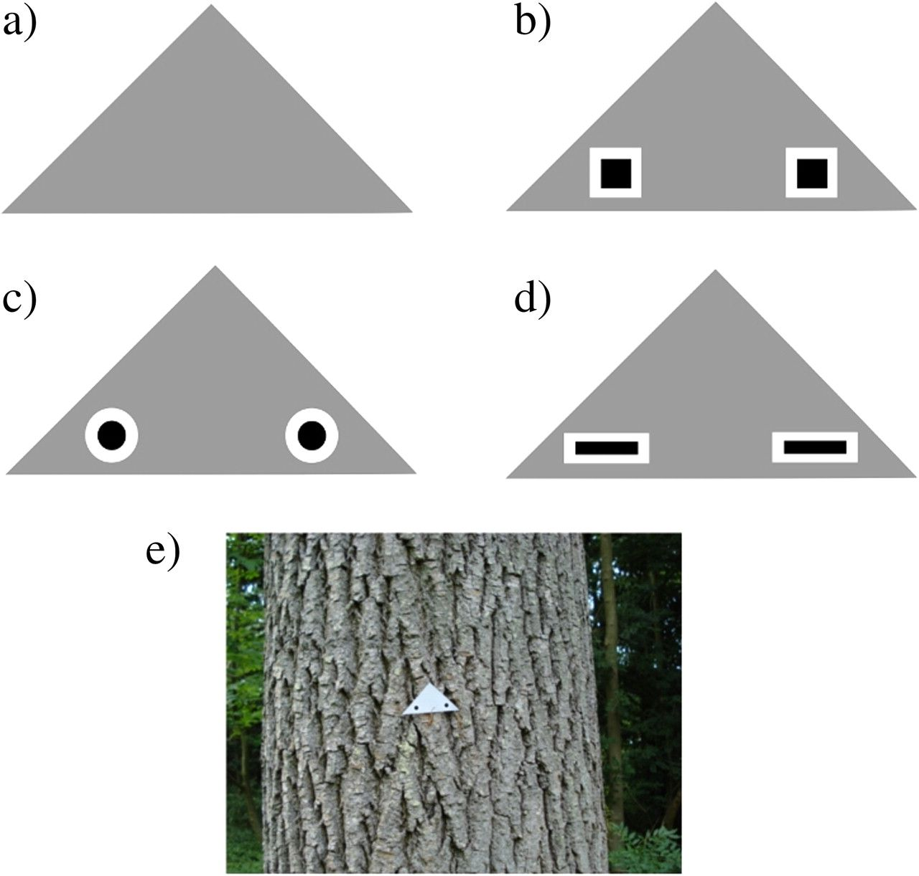
Figure 4 Examples of treatments used as part of studies conducted by Stevens and colleagues to test the effectiveness ...
Notes:
Figure 4 Examples of treatments used as part of studies conducted by Stevens and colleagues to test the effectiveness of different shapes on prey survival. The prey consisted of triangular pieces of gray card with specific patterns printed on and a mealworm placed in the center (either on or below the card). (a) Uniform gray control; (b) Prey with 2 squares; (c) Prey with 2 circular eyespots; and (d) Prey with 2 rectangles. Mealworms in all treatments with printed patterns survived better than the control, although there was no difference between different patterns. Adapted from Figure 2 of Stevens, Hardman, et al. (2008). (e) Photograph of a prey in the field.
Unless provided in the caption above, the following copyright applies to the content of this slide: © The Author 2011. Published by Oxford University Press on behalf of the International Society for Behavioral Ecology. All rights reserved. For permissions, please e-mail: journals.permissions@oup.com

Slide 5
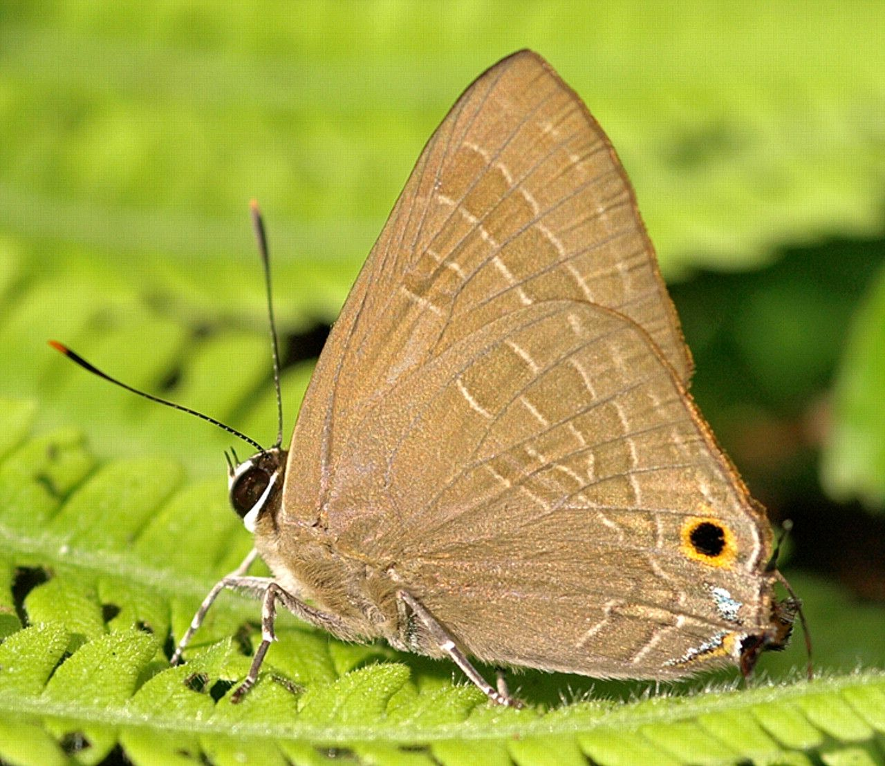
Figure 5 The “false-head” pattern in the lycaenid butterfly Deudorix epijarbus.
Notes:
Figure 5 The “false-head” pattern in the lycaenid butterfly Deudorix epijarbus.
Unless provided in the caption above, the following copyright applies to the content of this slide: © The Author 2011. Published by Oxford University Press on behalf of the International Society for Behavioral Ecology. All rights reserved. For permissions, please e-mail: journals.permissions@oup.com

Slide 6
Figure 6 Trials in Olofsson et al. (2010) that showed that marginal eyespots on the ventral wing surface of the ...
Notes:
Figure 6 Trials in Olofsson et al. (2010) that showed that marginal eyespots on the ventral wing surface of the Woodland Brown butterfly (Lopinga achine) can deflect attacks from birds (Blue Tits; Cyanistes caeruleus) under certain light conditions. (a) Distribution of bird attacks under high light intensity in the presence of UV (b) Distribution of bird attacks under low light intensity in the presence of UV (c) Distribution of bird attacks under low light intensity in the absence of UV. Figure taken from Olofsson et al. (2010); Figure 4 in the original paper.
Unless provided in the caption above, the following copyright applies to the content of this slide: © The Author 2011. Published by Oxford University Press on behalf of the International Society for Behavioral Ecology. All rights reserved. For permissions, please e-mail: journals.permissions@oup.com

Slide 7
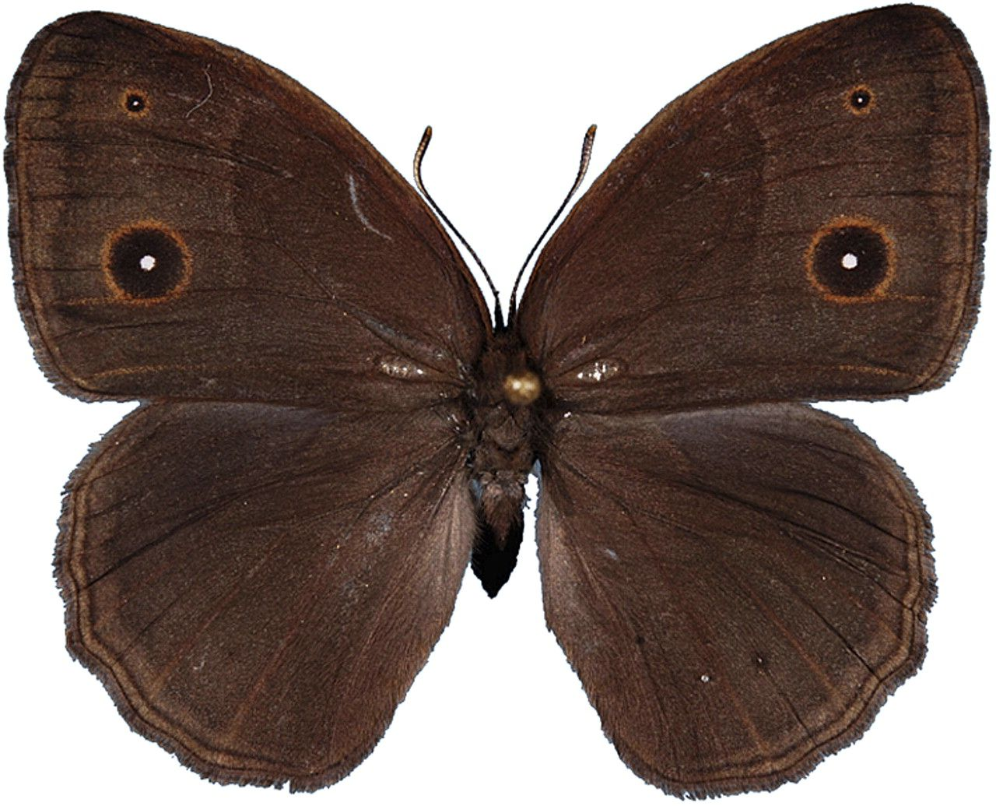
Figure 7 Dorsal wing surface of a Bicyclus anynana dry season female, illustrating the isolated-large eyespot on the ...
Notes:
Figure 7 Dorsal wing surface of a Bicyclus anynana dry season female, illustrating the isolated-large eyespot on the forewing. Experiments (Robertson and Monteiro 2005; Costanzo and Monteiro 2007; Prudic et al. 2011) have shown that both males and females use the size and UV reflectance of the central white pupil of the large eyespot in choosing mates.
Unless provided in the caption above, the following copyright applies to the content of this slide: © The Author 2011. Published by Oxford University Press on behalf of the International Society for Behavioral Ecology. All rights reserved. For permissions, please e-mail: journals.permissions@oup.com

