Slide 1
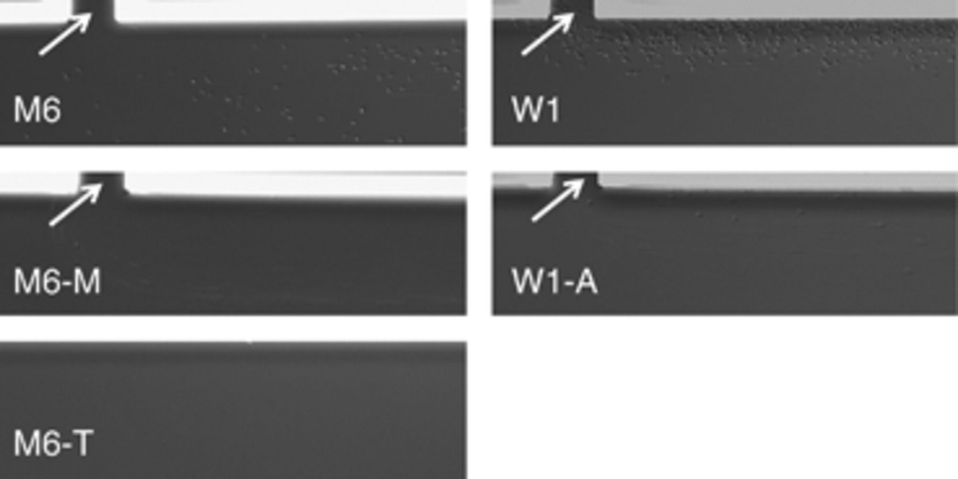
1 Differences in attachment abilities among wild-type and mutant strains of Acidovorax citrulli in microfluidic ...
Notes:
1 Differences in attachment abilities among wild-type and mutant strains of Acidovorax citrulli in microfluidic chambers. All pictures were taken during the first 40 min after cell introduction while the flow rate in the chambers was 0.25 μL min−1. Arrows indicate culture inlet points. Pictures are representative of results from three independent experiments.
Unless provided in the caption above, the following copyright applies to the content of this slide: © 2010 Federation of European Microbiological Societies Published by Blackwell Publishing Ltd. All rights reserved

Slide 2
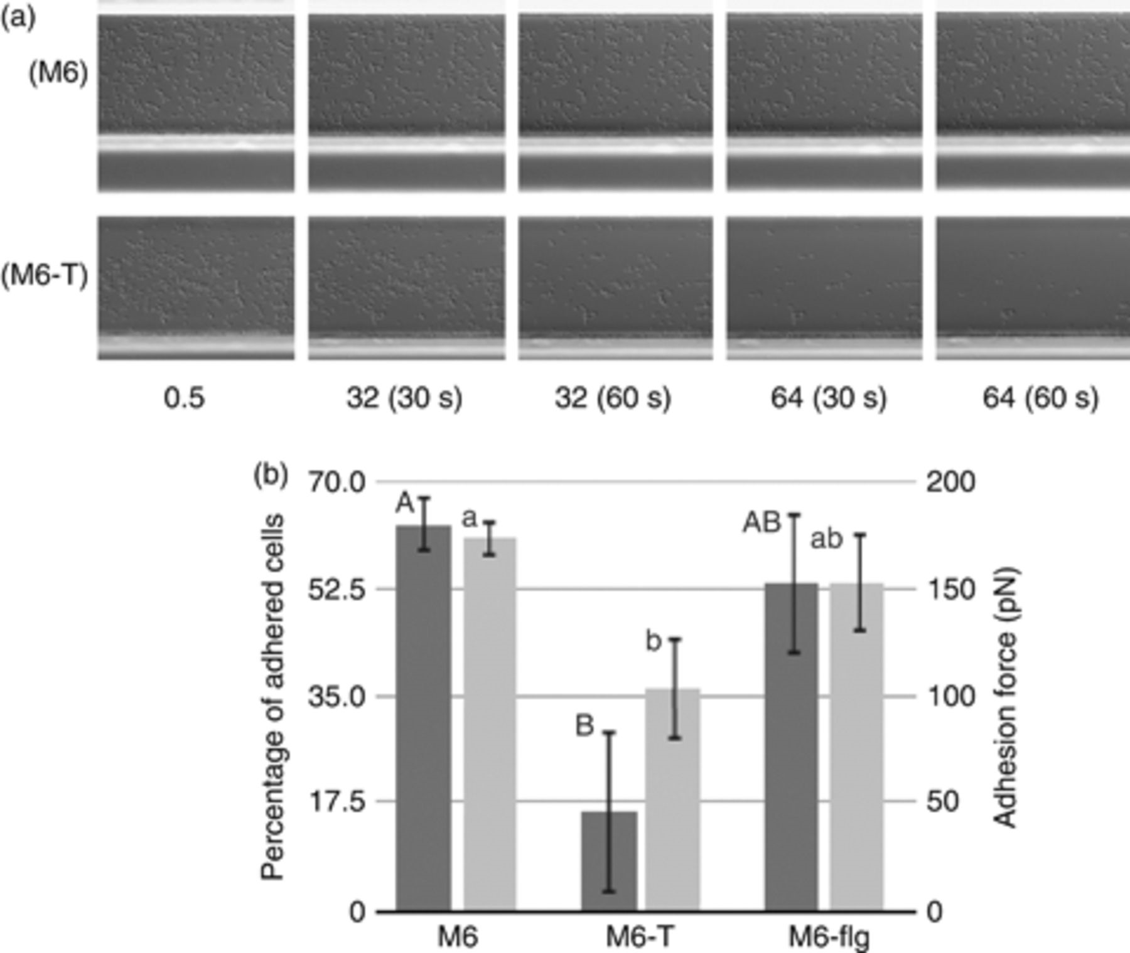
2 Comparison of adhesion strength in microfluidic chambers during an increase of the medium flow rate and ...
Notes:
2 Comparison of adhesion strength in microfluidic chambers during an increase of the medium flow rate and adhesion force measurements. (a) Sample pictures from one assay with M6 and M6-T strains. Numbers below pictures indicate the flow rate in μL min−1 and the time under the corresponding flow rate at which the picture was taken. (b) Quantitative estimation of cell attachment (left y-axis, dark gray columns) and adhesion force (right y-axis, light gray columns) of wild-type M6 and mutants M6-T and M6-flg. The left y-axis represents the percentage of cells that remained attached to the surface after 1 min under the maximum flow rate (64 μL min−1), relative to the beginning of the assay. The right y-axis represents the adhesion force of the cells. Averages and SEs from at least three replicates per strain are shown. Different letters indicate significant differences among strains (P=0.05 for cells attachment, upper case letters; P=0.01, for adhesion force, lower case letters).
Unless provided in the caption above, the following copyright applies to the content of this slide: © 2010 Federation of European Microbiological Societies Published by Blackwell Publishing Ltd. All rights reserved

Slide 3
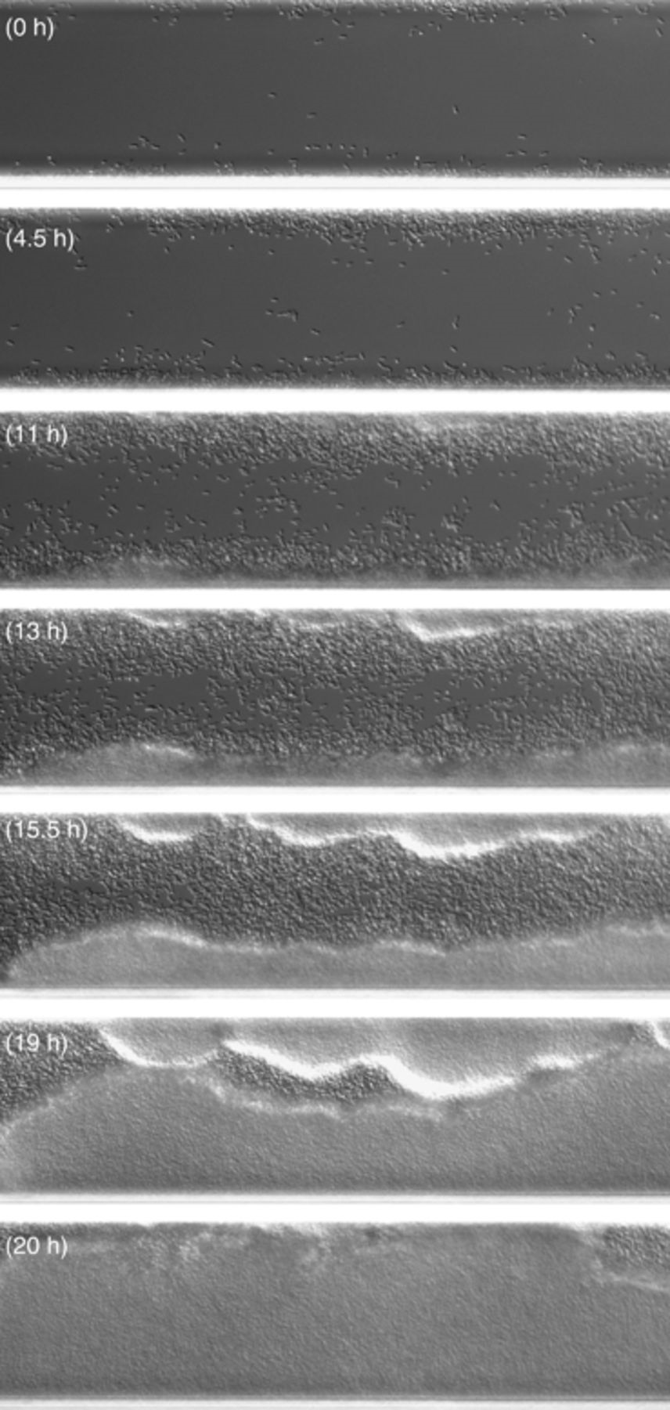
3 Biofilm formation by Acidovorax citrulli W1 inside the microfluidic chambers. The first frame (top) was taken ...
Notes:
3 Biofilm formation by Acidovorax citrulli W1 inside the microfluidic chambers. The first frame (top) was taken 72 h after assay initiation. The capture time of subsequent pictures is indicated on each picture in parentheses. The pictures are from a replicate of one experiment of three with similar results. A complete movie of this replicate can be seen in Movie S2.
Unless provided in the caption above, the following copyright applies to the content of this slide: © 2010 Federation of European Microbiological Societies Published by Blackwell Publishing Ltd. All rights reserved

