Slide 1
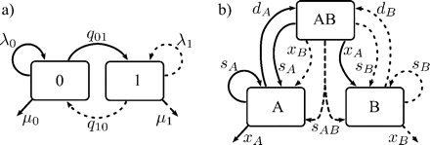
FIGURE 1. The states and allowed transitions in a) BiSSE and b) GeoSSE. Both models have six rate parameters and allow ...
Notes:
FIGURE 1. The states and allowed transitions in a) BiSSE and b) GeoSSE. Both models have six rate parameters and allow state-dependent speciation (λ or s) and extinction (μ or x), and anagenetic state changes (q, d, x). GeoSSE additionally allows state changes during speciation in association with the third (AB) character state.
Unless provided in the caption above, the following copyright applies to the content of this slide: © The Author(s) 2011. Published by Oxford University Press, on behalf of the Society of Systematic Biologists. All rights reserved. For Permissions, please email: journals.permissions@oup.com

Slide 2
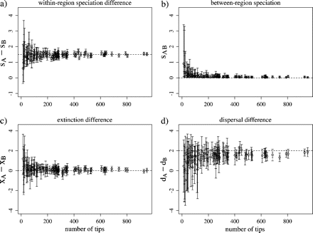
FIGURE 5. Credible intervals for diversity differences driven by source–sink dynamics (Batch 8). Each point shows ...
Notes:
FIGURE 5. Credible intervals for diversity differences driven by source–sink dynamics (Batch 8). Each point shows results for a single tree, ordered on the horizontal axis by tree size. Open circles show the median value of the quantity written on the vertical axis, and inner and outer whiskers mark the 50% and 90% credible intervals, respectively. Horizontal dashed lines indicate the values used in the simulations.
Unless provided in the caption above, the following copyright applies to the content of this slide: © The Author(s) 2011. Published by Oxford University Press, on behalf of the Society of Systematic Biologists. All rights reserved. For Permissions, please email: journals.permissions@oup.com

Slide 3
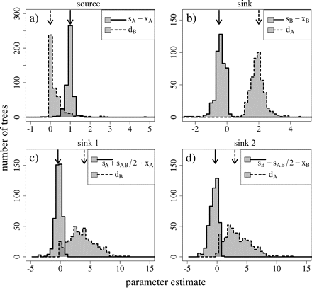
FIGURE 4. Histograms of maximum likelihood parameter estimates, with emphasis on dispersal maintaining diversity. ...
Notes:
FIGURE 4. Histograms of maximum likelihood parameter estimates, with emphasis on dispersal maintaining diversity. Panels (a) and (b) are for the source and sink regions in Batch 8, and panels (c) and (d) are for the two sink regions in Batch 9. Net diversification rates of and immigration rates into each region are shown. Arrows indicate the parameter values used in the simulations.
Unless provided in the caption above, the following copyright applies to the content of this slide: © The Author(s) 2011. Published by Oxford University Press, on behalf of the Society of Systematic Biologists. All rights reserved. For Permissions, please email: journals.permissions@oup.com

Slide 4
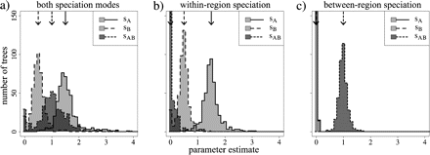
FIGURE 3. Histograms of maximum likelihood parameter estimates, with emphasis on geographic mode of speciation. Panels ...
Notes:
FIGURE 3. Histograms of maximum likelihood parameter estimates, with emphasis on geographic mode of speciation. Panels (a–c) are for Batches 5–7, respectively (Table 1). Arrows indicate the parameter values used in the simulations. In panel (c), the results for sA and sB are nearly identical thus overwrite each other.
Unless provided in the caption above, the following copyright applies to the content of this slide: © The Author(s) 2011. Published by Oxford University Press, on behalf of the Society of Systematic Biologists. All rights reserved. For Permissions, please email: journals.permissions@oup.com

Slide 5
FIGURE 2. Maximum likelihood parameter estimates under asymmetries in each of a) speciation, b) extinction, and c) ...
Notes:
FIGURE 2. Maximum likelihood parameter estimates under asymmetries in each of a) speciation, b) extinction, and c) dispersal. Of the 500 trees per batch, a representative 150 are shown. The symmetric parameter values (Batch 1 in Table 1) are shown by open circles, and the asymmetric parameter values (Batches 2–4 for panels (a–c), respectively) are shown by filled triangles. Large gray symbols show the median parameter estimates for all trees in each batch, and dashed lines show the values used in the simulations. Symbol sizes indicate the number of tips per tree, with the scale shown in the panel (a) legend.
Unless provided in the caption above, the following copyright applies to the content of this slide: © The Author(s) 2011. Published by Oxford University Press, on behalf of the Society of Systematic Biologists. All rights reserved. For Permissions, please email: journals.permissions@oup.com

Slide 6
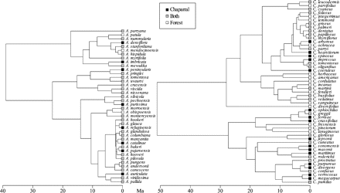
FIGURE 6. Summary phylogenies with tip states for Arctostaphylos and Ceanothus. These are the maximum clade credibility ...
Notes:
FIGURE 6. Summary phylogenies with tip states for Arctostaphylos and Ceanothus. These are the maximum clade credibility trees with mean node heights; the posterior set of trees was used in the analysis.
Unless provided in the caption above, the following copyright applies to the content of this slide: © The Author(s) 2011. Published by Oxford University Press, on behalf of the Society of Systematic Biologists. All rights reserved. For Permissions, please email: journals.permissions@oup.com

Slide 7
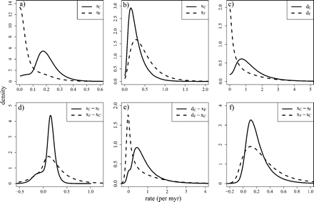
FIGURE 7. Posterior probability distributions of GeoSSE parameters for California plants. Rates of a) speciation, b) ...
Notes:
FIGURE 7. Posterior probability distributions of GeoSSE parameters for California plants. Rates of a) speciation, b) extinction, and c) dispersal were estimated for chaparral (solid lines) and forest (dashed lines) habitats. Differences in d) speciation and extinction rates between habitats, e) range contraction versus expansion, and f) mechanism of specialization were computed from the six estimated parameters.
Unless provided in the caption above, the following copyright applies to the content of this slide: © The Author(s) 2011. Published by Oxford University Press, on behalf of the Society of Systematic Biologists. All rights reserved. For Permissions, please email: journals.permissions@oup.com

