Slide 1
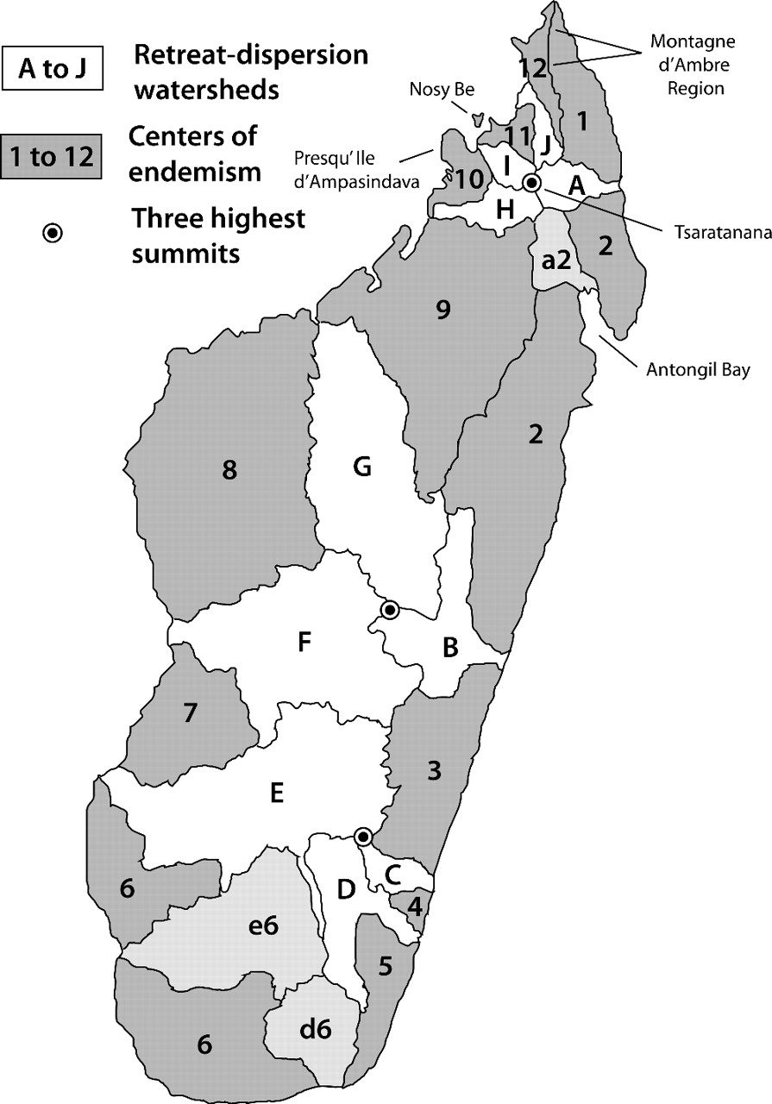
FIGURE 1. Map showing proposed centers of endemism (COEs; dark gray), retreat-dispersion watersheds (RDWs; white), and ...
Notes:
FIGURE 1. Map showing proposed centers of endemism (COEs; dark gray), retreat-dispersion watersheds (RDWs; white), and the 3 highest peaks in Madagascar. Light gray areas are designated as RDWs, with possibly some function as COEs. Modified from Wilmé et al. (2006).
Unless provided in the caption above, the following copyright applies to the content of this slide: © The Author(s) 2009. Published by Oxford University Press, on behalf of the Society of Systematic Biologists. All rights reserved. For Permissions, please email: journals.permissions@oxfordjournals.org

Slide 2
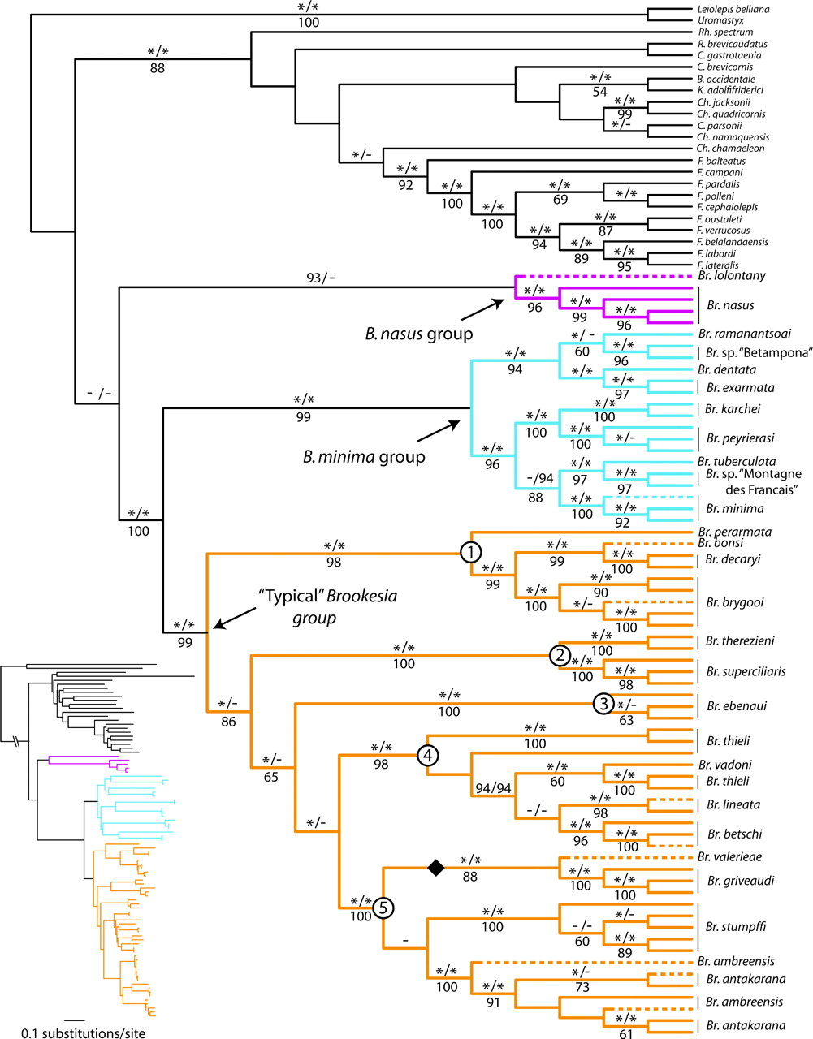
FIGURE 2. Combined mitochondrial (ND1/ND2/ND4) and nuclear (RAG1/CMOS) data, 12-partition relaxed-clock Bayesian (RCB) ...
Notes:
FIGURE 2. Combined mitochondrial (ND1/ND2/ND4) and nuclear (RAG1/CMOS) data, 12-partition relaxed-clock Bayesian (RCB) cladogram with maximum-likelihood (ML) phylogram insert. Analyses included all ougroup taxa, although for clarity, most nonchameleon taxa are not shown. Major clades are color coded, and major clades of “typical” Brookesia are numbered (see text). RCB/unrooted Bayesian (UB) PP > 95% are denoted by asterisks (PP between 90% and 95% are shown as actual values) above branches, and ML bootstrap values > 50% are shown below branches. Black diamond indicates alternate attachment point for Brookesia stumpffi clade in the UB and ML analyses. Dashed terminal branches mark individuals represented by ND4 data only.
Unless provided in the caption above, the following copyright applies to the content of this slide: © The Author(s) 2009. Published by Oxford University Press, on behalf of the Society of Systematic Biologists. All rights reserved. For Permissions, please email: journals.permissions@oxfordjournals.org

Slide 3
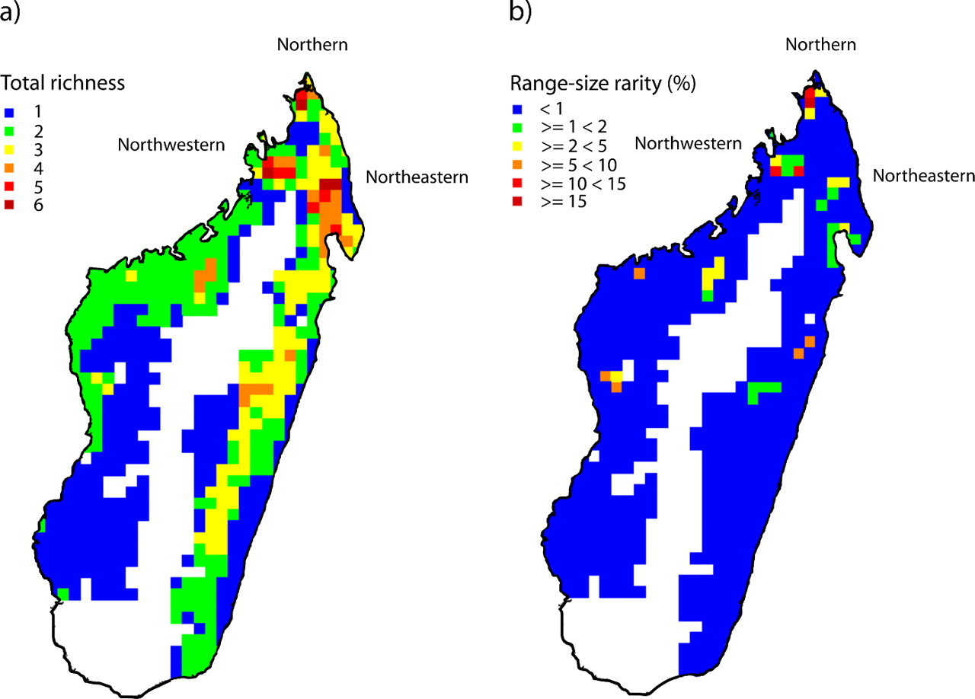
FIGURE 3. Maps illustrating (a) differential Brookesia species diversity (richness) across Madagascar, quantified as ...
Notes:
FIGURE 3. Maps illustrating (a) differential Brookesia species diversity (richness) across Madagascar, quantified as numbers of species present within one-quarter degree square grid cells covering the entire island and (b) degree of endemism in different parts of Madagascar. Endemism is calculated as a measure of range-size rarity, expressed as the percentage aggregated reciprocal range size for all species per one-quarter degree square grid cell.
Unless provided in the caption above, the following copyright applies to the content of this slide: © The Author(s) 2009. Published by Oxford University Press, on behalf of the Society of Systematic Biologists. All rights reserved. For Permissions, please email: journals.permissions@oxfordjournals.org

Slide 4
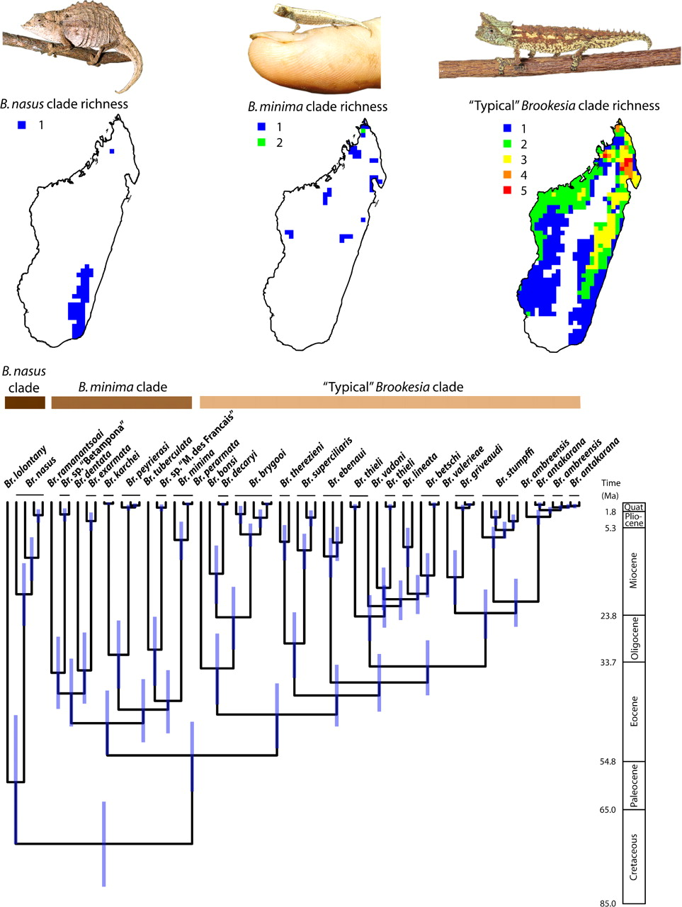
FIGURE 4. Chronogram from the 12-partition (ND1/ND2, ND4, CMOS, and RAG1, each partitioned by codon position) RCB ...
Notes:
FIGURE 4. Chronogram from the 12-partition (ND1/ND2, ND4, CMOS, and RAG1, each partitioned by codon position) RCB phylogenetic analysis. Time units on scale bar in millions of years ago. See Supplementary Materials for exact divergence time means and 95% CIs for all nodes. Maps above chronogram illustrate patterns of species richness (quantified as numbers of species present within one-quarter degree square grid cells) for the 3 main clades (1 = Brookesianasus group, 2 =Brookesiaminima group, and 3=“typical” Brookesia group).
Unless provided in the caption above, the following copyright applies to the content of this slide: © The Author(s) 2009. Published by Oxford University Press, on behalf of the Society of Systematic Biologists. All rights reserved. For Permissions, please email: journals.permissions@oxfordjournals.org

