Slide 1
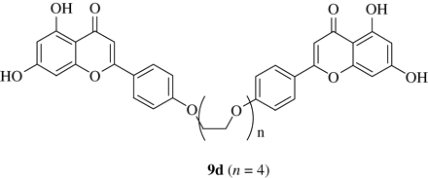
Figure 1 Structure of apigenin dimer 9d. Synthesis of apigenin dimer of general structure 9 has been reported ...
Notes:
Figure 1 Structure of apigenin dimer 9d. Synthesis of apigenin dimer of general structure 9 has been reported previously.41 Compound 9d used in this work consists of two apigenin moieties joined together with a linker of four ethylene glycol units (n = 4).
Unless provided in the caption above, the following copyright applies to the content of this slide: © The Author 2009. Published by Oxford University Press on behalf of the British Society for Antimicrobial Chemotherapy. All rights reserved. For Permissions, please e-mail: journals.permissions@oxfordjournals.org

Slide 2
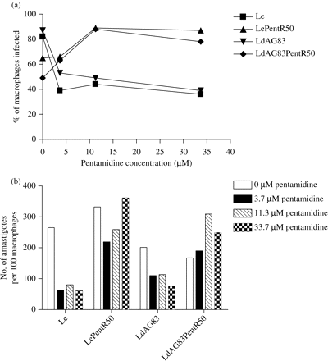
Figure 2 Pentamidine susceptibility of intracellular amastigotes. About 1 × 10⁵ mouse peritoneal ...
Notes:
Figure 2 Pentamidine susceptibility of intracellular amastigotes. About 1 × 105 mouse peritoneal macrophages were infected with stationary-phase promastigotes followed by incubation with different concentrations of pentamidine (0, 3.7, 11.3 and 33.7 µM). After 48 h, coverslips were stained with Giemsa and observed under a microscope. The extent of infection is presented either as percentage of macrophages infected (a) or number of amastigotes per 100 macrophages (b).
Unless provided in the caption above, the following copyright applies to the content of this slide: © The Author 2009. Published by Oxford University Press on behalf of the British Society for Antimicrobial Chemotherapy. All rights reserved. For Permissions, please e-mail: journals.permissions@oxfordjournals.org

Slide 3
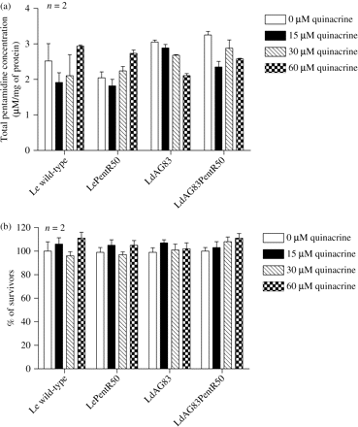
Figure 3 Effect of quinacrine on pentamidine accumulation in Leishmania parasites. (a) One millilitre of 4-day-old ...
Notes:
Figure 3 Effect of quinacrine on pentamidine accumulation in Leishmania parasites. (a) One millilitre of 4-day-old promastigotes at a cell density of 2 × 107 cells/mL was used for the pentamidine accumulation assay. The cells were washed with PBS and then incubated at 27°C for 3 h with increasing concentrations of quinacrine (0, 15, 30 and 60 µM). Each concentration of quinacrine was tested in triplicate and repeated twice in separate experiments. The values are presented as μM pentamidine per mg of protein (mean ± SEM, n = 2). (b) Cytotoxic effect of quinacrine on Leishmania parasites. Promastigotes were treated as in (a). Each concentration of quinacrine was tested in triplicate and repeated twice in separate experiments. The percentage of survivors was determined by MTS proliferation assay (mean ± SEM, n = 2).
Unless provided in the caption above, the following copyright applies to the content of this slide: © The Author 2009. Published by Oxford University Press on behalf of the British Society for Antimicrobial Chemotherapy. All rights reserved. For Permissions, please e-mail: journals.permissions@oxfordjournals.org

Slide 4
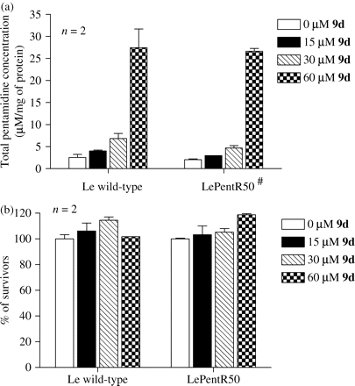
Figure 4 Effect of apigenin dimer 9d on pentamidine accumulation in Leishmania parasites. (a) Determination of ...
Notes:
Figure 4 Effect of apigenin dimer 9d on pentamidine accumulation in Leishmania parasites. (a) Determination of pentamidine accumulation. One millilitre of 4-day-old promastigotes (Le wild-type and LePentR50) at a cell density of 2 × 107 cells/mL was used for the pentamidine accumulation assay. The cells were washed with PBS and then incubated at 27°C for 3 h with increasing concentrations of 9d (0, 15, 30 and 60 µM). Each concentration of 9d was tested in triplicate and repeated twice in separate experiments. The amount of pentamidine accumulated was determined by HPLC and is presented as μM pentamidine per mg of protein (mean ± SEM, n = 2). #Dose-dependent pentamidine accumulation in LePentR50 has been reported previously34 and is included in this figure for comparison. (b) Cytotoxic effect of 9d on Leishmania parasites. Promastigotes were treated as in (a). Each concentration of 9d was tested in triplicate and repeated twice in separate experiments. The percentage of survivors was determined by MTS proliferation assay (mean ± SEM, n = 2).
Unless provided in the caption above, the following copyright applies to the content of this slide: © The Author 2009. Published by Oxford University Press on behalf of the British Society for Antimicrobial Chemotherapy. All rights reserved. For Permissions, please e-mail: journals.permissions@oxfordjournals.org

Slide 5
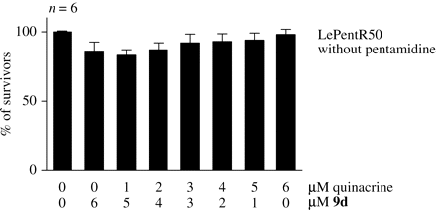
Figure 5 Cytotoxicity of quinacrine and apigenin dimer 9d combination towards LePentR50. Effects of combinations of ...
Notes:
Figure 5 Cytotoxicity of quinacrine and apigenin dimer 9d combination towards LePentR50. Effects of combinations of quinacrine and 9d on the cytotoxicity towards LePentR50 were tested by MTS proliferation assay. The cytotoxic effect of different combinations is presented as percentage of survivors (mean ± SEM, n = 6). No significant cytotoxicity was observed among different combinations.
Unless provided in the caption above, the following copyright applies to the content of this slide: © The Author 2009. Published by Oxford University Press on behalf of the British Society for Antimicrobial Chemotherapy. All rights reserved. For Permissions, please e-mail: journals.permissions@oxfordjournals.org

Slide 6
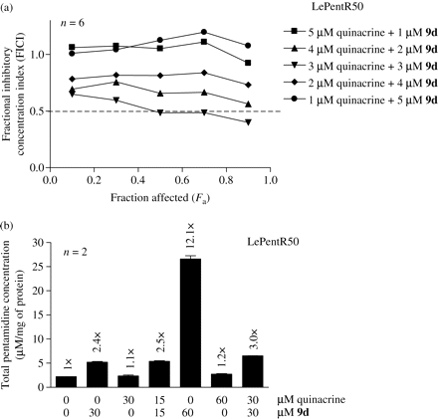
Figure 6 Synergistic effect of quinacrine and apigenin dimer 9d on modulating pentamidine resistance and pentamidine ...
Notes:
Figure 6 Synergistic effect of quinacrine and apigenin dimer 9d on modulating pentamidine resistance and pentamidine accumulation of LePentR50. (a) FICI versus Fa plots. FICIs are means from six independent experiments. Fa is the fraction affected by different combinations of quinacrine and 9d. FICI ≤0.5, >0.5–4 or >4 indicates synergism, additive effect or antagonism, respectively. Five experimental points (0.1, 0.3, 0.5, 0.7 and 0.9) are plotted. The dotted line represents an FICI of 0.5. The FICI values are <0.5 at the Fa of 0.5, 0.7 and 0.9 for the combination of 3 µM quinacrine with 3 µM 9d. The FICI values of other combinations at all Fa values are >0.5 and close to 1. (b) Determination of accumulation of pentamidine by HPLC. LePentR50 promastigotes were washed with PBS and then incubated at 27°C for 3 h with the different combinations of modulators indicated in the figure. Pentamidine accumulation was determined by HPLC. Each treatment was tested in triplicate and repeated twice in separate experiments. The amount of pentamidine accumulated in promastigotes is presented as μM pentamidine per mg of protein (mean ± SEM, n = 2). The fold increase in pentamidine accumulated, after normalization to that without quinacrine or 9d, is shown above each bar.
Unless provided in the caption above, the following copyright applies to the content of this slide: © The Author 2009. Published by Oxford University Press on behalf of the British Society for Antimicrobial Chemotherapy. All rights reserved. For Permissions, please e-mail: journals.permissions@oxfordjournals.org

