Slide 1
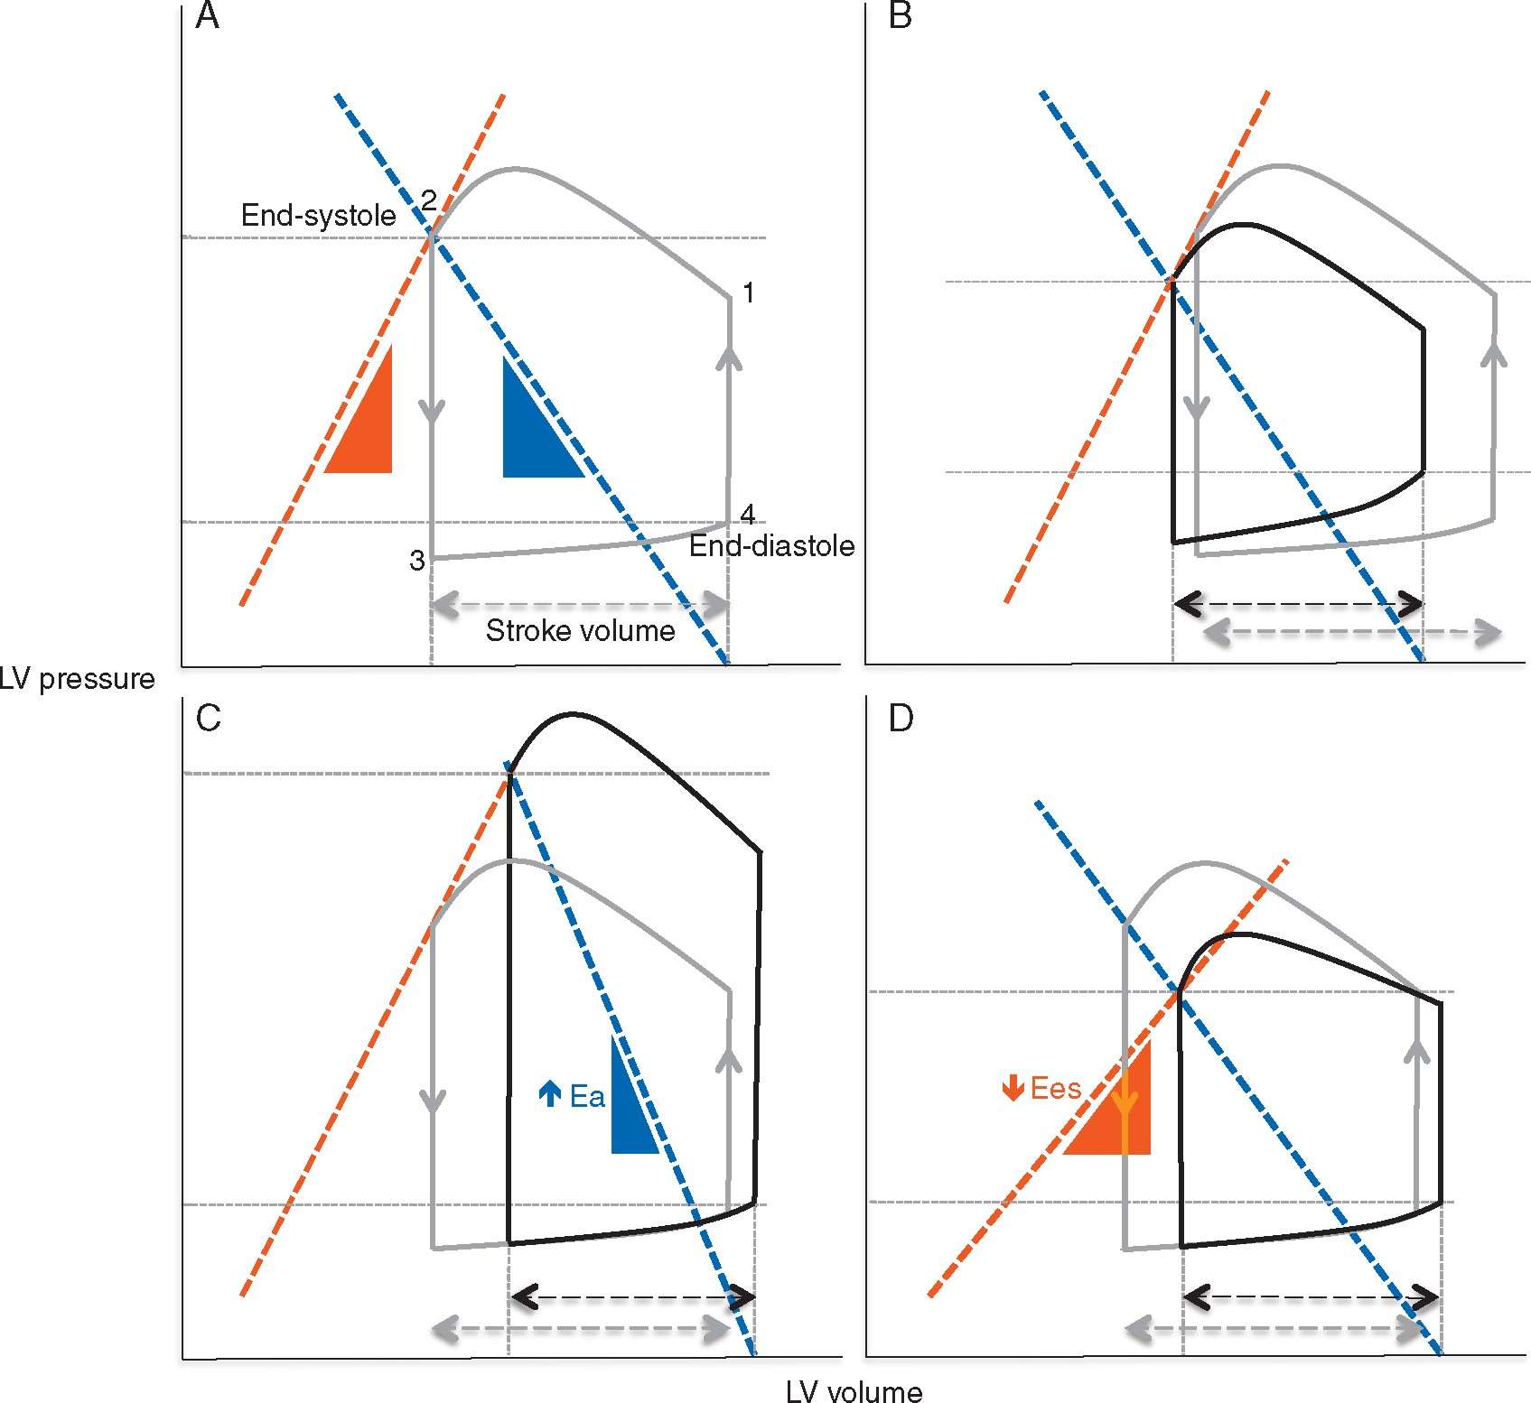
Fig 1 (A) The normal ventricular pressure volume loop (grey). (B–D) These panels show the ventricular pressure loop ...
Notes:
Fig 1 (A) The normal ventricular pressure volume loop (grey). (B–D) These panels show the ventricular pressure loop under pathological conditions (black). The red line represents the relationship between end-systolic pressure and volume (end-systolic ventricular elastance, Ees, where elastance, or ‘stiffness’, is the reciprocal of compliance), the gradient is an index of ventricular contractility (steeper line indicates greater contractility). The gradient of the blue line represents effective arterial elastance Ea, indicating the ventricular pressure (PV) required to overcome arterial impedance when ejecting SV. This line thus reflects ventricular afterload (steeper line indicates greater afterload). These lines intersect at the end of systole where arterial and ventricular pressure are equal. Red and blue triangles indicate changes in gradients of pressure/volume relationships (elastance) of the ventricle and arterial system, respectively. The top left corner of the loop represents end-systolic ventricular pressure and volume; the bottom right corner represents pressure and volume at end-diastole. (B): When ventricular compliance is reduced, EDV and SV are also either reduced or maintained at the expense of elevated end-diastolic pressure (frequently both). Nitrates and diuretics reduce EDV and hence EDP; this has the beneficial effect of lowering LAP and limiting pulmonary congestion, but may reduce preload and SV. (C): Increased arterial impedance elevates the ventricular pressure required to eject blood and decreases SV. It is also clear that to eject a given stroke volume, external work (the area of the PV loop) must increase. Therapies that reduce arterial impedance reduce the Ea gradient and restore SV. (D): Depressed ventricular contractility (reduced Ees) reduces stroke volume. Therapies that improve contractility, e.g. inotropes, restoration of coronary perfusion, increase Ees and ventricular ejection pressure, decreasing ESV and boosting SV. Note in panels C and D that EDV is shifted right as CO depression leads to elevated LAP.
Unless provided in the caption above, the following copyright applies to the content of this slide: © The Author 2017. Published by Oxford University Press on behalf of the British Journal of Anaesthesia. All rights reserved. For Permissions, please email: journals.permissions@oup.com

