Slide 1
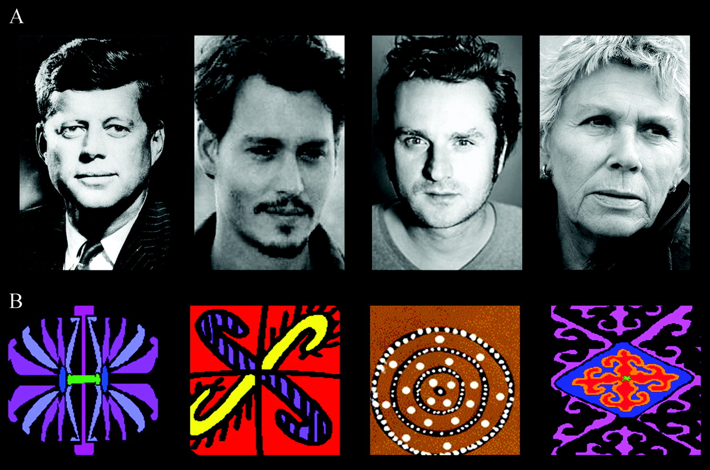
Figure 1. Examples of stimuli used in this study. Top: famous and unknown faces. Bottom: trial-unique abstract ...
Notes:
Figure 1. Examples of stimuli used in this study. Top: famous and unknown faces. Bottom: trial-unique abstract stimuli.
Unless provided in the caption above, the following copyright applies to the content of this slide: © 2007 The AuthorsThis is an Open Access article distributed under the terms of the Creative Commons Attribution Non-Commercial License (http://creativecommons.org/licenses/by-nc/2.0/uk/) which permits unrestricted non-commercial use, distribution, and reproduction in any medium, provided the original work is properly cited.

Slide 2
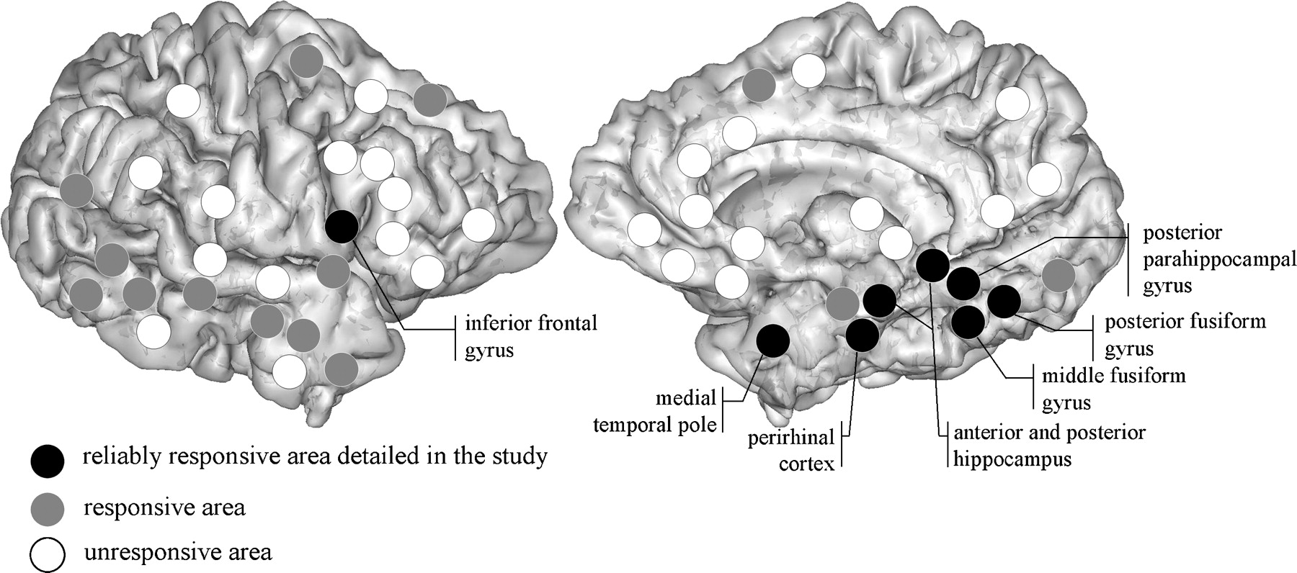
Figure 2. Schematic representation of all brain areas explored. Focal ERPs were recorded from different regions (in ...
Notes:
Figure 2. Schematic representation of all brain areas explored. Focal ERPs were recorded from different regions (in gray and black) but were found reliably with reproducible morphology at similar latencies only in the areas depicted in black. ERPs recorded in the areas in gray did not meet study criteria. No ERPs were recorded from the areas in white.
Unless provided in the caption above, the following copyright applies to the content of this slide: © 2007 The AuthorsThis is an Open Access article distributed under the terms of the Creative Commons Attribution Non-Commercial License (http://creativecommons.org/licenses/by-nc/2.0/uk/) which permits unrestricted non-commercial use, distribution, and reproduction in any medium, provided the original work is properly cited.

Slide 3
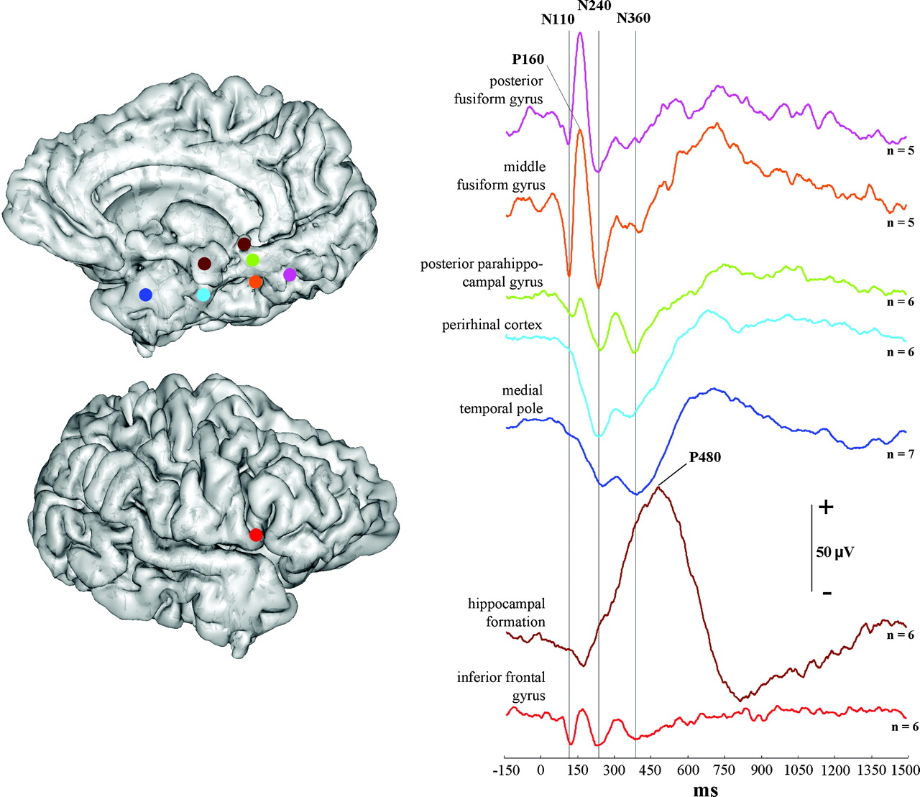
Figure 3. Comparison of the averaged ERPs to famous faces across regions using a color-coding scheme. The vertical ...
Notes:
Figure 3. Comparison of the averaged ERPs to famous faces across regions using a color-coding scheme. The vertical lines are drawn to facilitate comparison of the different peaks.
Unless provided in the caption above, the following copyright applies to the content of this slide: © 2007 The AuthorsThis is an Open Access article distributed under the terms of the Creative Commons Attribution Non-Commercial License (http://creativecommons.org/licenses/by-nc/2.0/uk/) which permits unrestricted non-commercial use, distribution, and reproduction in any medium, provided the original work is properly cited.

Slide 4
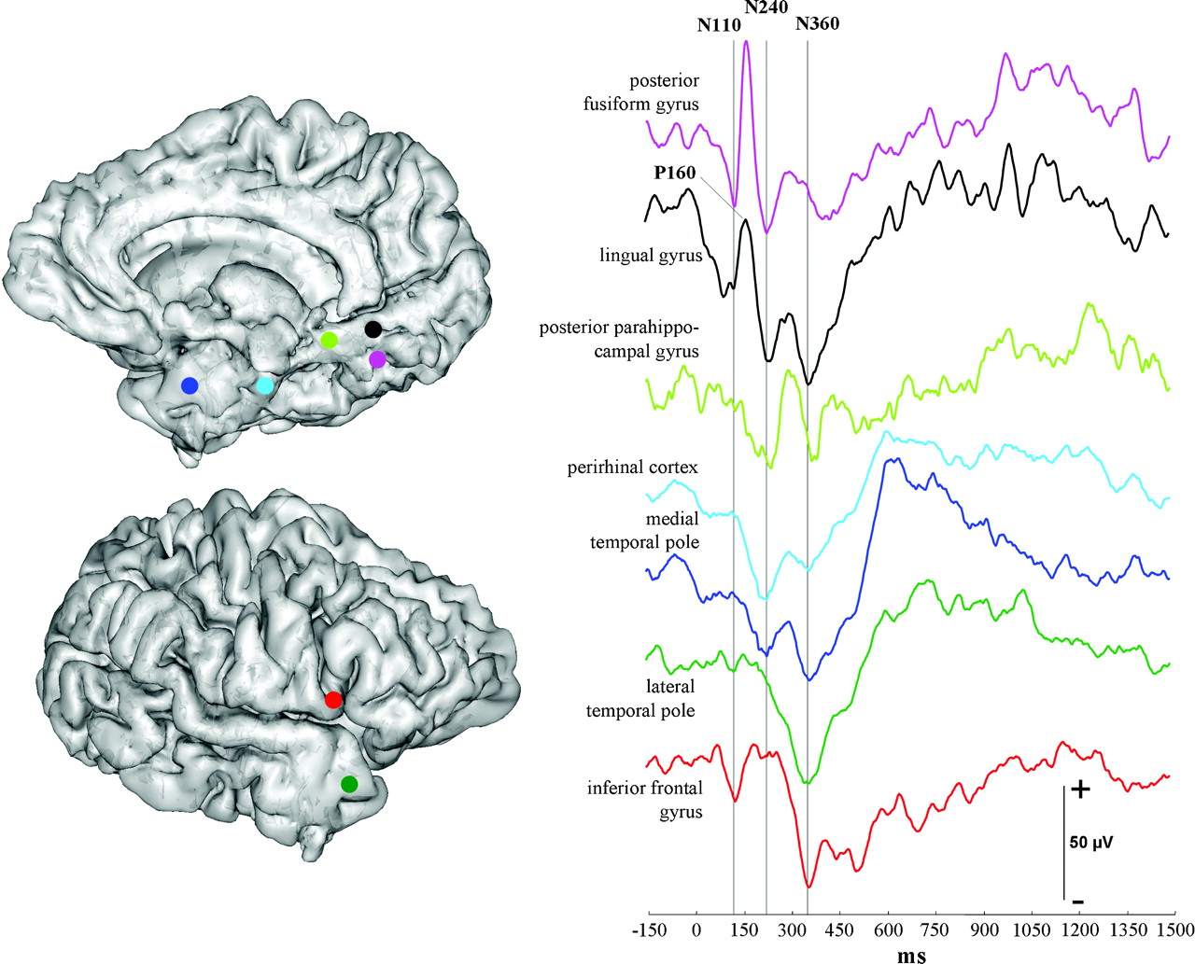
Figure 4. Intrasubject comparison of ERPs to famous faces across regions (subject 1, right hemisphere). ERPs recorded ...
Notes:
Figure 4. Intrasubject comparison of ERPs to famous faces across regions (subject 1, right hemisphere). ERPs recorded in the lingual gyrus and lateral temporal pole are presented to demonstrate that the N240–P300–N360 complex and N360 may be even more common than reported in the group study.
Unless provided in the caption above, the following copyright applies to the content of this slide: © 2007 The AuthorsThis is an Open Access article distributed under the terms of the Creative Commons Attribution Non-Commercial License (http://creativecommons.org/licenses/by-nc/2.0/uk/) which permits unrestricted non-commercial use, distribution, and reproduction in any medium, provided the original work is properly cited.

Slide 5
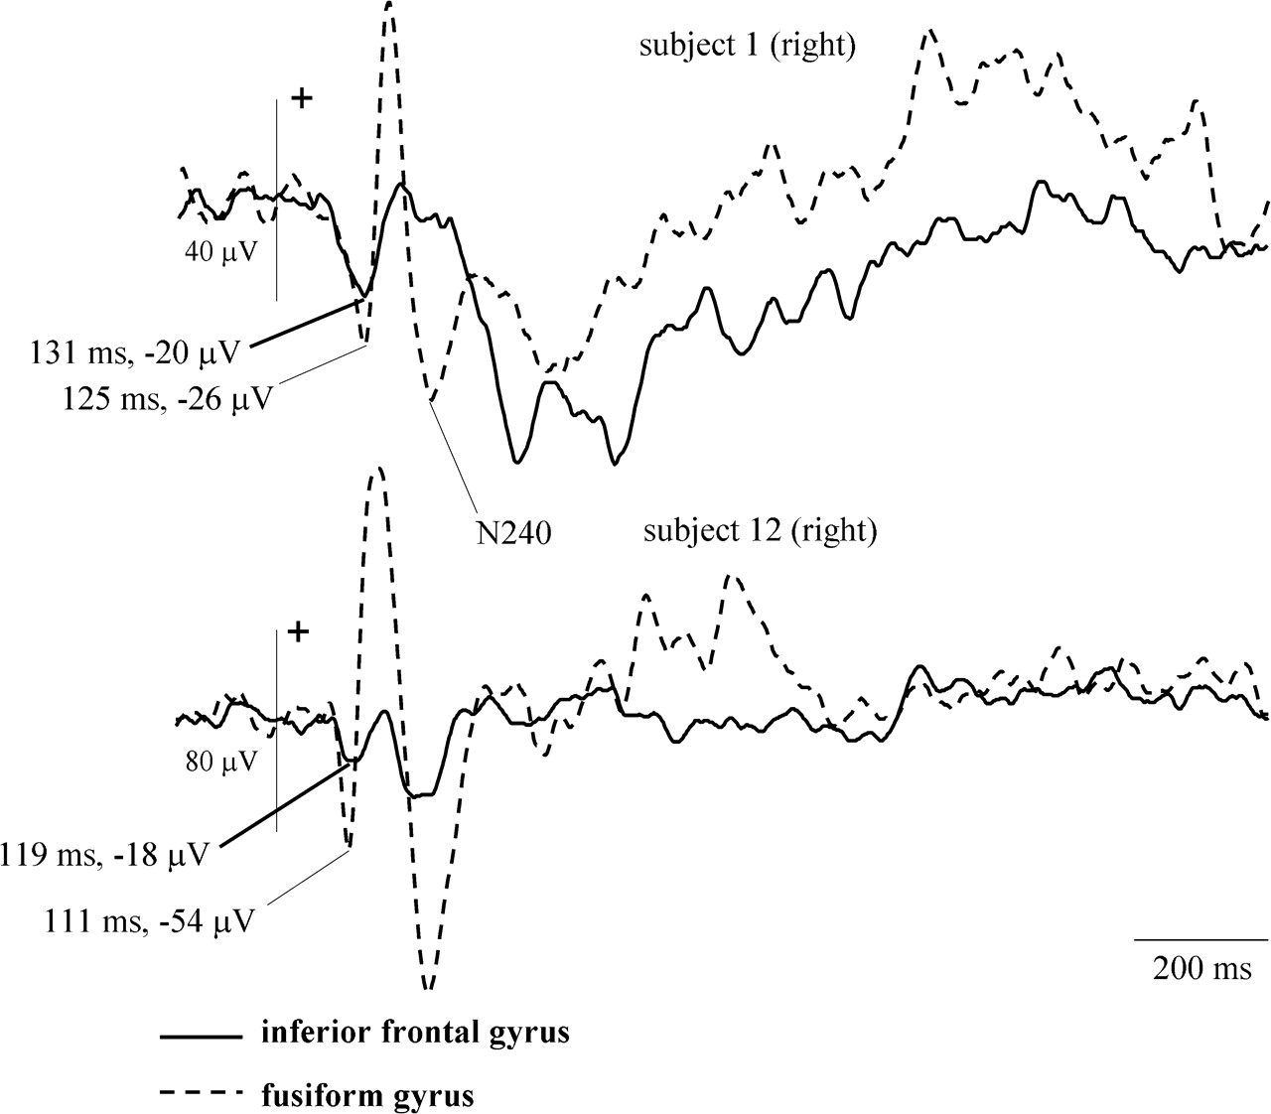
Figure 5. ERPs to famous faces recorded from the inferior frontal gyrus and the FG (posterior FG in subject 1, middle ...
Notes:
Figure 5. ERPs to famous faces recorded from the inferior frontal gyrus and the FG (posterior FG in subject 1, middle FG in subject 12). The N110 peaks slightly earlier in the FG. Note the different amplitude scales.
Unless provided in the caption above, the following copyright applies to the content of this slide: © 2007 The AuthorsThis is an Open Access article distributed under the terms of the Creative Commons Attribution Non-Commercial License (http://creativecommons.org/licenses/by-nc/2.0/uk/) which permits unrestricted non-commercial use, distribution, and reproduction in any medium, provided the original work is properly cited.

Slide 6
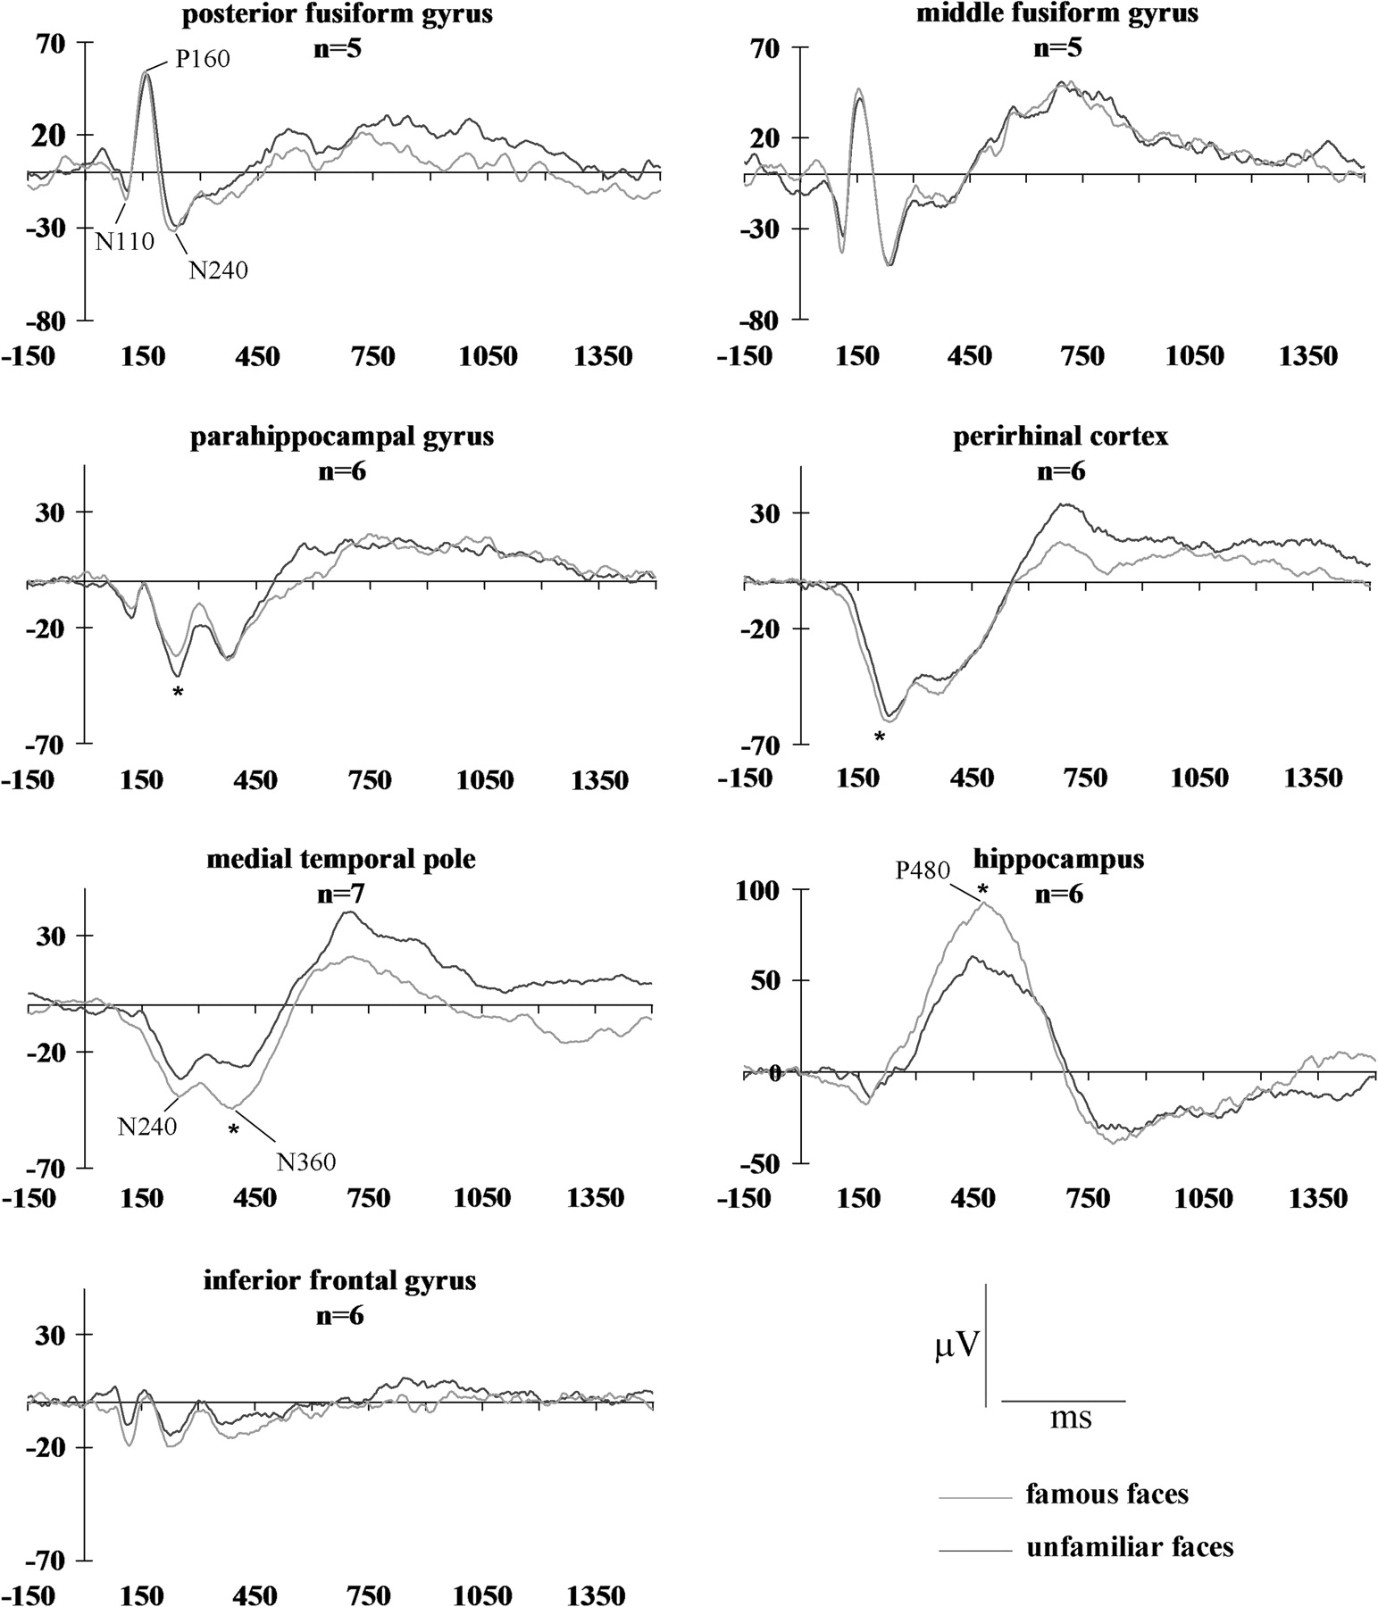
Figure 6. ERPs to famous and unfamiliar faces. Asterisk indicates P < 0.05. For clarity, peak labels are indicated for ...
Notes:
Figure 6. ERPs to famous and unfamiliar faces. Asterisk indicates P < 0.05. For clarity, peak labels are indicated for some brain areas only.
Unless provided in the caption above, the following copyright applies to the content of this slide: © 2007 The AuthorsThis is an Open Access article distributed under the terms of the Creative Commons Attribution Non-Commercial License (http://creativecommons.org/licenses/by-nc/2.0/uk/) which permits unrestricted non-commercial use, distribution, and reproduction in any medium, provided the original work is properly cited.

Slide 7
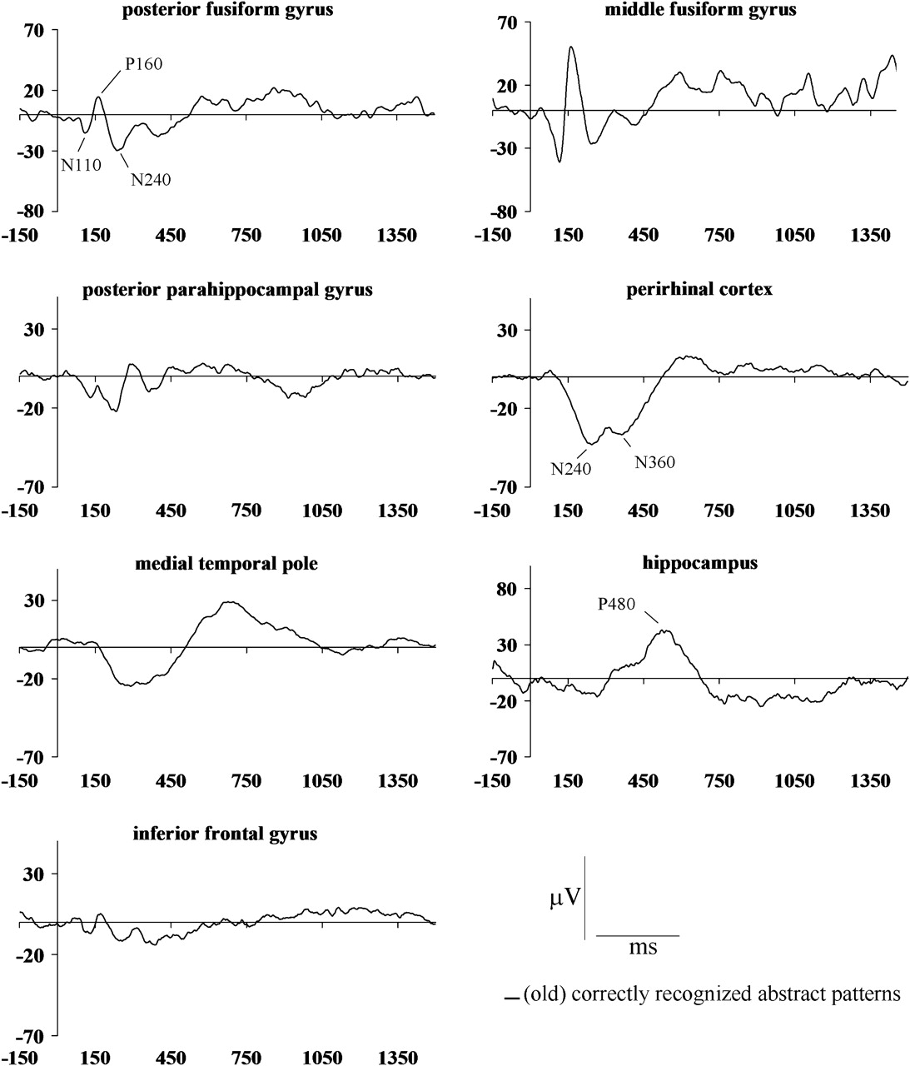
Figure 7. ERPs to (old) recognized abstract patterns. Same patients as in Figure 5. Left and right hemispheres ...
Notes:
Figure 7. ERPs to (old) recognized abstract patterns. Same patients as in Figure 5. Left and right hemispheres combined.
Unless provided in the caption above, the following copyright applies to the content of this slide: © 2007 The AuthorsThis is an Open Access article distributed under the terms of the Creative Commons Attribution Non-Commercial License (http://creativecommons.org/licenses/by-nc/2.0/uk/) which permits unrestricted non-commercial use, distribution, and reproduction in any medium, provided the original work is properly cited.

Slide 8
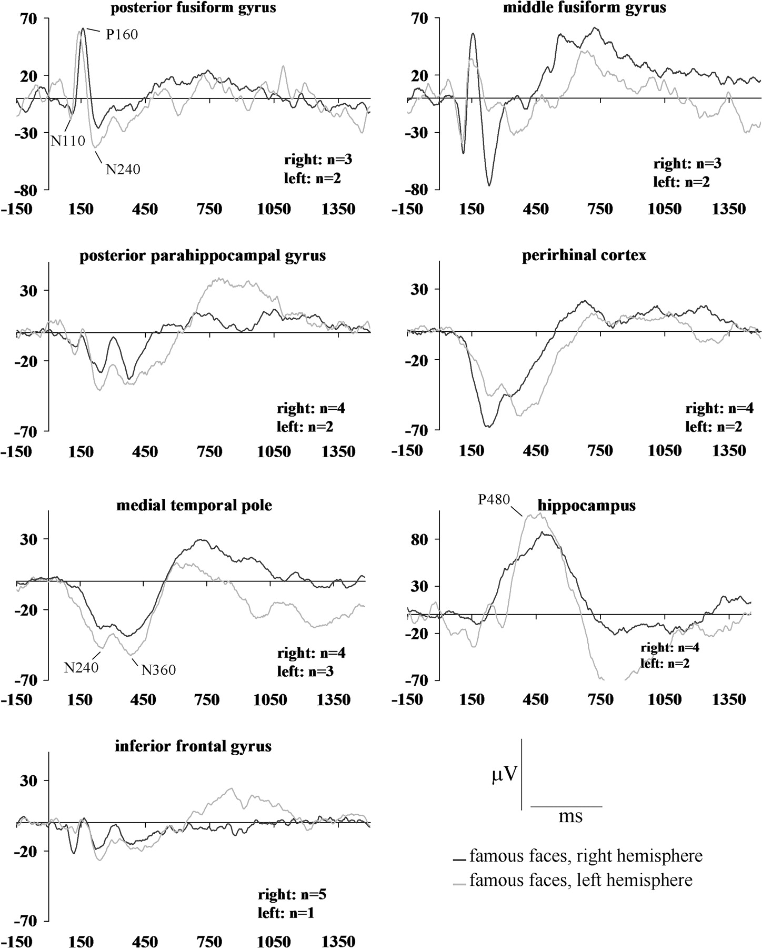
Figure 8. ERPs to famous faces recorded from the left and right hemispheres. For clarity, peak labels are indicated for ...
Notes:
Figure 8. ERPs to famous faces recorded from the left and right hemispheres. For clarity, peak labels are indicated for some brain areas only.
Unless provided in the caption above, the following copyright applies to the content of this slide: © 2007 The AuthorsThis is an Open Access article distributed under the terms of the Creative Commons Attribution Non-Commercial License (http://creativecommons.org/licenses/by-nc/2.0/uk/) which permits unrestricted non-commercial use, distribution, and reproduction in any medium, provided the original work is properly cited.

Slide 9
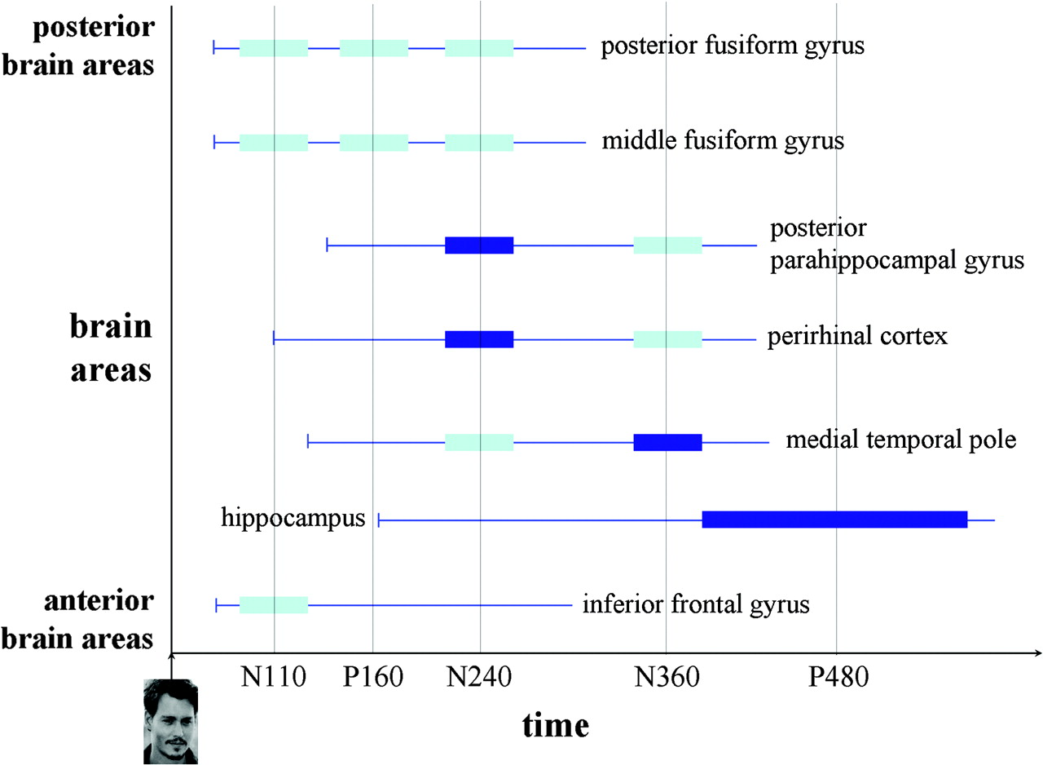
Figure 9. Schematic model of the main electrophysiological activities underlying face recognition in different brain ...
Notes:
Figure 9. Schematic model of the main electrophysiological activities underlying face recognition in different brain regions. Components’ names are indicated on the abscissa. The rectangles indicate the main peaks of the components in each region. The horizontal lines provide an idea of the components’ onsets. The rectangles in dark blue indicate the peaks during which a recognition effect was found.
Unless provided in the caption above, the following copyright applies to the content of this slide: © 2007 The AuthorsThis is an Open Access article distributed under the terms of the Creative Commons Attribution Non-Commercial License (http://creativecommons.org/licenses/by-nc/2.0/uk/) which permits unrestricted non-commercial use, distribution, and reproduction in any medium, provided the original work is properly cited.

