Slide 1
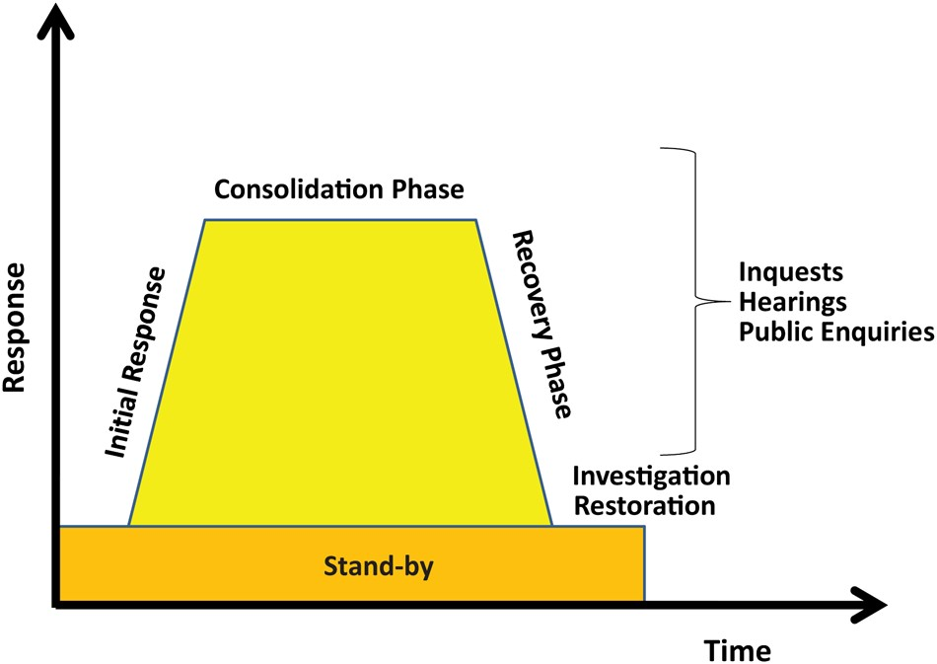
Fig 1 The stages of a major incident. London Emergency Services Liaison Panel.
Notes:
Fig 1 The stages of a major incident. London Emergency Services Liaison Panel.
Unless provided in the caption above, the following copyright applies to the content of this slide: © The Author 2016. Published by Oxford University Press on behalf of the British Journal of Anaesthesia. All rights reserved. For Permissions, please email: journals.permissions@oup.com

