Slide 1
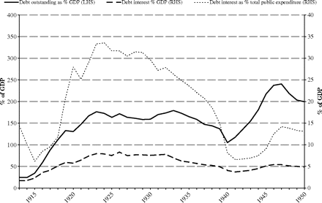
Figure 4 UK: outstanding national debt, debt interest and total public expenditure (% of GDP), 1913–50 Sources: ...
Notes:
Figure 4 UK: outstanding national debt, debt interest and total public expenditure (% of GDP), 1913–50 Sources: National debt outstanding at end of financial year: Mitchell (1988, pp. 602–3); debt interest, total public expenditure, and GDP: Middleton (1996, Table AI.1).
Unless provided in the caption above, the following copyright applies to the content of this slide: © Oxford University Press 2010

Slide 2
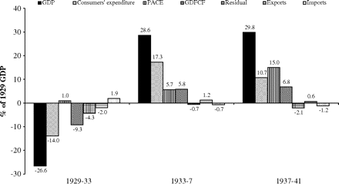
Figure 3 US: change in GDP and components (% of 1929 GDP), 1929–41 Source: Calculated from Carter et al. (2006, III, ...
Notes:
Figure 3 US: change in GDP and components (% of 1929 GDP), 1929–41 Source: Calculated from Carter et al. (2006, III, series Ca84-Ca89).
Unless provided in the caption above, the following copyright applies to the content of this slide: © Oxford University Press 2010

Slide 3
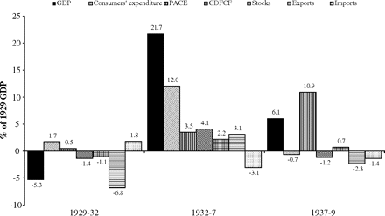
Figure 2 UK: change in GDP and components (% of 1929 GDP), 1929–39 Source: Calculated from Sefton and Weale (1995, ...
Notes:
Figure 2 UK: change in GDP and components (% of 1929 GDP), 1929–39 Source: Calculated from Sefton and Weale (1995, Table A.3).
Unless provided in the caption above, the following copyright applies to the content of this slide: © Oxford University Press 2010

Slide 4
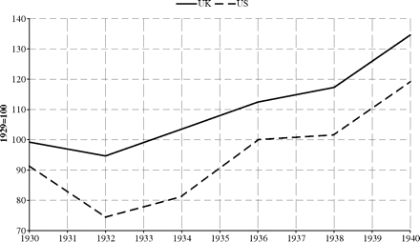
Figure 1 Real GDP (1929=100), US and UK, 1929–40 Sources: UK: Sefton and Weale (1995, Table A3); US: Carter et al. ...
Notes:
Figure 1 Real GDP (1929=100), US and UK, 1929–40 Sources: UK: Sefton and Weale (1995, Table A3); US: Carter et al. (2006, III, series Ca9).
Unless provided in the caption above, the following copyright applies to the content of this slide: © Oxford University Press 2010

Slide 5
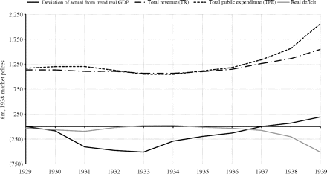
Figure 10 GDP deviations, total public expenditure, and total revenue, 1938 market prices, 1929–39 Sources: GDP: ...
Notes:
Figure 10 GDP deviations, total public expenditure, and total revenue, 1938 market prices, 1929–39 Sources: GDP: Feinstein (1972, Table 5); TPE and TR: Middleton (1996, Tables AI.1, AI.2) adjusted by GDP deflator, Feinstein (1972, Table 61).
Unless provided in the caption above, the following copyright applies to the content of this slide: © Oxford University Press 2010

Slide 6
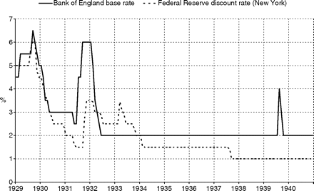
Figure 5 Official interest rates, monthly averages: UK and US, 1929–40 Sources: UK: ...
Notes:
Figure 5 Official interest rates, monthly averages: UK and US, 1929–40 Sources: UK: http://www.bankofengland.co.uk/statistics/rates/baserate.xls, 08.04.10; US: http://www.nber.org/ databases/macrohistory/contents/chapter13.html, 08.04.10.
Unless provided in the caption above, the following copyright applies to the content of this slide: © Oxford University Press 2010

Slide 7
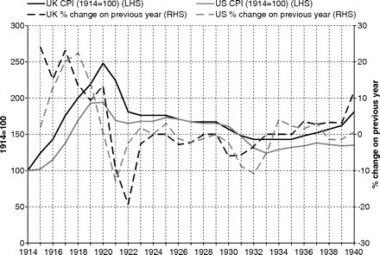
Figure 6 Consumer price index (1914 = 100), UK and US, 1914–40 Source: Derived from Maddison (1991, Tables E2-4).
Notes:
Figure 6 Consumer price index (1914 = 100), UK and US, 1914–40 Source: Derived from Maddison (1991, Tables E2-4).
Unless provided in the caption above, the following copyright applies to the content of this slide: © Oxford University Press 2010

Slide 8
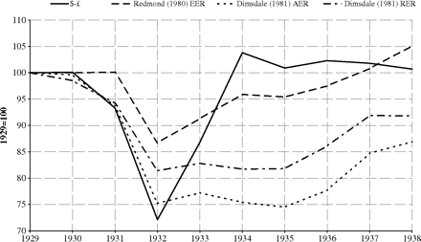
Figure 7 Sterling exchange rates (1929 = 100), 1929–38 Sources: Redmond (1980); Dimsdale (1981, Tables 3, 9).
Notes:
Figure 7 Sterling exchange rates (1929 = 100), 1929–38 Sources: Redmond (1980); Dimsdale (1981, Tables 3, 9).
Unless provided in the caption above, the following copyright applies to the content of this slide: © Oxford University Press 2010

Slide 9
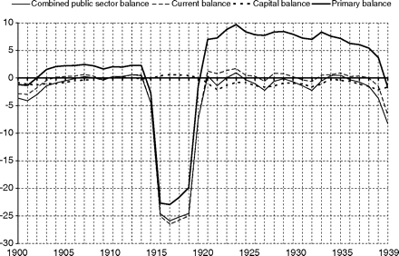
Figure 8 Public-sector budget balances, % of GDP, 1900–39 Source: Derived from Middleton (1996, Tables AI.1–AI.2).
Notes:
Figure 8 Public-sector budget balances, % of GDP, 1900–39 Source: Derived from Middleton (1996, Tables AI.1–AI.2).
Unless provided in the caption above, the following copyright applies to the content of this slide: © Oxford University Press 2010

Slide 10
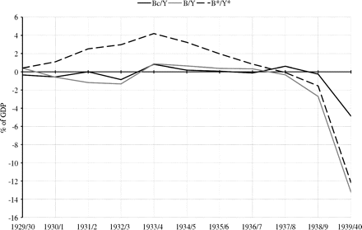
Figure 9 Summary measures of fiscal stance, % of actual and constant employment GDP, 1929/30–1939/40 Source: Middleton ...
Notes:
Figure 9 Summary measures of fiscal stance, % of actual and constant employment GDP, 1929/30–1939/40 Source: Middleton (1981, Table 5).
Unless provided in the caption above, the following copyright applies to the content of this slide: © Oxford University Press 2010

