Slide 1
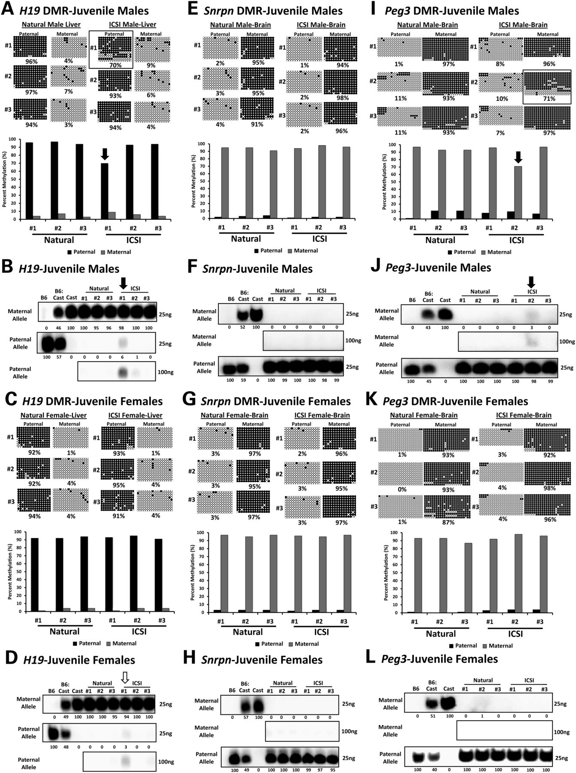
Figure 1. Allele-specific DNA methylation and expression of H19, Snrpn and Peg3 genes in somatic tissues of naturally ...
Notes:
Figure 1. Allele-specific DNA methylation and expression of H19, Snrpn and Peg3 genes in somatic tissues of naturally conceived and ICSI-derived juvenile mice. Bisulfite sequencing analysis of allele-specific DNA methylation at the H19 DMR in liver tissue from naturally conceived and ICSI-derived juvenile male (A) and female (C) mice. SNuPE analysis of allele-specific expression of the H19 gene in the liver tissue of naturally conceived and ICSI-derived juvenile male (B) and female (D) mice. Bisulfite sequencing analysis of allele-specific DNA methylation at the Snrpn DMR in brain tissue from naturally conceived and ICSI-derived juvenile male (E) and female (G) mice. SNuPE analysis of allele-specific expression of the Snrpn gene in the brain tissue of naturally conceived and ICSI-derived juvenile male (F) and female (H) mice. Bisulfite sequencing analysis of allele-specific DNA methylation at the Peg3 DMR in brain tissue from naturally conceived and ICSI-derived juvenile male (I) and female (K) mice. SNuPE analysis of allele-specific expression of the Peg3 gene in the brain tissue of naturally conceived and ICSI-derived juvenile male (J) and female (L) mice. In each case, bisulfite sequencing data are shown on a per strand basis (rows of circles) and as a bar graph. Each line of circles corresponds to a single strand of DNA, and each circle represents a single CpG dinucleotide. Black circles designate a methylated cytosine in an individual CpG dinucleotide and white circles represent unmethylated cytosines in CpG dinucleotides. The numbers to the left of each set of circles represent different individual mice, and the percent of methylated CpG sites is indicated below each set of DNA strands. For each gene expression analysis, the parental allele is indicated to the left of each gel. The numbers below each lane indicate the relative level of expression compared with the internal controls and are shown as percentage values determined by phosphorimager software. Percentages were adjusted for background and number of nucleotides added to the primer using the values obtained for B6 and Cast control samples. The amount of purified RT–PCR product loaded is indicated to the right of each gel. The 100-ng panel could not be quantified because the internal controls were saturated. Black boxes designate abnormal methylation profiles. Black arrows indicate abnormal allelic expression patterns that correlate with aberrant DNA methylation patterns. White arrows indicate abnormal allelic expression patterns that do not correlate with a detected aberrant methylation pattern. Expression controls: B6, 100% C57BL/6 RNA; Cast, 100% B6(CAST7) RNA; B6:Cast, 50% B6 RNA and 50% Cast RNA.
Unless provided in the caption above, the following copyright applies to the content of this slide: © The Author 2012. Published by Oxford University Press. All rights reserved. For Permissions, please email: journals.permissions@oup.com

Slide 2
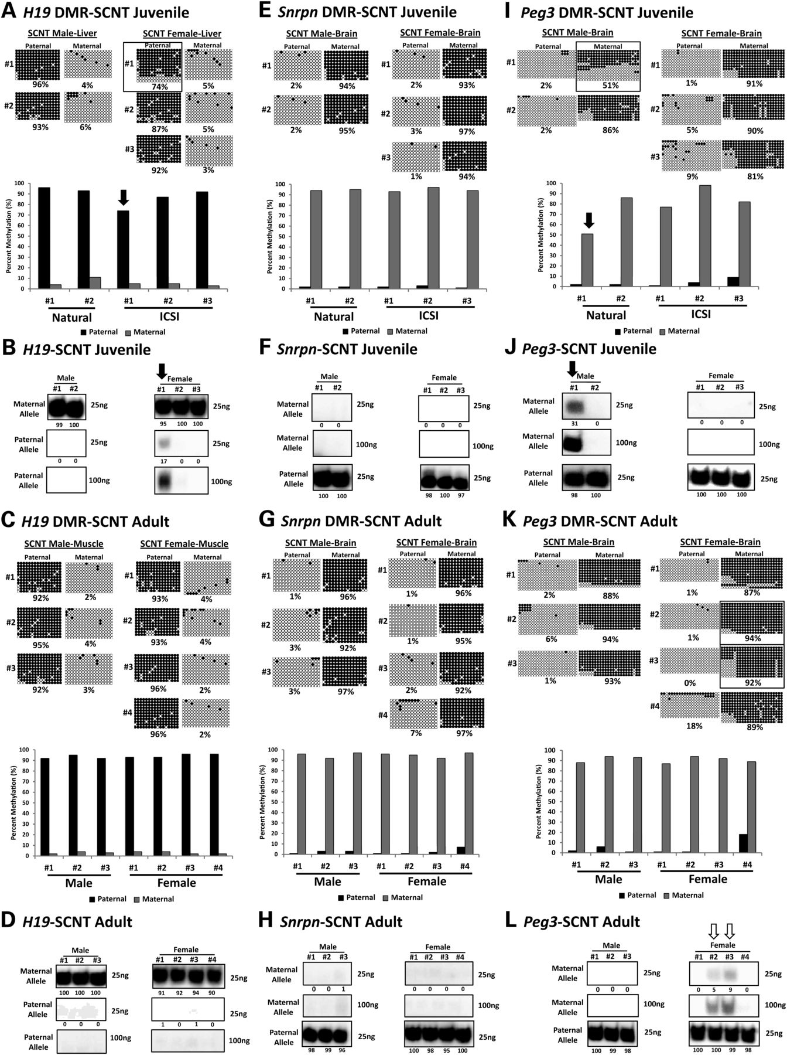
Figure 2. Allele-specific DNA methylation and expression of H19, Snrpn and Peg3 genes in somatic tissues of ...
Notes:
Figure 2. Allele-specific DNA methylation and expression of H19, Snrpn and Peg3 genes in somatic tissues of SCNT-derived juvenile and adult mice. Bisulfite sequencing analysis of allele-specific DNA methylation at the H19 DMR in liver tissue from SCNT-derived juvenile (A) and adult (C) male and female mice. SNuPE analysis of allele-specific expression of the H19 gene in liver tissue of SCNT-derived juvenile mice (B) and in brain tissue of SCNT-derived adult mice (D). Bisulfite sequencing analysis of allele-specific DNA methylation at the Snrpn DMR in brain tissue from SCNT-derived juvenile (E) and adult (G) mice. SNuPE analysis of allele-specific expression of the Snrpn gene in brain tissue of SCNT-derived juvenile (F) and adult (H) mice. Bisulfite sequencing analysis of allele-specific DNA methylation at the Peg3 DMR in brain tissue from SCNT-derived juvenile (I) and adult (K) mice. SNuPE analysis of allele-specific expression of the Peg3 gene in brain tissue of SCNT-derived juvenile (J) and adult (L) mice. Other details are as described in Figure 1.
Unless provided in the caption above, the following copyright applies to the content of this slide: © The Author 2012. Published by Oxford University Press. All rights reserved. For Permissions, please email: journals.permissions@oup.com

Slide 3
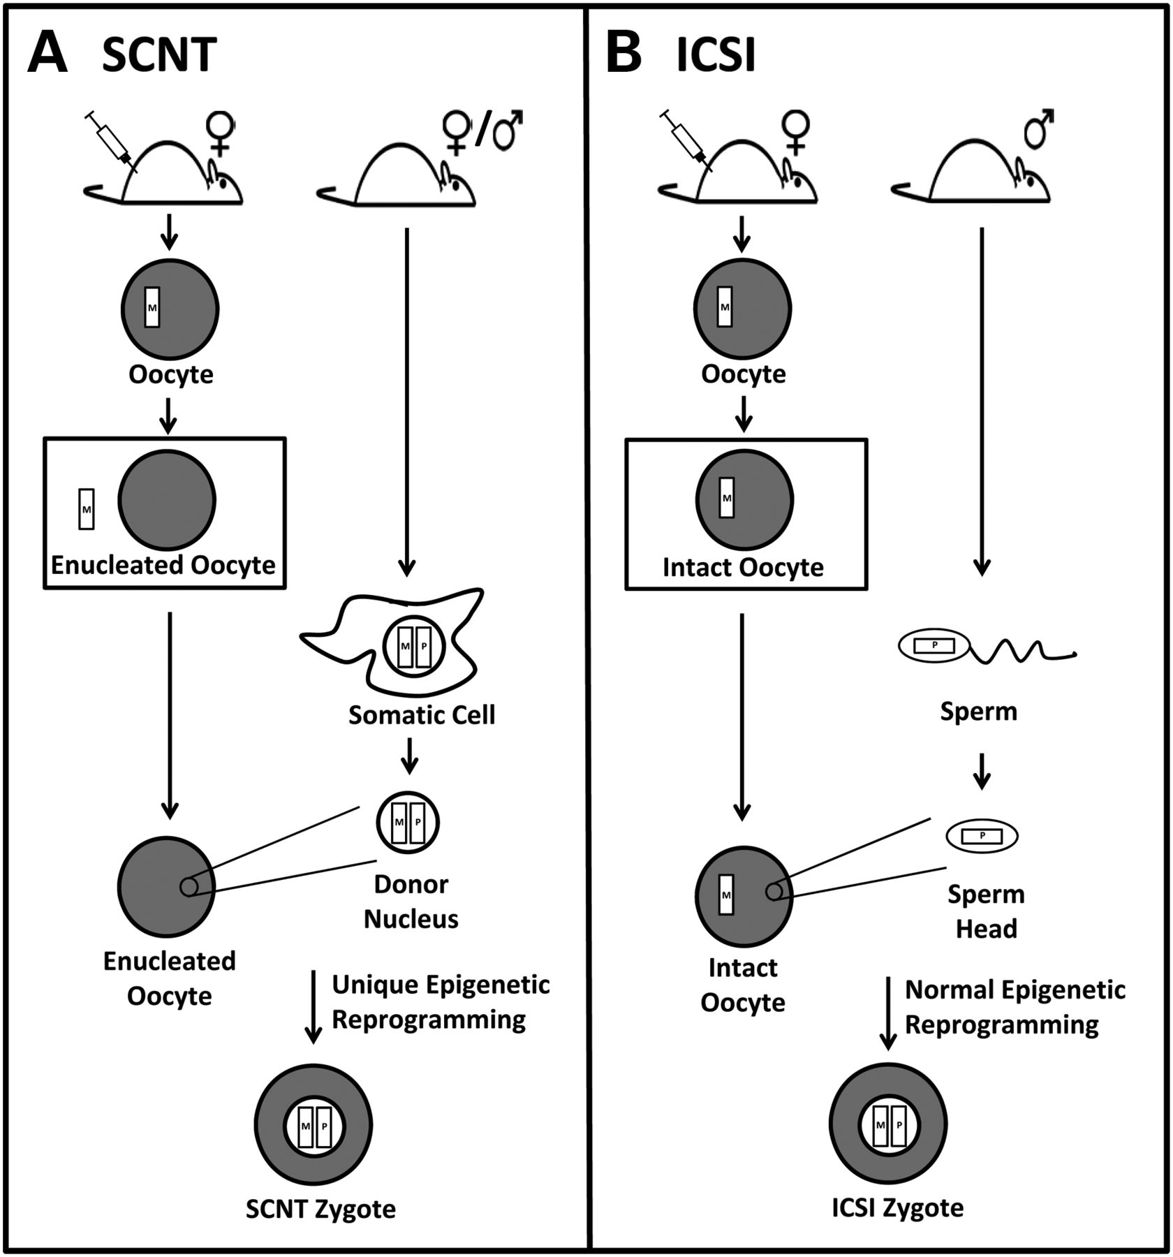
Figure 3. Schematic comparison of the SCNT and ICSI procedures. (A) The SCNT procedure begins with injecting exogenous ...
Notes:
Figure 3. Schematic comparison of the SCNT and ICSI procedures. (A) The SCNT procedure begins with injecting exogenous gonadotropins into a female mouse to induce superovulation. After the oocytes are collected, the maternal genome is removed, and a donor nucleus is subsequently injected into the enucleated oocyte. The cloned embryo is then cultured for 2 days before being transferred into a surrogate dam to be carried to term. (B) The ICSI procedure also begins with injection of exogenous hormones into a female mouse to stimulate superovulation. However, collected oocytes are allowed to remain intact and are fertilized by injection of a single sperm head. The remaining aspects of the ICSI procedure (embryo culture and embryo transfer) are identical to those of the SCNT procedure. A primary difference between the two procedures is the enucleation of the oocytes used for SCNT, while oocytes used for ICSI are allowed to remain intact.
Unless provided in the caption above, the following copyright applies to the content of this slide: © The Author 2012. Published by Oxford University Press. All rights reserved. For Permissions, please email: journals.permissions@oup.com

Slide 4
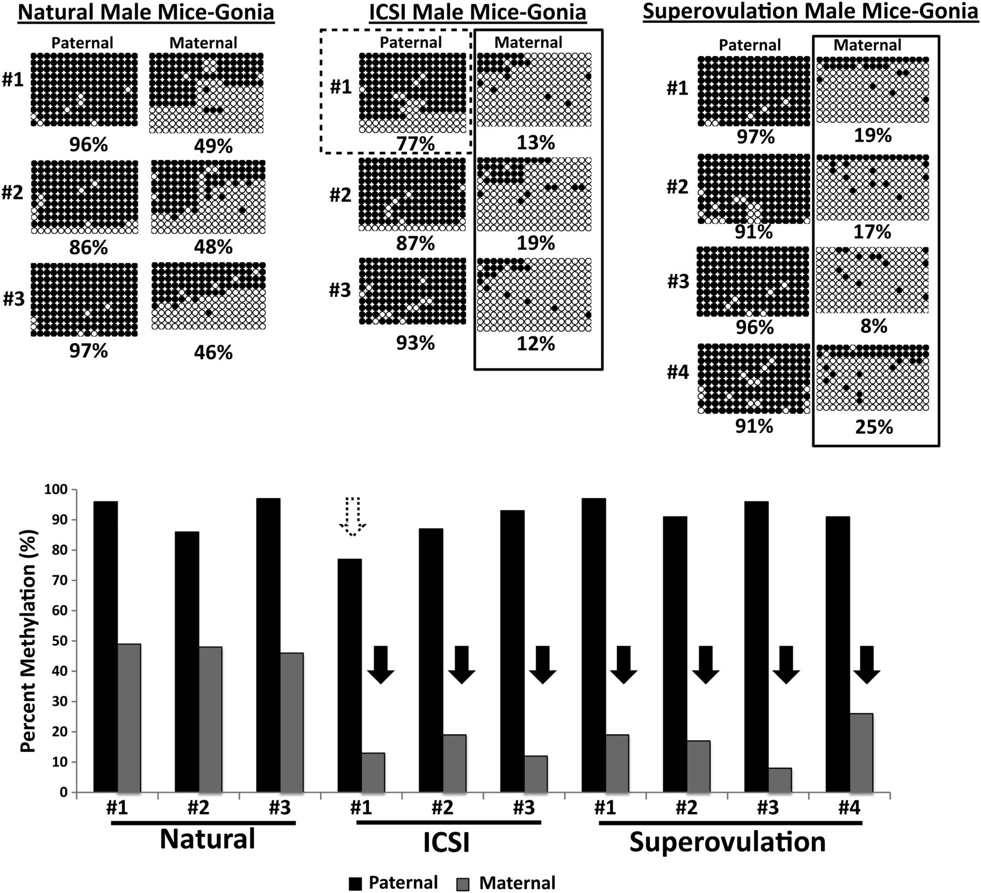
Figure 5. Allele-specific DNA methylation of the H19 DMR in spermatogonia purified from naturally conceived, ...
Notes:
Figure 5. Allele-specific DNA methylation of the H19 DMR in spermatogonia purified from naturally conceived, ICSI-derived and superovulation-derived juvenile male mice. Bisulfite sequencing analysis of allele-specific DNA methylation at the H19 DMR in populations of type A spermatogonia purified from naturally conceived, ICSI-derived and superovulation-derived juvenile male mice. Bisulfite sequencing data are shown on a per strand basis (rows of circles) and as a bar graph. Solid black boxes and black arrows indicate abnormally low DNA methylation profiles detected at the maternal H19 DMR in all ICSI- and superovulation-derived mice. The dashed black box and the white arrow highlight evidence of incomplete reprogramming (correction) of the paternal DMR in an ICSI-derived mouse that also exhibited an epimutation associated with the H19 DMR in liver tissue.
Unless provided in the caption above, the following copyright applies to the content of this slide: © The Author 2012. Published by Oxford University Press. All rights reserved. For Permissions, please email: journals.permissions@oup.com

Slide 5
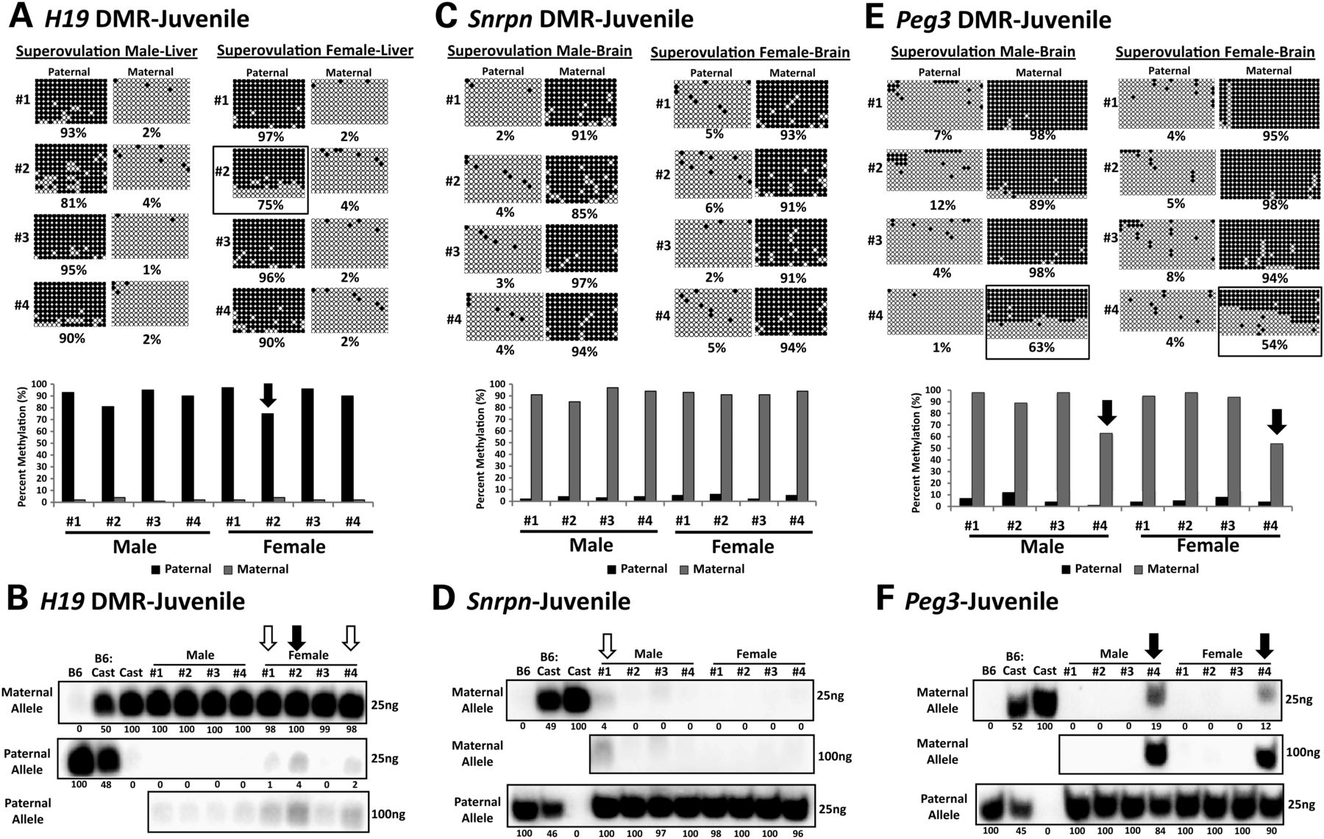
Figure 4. Allele-specific DNA methylation and expression of H19, Snrpn and Peg3 in somatic tissues of ...
Notes:
Figure 4. Allele-specific DNA methylation and expression of H19, Snrpn and Peg3 in somatic tissues of superovulation-derived mice. Bisulfite sequencing analysis of allele-specific DNA methylation at the H19 DMR in liver tissue (A), the Snrpn DMR in brain tissue (C) and the Peg3 DMR in brain tissue (E) from superovulation-derived male and female mice. SNuPE analysis of allele-specific expression of the H19 gene in liver tissue (B), the Snrpn gene in brain tissue (D) and the Peg3 gene in brain tissue (F) of superovulation-derived male and female mice. Other details are as described in Figure 1.
Unless provided in the caption above, the following copyright applies to the content of this slide: © The Author 2012. Published by Oxford University Press. All rights reserved. For Permissions, please email: journals.permissions@oup.com

