Slide 1
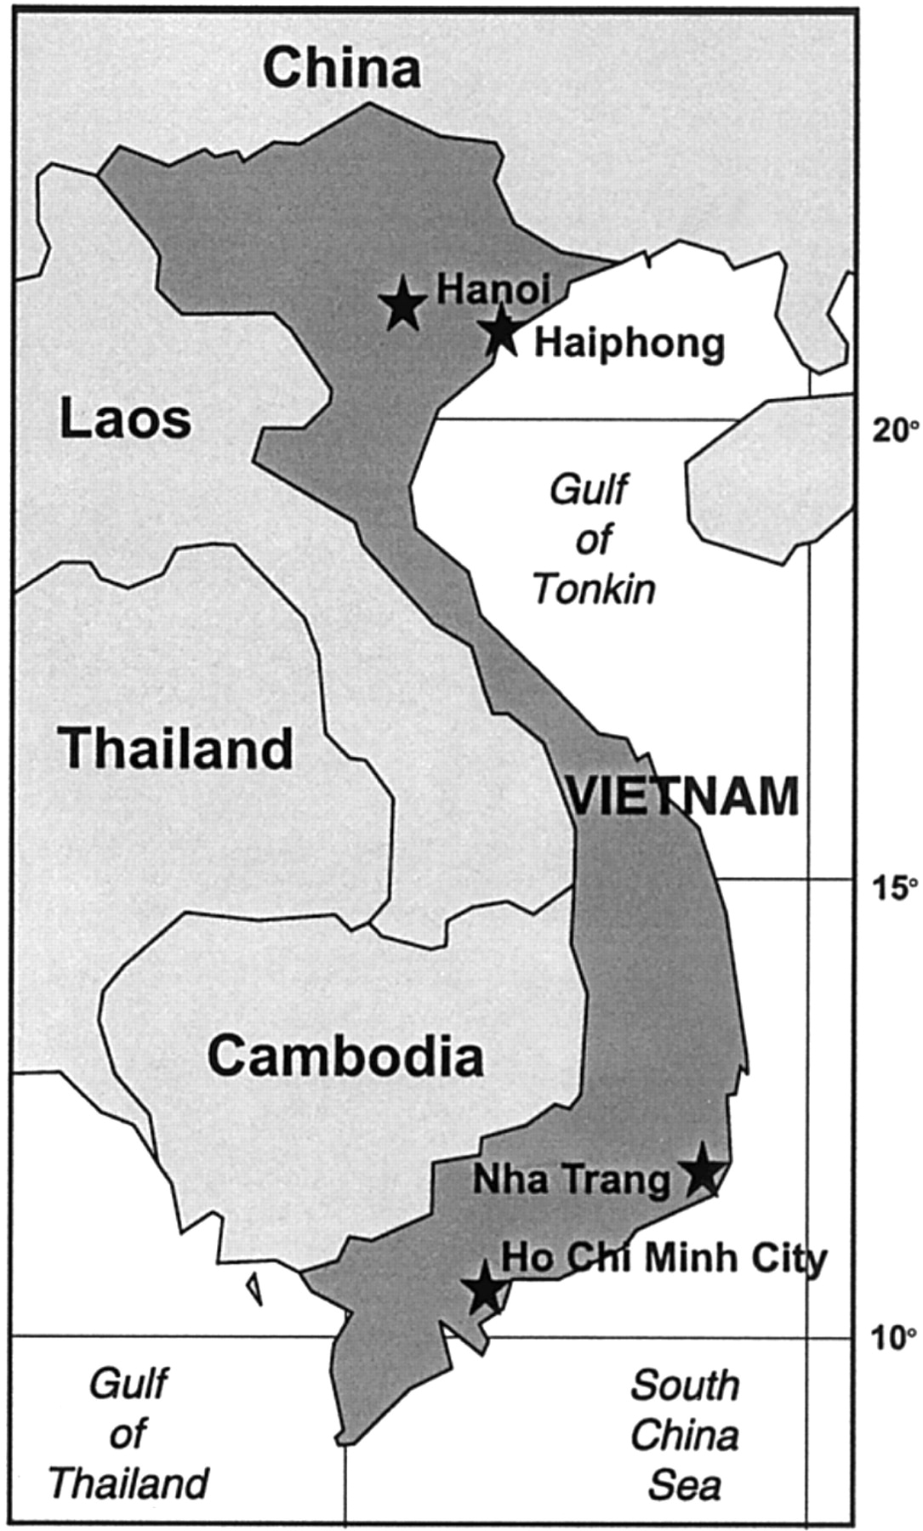
Figure 1 Map of Vietnam, indicating location of surveillance sites in the north (Hanoi and Haiphong) and south (Ho Chi ...
Notes:
Figure 1 Map of Vietnam, indicating location of surveillance sites in the north (Hanoi and Haiphong) and south (Ho Chi Minh City and Nha Trang [Khan Hoa])
Unless provided in the caption above, the following copyright applies to the content of this slide: © 2001 by the Infectious Diseases Society of America

Slide 2
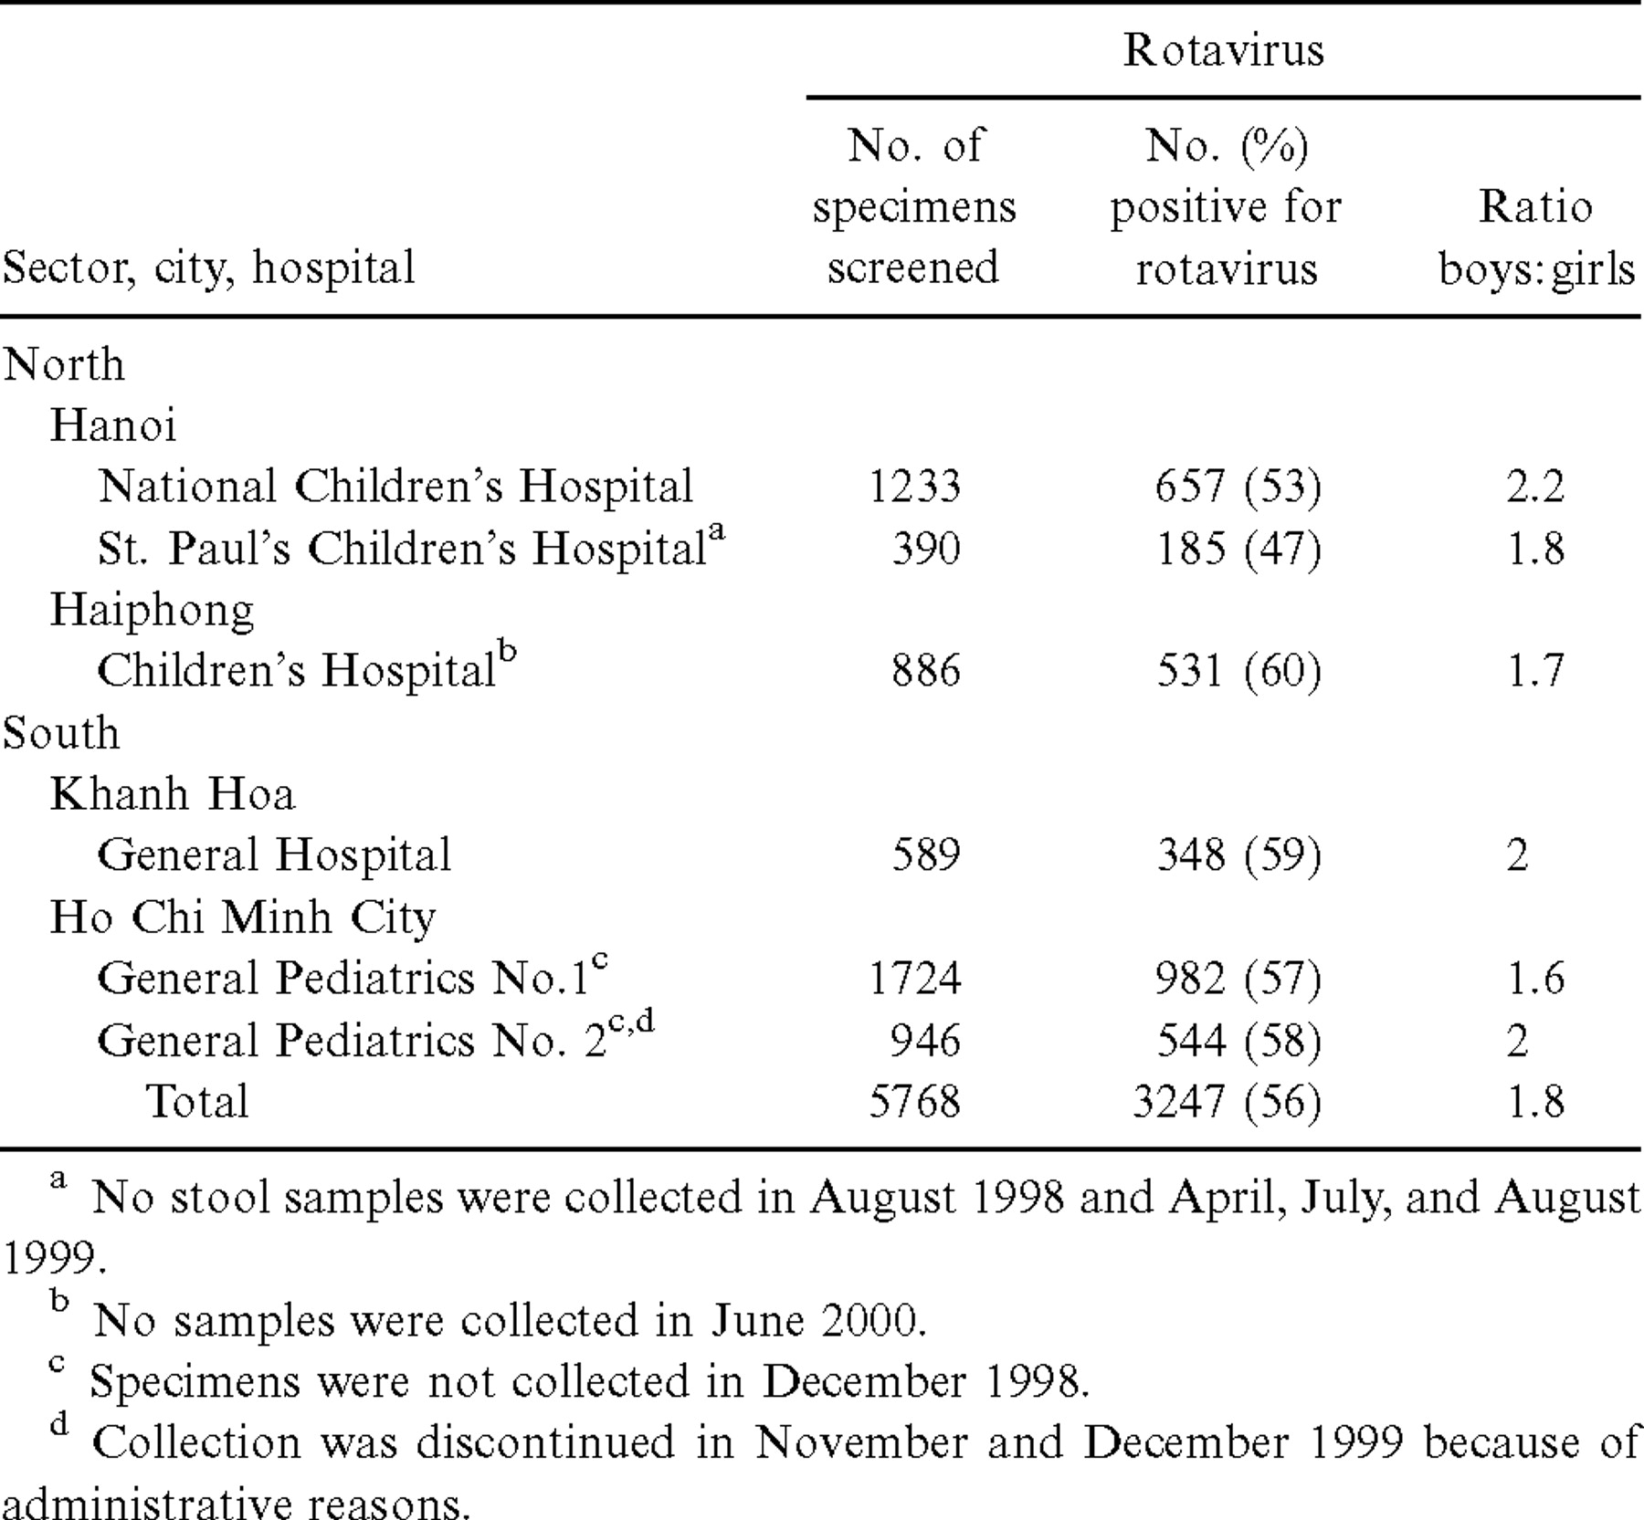
Table 1 Detection rates of rotavirus among children <5 years old who were hospitalized for diarrhea in 6 sentinel ...
Notes:
Table 1 Detection rates of rotavirus among children <5 years old who were hospitalized for diarrhea in 6 sentinel hospitals in Vietnam, July 1998 to June 2000
Unless provided in the caption above, the following copyright applies to the content of this slide: © 2001 by the Infectious Diseases Society of America

Slide 3
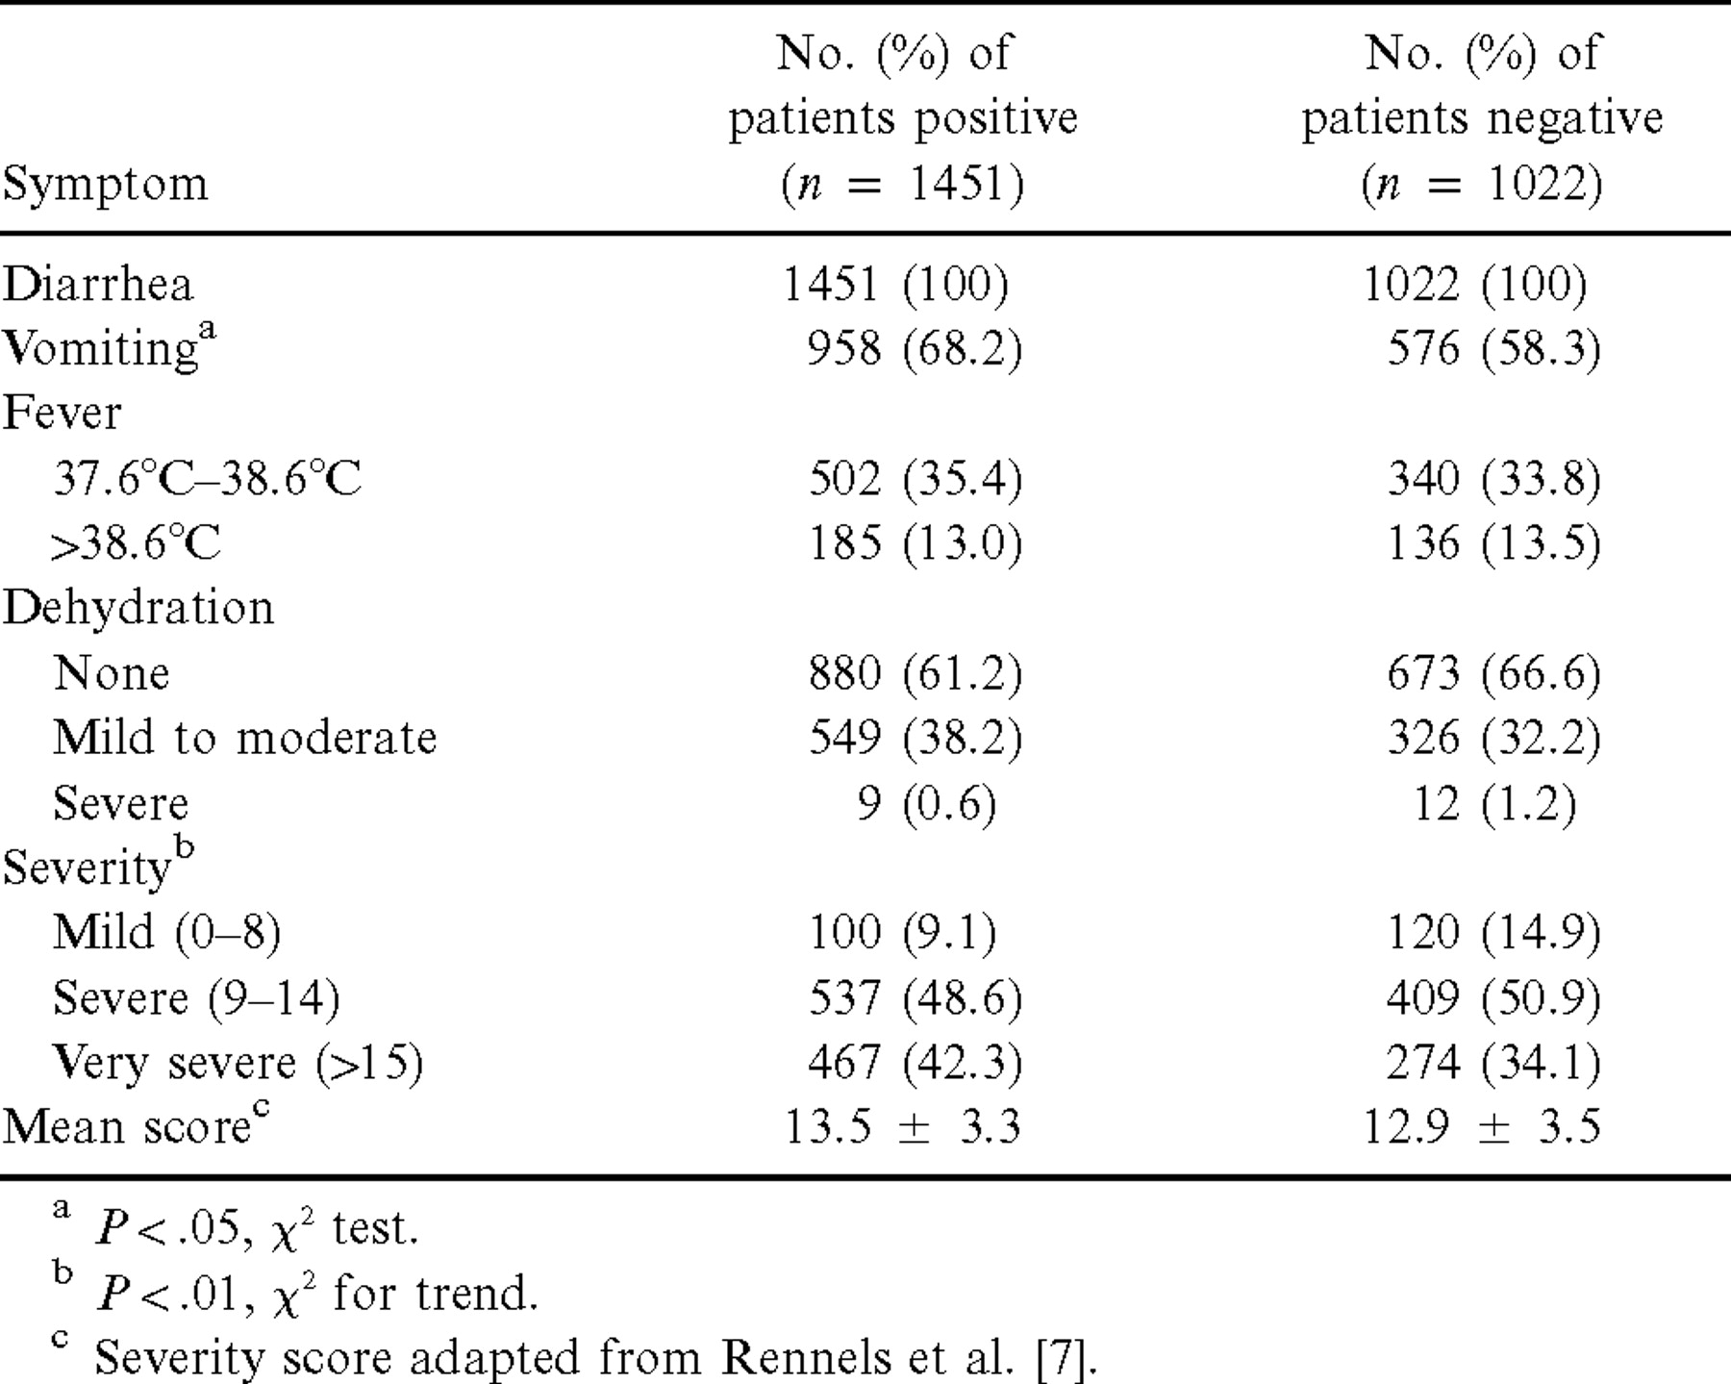
Table 2 Sentinel hospital surveillance in Vietnam: comparison of symptoms of a subset of 2473 patients <5 years old ...
Notes:
Table 2 Sentinel hospital surveillance in Vietnam: comparison of symptoms of a subset of 2473 patients <5 years old hospitalized for diarrhea with and without rotavirus
Unless provided in the caption above, the following copyright applies to the content of this slide: © 2001 by the Infectious Diseases Society of America

Slide 4
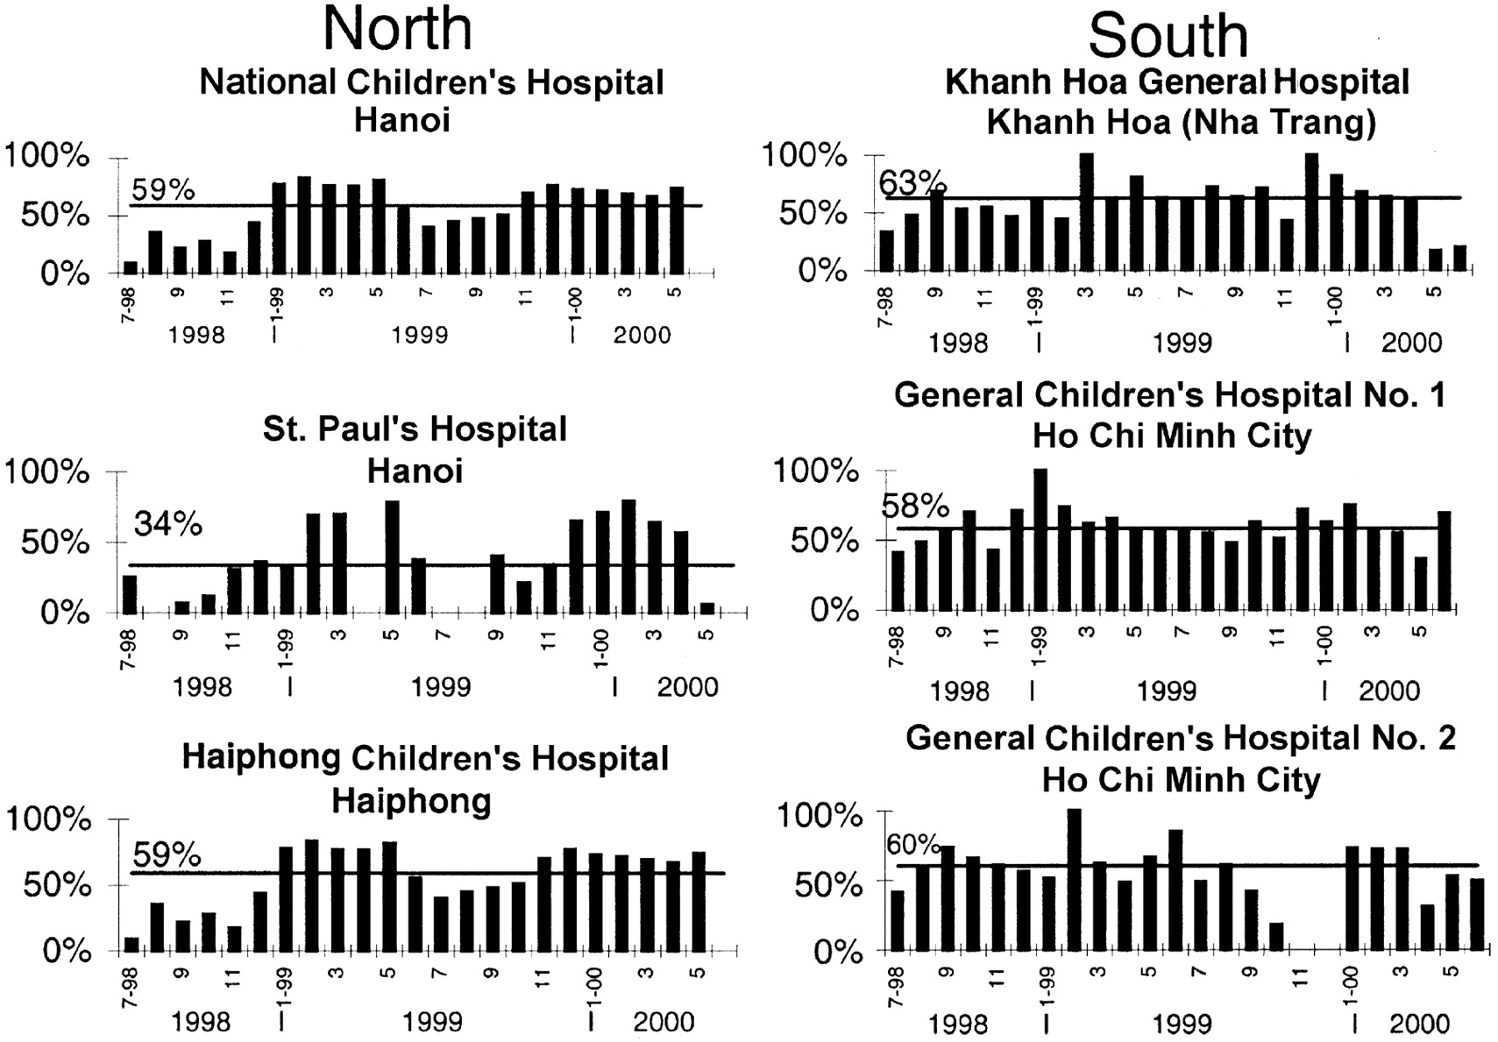
Figure 2 Monthly detection of rotavirus among children with diarrhea admitted to 3 sentinel hospitals in North Vietnam ...
Notes:
Figure 2 Monthly detection of rotavirus among children with diarrhea admitted to 3 sentinel hospitals in North Vietnam (Hanoi and Haiphong) and 3 in South Vietnam (Khan Hoa and Ho Chi Minh City) from July 1998 through June 1999. Solid line indicates the median detection rate at each site. Left panel Hospitals in the north; right panel hospitals in the south
Unless provided in the caption above, the following copyright applies to the content of this slide: © 2001 by the Infectious Diseases Society of America

Slide 5
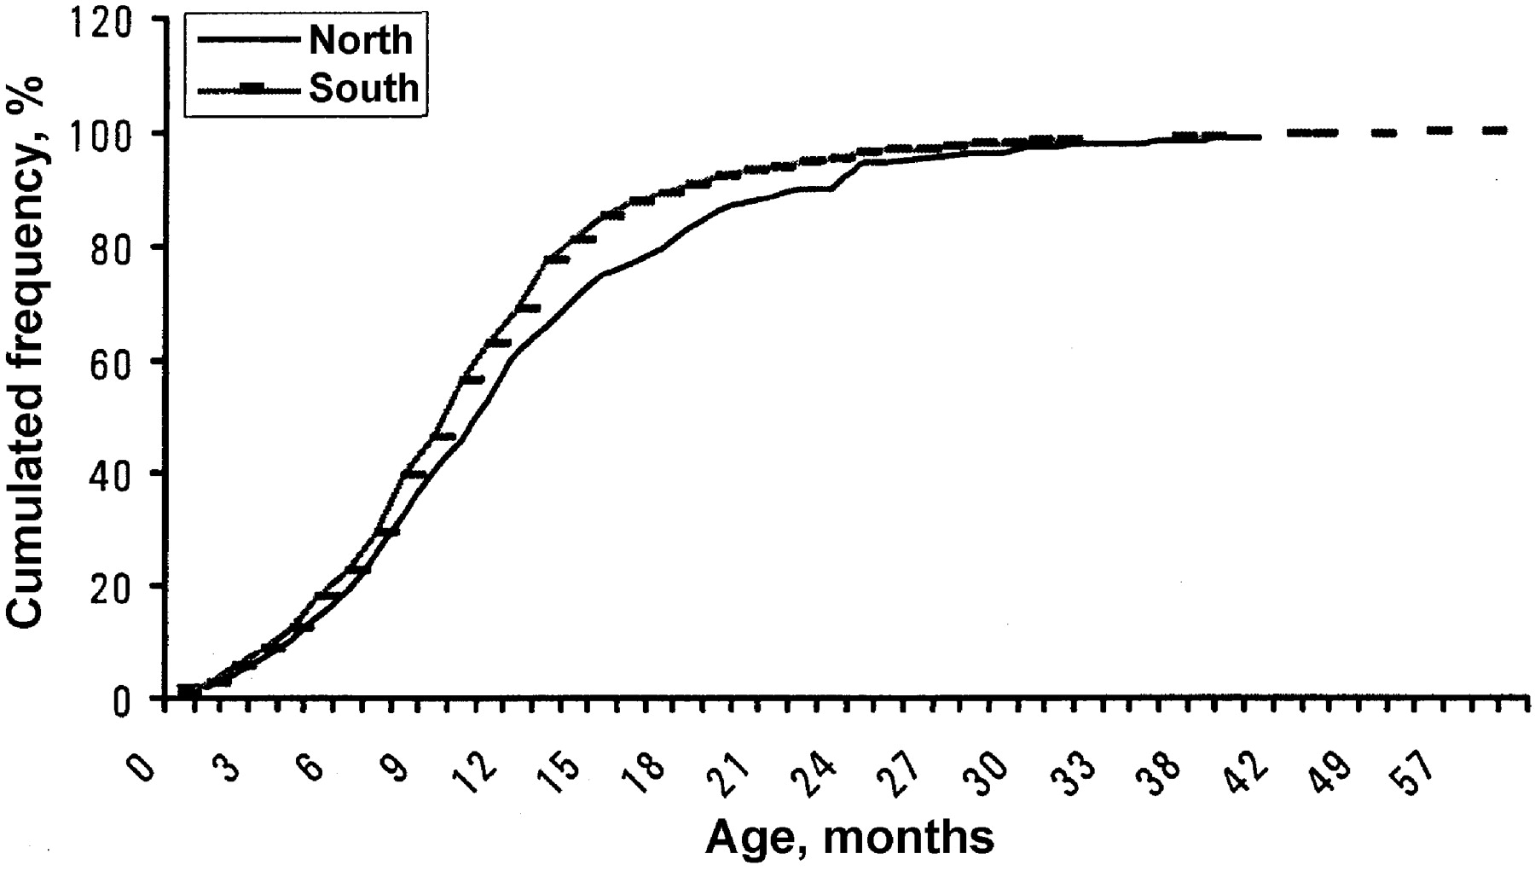
Figure 3 Comparison of the age distribution of patients with rotavirus diarrhea in North and South Vietnam
Notes:
Figure 3 Comparison of the age distribution of patients with rotavirus diarrhea in North and South Vietnam
Unless provided in the caption above, the following copyright applies to the content of this slide: © 2001 by the Infectious Diseases Society of America

Slide 6
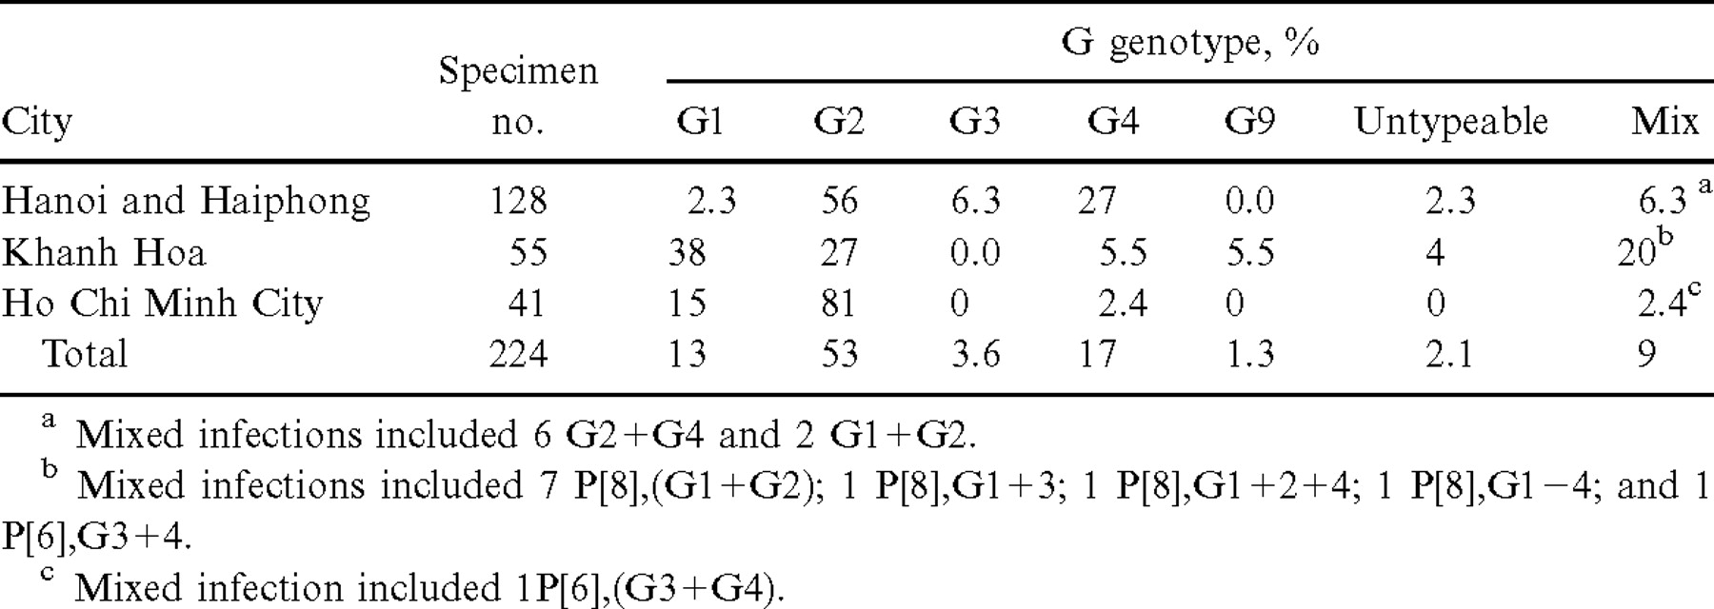
Table 3 Distribution of rotavirus G genotypes by regions of Vietnam, July 1998 to June 1999
Notes:
Table 3 Distribution of rotavirus G genotypes by regions of Vietnam, July 1998 to June 1999
Unless provided in the caption above, the following copyright applies to the content of this slide: © 2001 by the Infectious Diseases Society of America

Slide 7
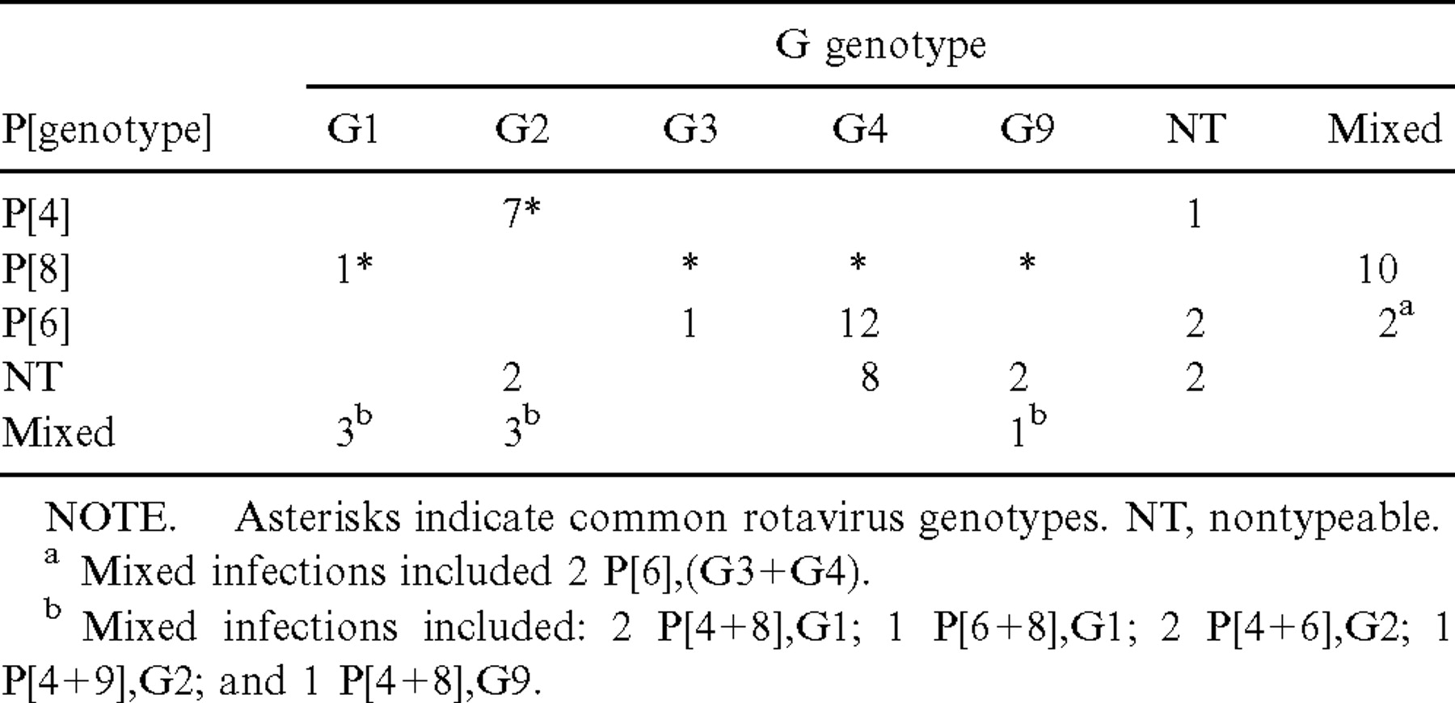
Table 4 Distribution of P[genotypes] of 140 strains from Vietnamese children <5 years old
Notes:
Table 4 Distribution of P[genotypes] of 140 strains from Vietnamese children <5 years old
Unless provided in the caption above, the following copyright applies to the content of this slide: © 2001 by the Infectious Diseases Society of America

