Slide 1
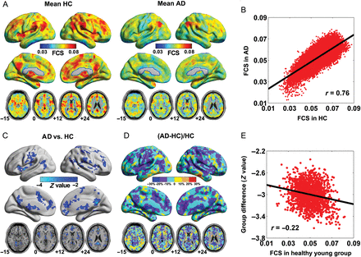
Figure 1. Within- and between-group FCS maps. (A) Mean FCS maps within HC and AD groups. (B) Scatter plot showing the ...
Notes:
Figure 1. Within- and between-group FCS maps. (A) Mean FCS maps within HC and AD groups. (B) Scatter plot showing the across-voxel relationship between the mean FCS maps of the 2 groups. (C) Z-statistical difference maps between the 2 groups. (D) The reduced proportion of FCS in the AD group relative to the HC group. Notably, most of the regions showing AD-related changes in FCS were up to 20% lower in AD than in the control group. (E) Scatter plot showing the across-voxel relationship between the FCS values of hub regions in a healthy young adult group and the Z-statistical difference map. Notably, the correlation analysis was performed within a set of GM voxels that were considered hubs in the healthy young group and simultaneously showed significant differences between the AD and control groups. We resampled the FCS and Z-values into a Gaussian distribution, respectively: a mean of 0.05 and a standard deviation of 0.01 dimensionless units for FCS values, a mean of −3 and a standard deviation of 0.2 dimensionless units for Z-values. The FCS values were mapped on the cortical surface by using in-house BrainNet Viewer (Xia et al., 2013). FCS, functional connectivity strength; HC, healthy control; AD, Alzheimer's disease.
Unless provided in the caption above, the following copyright applies to the content of this slide: © The Author 2014. Published by Oxford University Press. All rights reserved. For Permissions, please e-mail: journals.permissions@oup.com

Slide 2
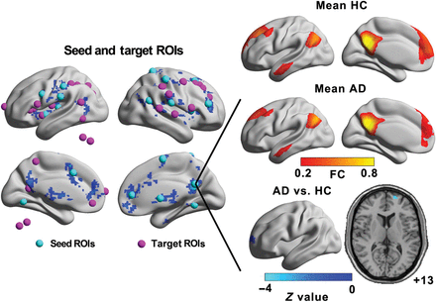
Figure 2. Definitions of seed and target ROIs. The left panel indicates the locations of the seed (cyan spheres) and ...
Notes:
Figure 2. Definitions of seed and target ROIs. The left panel indicates the locations of the seed (cyan spheres) and target ROIs (magenta spheres). The magenta nodes outside of the brain are the regions of cerebellum. As an example, the right panel shows the mean functional connectivity maps of the PCC seed ROI (a 4-mm radius sphere centered on the maximal peak voxel: x, y, z = [0, −54, 27] mm) within the HC and AD groups and the Z-statistical differences between the 2 groups. Notably, the PCC showed significant group differences in the MPFC, which was considered a target ROI. The details of the 20 seed and 27 target ROIs are presented in Table 3. PCC, posterior cingulate cortex; MPFC, medial prefrontal cortex; HC, healthy control; AD, Alzheimer's disease.
Unless provided in the caption above, the following copyright applies to the content of this slide: © The Author 2014. Published by Oxford University Press. All rights reserved. For Permissions, please e-mail: journals.permissions@oup.com

Slide 3
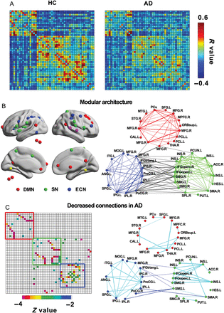
Figure 3. Modular analysis of the brain functional network. (A) Correlation matrices among 47 ROIs are shown for the HC ...
Notes:
Figure 3. Modular analysis of the brain functional network. (A) Correlation matrices among 47 ROIs are shown for the HC (left panel) and AD (right panel) groups. (B) Surface (left panel) and topological (right panel) representations of the modular architecture of the brain networks in the HC group. Three modules were identified, the DMN (red colors), SN (green colors) and ECN (blue colors). The red nodes outside the brain are the regions of cerebellum. The within-module nodes and edges are marked in the same color. The intermodule connections are marked with black lines. Notably, 4 nodes (2 in magenta and 2 in yellow) on the surfaces did not belong to the DMN, SN, or ECN in the modular detection and therefore were not shown in the right panel. (C) Matrix (left panel) and topological (right panel) representations of AD-related functional connectivity decreases. Blue and cyan lines represent AD-related decreases in inter- and intramodule connections, respectively. Notably, between-group statistical comparisons were restricted to positive correlations of either the HC or AD group. DMN, default-mode network; SN, salience network; ECN, executive-control network; HC, healthy control; AD, Alzheimer's disease.
Unless provided in the caption above, the following copyright applies to the content of this slide: © The Author 2014. Published by Oxford University Press. All rights reserved. For Permissions, please e-mail: journals.permissions@oup.com

Slide 4
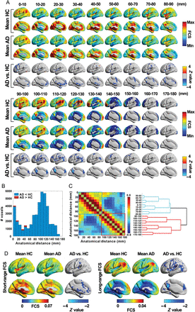
Figure 4. Distance-dependent within- and between-group FCS maps. (A) Within-group mean FCS maps and between-group ...
Notes:
Figure 4. Distance-dependent within- and between-group FCS maps. (A) Within-group mean FCS maps and between-group Z-statistical difference maps in different distance bins. (B) The number of voxels showing significant group differences in FCS in different distance bins. (C) Hierarchical clustering analysis based on the spatial correlation map of FCS under different distance bins for the HC group. (D) Within-group mean FCS maps and between-group Z-statistical difference maps for short- and long-range FCS. FCS, functional connectivity strength; HC, healthy control; AD, Alzheimer's disease.
Unless provided in the caption above, the following copyright applies to the content of this slide: © The Author 2014. Published by Oxford University Press. All rights reserved. For Permissions, please e-mail: journals.permissions@oup.com

Slide 5
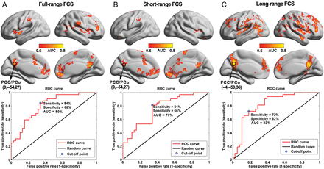
Figure 5. VDA-ROC analysis results based on the full-, short- and long-range FCS maps. The upper panel shows VDA-ROC ...
Notes:
Figure 5. VDA-ROC analysis results based on the full-, short- and long-range FCS maps. The upper panel shows VDA-ROC analysis of full-range (A), short-range (B), and long-range (C) maps. The lower panel plots the ROC curves at the highest classification power location (i.e., PCC/PCu). FCS, functional connectivity strength; VDA-ROC, voxel-wise discriminant analysis based on the receiver operating characteristics curve approach.
Unless provided in the caption above, the following copyright applies to the content of this slide: © The Author 2014. Published by Oxford University Press. All rights reserved. For Permissions, please e-mail: journals.permissions@oup.com

Slide 6
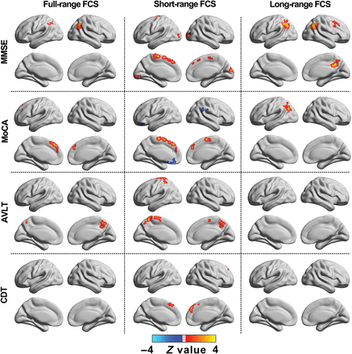
Figure 6. Correlation maps of cognitive performance and full-, short-, and long-range FCS values in the AD group. Red ...
Notes:
Figure 6. Correlation maps of cognitive performance and full-, short-, and long-range FCS values in the AD group. Red colors represent positive correlations and blue colors represent negative correlations. MMSE, Mini-Mental State Examination; MoCA, Montreal Cognitive Assessment; AVLT, World Health Organization–University of California–Los Angeles Auditory Verbal Learning Test; CDT, Clock Drawing Task; FCS, functional connectivity strength.
Unless provided in the caption above, the following copyright applies to the content of this slide: © The Author 2014. Published by Oxford University Press. All rights reserved. For Permissions, please e-mail: journals.permissions@oup.com

Slide 7
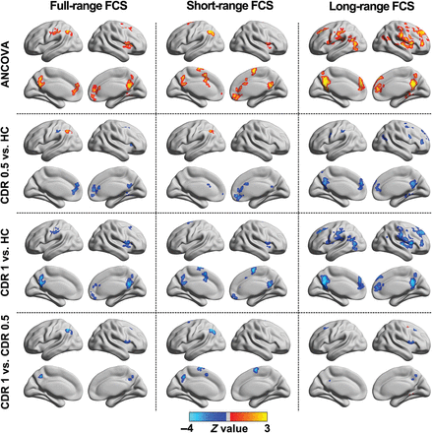
Figure 7. Disrupted FCS patterns in the very mild (CDR = 0.5) and mild (CDR = 1) AD groups when compared with the HC ...
Notes:
Figure 7. Disrupted FCS patterns in the very mild (CDR = 0.5) and mild (CDR = 1) AD groups when compared with the HC group. These group-based analysis results based on full-, short-, and long-range FCS maps were separately obtained by using a voxel-based, one-way analysis of covariance (ANCOVA) with age and gender as covariates, followed by post hoc two-sample t-tests. Notably, there were no significant differences in age, gender, and education level among the 3 groups. ANCOVA, one-way analysis of covariance; CDR, Clinical Dementia Rating; FCS, functional connectivity strength; HC, healthy control.
Unless provided in the caption above, the following copyright applies to the content of this slide: © The Author 2014. Published by Oxford University Press. All rights reserved. For Permissions, please e-mail: journals.permissions@oup.com

Slide 8
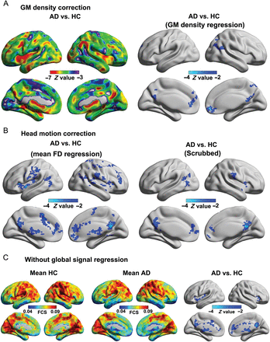
Figure 8. Validation analyses of between-group FCS differences. (A) The effect of GM density correction. The left panel ...
Notes:
Figure 8. Validation analyses of between-group FCS differences. (A) The effect of GM density correction. The left panel shows Z-statistical differences in GM density between 2 groups. The right panel shows Z-statistical differences in FCS after considering GM density as additional covariates. (B) The effect of head motion correction. Between-group Z-statistical differences in FCS after considering the mean framewise displacement as an additional covariate (left panel) or after a ‘scrubbing’ procedure during preprocessing (right panel). (C) The effect of global signal regression. Within-group mean FCS maps and between-group Z-statistical FCS difference maps without global signal regression. GM, gray matter; FCS, functional connectivity strength; HC, healthy control; AD, Alzheimer's disease.
Unless provided in the caption above, the following copyright applies to the content of this slide: © The Author 2014. Published by Oxford University Press. All rights reserved. For Permissions, please e-mail: journals.permissions@oup.com

