Slide 1
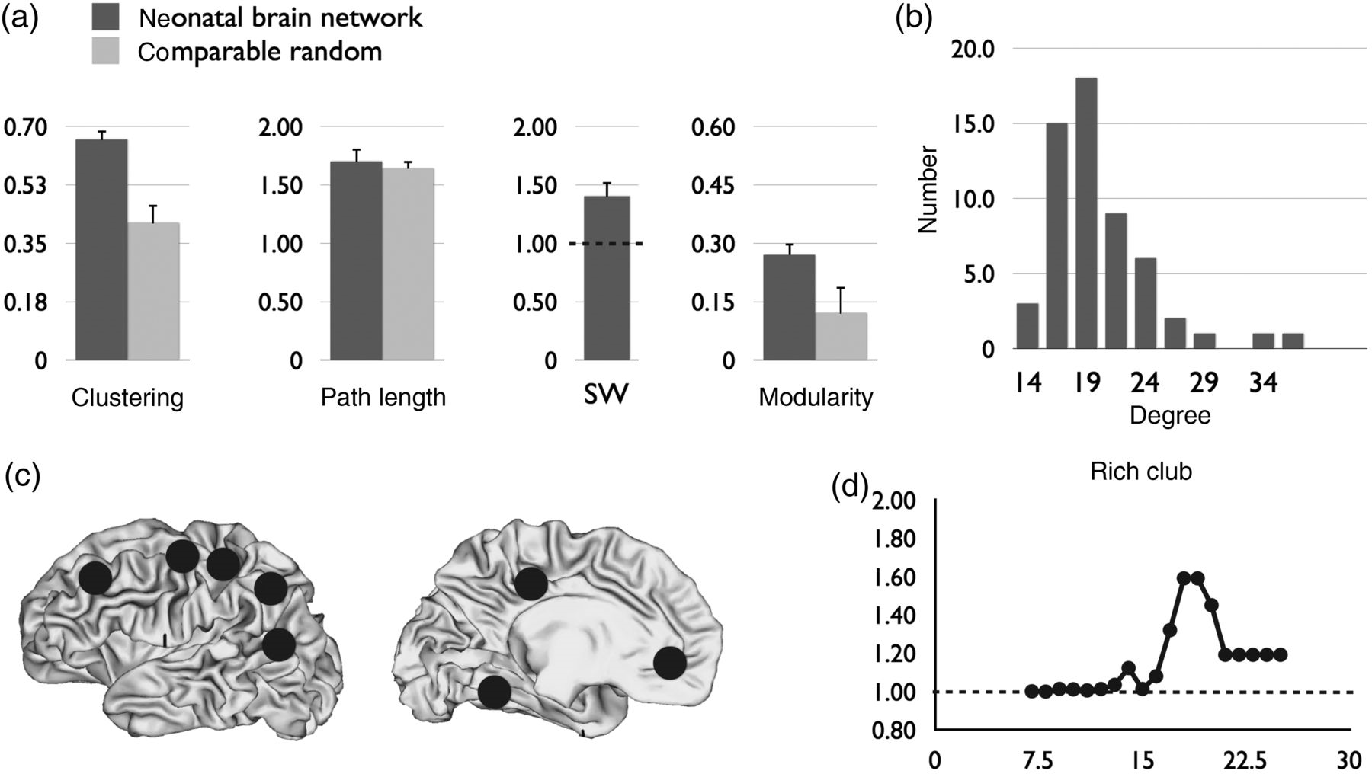
Figure 1. Network descriptive of the neonatal connectome. (a) “Small-world organization of the neonatal brain.” Figure ...
Notes:
Figure 1. Network descriptive of the neonatal connectome. (a) “Small-world organization of the neonatal brain.” Figure shows the clustering coefficient and shortest path length values of the individual neonatal connectome (dark gray bars) and levels of a set of comparable networks (light gray). Error bars depict variation (standard deviations) across the individual datasets. The small-world index SW was significantly higher than 1, suggesting a small-world organization of the neonatal connectome at term. (b) “Degree distribution.” Figure shows a right-tailed distribution of the group-averaged connectome, indicating the existence of high-degree hub nodes in the neonatal brain. (c) “Hubs.” Figure illustrates the locations of the top 12 high-degree hub nodes in the group-averaged neonatal connectome (locations are shown on one hemisphere only, yielding 8 unique hub locations, see Results). (d) “Rich club organization.” Rich club analysis revealed above rich club coefficient levels >1, indicating dense levels of connectivity between high-degree nodes, as previously reported for the adult connectome.
Unless provided in the caption above, the following copyright applies to the content of this slide: © The Author 2014. Published by Oxford University PressThis is an Open Access article distributed under the terms of the Creative Commons Attribution Non-Commercial License (http://creativecommons.org/licenses/by-nc/3.0/), which permits non-commercial re-use, distribution, and reproduction in any medium, provided the original work is properly cited. For commercial re-use, please contact journals.permissions@oup.com

Slide 2
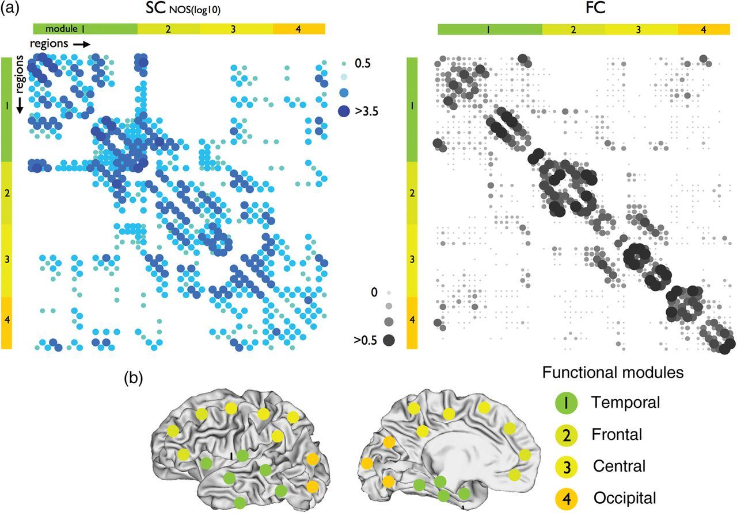
Figure 2. Structural and functional connectivity matrices of the neonatal connectome. Figure shows the structural and ...
Notes:
Figure 2. Structural and functional connectivity matrices of the neonatal connectome. Figure shows the structural and functional connectivity matrices of the group-averaged neonatal brain. Rows and columns include all cortical regions, expressing the level of structural and functional connections between each pair of regions in the neonatal brain. The structural connectivity matrix (SC) is shown in the left panel, with the levels of connectivity expressed as the number of reconstructed streamlines (NOS) between each pair of regions. Higher levels of SC are indicated by larger dots. Levels of positive functional coupling (i.e., functional connectivity, higher levels of FC are indicated by larger dots) between each pair of regions are shown in the functional connectivity (FC) matrix as shown in the right panel. The columns and rows (i.e., nodes of the network) are ordered according to the community assignment as based on community detection on the FC matrix (see Materials and Methods) revealing the existence of 4 functional communities in the neonatal brain. These communities overlapped temporal (auditory regions), occipital (visual regions), central (motor and sensory regions) and frontal cortex. Distribution of the nodes across the cortex are illustrated in the lower panel. Figure illustrates clear overlap between the SC and FC matrix of the neonatal brain, indicating a structural basis of functional connectivity in the neonatal brain. To aid visual comparison between the SC and FC matrices, positive values are shown in the FC matrices with all negative correlations represented as empty cells.
Unless provided in the caption above, the following copyright applies to the content of this slide: © The Author 2014. Published by Oxford University PressThis is an Open Access article distributed under the terms of the Creative Commons Attribution Non-Commercial License (http://creativecommons.org/licenses/by-nc/3.0/), which permits non-commercial re-use, distribution, and reproduction in any medium, provided the original work is properly cited. For commercial re-use, please contact journals.permissions@oup.com

Slide 3
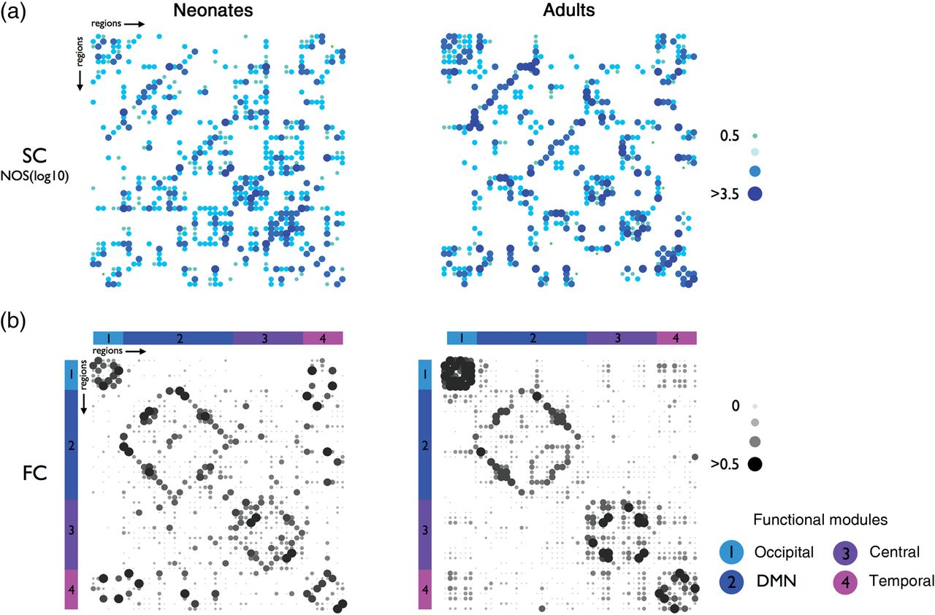
Figure 3. Comparison of the group-averaged neonatal and adult connectome. Upper panels show the structural connectivity ...
Notes:
Figure 3. Comparison of the group-averaged neonatal and adult connectome. Upper panels show the structural connectivity (SC) matrices (NOS weighted) of the neonatal (left) and adult (right) group-averaged connectome. Rows and columns (i.e., nodes of the network) are ordered according to the community structure of the adult FC matrix. Lower panels show the level of positive functional coupling (functional connectivity FC) between each pair of regions in the neonatal (left) an adult connectome (right). Columns and rows (nodes) of the matrices are ordered according to module decomposition of the adult functional connectome, revealing 4 distinct functional modules, overlapping an occipital (visual), temporal (auditory), central (sensory, motor network) and the functional default mode network. Figure shows overlap between both the SC matrices of the neonatal and adult group (overlap: 81%, see Results), confirming our observations that overall SC structure is present before term equivalent birth. Furthermore, overlap between the FC matrices (overlap: 79%, see Results) suggests the presence of outlines of functional modules in the neonatal brain, albeit being in an immature state. Note that the rows and columns (i.e., nodes of the network) are ordered according to the community structure of the adult FC matrix, and thus different from the ordering used in Figure 2.
Unless provided in the caption above, the following copyright applies to the content of this slide: © The Author 2014. Published by Oxford University PressThis is an Open Access article distributed under the terms of the Creative Commons Attribution Non-Commercial License (http://creativecommons.org/licenses/by-nc/3.0/), which permits non-commercial re-use, distribution, and reproduction in any medium, provided the original work is properly cited. For commercial re-use, please contact journals.permissions@oup.com

Slide 4
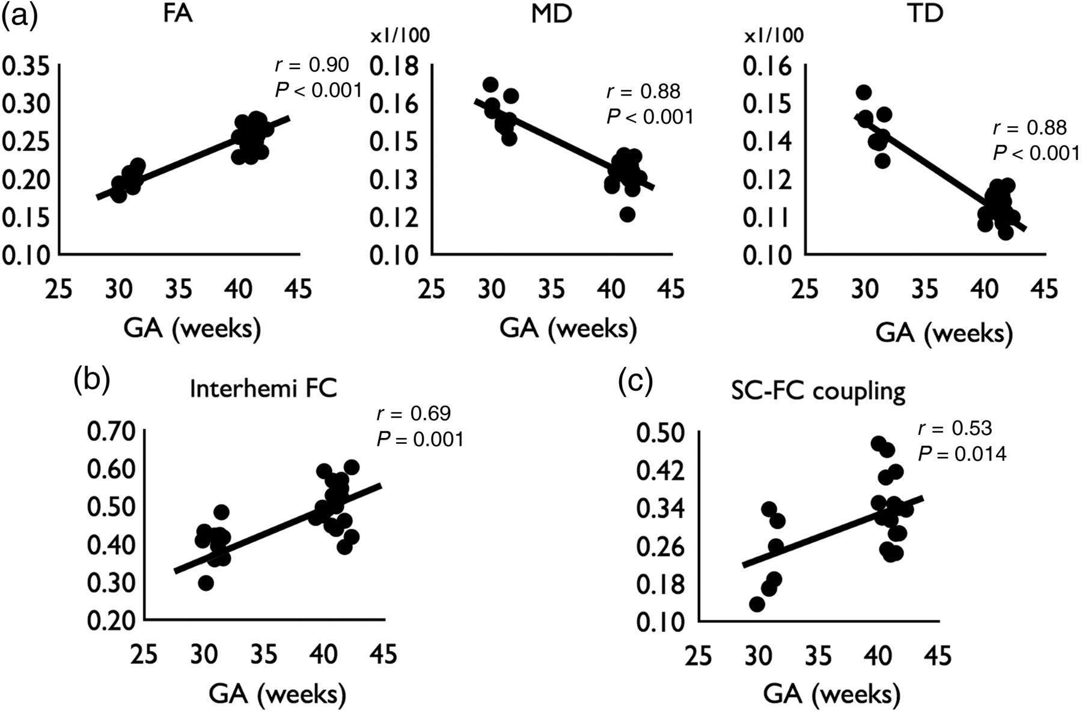
Figure 4. Development of structural and functional connectivity (a) Panels show individual levels of fractional ...
Notes:
Figure 4. Development of structural and functional connectivity (a) Panels show individual levels of fractional anisotropy (FA), mean diffusivity (MD) and transverse diffusivity (TD) of each included neonatal dataset in relationship to age. Panels show a clear increase in white matter development between week 30 and week 40 gestational age (GA), illustrated by an increase in FA and a decrease in MD and TD over time. (b) Panel shows individual levels of interhemisperic functional connectivity. (c) Developmental change of structural - functional coupling between week 30 and week 40 GA.
Unless provided in the caption above, the following copyright applies to the content of this slide: © The Author 2014. Published by Oxford University PressThis is an Open Access article distributed under the terms of the Creative Commons Attribution Non-Commercial License (http://creativecommons.org/licenses/by-nc/3.0/), which permits non-commercial re-use, distribution, and reproduction in any medium, provided the original work is properly cited. For commercial re-use, please contact journals.permissions@oup.com

Slide 5
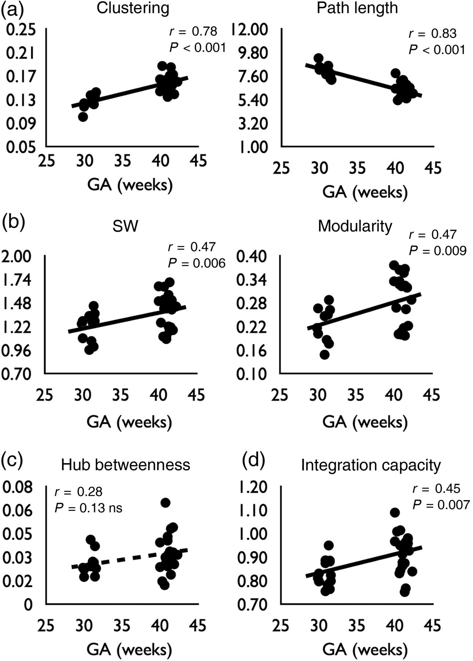
Figure 5. Development of network characteristics. Figure shows individual levels of several network characteristics of ...
Notes:
Figure 5. Development of network characteristics. Figure shows individual levels of several network characteristics of the (unweighted) structural neonatal brain network between 30 and 40 weeks gestational age (GA). (a) The level of clustering C was found to significantly increase over time. Furthermore, the level of path length L was found to decrease over time, indicating the formation of shorter communication pathways in the neonatal brain. (b) The increase in clustering and decrease in path length resulted in a significant increase in small-world topology of the neonatal brain between week 30 and week 40. Neonatal development was also found to involve an increase in network modularity, suggesting a sharper definition of structural modules in the neonatal brain over time. (c) Hub nodes (see Materials and Methods, and Fig. 1) in the neonatal brain network were only found to show, at best, a marginal increase in centrality over time. This effect was not significant (P = 0.13 ns). (d) The level of Integration Capacity (as estimated by mathematical modeling on basis of the structural connectivity network) was found to increase between week 30 and week 40 GA.
Unless provided in the caption above, the following copyright applies to the content of this slide: © The Author 2014. Published by Oxford University PressThis is an Open Access article distributed under the terms of the Creative Commons Attribution Non-Commercial License (http://creativecommons.org/licenses/by-nc/3.0/), which permits non-commercial re-use, distribution, and reproduction in any medium, provided the original work is properly cited. For commercial re-use, please contact journals.permissions@oup.com

Slide 6
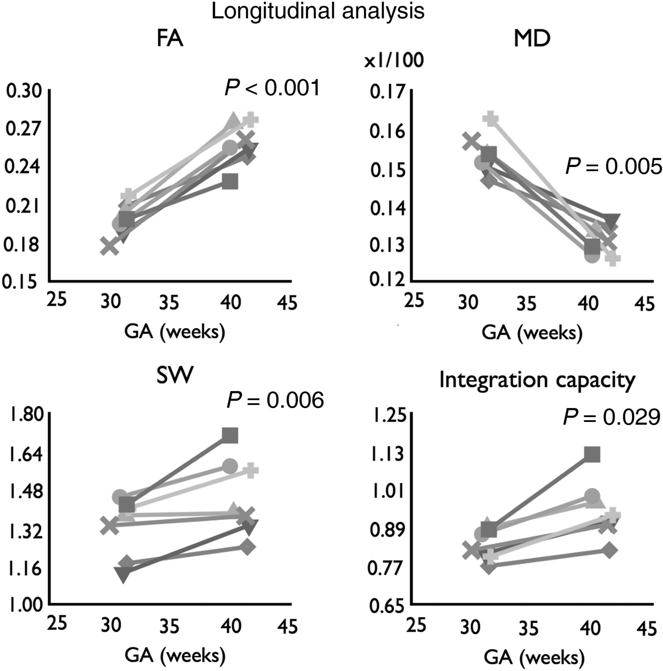
Figure 6. Development of structural connectivity and network characteristics (longitudinal analysis). Of 7 neonates, ...
Notes:
Figure 6. Development of structural connectivity and network characteristics (longitudinal analysis). Of 7 neonates, longitudinal assessment of brain development was possible, on the basis of a structural and functional MRI measurement at both (around) week 30 and week 40 gestational age (GA). Longitudinal analysis confirmed developmental changes in structural and functional properties of the neonatal brain network. White matter microstructure showed a clear development between week 30 and week 40 GA in all 4 neonates, including a significant increase in fractional anisotropy (FA), a decrease in mean diffusivity (MD) of white matter and an increase in small-world (SW) properties of the network. Furthermore, confirming the cross-sectional findings, integration capacity showed a significant increase during week 30 and week 40 GA.
Unless provided in the caption above, the following copyright applies to the content of this slide: © The Author 2014. Published by Oxford University PressThis is an Open Access article distributed under the terms of the Creative Commons Attribution Non-Commercial License (http://creativecommons.org/licenses/by-nc/3.0/), which permits non-commercial re-use, distribution, and reproduction in any medium, provided the original work is properly cited. For commercial re-use, please contact journals.permissions@oup.com

