Slide 1
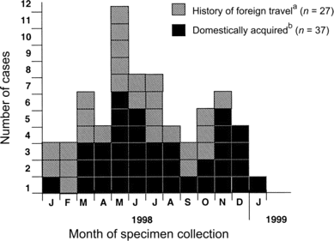
Figure 1 Cases of fluoroquinolone-resistant Campylobacter infection in Foodborne Disease Active Surveillance Network ...
Notes:
Figure 1 Cases of fluoroquinolone-resistant Campylobacter infection in Foodborne Disease Active Surveillance Network sites (Connecticut, Georgia, Minnesota, and Oregon and selected counties in California, Maryland, and New York), 1998–1999. aTraveled outside of the United States in the 7 days before the onset of illness. bDid not travel outside the United States in the 7 days before the onset of illness.
Unless provided in the caption above, the following copyright applies to the content of this slide: © 2004 by the Infectious Diseases Society of America

Slide 2
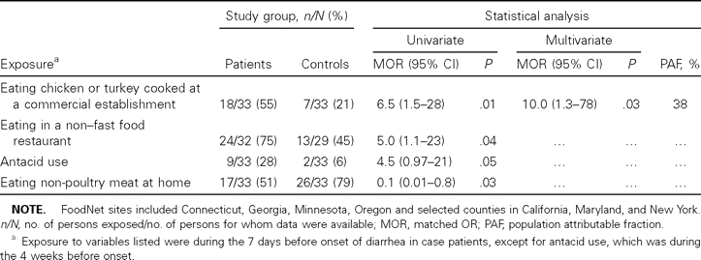
Table 1 Exposures of patients with domestically acquired fluoroquinolone-resistant Campylobacter infection versus ...
Notes:
Table 1 Exposures of patients with domestically acquired fluoroquinolone-resistant Campylobacter infection versus those of matched healthy controls in Foodborne Disease Active Surveillance Network (FoodNet) sites, 1998–1999.
Unless provided in the caption above, the following copyright applies to the content of this slide: © 2004 by the Infectious Diseases Society of America

