Slide 1
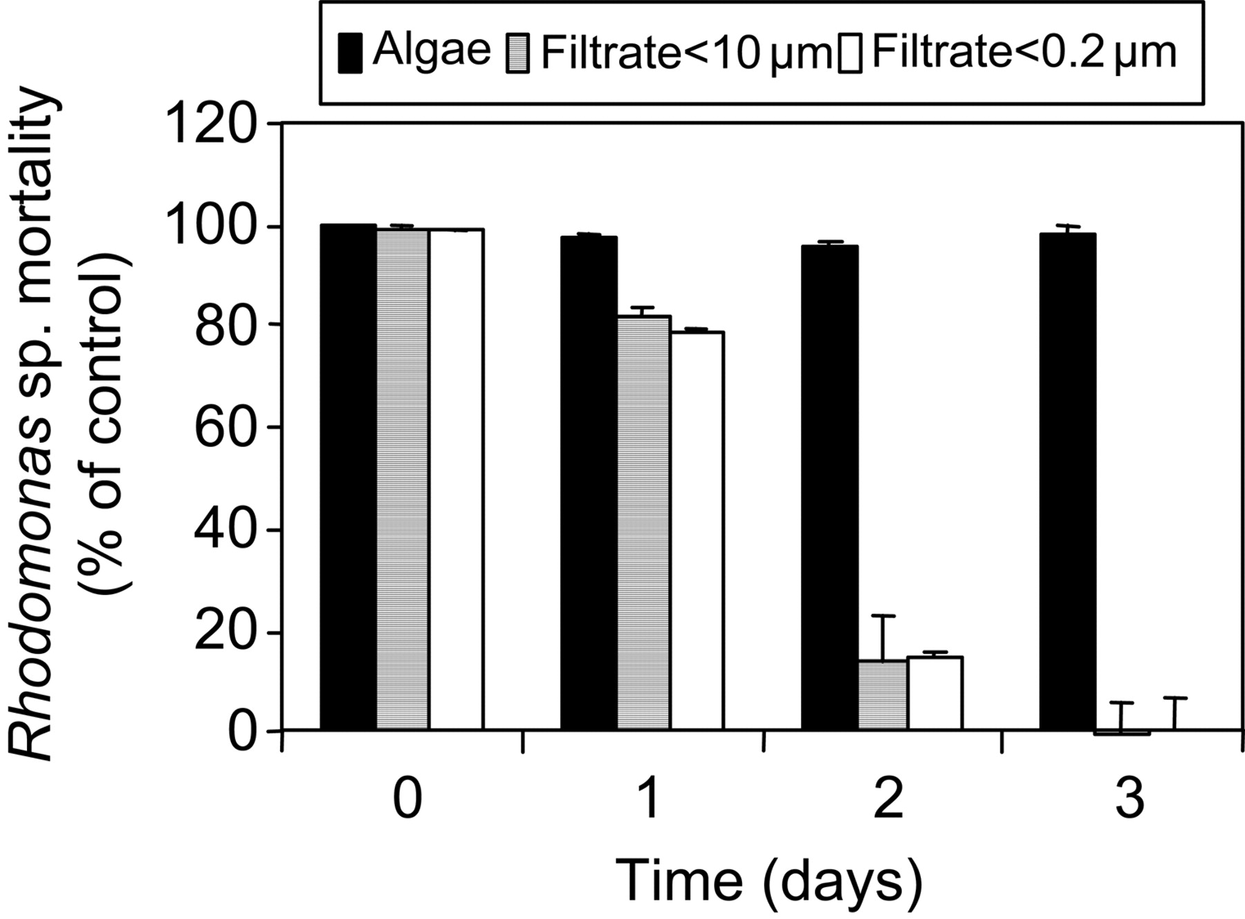
Fig. 6. Effect of ageing culture filtrate of A. ostenfeldii strain BAHME136. Rhodomonas sp. mortality (% of control) ...
Notes:
Fig. 6. Effect of ageing culture filtrate of A. ostenfeldii strain BAHME136. Rhodomonas sp. mortality (% of control) was recorded after 0, 1, 2 and 3 days of ageing of whole algal culture, of filtrate from 10 µm gauze filtration or of filtrate from by 0.2 µm pore-size filtration. Results expressed as triplicate mean ± 1 SD.
Unless provided in the caption above, the following copyright applies to the content of this slide: © The Author 2007. Published by Oxford University Press. All rights reserved. For permissions, please email: journals.permissions@oxfordjournals.org

Slide 2
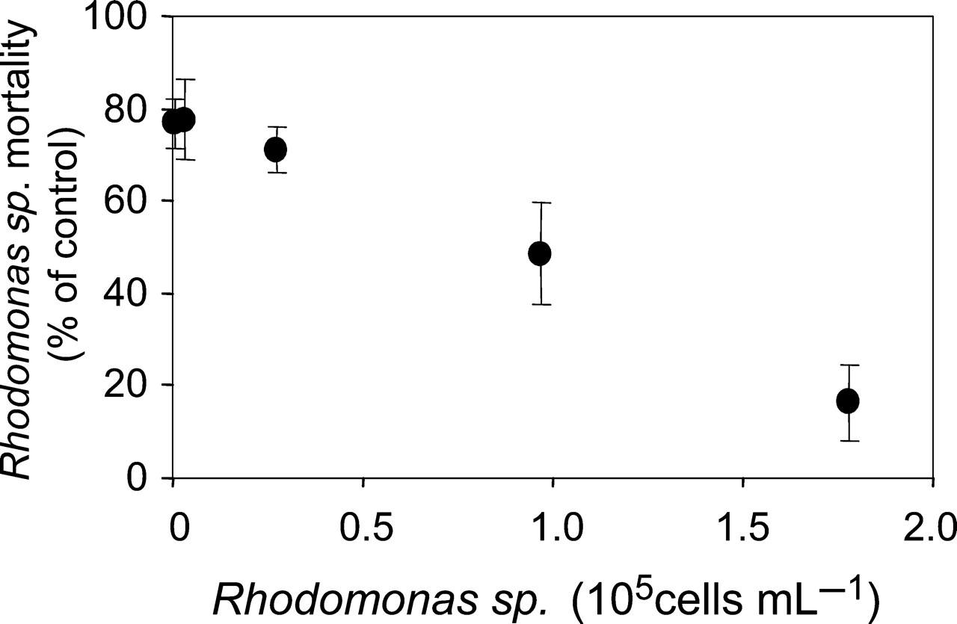
Fig. 7. Mortality of Rhodomonas sp. (% of control) as a function of initial cell concentration. Different cell ...
Notes:
Fig. 7. Mortality of Rhodomonas sp. (% of control) as a function of initial cell concentration. Different cell concentrations of Rhodomonas sp. were exposed to cells of A. ostenfeldii BAHME136 (final concentration: 500 mL−1) for 3 h. Data points represent mean values (n = 3) with error bars (±1SD).
Unless provided in the caption above, the following copyright applies to the content of this slide: © The Author 2007. Published by Oxford University Press. All rights reserved. For permissions, please email: journals.permissions@oxfordjournals.org

Slide 3
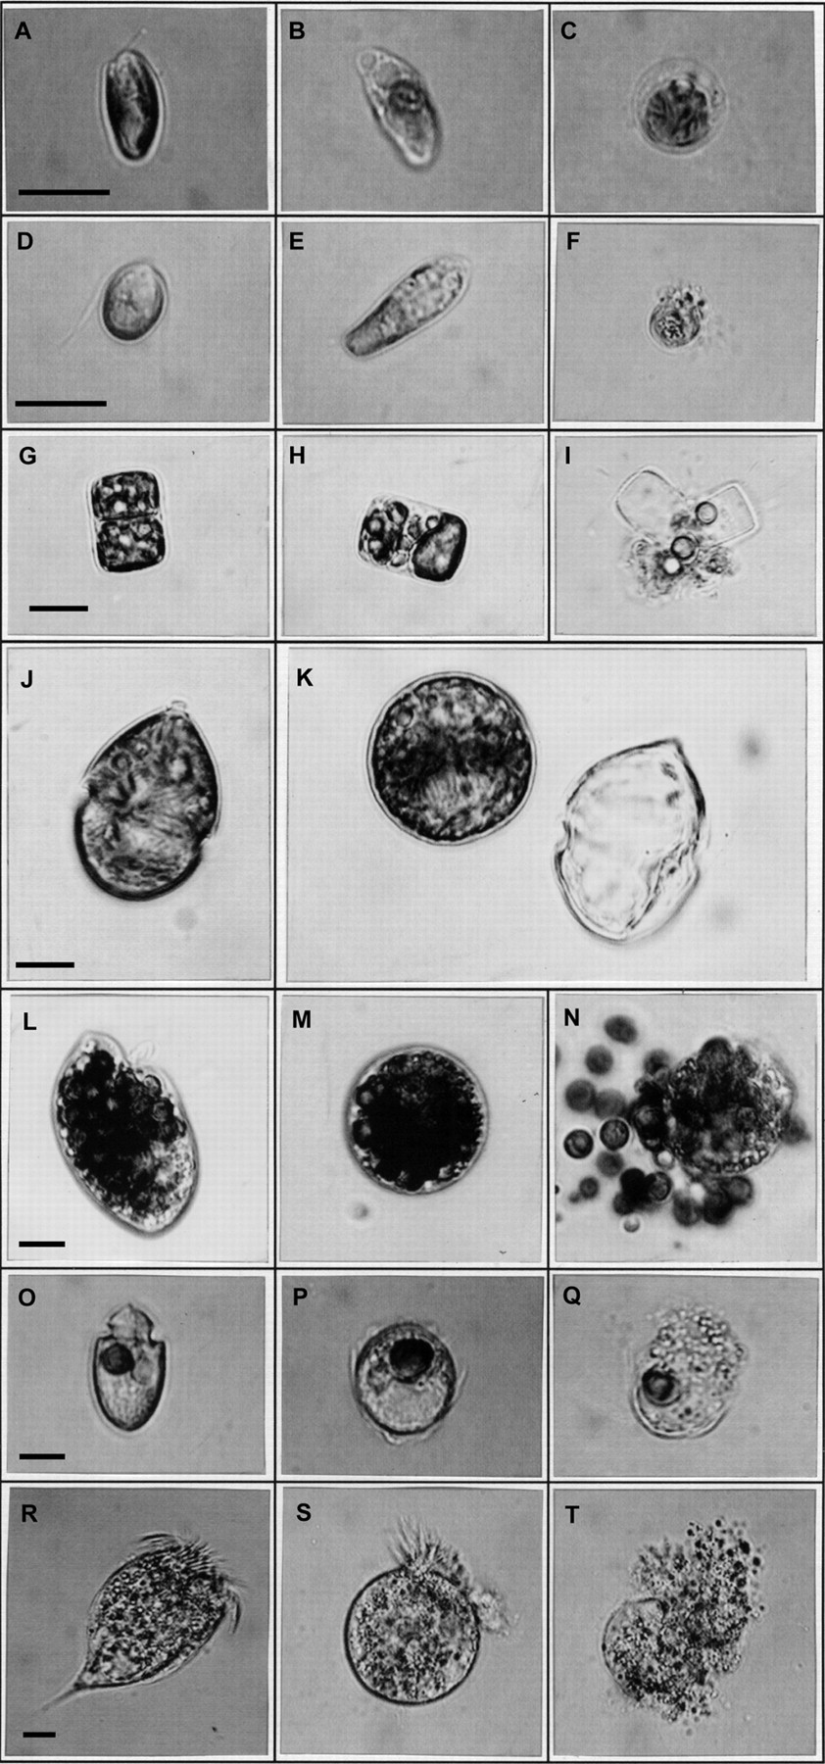
Fig. 1. Microscopic observations of lytic effects of A. ostenfeldii on different target species. Photos in the left ...
Notes:
Fig. 1. Microscopic observations of lytic effects of A. ostenfeldii on different target species. Photos in the left row (A, D, G, J, L, O and R) show unaffected cells from control treatment. (A–C) Rhodomonas sp.; (B) beginning of cell lysis, note the formation of blisters; (C) completely lysed cell. (D–F) Dunaliella salina; (E) elongated cell frequently found after short-term incubation (hours); (F) completely lysed cell. (G–I) Thalassiosira weissflogii; (H) cell with partly granulated cytoplasm; (I) completely lysed cell. (J and K) Scrippsiella trochoidea; (K) temporary cysts with empty theca. (L–N) Oxyrrhis marina (round dark particles are remains of Dunaliella salina used as food in O. marina cultures; (M) round cell; (N) lysed cell. (O–Q) Amphidinium crassum; (P) round cell; (Q) lysed cell. (R–T) Rimostrombidium caudatum; (S) round cell; (T) lysed cell. Scale bar represents 10 µm. Note that the sequence of prints is not a true time course.
Unless provided in the caption above, the following copyright applies to the content of this slide: © The Author 2007. Published by Oxford University Press. All rights reserved. For permissions, please email: journals.permissions@oxfordjournals.org

Slide 4
Fig. 5. Numbers of intact cells of different target organisms exposed to fresh culture medium (control) or to ...
Notes:
Fig. 5. Numbers of intact cells of different target organisms exposed to fresh culture medium (control) or to whole-cell culture of three A. ostenfeldii strains (K-0287, BAHME136, AOSH1). Samples were taken after 3 h (black bars) and in some cases after 24 h (white bars) after incubation. (A) Rhodomonas sp.; (B) D. salina; (C) T. weissflogii; (D) A. crassum; (E) R. caudatum; (F) Strombidium sp.; (G) P. parvum; (H) E. huxleyi. Results expressed as triplicate mean ± 1 SD. Asterisks above bars indicate values significantly (P < 0.01) different from control.
Unless provided in the caption above, the following copyright applies to the content of this slide: © The Author 2007. Published by Oxford University Press. All rights reserved. For permissions, please email: journals.permissions@oxfordjournals.org

Slide 5
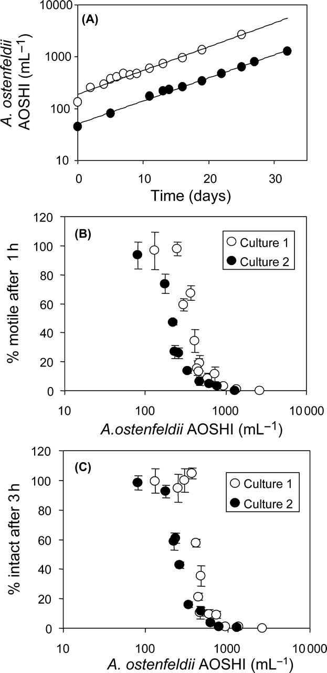
Fig. 2. Two different batch cultures of A. ostenfeldii (strain AOSH1) grown at 15°C and photon flux density of 100 ...
Notes:
Fig. 2. Two different batch cultures of A. ostenfeldii (strain AOSH1) grown at 15°C and photon flux density of 100 µmol m−2 s−1. (A) Growth curves. (B) Percentage of motile O. marina cells after 1 h exposure (live counts) as a function of algal cell concentration when measured along the growth curve. (C) Percentage of intact O. marina cells after 3 h incubation (fixed cell counts) as a function of different cell concentrations when measured along the growth curve. Results in (B) and (C) are expressed as triplicate mean ± 1 SD.
Unless provided in the caption above, the following copyright applies to the content of this slide: © The Author 2007. Published by Oxford University Press. All rights reserved. For permissions, please email: journals.permissions@oxfordjournals.org

Slide 6
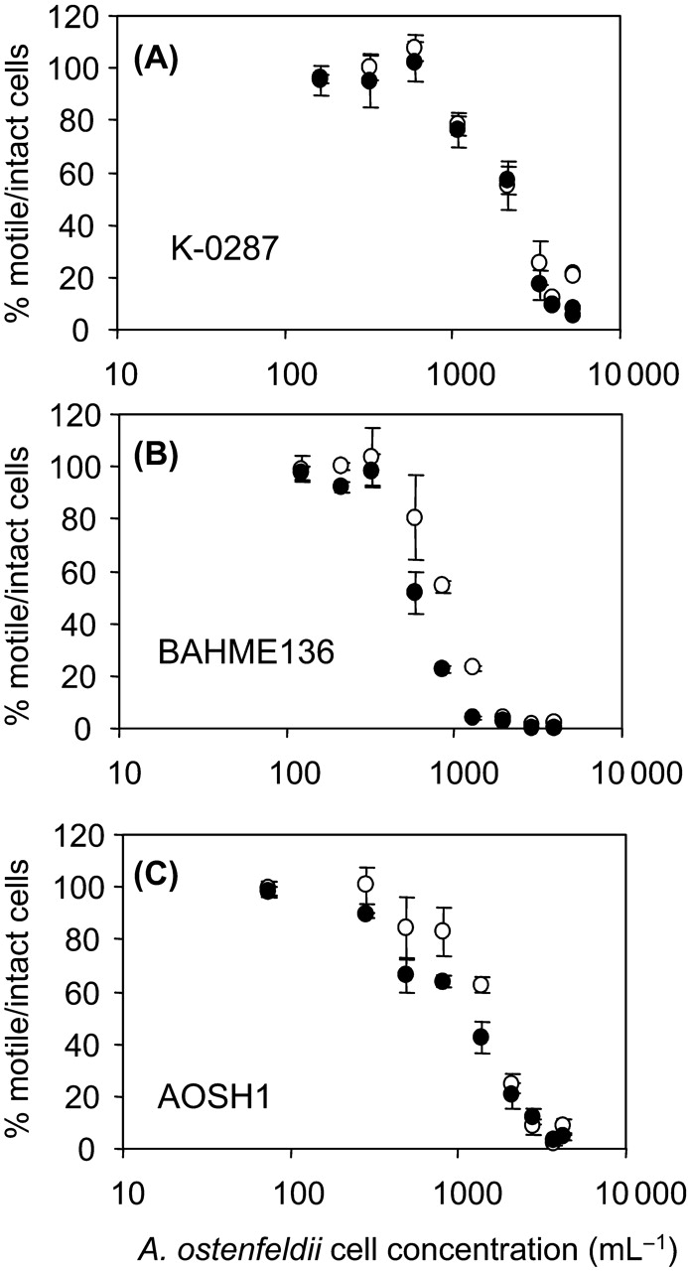
Fig. 3. Percentage of motile O. marina cells after 1 h incubation (open circles) and intact O. marina after 3 h ...
Notes:
Fig. 3. Percentage of motile O. marina cells after 1 h incubation (open circles) and intact O. marina after 3 h incubation (filled circles) as a function of algal cell concentration for (A) A. ostenfeldii strain K-0287, (B) strain BAHME 136 and (C) strain AOSH1 when measured along the growth curve. Results are expressed as triplicate mean ± 1 SD.
Unless provided in the caption above, the following copyright applies to the content of this slide: © The Author 2007. Published by Oxford University Press. All rights reserved. For permissions, please email: journals.permissions@oxfordjournals.org

Slide 7
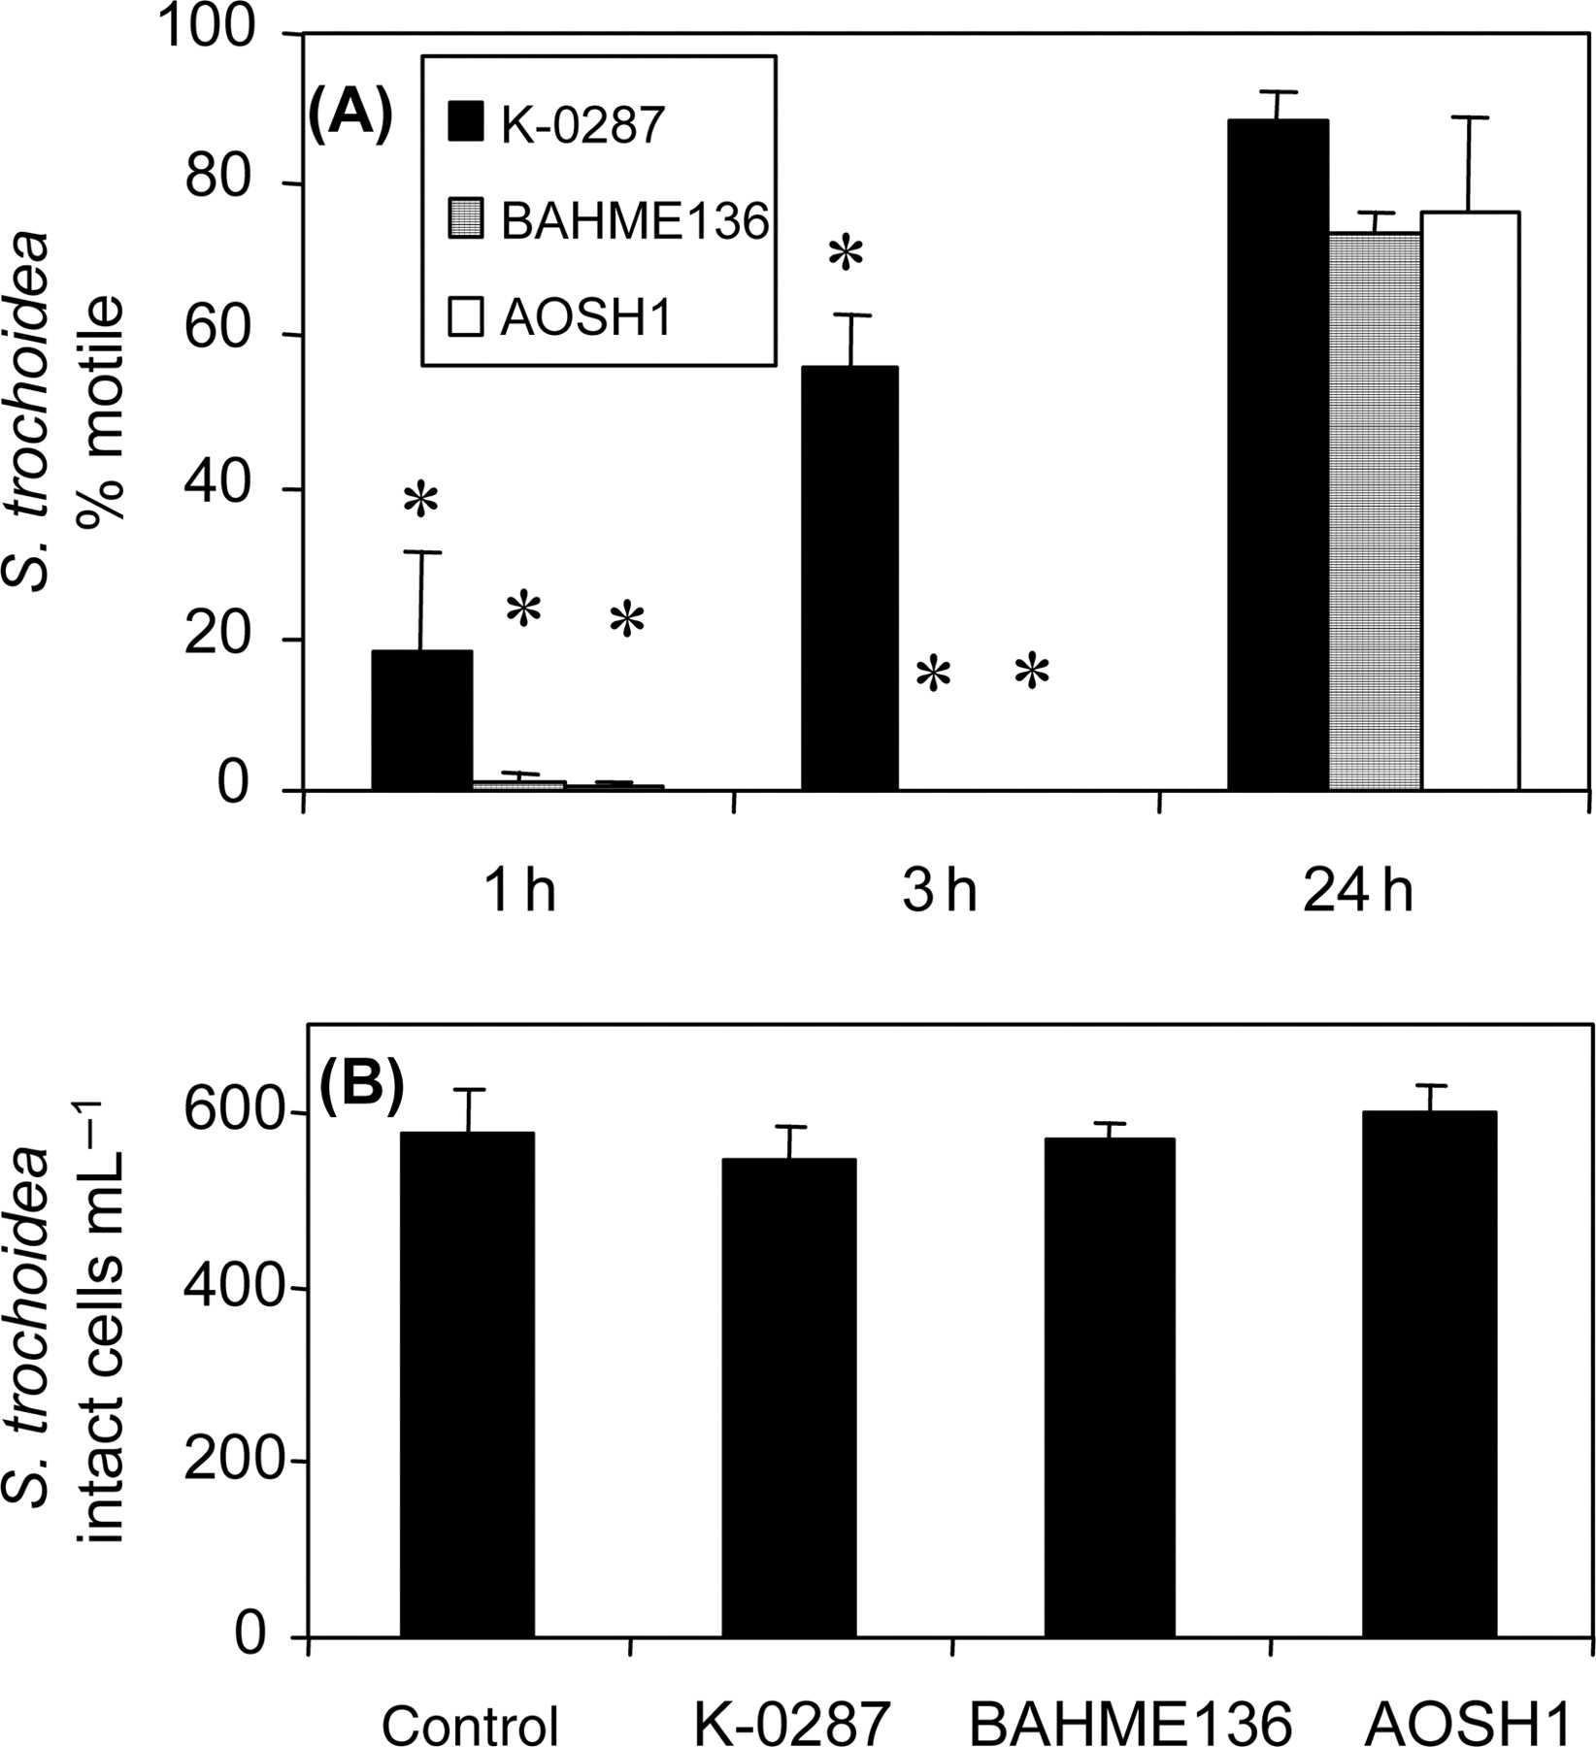
Fig. 4. Effects of A. ostenfeldii filtrate on S. trochoidea. (A): Percent of motile S. trochoidea cells (compared ...
Notes:
Fig. 4. Effects of A. ostenfeldii filtrate on S. trochoidea. (A): Percent of motile S. trochoidea cells (compared with seawater control) when incubated for 1, 3 or 24 h with culture filtrate of A. ostenfeldii strain K-0287, BAHME136 or AOSH1. (B): Number of intact S. trochoidea cells after 3 h incubation (fixed samples). Results expressed as triplicate mean ± 1 SD. Asterisks above bars indicate values significantly (P < 0.01) different from control.
Unless provided in the caption above, the following copyright applies to the content of this slide: © The Author 2007. Published by Oxford University Press. All rights reserved. For permissions, please email: journals.permissions@oxfordjournals.org

Slide 8
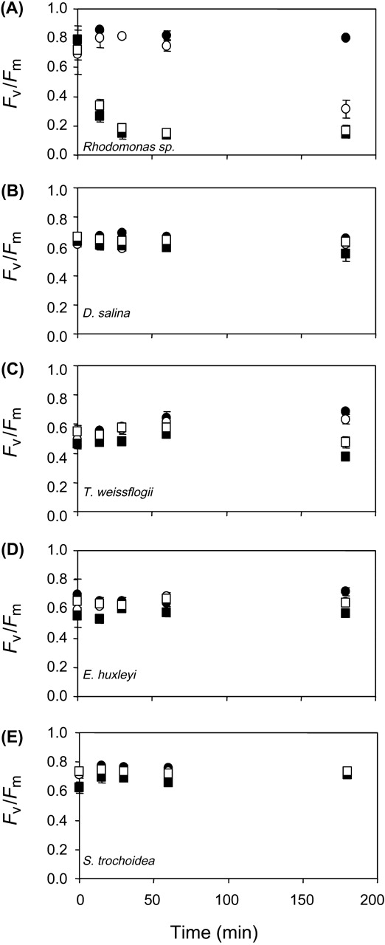
Fig. 8. Fluorescence yield (F_{v}/F_{m}) of different target algae as a function of incubation time ...
Notes:
Fig. 8. Fluorescence yield (Fv/Fm) of different target algae as a function of incubation time with fresh culture medium (control, filled circles) or 10 µm gauze filtrate of A. ostenfeldii K-0287 (open circles), strain BAHME136 (filled squares) or strain AOSH1 (open squares). (A) Rhodomonas sp.; (B) D. salina; (C) T. weissflogii; (D) E. huxleyi; (E) S. trochoidea. Data points represent mean values (n = 3) with error bars (±1SD).
Unless provided in the caption above, the following copyright applies to the content of this slide: © The Author 2007. Published by Oxford University Press. All rights reserved. For permissions, please email: journals.permissions@oxfordjournals.org

Slide 9
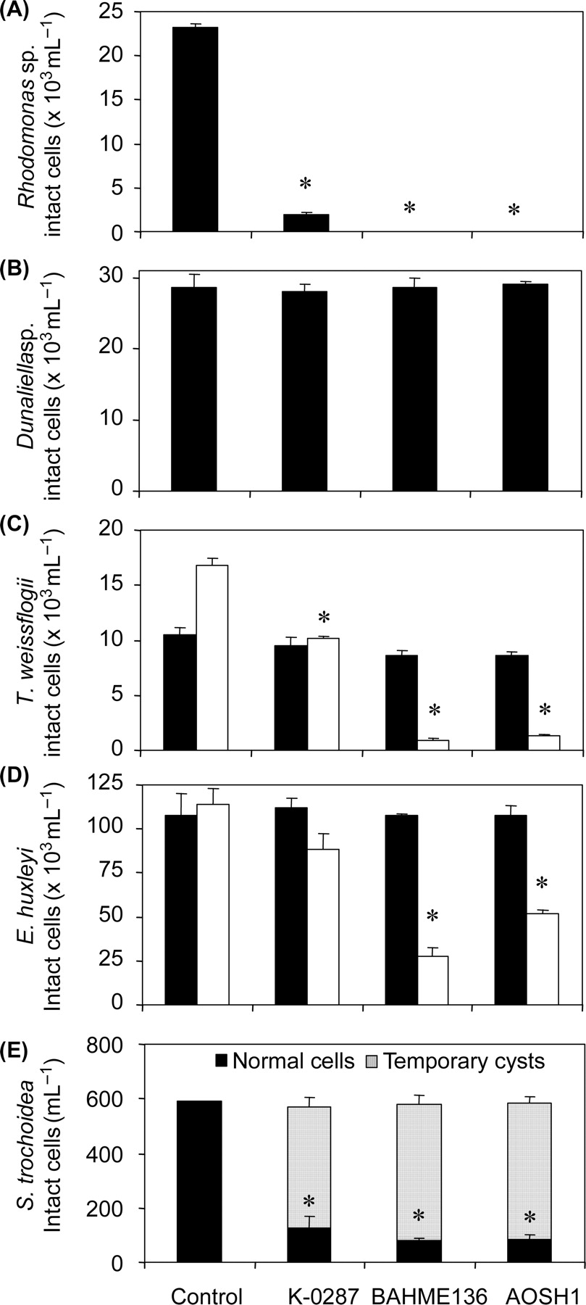
Fig. 9. Number of intact cells from the PAM fluorometry experiment for (A) Rhodomonas sp., (B) D. salina, (C) T. ...
Notes:
Fig. 9. Number of intact cells from the PAM fluorometry experiment for (A) Rhodomonas sp., (B) D. salina, (C) T. weissflogii, (D) E. huxleyi and (E) S. trochoidea. Black bars: cell counts after 3 h incubation. Open bars (for T. weissflogii and E. huxleyi): cell counts after 24 h incubation. Dotted area in (E) represent fraction of temporary cysts. Data represent mean value (n = 3) with error bars (±1 SD). Asterisks above bars indicate values significantly (P < 0.01) different from control.
Unless provided in the caption above, the following copyright applies to the content of this slide: © The Author 2007. Published by Oxford University Press. All rights reserved. For permissions, please email: journals.permissions@oxfordjournals.org

