Slide 1
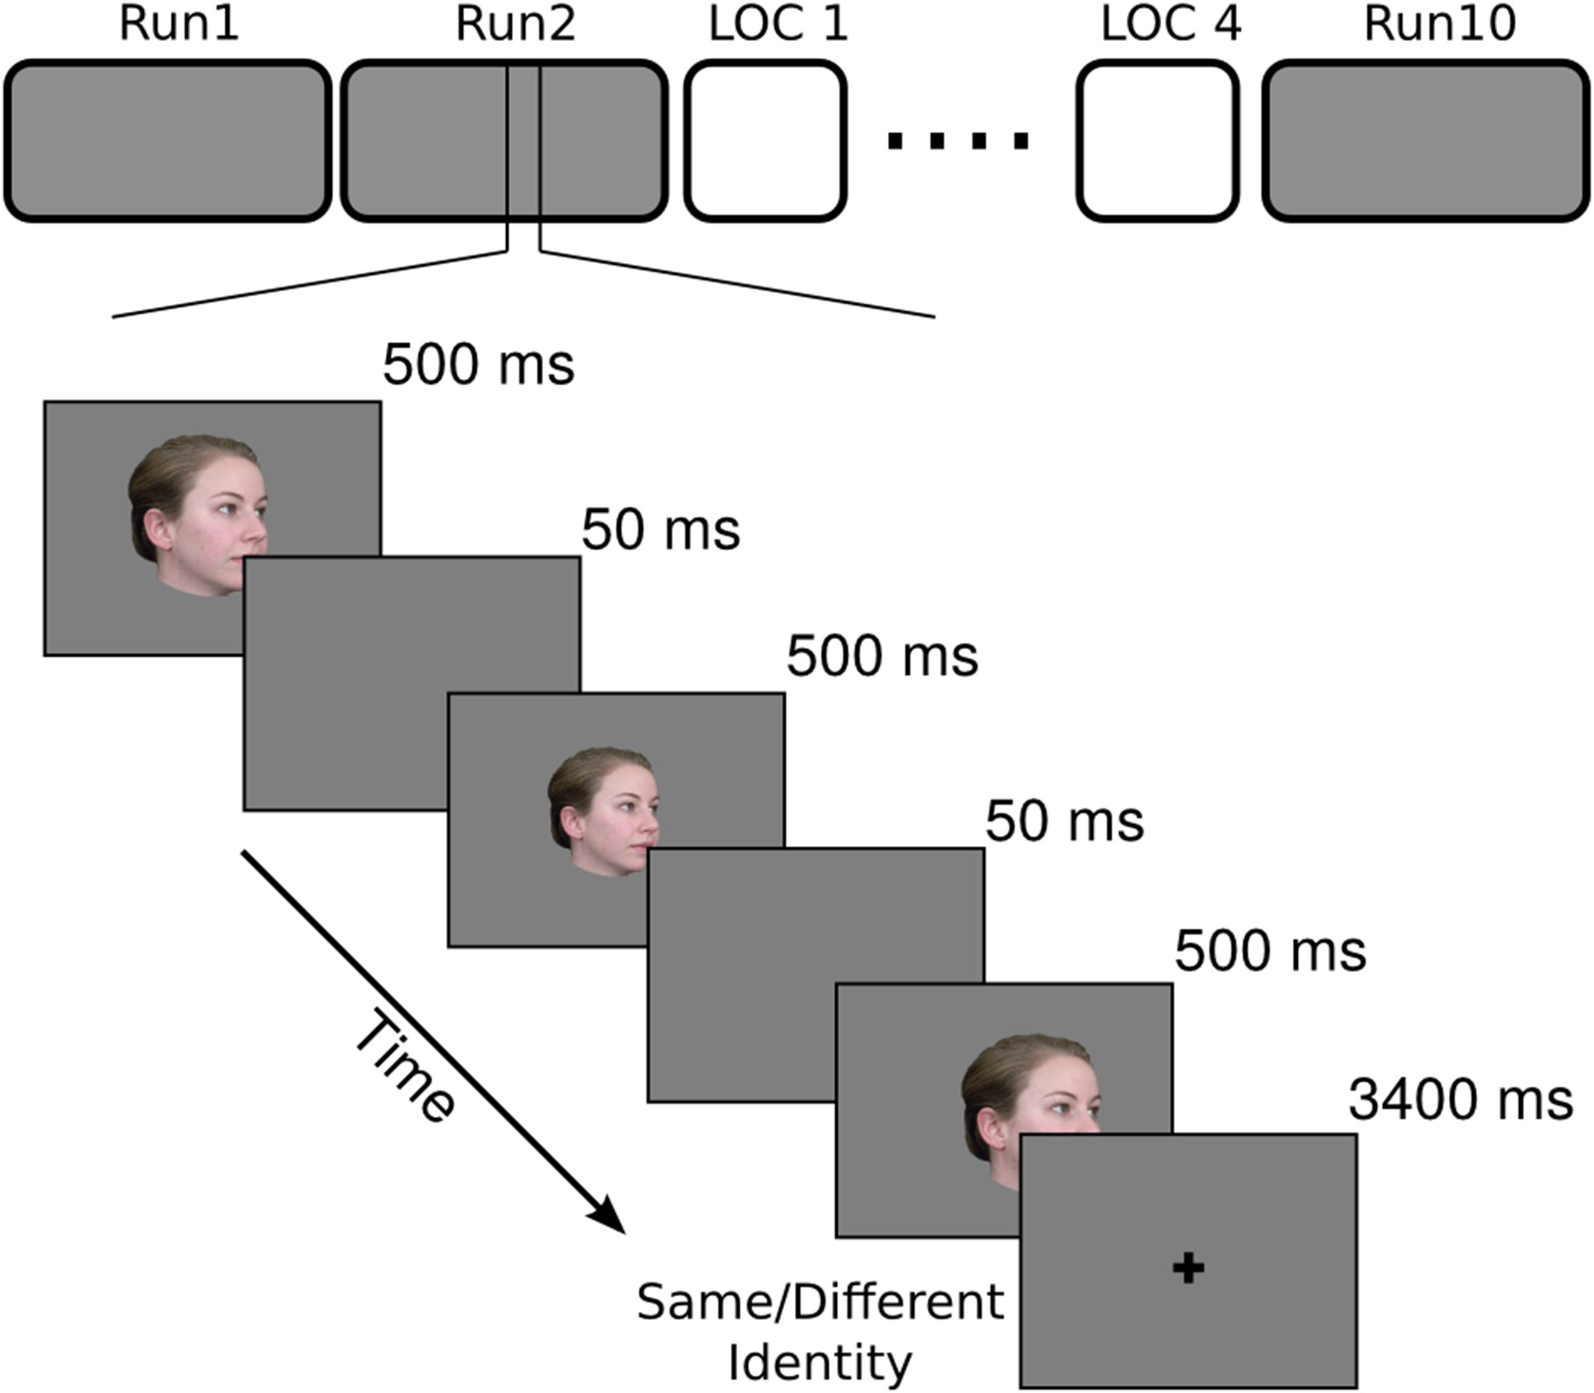
Figure 1. Schematic of the main experiment with an example of the trial structure. fMRI study had 10 runs of the main ...
Notes:
Figure 1. Schematic of the main experiment with an example of the trial structure. fMRI study had 10 runs of the main experiment and 4 runs of localizer interspersed. Each run of the main experiment had 63 trials—60 stimulus trials and 3 fixation trials. Each trial started with one of the 20 face images presented 3 times at variable size and location with 50 ms of ISI between presentations, and ended with a 3400 ms fixation. Subjects performed a 1-back identity matching task to keep their attention to the stimuli.
Unless provided in the caption above, the following copyright applies to the content of this slide: © The Author 2016. Published by Oxford University Press.This is an Open Access article distributed under the terms of the Creative Commons Attribution Non-Commercial License (http://creativecommons.org/licenses/by-nc/4.0/), which permits non-commercial re-use, distribution, and reproduction in any medium, provided the original work is properly cited. For commercial re-use, please contact journals.permissions@oup.com

Slide 2
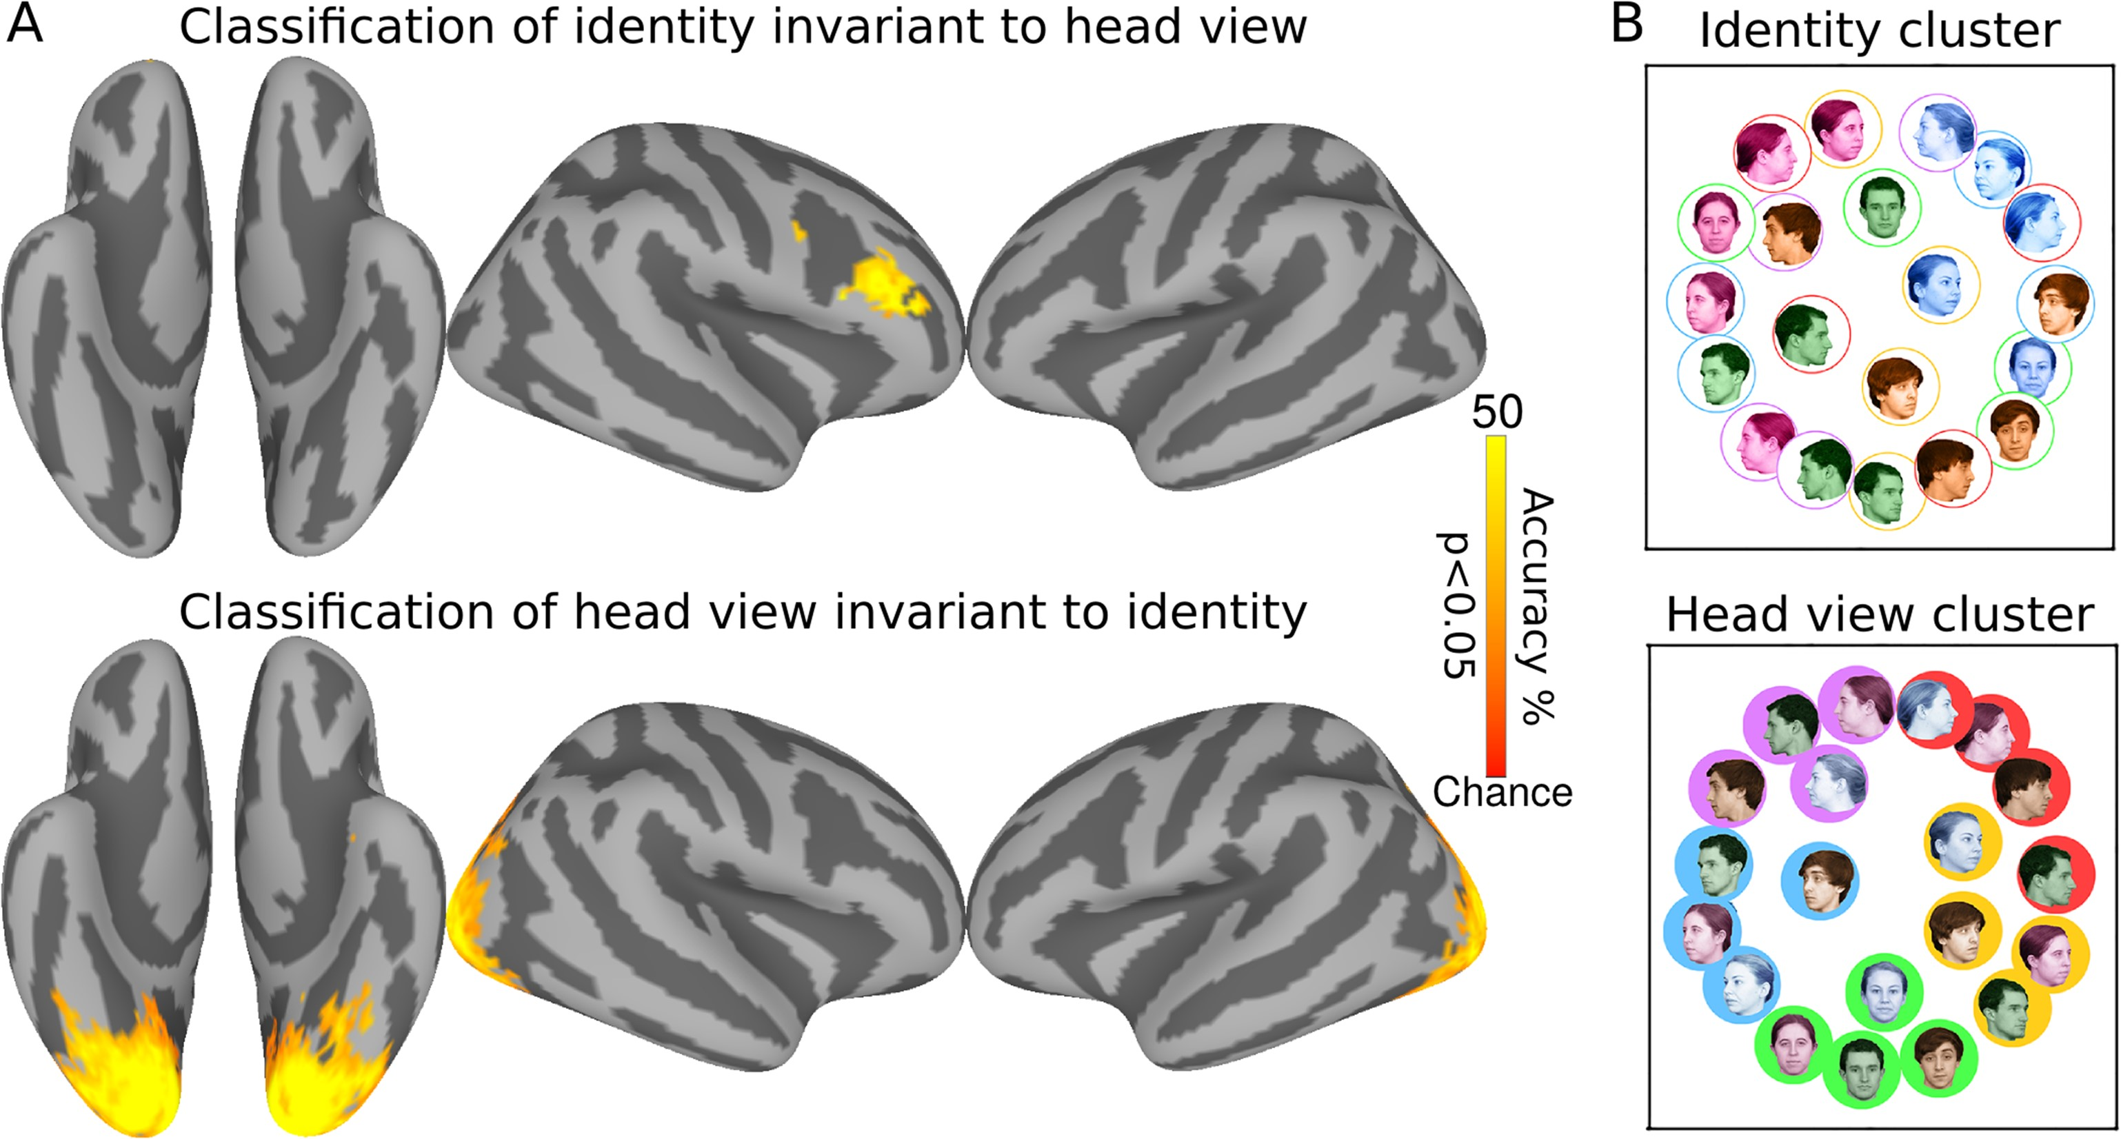
Figure 2. Surface searchlight classification of faces. (A) Classification accuracies for face identity cross-validated ...
Notes:
Figure 2. Surface searchlight classification of faces. (A) Classification accuracies for face identity cross-validated over views (top) and head view cross-validated over identities (bottom). Chance accuracy is 25% for face identity and 20% for head view classifications. Maps are thresholded at P < 0.05 after correcting for multiple comparisons using permutation testing. (B) MDS plots of representational geometries of responses to face stimuli in the identity cluster (top) and the head view cluster (bottom). Faces of the same identity are colored the same, and faces with same head view have the same background or outline. Coloring based on the identity is emphasized on the top and coloring based on the head view emphasized on the bottom.
Unless provided in the caption above, the following copyright applies to the content of this slide: © The Author 2016. Published by Oxford University Press.This is an Open Access article distributed under the terms of the Creative Commons Attribution Non-Commercial License (http://creativecommons.org/licenses/by-nc/4.0/), which permits non-commercial re-use, distribution, and reproduction in any medium, provided the original work is properly cited. For commercial re-use, please contact journals.permissions@oup.com

Slide 3
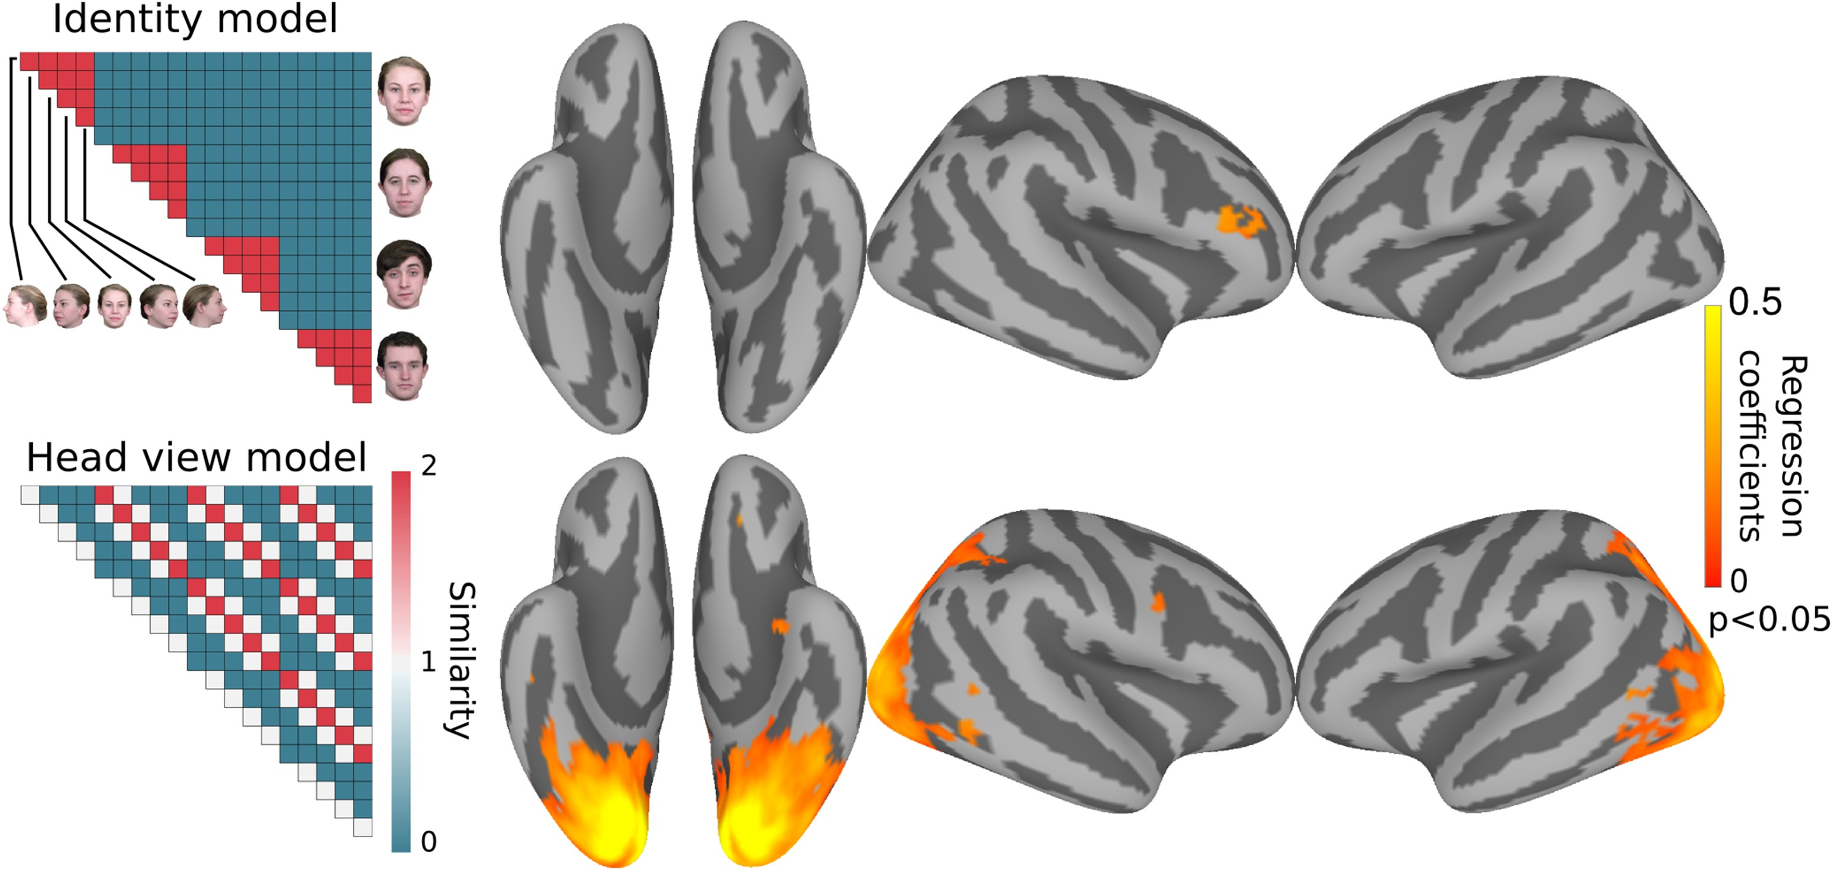
Figure 3. Surface searchlight based modeling of representational geometry. Neural representation of faces in each ...
Notes:
Figure 3. Surface searchlight based modeling of representational geometry. Neural representation of faces in each searchlight was modeled with 3 model similarity structures as regressors using ridge regression. Representational geometry in the rIFFA correlated with the identity model (top), whereas representational geometry in EVC correlated with the head view model (bottom). Maps are thresholded at P < 0.05 after correcting for multiple comparisons using permutation testing. Correlation with the mirror symmetry model did not reveal any significant clusters.
Unless provided in the caption above, the following copyright applies to the content of this slide: © The Author 2016. Published by Oxford University Press.This is an Open Access article distributed under the terms of the Creative Commons Attribution Non-Commercial License (http://creativecommons.org/licenses/by-nc/4.0/), which permits non-commercial re-use, distribution, and reproduction in any medium, provided the original work is properly cited. For commercial re-use, please contact journals.permissions@oup.com

Slide 4
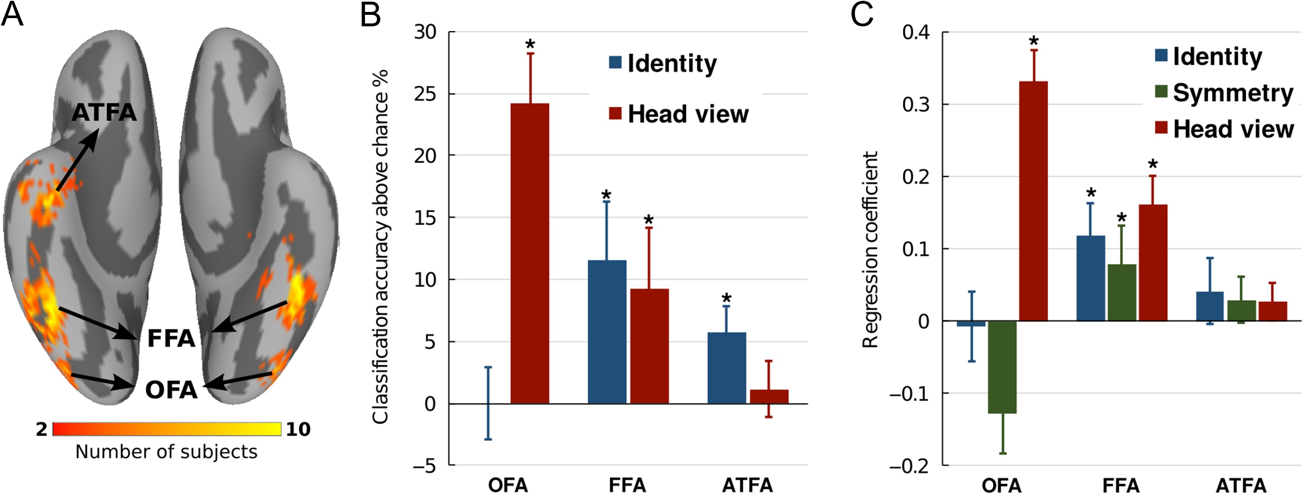
Figure 4. Classification and representational similarity analyses in face-selective ROIs. (A) Anatomical locations of ...
Notes:
Figure 4. Classification and representational similarity analyses in face-selective ROIs. (A) Anatomical locations of face-selective ROIs as determined by localizer. (B) Classification accuracies of face identity invariant to view and head view invariant to identity in regions of the core face system. (C) Modeling representational geometry in ROIs. Asterisks indicate accuracies that were significant with permutation. Error bars indicate standard error (SEM).
Unless provided in the caption above, the following copyright applies to the content of this slide: © The Author 2016. Published by Oxford University Press.This is an Open Access article distributed under the terms of the Creative Commons Attribution Non-Commercial License (http://creativecommons.org/licenses/by-nc/4.0/), which permits non-commercial re-use, distribution, and reproduction in any medium, provided the original work is properly cited. For commercial re-use, please contact journals.permissions@oup.com

