Slide 1
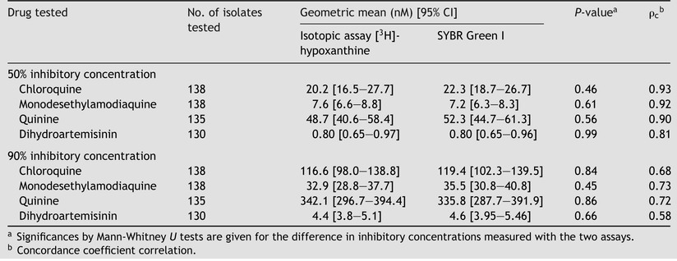
Table 1 Comparison of the isotopic and SYBR Green I measurements for clinical isolates of Plasmodium falciparum ...
Notes:
Table 1 Comparison of the isotopic and SYBR Green I measurements for clinical isolates of Plasmodium falciparum tested against four drugs
Unless provided in the caption above, the following copyright applies to the content of this slide: © Royal Society of Tropical Medicine and Hygiene 2008

Slide 2
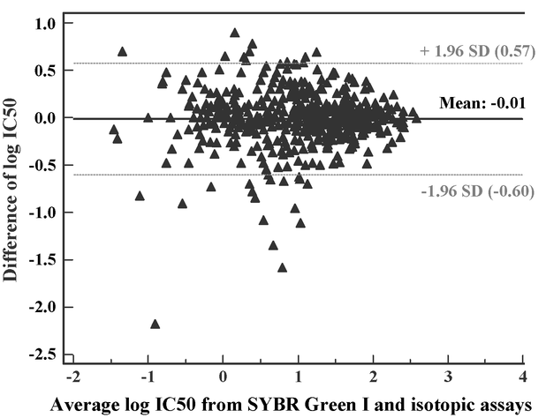
Figure 1 Bland and Altman graph of the difference in log IC50s between the two methods (SYBR Green I and isotopic ...
Notes:
Figure 1 Bland and Altman graph of the difference in log IC50s between the two methods (SYBR Green I and isotopic assays) for chloroquine, monodesethylamodiaquine, quinine and dihydroartemisinin plotted against the mean values. The estimated mean difference (− 0.01) and its confidence interval (2 SD) were calculated and are drawn as horizontal lines. As the IC50s increase, no tendency for greater or smaller differences between the methods is observed on the plot.
Unless provided in the caption above, the following copyright applies to the content of this slide: © Royal Society of Tropical Medicine and Hygiene 2008

Slide 3
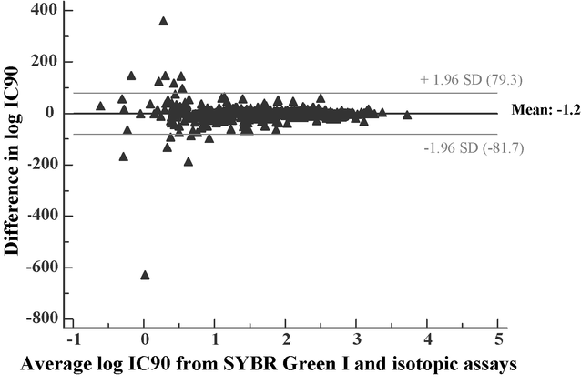
Figure 2 Bland and Altman graph of the difference in log IC90s between the two methods (SYBR Green I and isotopic ...
Notes:
Figure 2 Bland and Altman graph of the difference in log IC90s between the two methods (SYBR Green I and isotopic assays) for chloroquine, monodesethylamodiaquine, quinine and dihydroartemisinin plotted against the mean values. The estimated mean difference (+ 1.2) and its confidence interval (2 SD) were calculated and are drawn as horizontal lines. As the IC90s increase, no tendency for greater or smaller differences between the methods is observed on the plot.
Unless provided in the caption above, the following copyright applies to the content of this slide: © Royal Society of Tropical Medicine and Hygiene 2008

