Slide 1
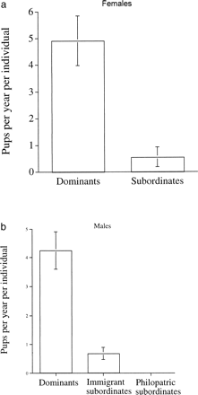
Figure 1 The average number of pups produced per year per individual in Ranch groups in which information on group ...
Notes:
Figure 1 The average number of pups produced per year per individual in Ranch groups in which information on group membership during breeding events was available, comparing dominant and subordinate females (a, n = 9 groups) and dominant, subordinate immigrant, and subordinate philopatric males (b, n = 7 groups)
Unless provided in the caption above, the following copyright applies to the content of this slide: International Society for Behavioral Ecology

Slide 2
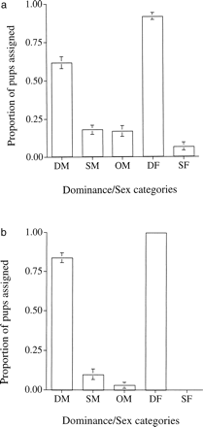
Figure 2 Reproductive skew between different categories of males and females: dominant, immigrant subordinate, and ...
Notes:
Figure 2 Reproductive skew between different categories of males and females: dominant, immigrant subordinate, and males from outside the group. Mean (± SE) percentages of the total number of pups for which parentage was assigned or for which all adult males in a group were excluded (i.e., had a LOD score of 0), and therefore, paternity was attributed to a male from outside the group. (a) Data from the Ranch site (n = 10 groups). (b) Data from the Park site (n = 6 groups). DM indicates dominant male; SM, subordinate male; OM, outside male; DF, dominant female; and SF, subordinate female
Unless provided in the caption above, the following copyright applies to the content of this slide: International Society for Behavioral Ecology

Slide 3
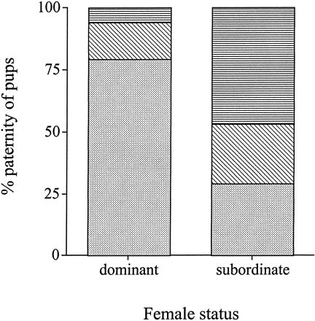
Figure 3 The proportion of the dominant and subordinate females' pups that were fathered by dominant (dotted), ...
Notes:
Figure 3 The proportion of the dominant and subordinate females' pups that were fathered by dominant (dotted), subordinate (immigrant) (diagonal stripes) and outside (horizontal stripes) males (n = 115 for dominant females and n = 17 for subordinate females)
Unless provided in the caption above, the following copyright applies to the content of this slide: International Society for Behavioral Ecology

Slide 4
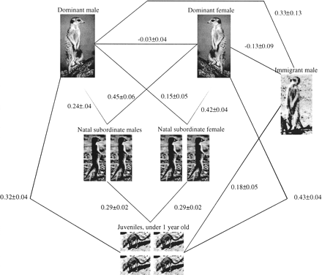
Figure 4 Diagram of an average meerkat group at the Ranch showing the different categories of status, sex, and ...
Notes:
Figure 4 Diagram of an average meerkat group at the Ranch showing the different categories of status, sex, and dispersal and relatedness between different categories
Unless provided in the caption above, the following copyright applies to the content of this slide: International Society for Behavioral Ecology

Slide 5
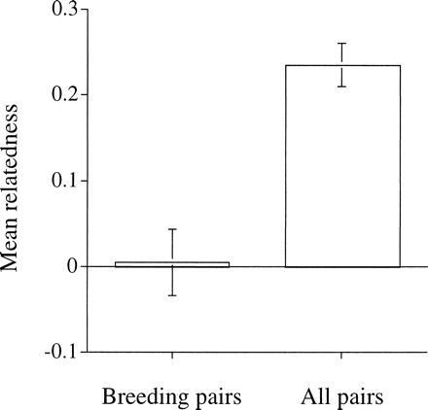
Figure 5 Mean (±SE) relatedness between breeding pairs compared with that between all opposite sex pairs of adults in ...
Notes:
Figure 5 Mean (±SE) relatedness between breeding pairs compared with that between all opposite sex pairs of adults in all groups (n = 16 groups)
Unless provided in the caption above, the following copyright applies to the content of this slide: International Society for Behavioral Ecology

Slide 6
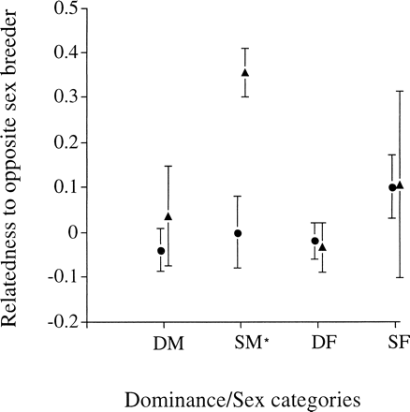
Figure 6 Mean (±SE) of relatedness to the breeder of the opposite sex (sample consists of 96 adults at the Ranch ...
Notes:
Figure 6 Mean (±SE) of relatedness to the breeder of the opposite sex (sample consists of 96 adults at the Ranch measured at the time of conception of 46 litters). Circles indicate mean for breeders; triangles, mean for nonbreeders. *All sex/rank categories had a relatedness to the opposite sex breeder that was not significantly different from zero, apart from subordinate males (df = 24, p <.01)
Unless provided in the caption above, the following copyright applies to the content of this slide: International Society for Behavioral Ecology

