Slide 1
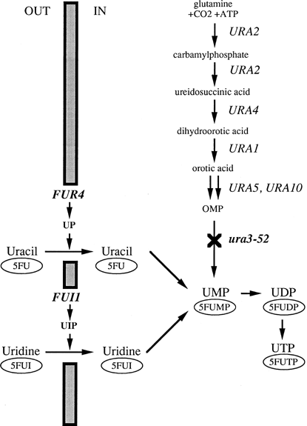
1 Pyrimidine metabolic pathway in strain FY1679-5C (leu2Δ1 his3Δ200 ura3-52) used for YBL042 gene disruption. ...
Notes:
1 Pyrimidine metabolic pathway in strain FY1679-5C (leu2Δ1 his3Δ200 ura3-52) used for YBL042 gene disruption. UP, uracil permease; UIP, uridine permease; 5FU, 5-fluorouracil; 5FUI, 5-fluorouridine.
Unless provided in the caption above, the following copyright applies to the content of this slide: © 1998 Federation of European Microbiological Societies. Published by Elsevier Science B.V.

