Slide 1
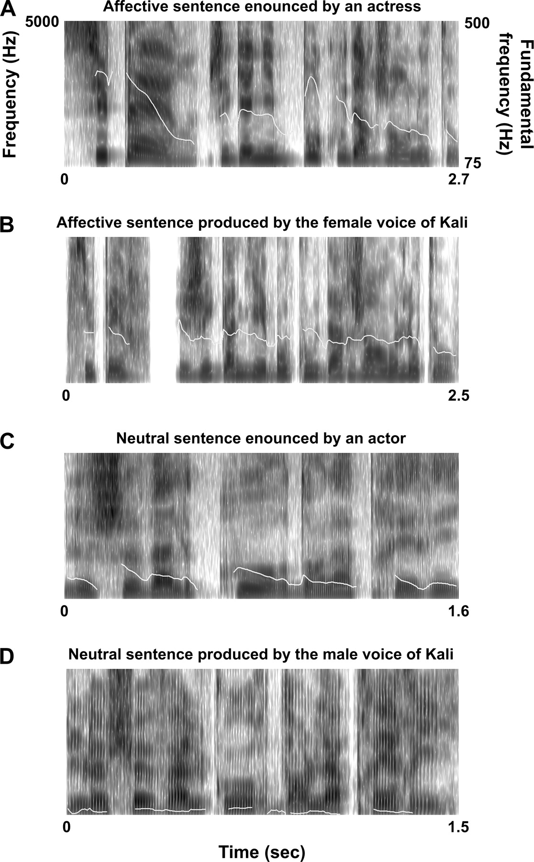
Figure 1 Spectrograms and pitch contours. Frequency (left ordinate) and fundamental frequency (white line, right ...
Notes:
Figure 1 Spectrograms and pitch contours. Frequency (left ordinate) and fundamental frequency (white line, right ordinate) are given in function of time (abscissa, ms) for a sentence with affective semantic content (“Super, j'ai gagné beaucoup d'argent au loto”/“Great, I've won lot of money on the lotto”) (A) enounced by an actress and (B) produced by the female voice of Kali, a text-to-speech software, and for a sentence with neutral semantic content (“Le cheval court dans la prairie”/“The horse runs in the meadow”) (C) enounced by an actor and (D) produced by the male voice of Kali.
Unless provided in the caption above, the following copyright applies to the content of this slide: © The Author 2006. Published by Oxford University Press. All rights reserved. For permissions, please e-mail: journals.permissions@oxfordjournals.org

Slide 2
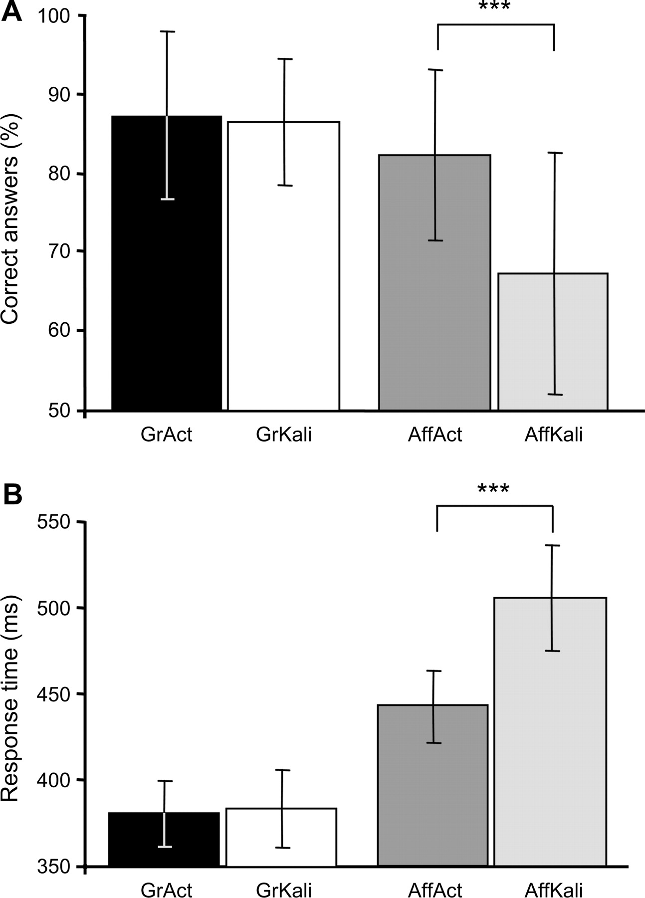
Figure 2 Behavioral results. (A) Average percentage of CA and (B) mean RTs (± standard deviation, ms) during affective ...
Notes:
Figure 2 Behavioral results. (A) Average percentage of CA and (B) mean RTs (± standard deviation, ms) during affective classification of sentences with affective semantic content enounced by actors (AffAct, dark gray bar) or produced by Kali (AffKali, light gray bar), during the grammatical classification of sentences with neutral semantic content spoken by actors (GrAct, black bar) or produced by Kali (GrKali, white bar, ***P ≤ 0.001).
Unless provided in the caption above, the following copyright applies to the content of this slide: © The Author 2006. Published by Oxford University Press. All rights reserved. For permissions, please e-mail: journals.permissions@oxfordjournals.org

Slide 3
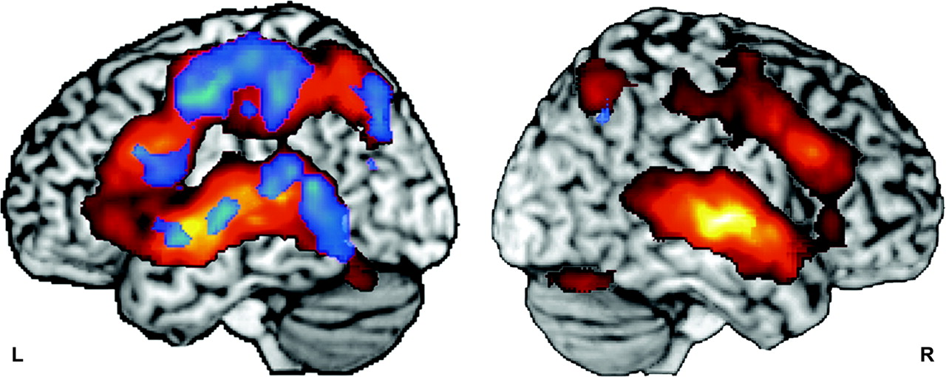
Figure 3 Cortical network engaged during the grammatical classification of sentences with neutral verbal content ...
Notes:
Figure 3 Cortical network engaged during the grammatical classification of sentences with neutral verbal content regardless of speaker. Cortical areas significantly activated during the grammatical classification of sentences produced either by Kali or by actors compared with beep detection are projected on the left (L) and right (R) hemisphere of MNI reference brain (conjunction analysis given at 0.0025 corrected threshold for multiple comparisons). Red scale is for BOLD signal variation; blue scale is for significantly asymmetrical BOLD variations in each hemisphere.
Unless provided in the caption above, the following copyright applies to the content of this slide: © The Author 2006. Published by Oxford University Press. All rights reserved. For permissions, please e-mail: journals.permissions@oxfordjournals.org

Slide 4
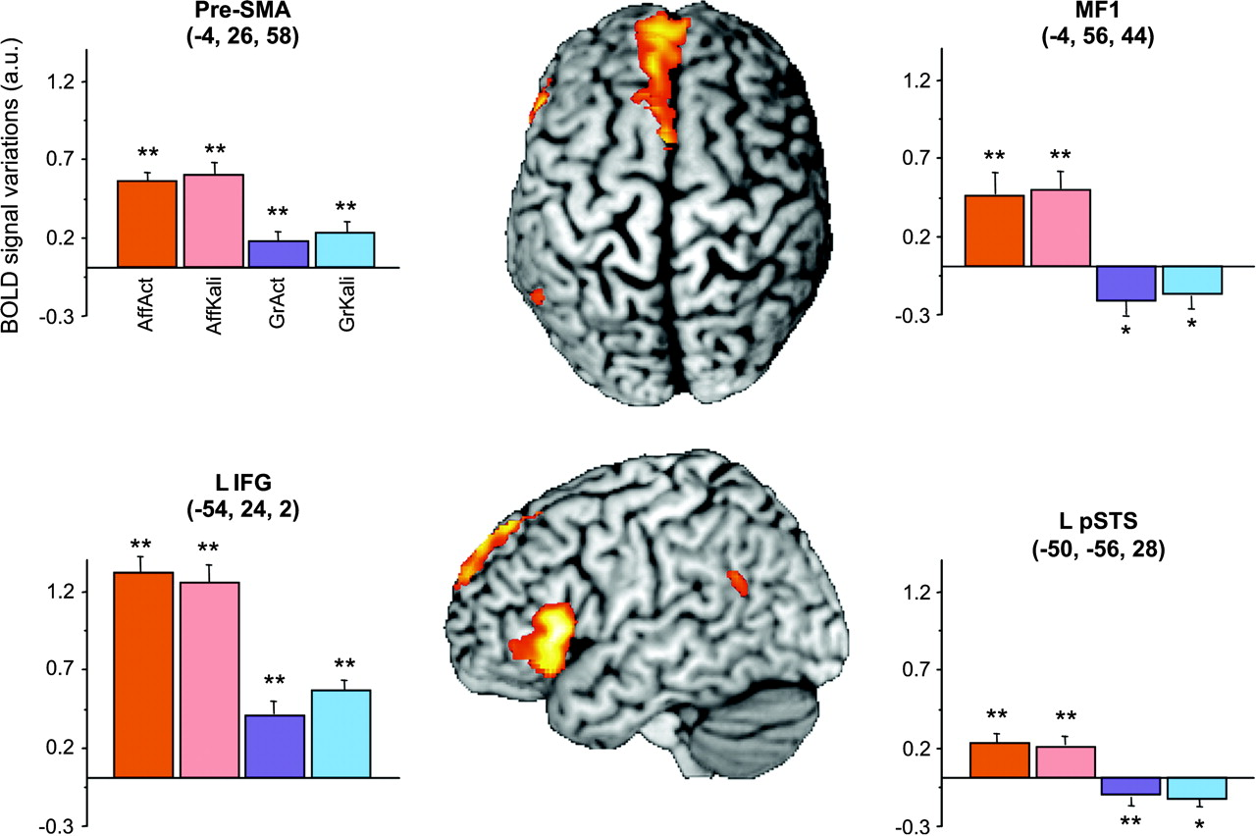
Figure 4 Brain areas more activated by affective than grammatical classification. Conjunction analysis of the ...
Notes:
Figure 4 Brain areas more activated by affective than grammatical classification. Conjunction analysis of the affective minus grammatical classification of sentences enounced by actors (respectively, AffAct and GrAct) with the same contrast on sentences produced by Kali (respectively, AffKali and GrKali) overlaid on MNI-referenced brain template (P ≤ 0.0025 corrected threshold for multiple comparisons). Areas evidenced by this conjunction and thus showing a significant larger activity when the sentences included an affective content whatever the presence of affective prosody than during grammatical classification of neutral sentences were located in the pre-SMA, the MF1, the left IFG (L IFG), and the left pSTS (L pSTS). Bar charts provide the average BOLD signal variation during each condition compared with the beep detection reference task at the local maximal peak of activity (error bars correspond to standard error of the mean; peaks coordinates are given in stereotaxic coordinates in mm; *P < 0.05, **P < 0.01 correspond to the results of one sample t-tests comparing the BOLD signal variation during each conditions with beep detection reference task; a.u., arbitrary unity; AffAct, red bar; AffKali, pink bar; GrAct, blue bar; GrKali, purple bar).
Unless provided in the caption above, the following copyright applies to the content of this slide: © The Author 2006. Published by Oxford University Press. All rights reserved. For permissions, please e-mail: journals.permissions@oxfordjournals.org

Slide 5
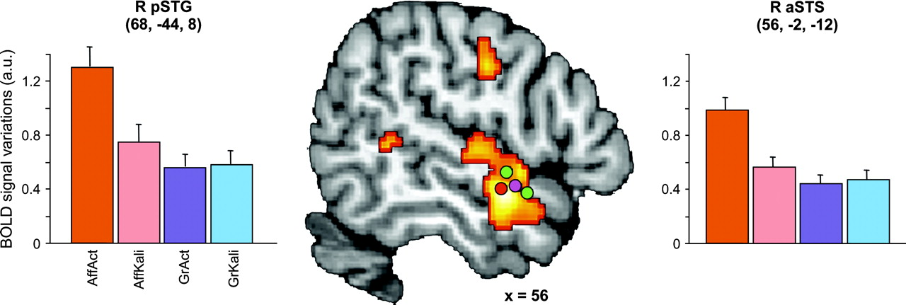
Figure 5 The right temporal areas and affective prosody. The right aSTS areas (R aSTS) and the right pSTG (R pSTG) ...
Notes:
Figure 5 The right temporal areas and affective prosody. The right aSTS areas (R aSTS) and the right pSTG (R pSTG) that were more activated during affective classification in the presence of affective prosody (sentences enounced by actors) than in the absence of affective prosody (sentences produced by Kali) are superimposed on a sagittal slice of the MNI-referenced brain (x = 56, P ≤ 0.001 uncorrected threshold). The cluster R aSTS, which shows a greater BOLD signal increase in presence of affective prosody than in other conditions, is located close to HSVA as defined in Belin and others (2000), Belin and Zatorre (2003), and Kriegstein and others (2003). Bar charts provide the average BOLD signal variation during each condition compared with the beep detection reference task at the local maximal peak of activity (error bars correspond to standard error of the mean; peak coordinates are given in stereotaxic coordinates in mm; a.u., arbitrary unity; AffAct, red bar; AffKali, pink bar; GrAct, blue bar; GrKali, purple bar).
Unless provided in the caption above, the following copyright applies to the content of this slide: © The Author 2006. Published by Oxford University Press. All rights reserved. For permissions, please e-mail: journals.permissions@oxfordjournals.org

Slide 6
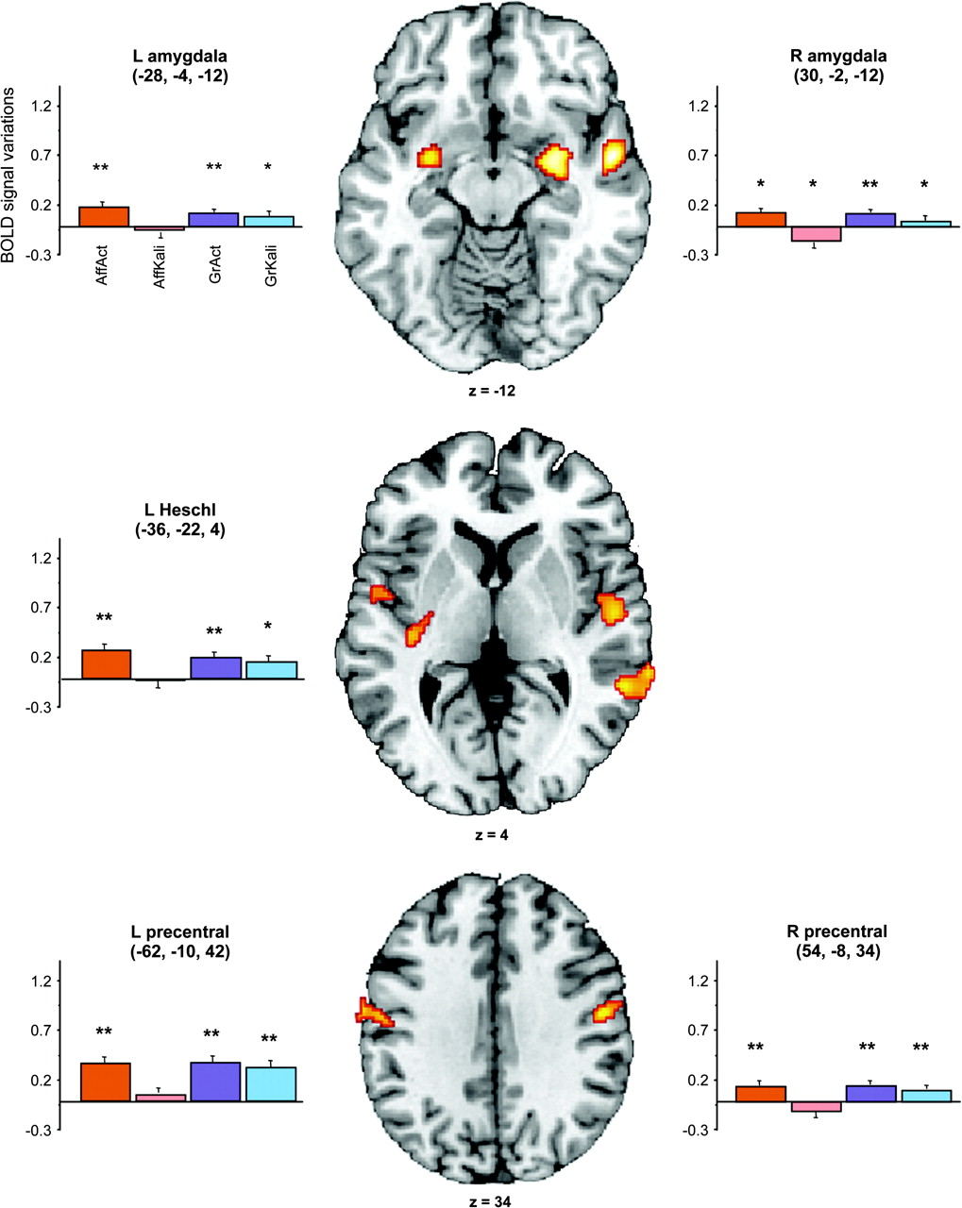
Figure 6 Areas showing decreased activity when affective semantic sentences lacked affective prosody. The clusters in ...
Notes:
Figure 6 Areas showing decreased activity when affective semantic sentences lacked affective prosody. The clusters in bilateral amygdala, left heschl gyrus, and bilateral precentral gyrus, which were obtained in the contrast of affective classification in the presence of affective prosody versus in the absence of affective prosody are represented on axial slices of the MNI brain. Bar charts provide the average BOLD signal variation during each condition compared with the beep detection reference task at the local maximal peak of activity (error bars correspond to standard error of the mean; peaks coordinates are given in stereotaxic coordinates in mm; *P < 0.05, **P < 0.01 correspond to the results of one sample t-tests comparing the BOLD signal variation during each conditions with beep detection reference task; a.u., arbitrary unity; AffAct, red bar; AffKali, pink bar; GrAct, blue bar; GrKali, purple bar).
Unless provided in the caption above, the following copyright applies to the content of this slide: © The Author 2006. Published by Oxford University Press. All rights reserved. For permissions, please e-mail: journals.permissions@oxfordjournals.org

Slide 7
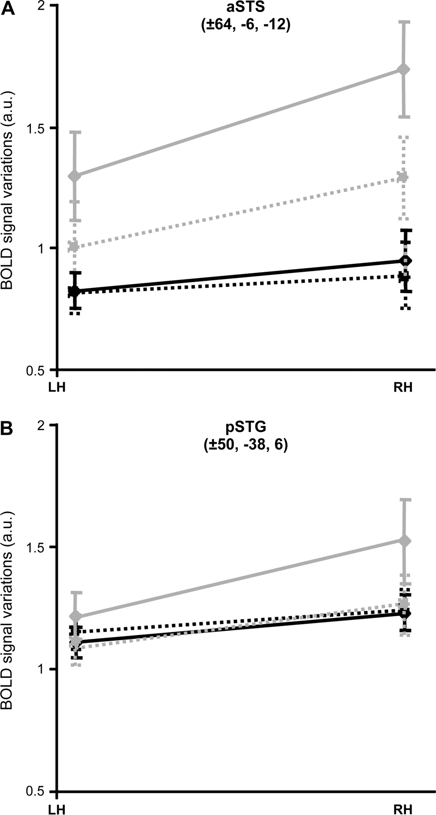
Figure 7 Lateralization of temporal areas in presence of affective prosody. Variation of the BOLD signal during the 4 ...
Notes:
Figure 7 Lateralization of temporal areas in presence of affective prosody. Variation of the BOLD signal during the 4 conditions in the clusters corresponding to the local maximal peaks in (A) the aSTS and (B) the pSTG ( AffAct, gray line; AffKali, gray dotted line; GrAct, black line; GrKali, dark dotted line; LH, left hemisphere; RH, right hemisphere).
Unless provided in the caption above, the following copyright applies to the content of this slide: © The Author 2006. Published by Oxford University Press. All rights reserved. For permissions, please e-mail: journals.permissions@oxfordjournals.org

Slide 8
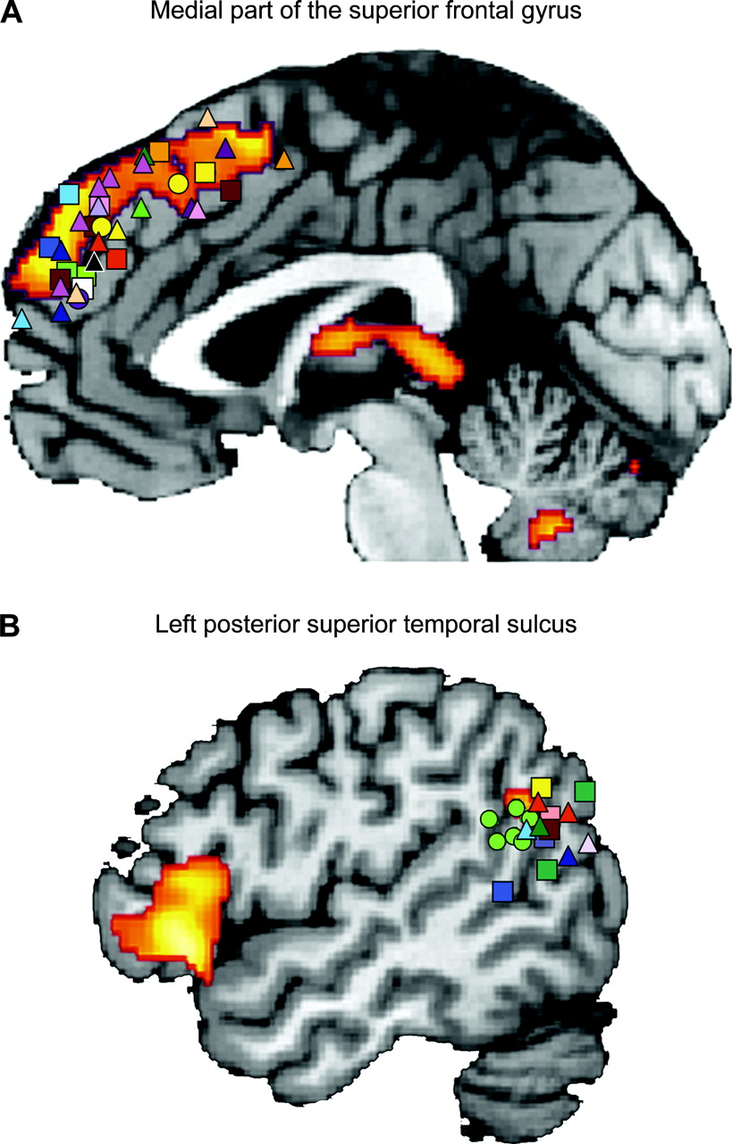
Figure 8 Meta-analysis in the medial frontal gyrus and pSTS: activations related to the processing of affective ...
Notes:
Figure 8 Meta-analysis in the medial frontal gyrus and pSTS: activations related to the processing of affective sentences are superimposed on the internal surface and sagittal slice of MNI single subject. Peaks issued from studies dealing with TOM (squares), self (triangles), emotion (pink and purple circles), and syntactic processing (green circles) are represented. (A) Projection on the medial surface and (B) on the sagittal slice (x = −50) of the MNI-referenced brain template of 1) activation detected with a conjunction analysis of the affective minus grammatical classification of sentences enounced by actors and produced by Kali (from red to yellow, P ≤ 0.0025 corrected threshold for multiple comparisons); peaks of activation coming from 2) studies on TOM processing such as judging intentionality (Brunet and others 2000; Castelli and others 2000; Iacoboni and others 2004; Walter and others 2004; Harris and others 2005), comprehension of TOM stories (Fletcher and others 1995; Gallagher and others 2000; Vogeley and others 2001; Ferstl and Von Cramon 2002; Saxe and Kanwisher 2003), and judging other knowledge (Goel and others 1995; Ruby 2004), 3) studies on self-reflection such as self preference's judgment (Craik and others 1999; Suguira and others 2004; Johnson and others 2005; Ochsner and others 2005; Schmitz and Johnson 2005), self knowledge's evaluation (Ruby and Decety 2003; den Ouden and others 2005), emphatic situations (Lawrence and others 2006; Mitchell, Banaji, and Macrae 2005; Mitchell and others 2005a, 2005b; Hynes and others 2006; Vollm and others 2006), self-evaluation of emotional content (Reiman and others 1997; Ochsner and others 2002;), 4) studies on emotional processing: comparing the processing of emotional with neutral words (Beauregard and others 1997) or faces (Blair and others 1999), or 5) studies on the integration of semantic and syntactic processing at the level of sentences (Embick and others 2000; Kuperberg and others 2000; Kircher and others 2001; Luke and others 2002) or texts (Goel and others 1998; Homae and others 2002). All peaks of activations were placed in the MNI stereotaxic space (for methods, see Jobard and others 2003).
Unless provided in the caption above, the following copyright applies to the content of this slide: © The Author 2006. Published by Oxford University Press. All rights reserved. For permissions, please e-mail: journals.permissions@oxfordjournals.org

