Slide 1
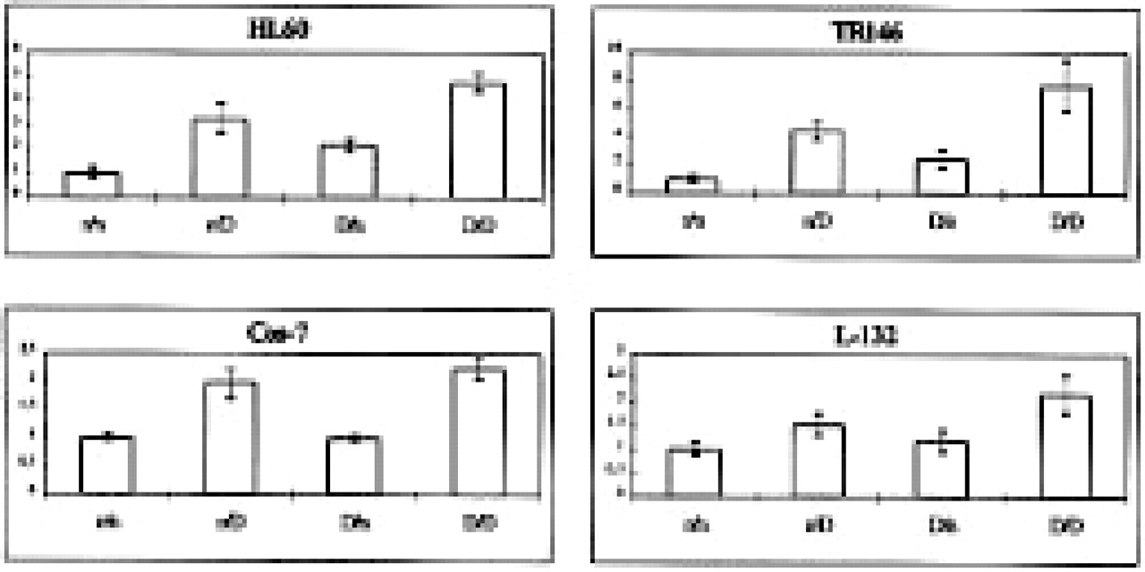
Figure 2 Comparison of the β-galactosidase activity of the pCMVβ plasmid in cell lines with and without DMSO. Groups ...
Notes:
Figure 2 Comparison of the β-galactosidase activity of the pCMVβ plasmid in cell lines with and without DMSO. Groups are as follows: n/n without DMSO during and after electroporation; n/D: no DMSO during, but 1.25% after, electroporation; D/n: 1.25% DMSO but not after electroporation; D/D: 1.25% DMSO during and after electroporation. The data are normalized with respect to the n/n group for better comparability. Data are shown as ± SD of four completely individual experiments.
Unless provided in the caption above, the following copyright applies to the content of this slide: © 1996 Oxford University Press

Slide 2
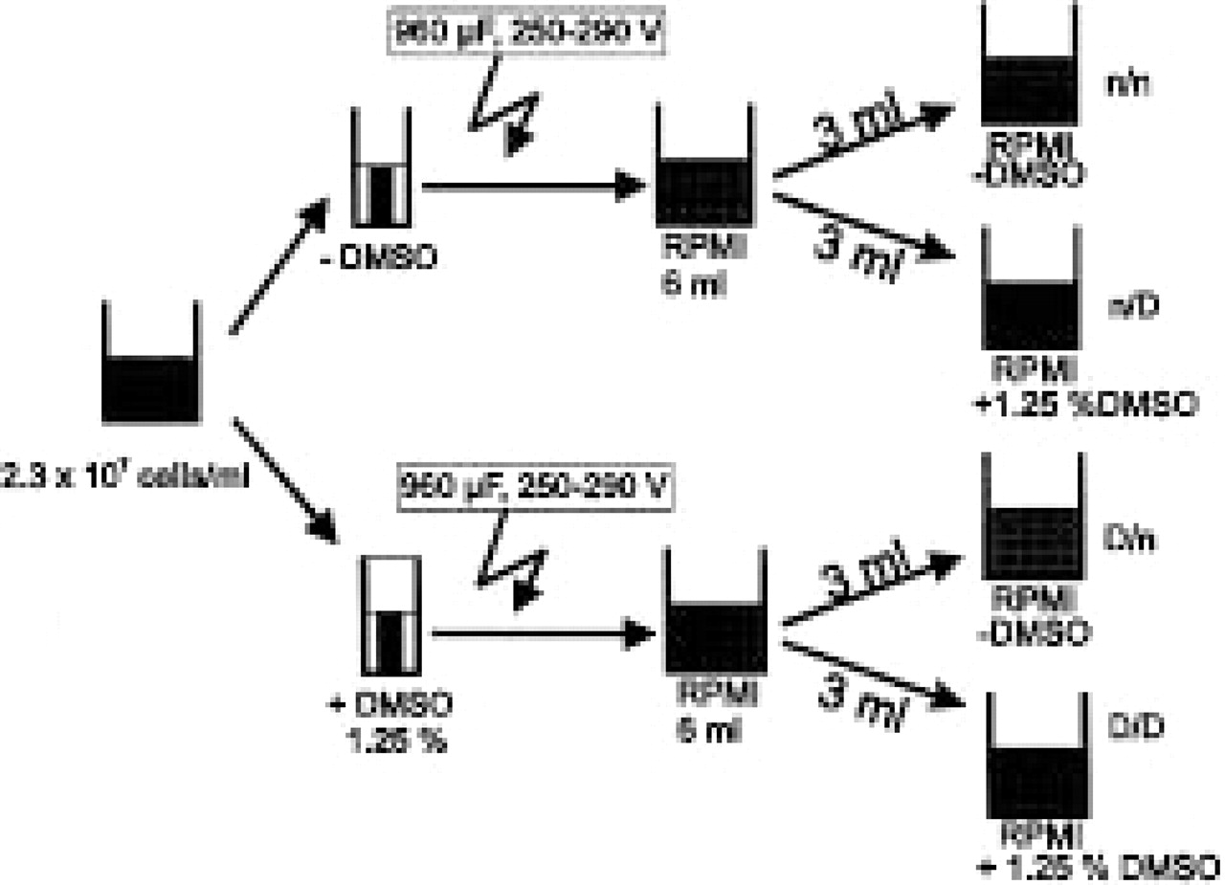
Figure 1 The diagram shows the experimental procedure to obtain the most comparable conditions. After the electrical ...
Notes:
Figure 1 The diagram shows the experimental procedure to obtain the most comparable conditions. After the electrical pulse, the cells were resuspended in 6 ml RPMI/10% FCS, split into 2 × 3 ml and mixed with 2 ml RPMI/10% FCS with 3.125% DMSO (n/D and D/D) to give a final DMSO concentration of 1.25%, or without DMSO (n/n and D/n).
Unless provided in the caption above, the following copyright applies to the content of this slide: © 1996 Oxford University Press

