Slide 1
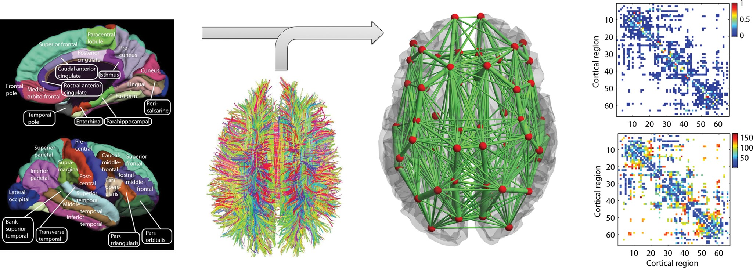
Figure 1. Anatomical connectome derived by Hagmann et al. (2007) using DSI averaged over 5 healthy subjects. (Left) The ...
Notes:
Figure 1. Anatomical connectome derived by Hagmann et al. (2007) using DSI averaged over 5 healthy subjects. (Left) The parcellation scheme dividing the cortex into 33 anatomically segregated regions in each hemisphere [adapted from Hagmann et al. (2008)]. (Middle-left) White matter tracts detected using DSI and tractography [adapted from Honey et al. (2007)]. (Middle-right) Schematic representation of the anatomical network, where regions are represented by red spheres placed at their center of gravity and the link's thickness is proportional to the number of fiber tracts detected in each connection. (Right-top) The coupling weights are proportional to the number of tracts detected. White color means that no fiber connecting the 2 corresponding regions was detected. Weights were normalized so that they are between 0 and 1. (Right-bottom) Distance between regions (in mm) given as the average length of the fibers connecting a pair of regions. The list of brain regions is reported in Table 2.
Unless provided in the caption above, the following copyright applies to the content of this slide: © The Author 2013. Published by Oxford University Press. All rights reserved. For Permissions, please e-mail: journals.permissions@oup.com

Slide 2
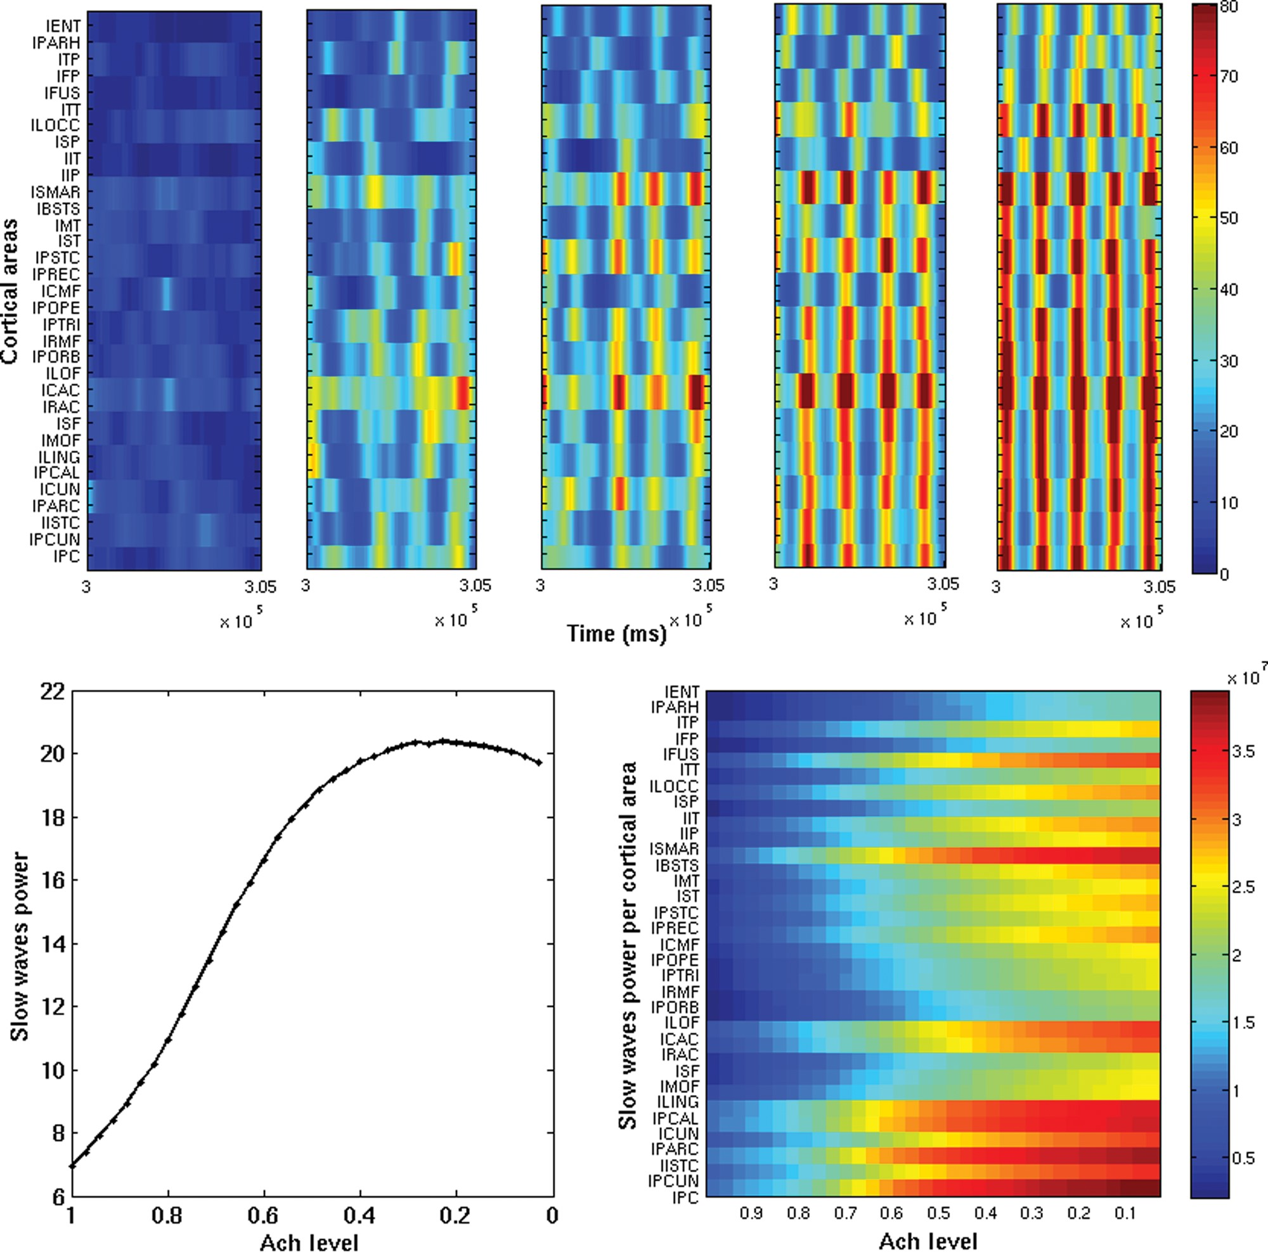
Figure 2. Top subpanels: Envelopes of the slow sleep oscillations of each cortical area (based on the firing rates) as ...
Notes:
Figure 2. Top subpanels: Envelopes of the slow sleep oscillations of each cortical area (based on the firing rates) as a function of time, for 5 snapshot of 10 s (after the first 10 min). Only half hemisphere is shown. The 5 snapshots correspond to different Ach levels, namely: ζ = 1, 0.71, 0.57, 0.42, 0, and 1, from left to right, respectively. Increasing the level of Ach (i.e. getting awake) reduces the presence of slow sleep waves, so that only local (in space and time) slow sleep waves emerge according to the experimental observations of Vyazovskiy et al. (2011). Bottom panel (left): Total power (summed over all cortical areas) of slow sleep waves as a function of the Ach level. Bottom panel (right): Power of slow sleep waves for each cortical area as a function of the Ach level. Awakening decreases the power of the slow sleep waves.
Unless provided in the caption above, the following copyright applies to the content of this slide: © The Author 2013. Published by Oxford University Press. All rights reserved. For Permissions, please e-mail: journals.permissions@oup.com

Slide 3
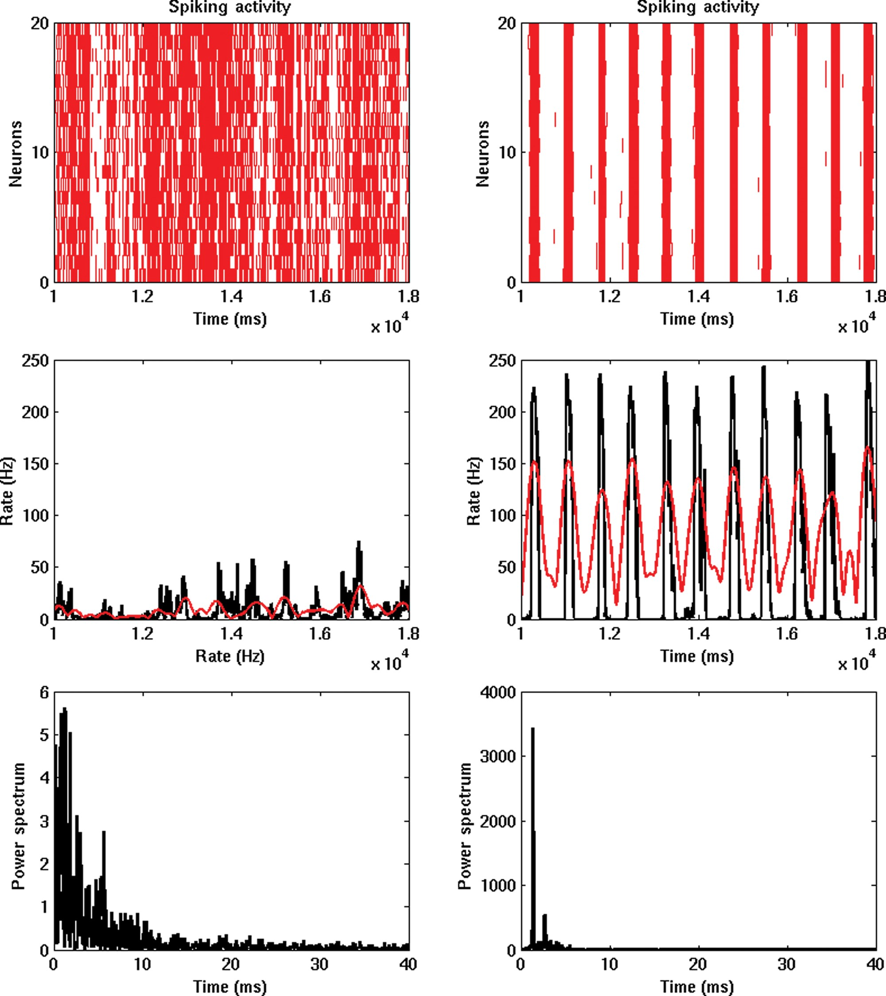
Figure 3. Firing rate activity of one particular area (lPC). Left (right) subpanels correspond to high (low) Ach levels ...
Notes:
Figure 3. Firing rate activity of one particular area (lPC). Left (right) subpanels correspond to high (low) Ach levels (i.e. to awake, deep sleep phases, respectively). Top panels show the spiking activity of 20 randomly chosen neurons of the lPC excitatory population. The middle panels show the corresponding firing rate activity (in black) calculated using all neurons on the excitatory population of the lPC (and no filtering at all). These panels also show the results of the filtering and Hilbert transform (in red), which confirms that the procedure properly captures the slow waves events (amplitude and phases). The bottom panels show the corresponding power spectrum.
Unless provided in the caption above, the following copyright applies to the content of this slide: © The Author 2013. Published by Oxford University Press. All rights reserved. For Permissions, please e-mail: journals.permissions@oup.com

Slide 4
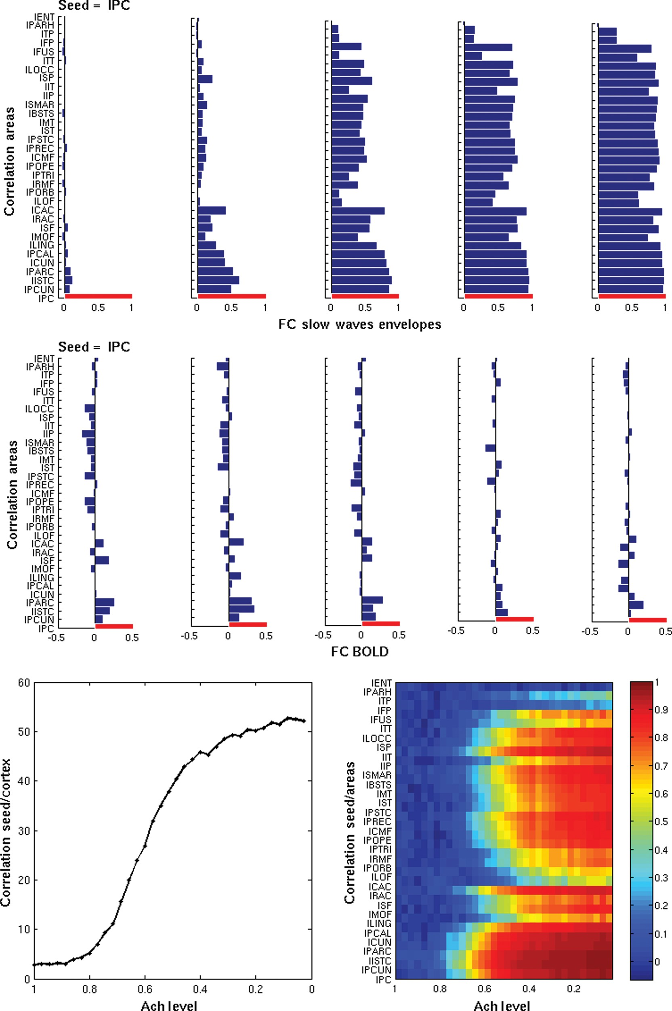
Figure 4. Temporal correlation of the slow sleep envelopes (based on the firing rates) between different nodes and of ...
Notes:
Figure 4. Temporal correlation of the slow sleep envelopes (based on the firing rates) between different nodes and of the BOLD signal. First row top panels: Correlation of the envelopes of the slow sleep waves between a specific seed (left posterior cingulate, lPC) and all cortical areas, for 5 snapshots corresponding to different levels of Ach (ζ = 0, 0.42, 0.57, 0.71, and 1, from left to right, respectively). Second row panels: Correlation of the underlying fMRI BOLD signal, for the same seed and for the same 5 snapshots. Only half hemisphere is shown. Bottom panels (left): Total correlation (summed over all areas) between the envelopes of the slow sleep waves for the same seed as a function of the Ach level. Bottom panel (right): Correlation between the envelopes of the slow sleep waves for each cortical area and for the same seed as a function of the Ach level.
Unless provided in the caption above, the following copyright applies to the content of this slide: © The Author 2013. Published by Oxford University Press. All rights reserved. For Permissions, please e-mail: journals.permissions@oup.com

Slide 5
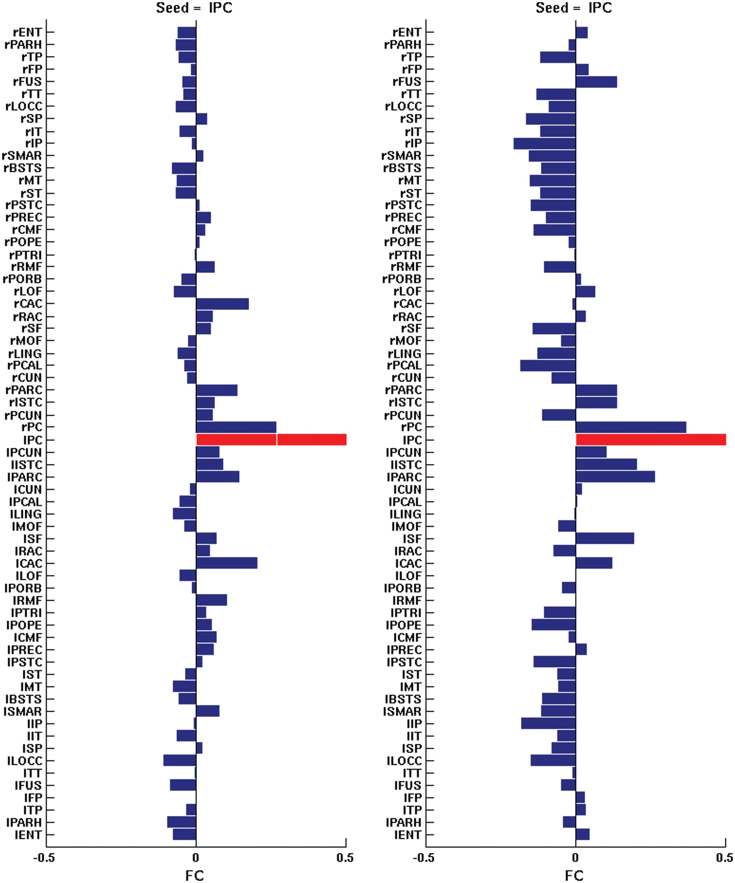
Figure 5. Detailed comparison between the empirical and the simulated resting-state BOLD FC for the wake state (Ach ...
Notes:
Figure 5. Detailed comparison between the empirical and the simulated resting-state BOLD FC for the wake state (Ach level ζ = 1) and for an specific seed (left posterior cingulate, lPC). Left: Empirical resting-state BOLD FC. Right: Simulated resting-state BOLD FC. Both hemispheres are shown.
Unless provided in the caption above, the following copyright applies to the content of this slide: © The Author 2013. Published by Oxford University Press. All rights reserved. For Permissions, please e-mail: journals.permissions@oup.com

Slide 6
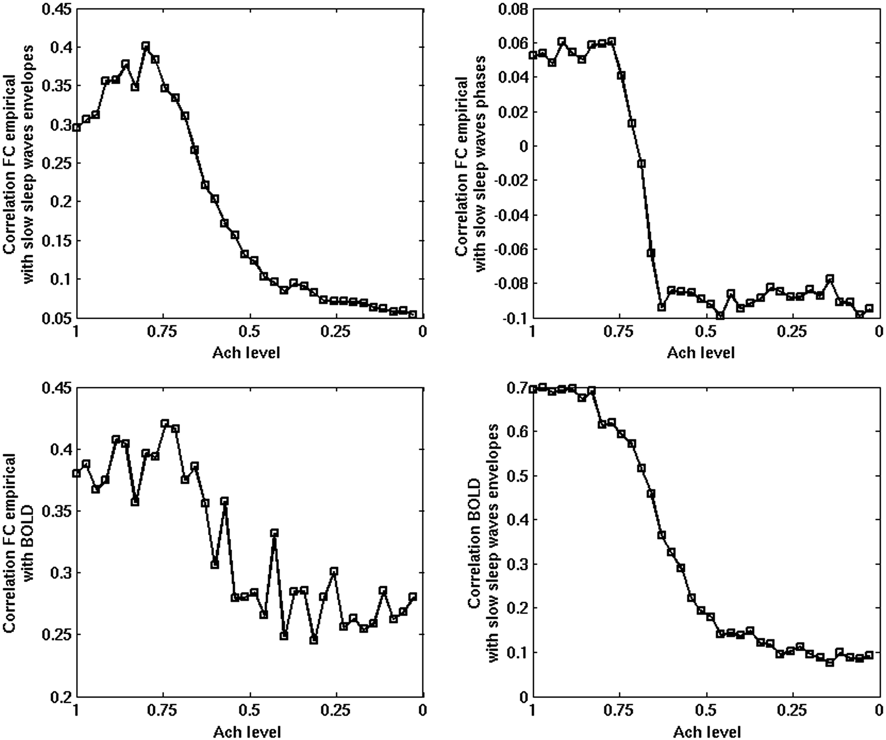
Figure 6. Top left panel: Correlation between the experimentally obtained resting-state BOLD FC (wakefulness only) and ...
Notes:
Figure 6. Top left panel: Correlation between the experimentally obtained resting-state BOLD FC (wakefulness only) and the envelopes of the slow sleep waves as a function of sleep stage. Top right panel: Correlation between the phases of the slow sleep waves and the same empirical resting-state BOLD FC. Bottom left panel: Correlation between the empirical and the simulated BOLD FC. Bottom right panel: Correlation between the simulated BOLD signal and the envelopes of the slow sleep waves. During awakening (increasing the Ach level), the correlation between slow sleep waves gets more shaped according to the resting-state FC.
Unless provided in the caption above, the following copyright applies to the content of this slide: © The Author 2013. Published by Oxford University Press. All rights reserved. For Permissions, please e-mail: journals.permissions@oup.com

Slide 7
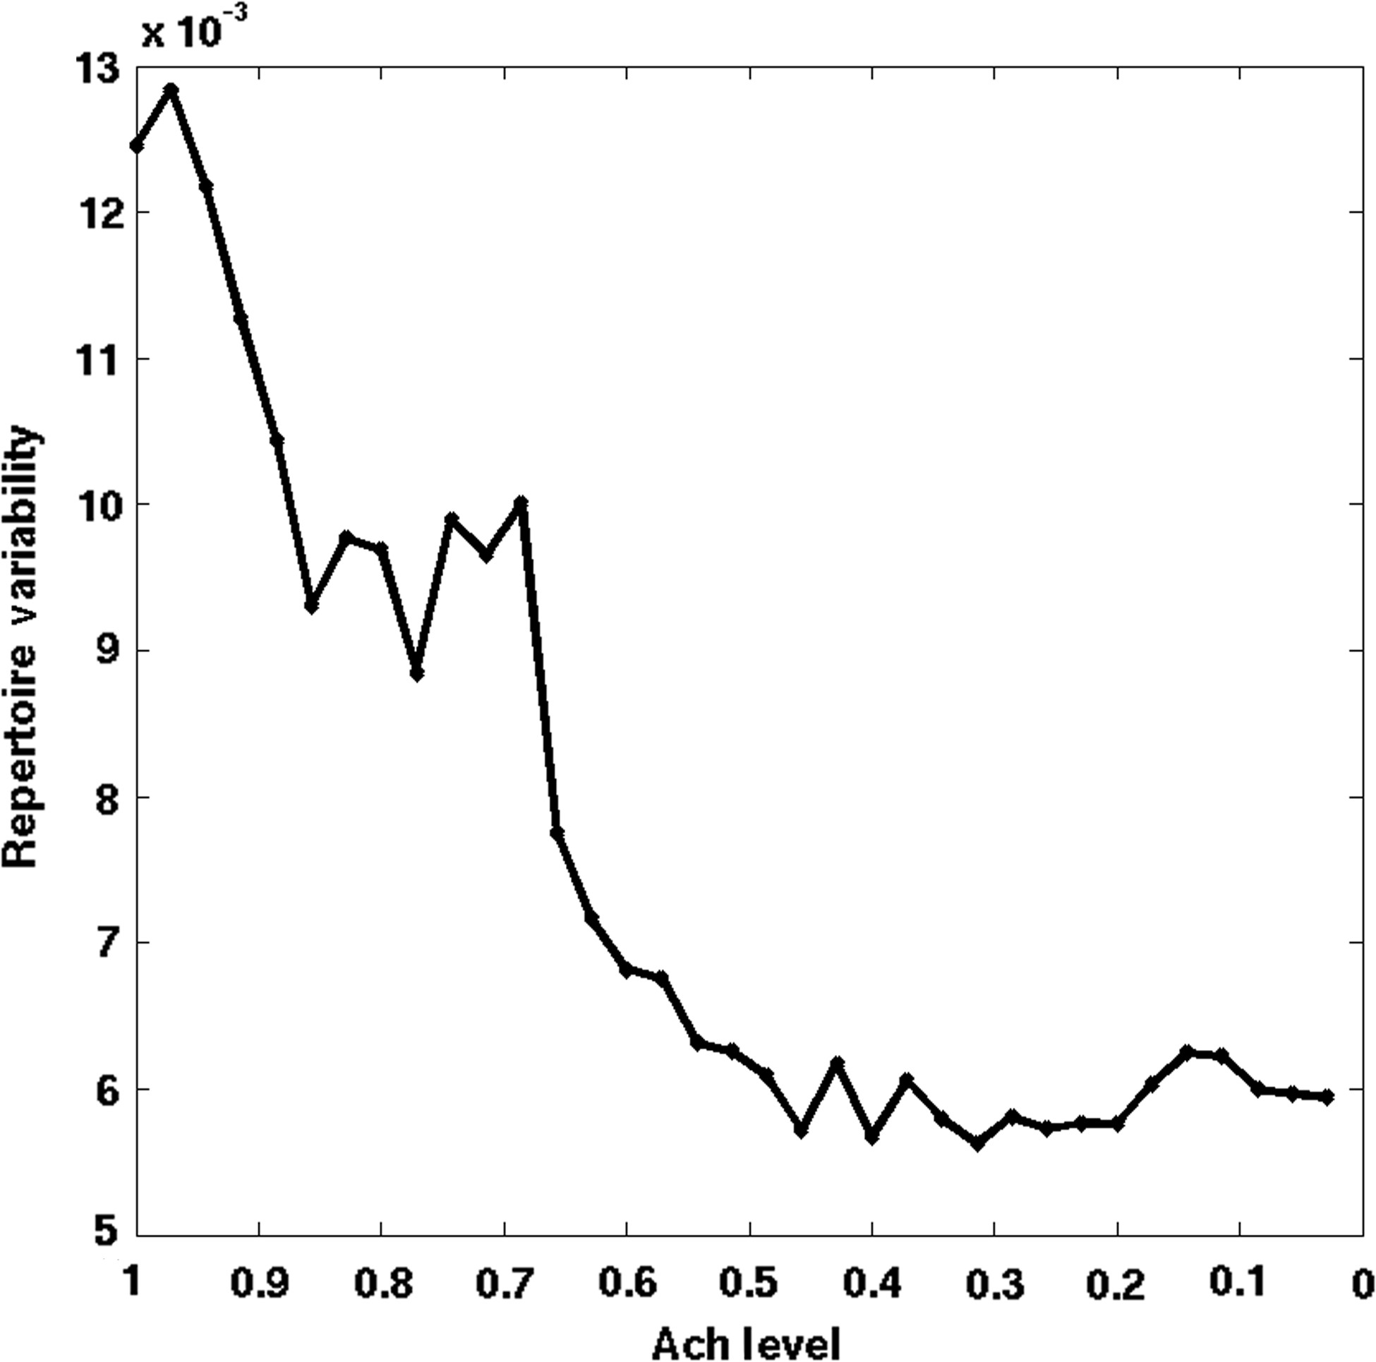
Figure 7. Variance of connectivity as a function of sleep stage. The variance of connectivity is calculated for all ...
Notes:
Figure 7. Variance of connectivity as a function of sleep stage. The variance of connectivity is calculated for all pair-wise correlation coefficients of between the BOLD signals of the parcellated brain regions. The variance of the strength of regional connectivity is presumed to reflect the repertoire of states accessed by the brain over time.
Unless provided in the caption above, the following copyright applies to the content of this slide: © The Author 2013. Published by Oxford University Press. All rights reserved. For Permissions, please e-mail: journals.permissions@oup.com

