Slide 1
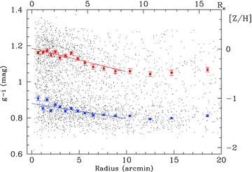
Figure 1 Globular cluster colour–radial distribution from Subaru photometry. The small circles show individual GCs ...
Notes:
Figure 1 Globular cluster colour–radial distribution from Subaru photometry. The small circles show individual GCs from Subaru photometry with i < 24 (and errors ≤0.03 mag). Mean colours and error on the mean are represented by filled squares. The solid lines show the best-fitting linear gradient within 10 arcmin. The top and right axes show transformations into effective radius and metallicity, respectively. Both subpopulations show a strong gradient in mean colour within the central ∼10 arcmin (8.5 Re, 69 kpc). The galaxy starlight at 1 Re has a colour g−i∼ 1.2, similar to the mean colour of the red GCs.
Unless provided in the caption above, the following copyright applies to the content of this slide: © 2011 The Authors Monthly Notices of the Royal Astronomical Society © 2011 RAS

Slide 2
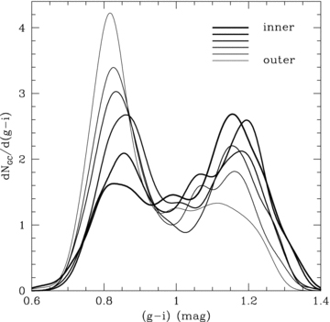
Figure 2 Globular cluster colour–radius probability density function (PDF). The curves show the PDF in six radial bins ...
Notes:
Figure 2 Globular cluster colour–radius probability density function (PDF). The curves show the PDF in six radial bins from inner (thick line) to outer (thin line). Other than the innermost radial bin the blue GCs show a steady trend of getting bluer with radius. For the red GCs the radial trend is less clear due to possible colour substructure in the inner regions.
Unless provided in the caption above, the following copyright applies to the content of this slide: © 2011 The Authors Monthly Notices of the Royal Astronomical Society © 2011 RAS

Slide 3
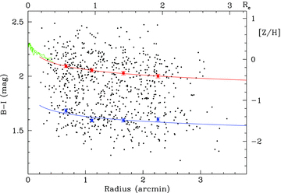
Figure 3 Globular cluster colour–radial distribution from HST photometry. The small circles show individual GCs from ...
Notes:
Figure 3 Globular cluster colour–radial distribution from HST photometry. The small circles show individual GCs from HST photometry. Mean colours and error on the mean are represented by filled squares. The top and right axes show transformations into effective radius and metallicity, respectively. The solid lines show the best-fitting gradient in colour–log radius space. The galaxy starlight at 1 Re has a colour B−I∼2.2, similar to the mean colour of the red GCs. The green lines within 0.5Re show the galaxy field star metallicity from Spolaor et al. (2008).
Unless provided in the caption above, the following copyright applies to the content of this slide: © 2011 The Authors Monthly Notices of the Royal Astronomical Society © 2011 RAS

Slide 4
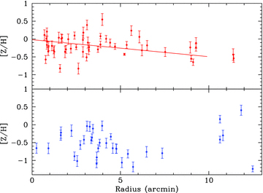
Figure 4 Globular cluster metallicity–radial distribution derived from calcium triplet measurements. The top panel ...
Notes:
Figure 4 Globular cluster metallicity–radial distribution derived from calcium triplet measurements. The top panel shows the red GC subpopulation, and the bottom panel shows the blue GC subpopulation. A clear radial gradient is seen in the red GC subpopulation. The solid line shown in the top panel is not a fit to the data but rather the metallicity gradient from Fig. 1 superposed.
Unless provided in the caption above, the following copyright applies to the content of this slide: © 2011 The Authors Monthly Notices of the Royal Astronomical Society © 2011 RAS

