Slide 1
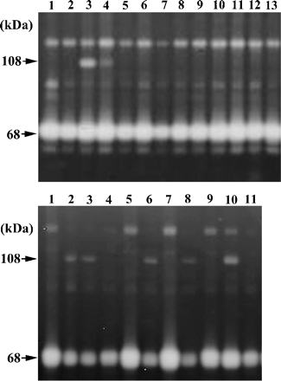
Fig. 1. Expression cloning. Aliquots of plasmid DNA from the human placental cDNA library were co-transfected ...
Notes:
Fig. 1. Expression cloning. Aliquots of plasmid DNA from the human placental cDNA library were co-transfected into HEK293T cells with MMP-2 and MT1-MMP. The cells were cultured in 96-well microplates as described under “materials and methods”, and a lysate from each well was subjected to gelatin zymography at 48 h after transfection (upper panel). Note the 108 kDa gelatinolytic band in lane 3. Single clones of plasmid DNA indicated by the first screening were analyzed in the same way (lower panel). The 108 kDa gelatinolytic band can be observed in lanes 2, 3, 6, 8, and 10.
Unless provided in the caption above, the following copyright applies to the content of this slide:

Slide 2
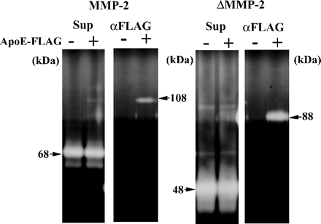
Fig. 2. Complex formation between pro-MMP-2 and apoE protein. An expression plasmids for MMP-2 or ΔMMP-2 was ...
Notes:
Fig. 2. Complex formation between pro-MMP-2 and apoE protein. An expression plasmids for MMP-2 or ΔMMP-2 was transfected into HEK293T cells either alone (lanes –) or with the apoE-FLAG plasmid (lanes +). Culture supernatants were subjected to gelatin zymography (lanes Sup). ApoE-FLAG protein was collected from the culture supernatant of transfected cells using anti-FLAG antibody beads, and co-precipitated MMP was analyzed by gelatin zymography (lanes αFLAG).
Unless provided in the caption above, the following copyright applies to the content of this slide:

Slide 3
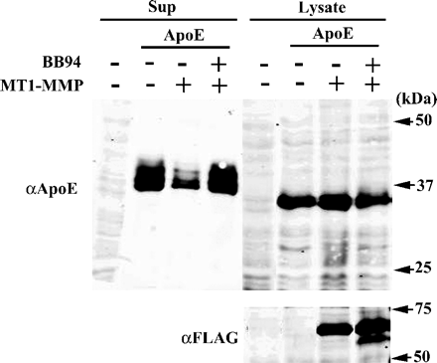
Fig. 3. In vivo degradation of apoE by MT1-MMP. The expression plasmid for apoE (ApoE) or empty pSG5 plasmid ...
Notes:
Fig. 3. In vivo degradation of apoE by MT1-MMP. The expression plasmid for apoE (ApoE) or empty pSG5 plasmid (–) was co-transfected (0.4 µg) with the plasmid for MT1-MMP tagged with the FLAG epitope (1.6 µg) into HEK293T cells cultured in 35-mm dishes. At 36 h after transfection, the culture medium was replaced with serum-free medium with or without 0.1 µM BB94, and the cells were incubated for another 24 h. Culture supernatants (Sup) and cell lysates (Lysate) were then analyzed by Western blotting using anti-apoE antibodies as described under “materials and methods” (upper panels). Expression of MT1-MMP was examined by Western blotting of cell lysates using anti–FLAG M2 antibodies (lower panel).
Unless provided in the caption above, the following copyright applies to the content of this slide:

Slide 4
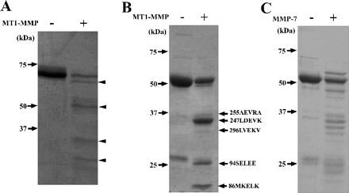
Fig. 4. Cleavage of apoE by MT1-MMP. (A) Native apoE protein (5 µg) was incubated with or without the ...
Notes:
Fig. 4. Cleavage of apoE by MT1-MMP. (A) Native apoE protein (5 µg) was incubated with or without the recombinant MT1-MMP catalytic domain (0.5 µg) in 30 µl of TNC buffer containing 0.03% Brij at 37°C for 3 h, separated by 12% SDS-PAGE, and then stained with Coomassie Brilliant Blue. (B) ApoE-GST fusion protein (5 µg) was incubated with recombinant MT1-MMP catalytic domain (0.5 µg), and then analyzed as described above. The N-terminal amino acid sequence of each fragment was determined as described under “materials and methods.” (C) ApoE-GST fusion protein was incubated with recombinant MMP-7, and then analyzed as described above.
Unless provided in the caption above, the following copyright applies to the content of this slide:

Slide 5
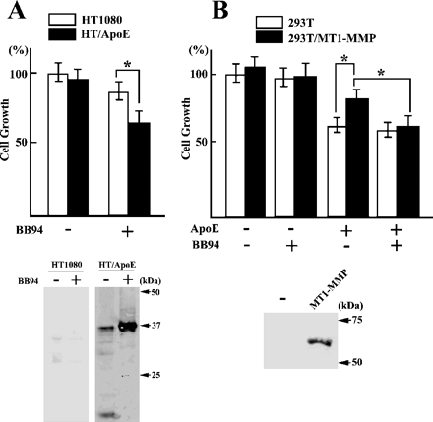
Fig. 5. Suppression of cell proliferation by apoE. (A) Proliferation of HT1080 cells transfected with the ...
Notes:
Fig. 5. Suppression of cell proliferation by apoE. (A) Proliferation of HT1080 cells transfected with the empty pEAK8 plasmid (HT1080) or apoE plasmid (HT/ApoE) was monitored in the presence or absence of BB94 as described under “materials and methods” (upper panel). Secretion of apoE protein into the culture medium was detected by Western blotting using anti-apoE antibodies (lower panel). (B) HEK293T cells stably transfected with the empty plasmid (293T) or MT1-MMP plasmid (293T/MT1-MMP) were incubated in the presence or absence of 10 µg/ml apoE-GST protein or 10–7 M BB94, and the cell proliferation was determined as described above (upper panel). Expression of MT1-MMP in control HEK293T cells (lane –) or 293T/MT1-MMP (lane MT1-MMP) was detected by Western blotting using anti–MT1-MMP antibodies (lower panel). Bars indicate mean values. *p < 0.01.
Unless provided in the caption above, the following copyright applies to the content of this slide:

