Slide 1
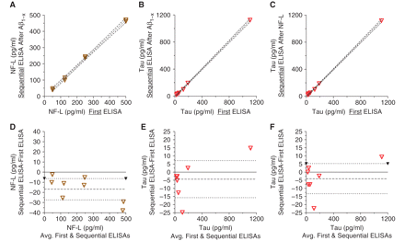
Figure 1 Verification of the accuracy of sequential ELISA methods using mock microdialysis samples. Symbols indicate ...
Notes:
Figure 1 Verification of the accuracy of sequential ELISA methods using mock microdialysis samples. Symbols indicate measured sample points. Dashed lines indicate linear best fits and 95% CIs. (A) NF-L sequential ELISA after Aβ1-x ELISA versus NF-L as the first ELISA: r2 = 0.99, slope 95% CI 0.90–0.99, y-intercept 95% CI −17.6 to 8.1. (B) Tau sequential ELISA after Aβ1-x ELISA versus tau as the first ELISA. r2 = 0.99, slope 95% CI 0.99–1.05, y-intercept 95% CI −20.5 to 2.3. (C) Tau sequential ELISA after NF-L ELISA versus tau as the first ELISA. r2 = 0.99, slope 95% CI 0.99–1.03, y-intercept 95% CI −17.7 to 3.4. (D–F) Bland-Altman plots for the data presented in panels (A–C).
Unless provided in the caption above, the following copyright applies to the content of this slide: © The Author (2011). Published by Oxford University Press on behalf of the Guarantors of Brain. All rights reserved. For Permissions, please email: journals.permissions@oup.com

Slide 2
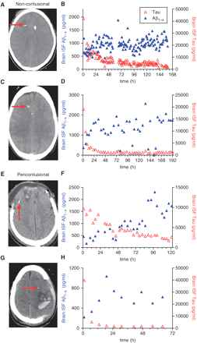
Figure 2 Examples of microdialysis-based measurements of tau and Aβ dynamics in the injured human brain. (A) CT scan ...
Notes:
Figure 2 Examples of microdialysis-based measurements of tau and Aβ dynamics in the injured human brain. (A) CT scan of the brain from a patient in the non-contusional group. Microdialysis catheters tip (red arrow) apparent in normal-appearing right frontal subcortical white matter.(B) Brain interstitial fluid Aβ (left y-axis) and tau (right y-axis) levels as a function of time (h) since placement of the microdialysis catheter. (C and D) CT scan plus brain interstitial fluid Aβ and tau levels from another non-contusional patient. (E–H) CT scans plus brain interstitial fluid Aβ and tau levels from two patients with traumatic frontal contusions. Microdialysis catheter tips (red arrows) apparent near the frontal lobe contusions.
Unless provided in the caption above, the following copyright applies to the content of this slide: © The Author (2011). Published by Oxford University Press on behalf of the Guarantors of Brain. All rights reserved. For Permissions, please email: journals.permissions@oup.com

Slide 3
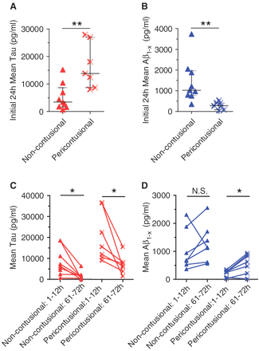
Figure 3 Tau and Aβ measurements in non-contusional versus pericontusional groups. (A) Mean tau levels during the ...
Notes:
Figure 3 Tau and Aβ measurements in non-contusional versus pericontusional groups. (A) Mean tau levels during the initial 24 h of microdialysis sampling were higher in patients with catheters placed in pericontusional regions: Error bars represent median and 25–75th percentiles (**P = 0.005, Mann–Whitney U-test). (B) Mean Aβ levels during the initial 24 h of microdialysis sampling were lower in pericontusional group (**P = 0.0012). (C) Tau levels decreased with time in all patients (*P = 0.0078 for non-contusional group, P = 0.016 for pericontusional group, Wilcoxon paired rank tests). (D) Aβ levels rose over time in all but one non-contusional patient (P = 0.29) and all but one pericontusional patient (*P = 0.031). NS = not significant.
Unless provided in the caption above, the following copyright applies to the content of this slide: © The Author (2011). Published by Oxford University Press on behalf of the Guarantors of Brain. All rights reserved. For Permissions, please email: journals.permissions@oup.com

Slide 4
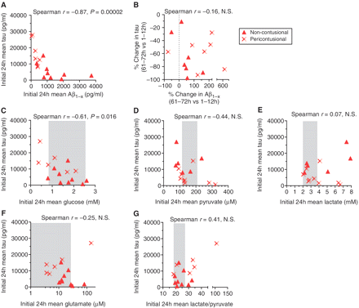
Figure 4 Correlations between tau and other microdialysis analytes. (A) Inverse correlation between initial Aβ levels ...
Notes:
Figure 4 Correlations between tau and other microdialysis analytes. (A) Inverse correlation between initial Aβ levels and initial tau levels. (B) No correlation between the per cent change in Aβ levels and per cent change in tau levels. (C) Inverse correlation between initial brain interstitial fluid glucose levels and initial tau levels. (D) No significant correlation between initial brain interstitial fluid pyruvate levels and initial tau levels. (E) No correlation between initial brain interstitial fluid lactate levels and initial tau levels. (F) No correlation between initial brain interstitial fluid glutamate levels and initial tau levels. (G) No significant correlation between initial brain interstitial fluid lactate/pyruvate levels and initial tau levels. Shaded regions represent mean ± 1 standard deviation of estimated normal values (Reinstrup et al., 2000; Hillered et al., 2005). NS = not significant.
Unless provided in the caption above, the following copyright applies to the content of this slide: © The Author (2011). Published by Oxford University Press on behalf of the Guarantors of Brain. All rights reserved. For Permissions, please email: journals.permissions@oup.com

Slide 5
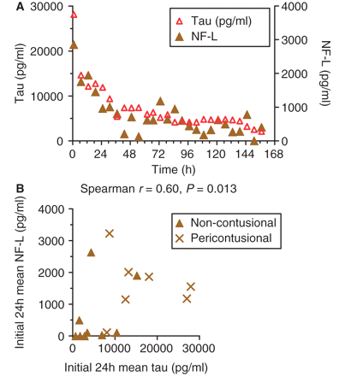
Figure 5 Close correspondence between microdialysis measurements of tau and NF-L. (A) Example of microdialysis-based ...
Notes:
Figure 5 Close correspondence between microdialysis measurements of tau and NF-L. (A) Example of microdialysis-based measurements of brain interstitial fluid tau (left y-axis) and NF-L (right y-axis) dynamics in a non-contusional patient. (B) Positive correlation between initial tau and NF-L levels in 16 patients.
Unless provided in the caption above, the following copyright applies to the content of this slide: © The Author (2011). Published by Oxford University Press on behalf of the Guarantors of Brain. All rights reserved. For Permissions, please email: journals.permissions@oup.com

Slide 6
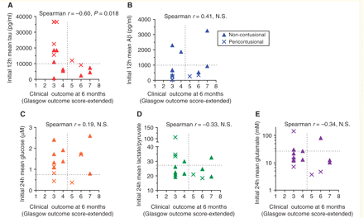
Figure 6 Tau levels, but not levels of other microdialysis analytes, predicted overall clinical outcomes 6 months ...
Notes:
Figure 6 Tau levels, but not levels of other microdialysis analytes, predicted overall clinical outcomes 6 months after injury. (A) Significant correlation between tau levels in the first 12 h after catheter placement and overall clinical outcomes. Better outcomes indicated by higher Glasgow Outcome Score-Extended scores. (B) Non-significant correlation between initial Aβ levels and clinical outcomes. (C) No correlation between initial brain interstitial fluid glucose levels and clinical outcomes. (D) Non-significant correlation between initial brain interstitial fluid lactate/pyruvate levels and clinical outcomes. (E) Non-significant correlation between initial brain interstitial fluid glutamate levels and clinical outcomes. NS = not significant.
Unless provided in the caption above, the following copyright applies to the content of this slide: © The Author (2011). Published by Oxford University Press on behalf of the Guarantors of Brain. All rights reserved. For Permissions, please email: journals.permissions@oup.com

