Slide 1
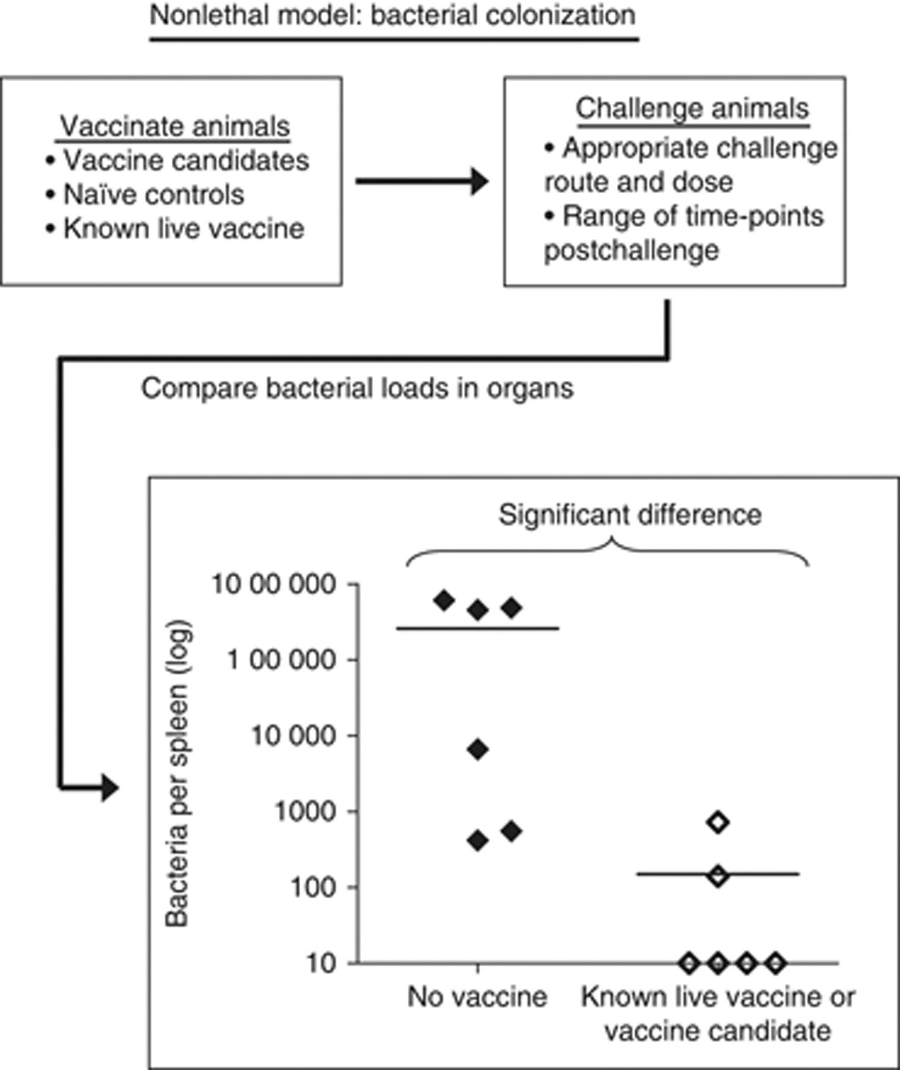
Figure 1 Schematic representation of the method for evaluating novel vaccine candidates for brucellosis in mice.
Notes:
Figure 1 Schematic representation of the method for evaluating novel vaccine candidates for brucellosis in mice.
Unless provided in the caption above, the following copyright applies to the content of this slide: © 2010 Federation of European Microbiological Societies.

