Slide 1
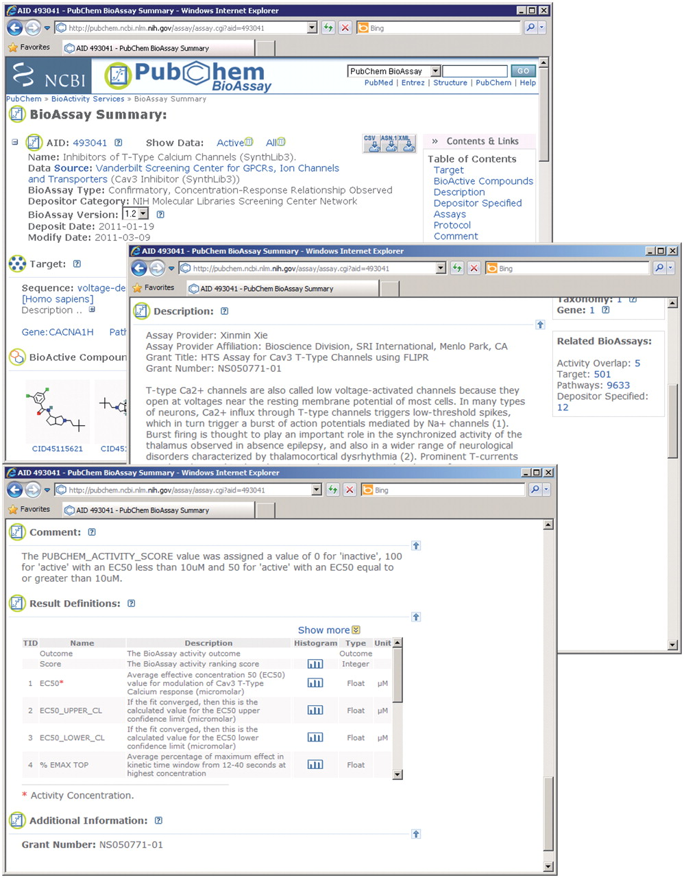
Figure 1. The summary view of a PubChem bioassay record. Assay results can be retrieved through the Show Data | Active ...
Notes:
Figure 1. The summary view of a PubChem bioassay record. Assay results can be retrieved through the Show Data | Active and Show Data | All links.
Unless provided in the caption above, the following copyright applies to the content of this slide: Published by Oxford University Press 2011.This is an Open Access article distributed under the terms of the Creative Commons Attribution Non-Commercial License (http://creativecommons.org/licenses/by-nc/3.0), which permits unrestricted non-commercial use, distribution, and reproduction in any medium, provided the original work is properly cited.

Slide 2
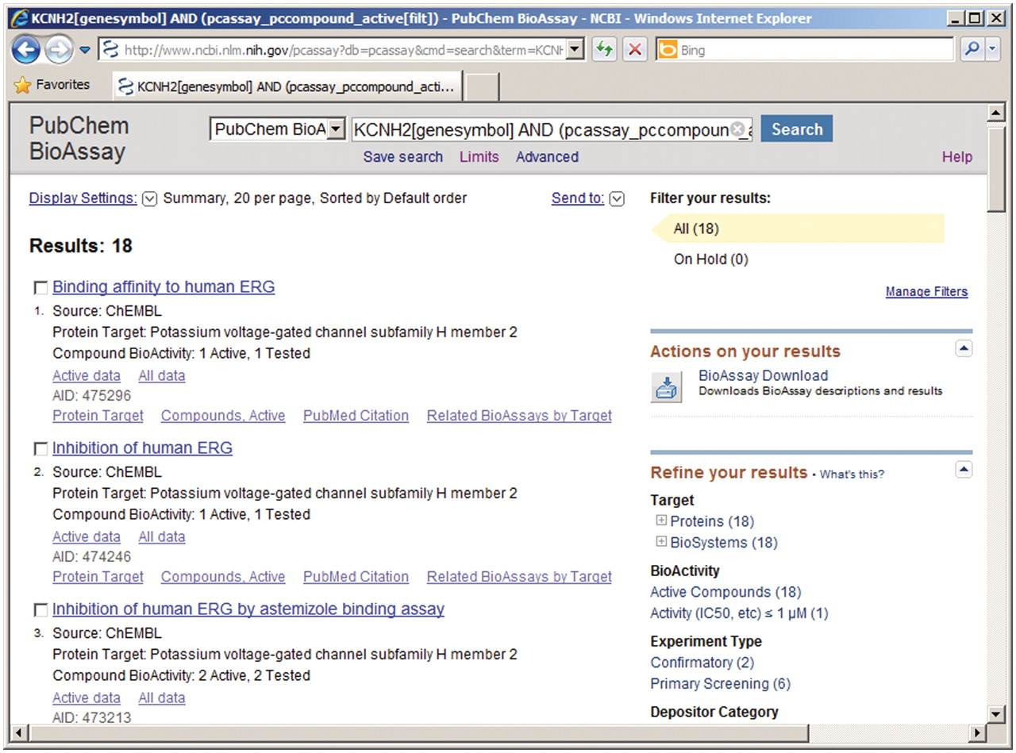
Figure 2. Entrez DocSum report for bioassay search results.
Notes:
Figure 2. Entrez DocSum report for bioassay search results.
Unless provided in the caption above, the following copyright applies to the content of this slide: Published by Oxford University Press 2011.This is an Open Access article distributed under the terms of the Creative Commons Attribution Non-Commercial License (http://creativecommons.org/licenses/by-nc/3.0), which permits unrestricted non-commercial use, distribution, and reproduction in any medium, provided the original work is properly cited.

Slide 3
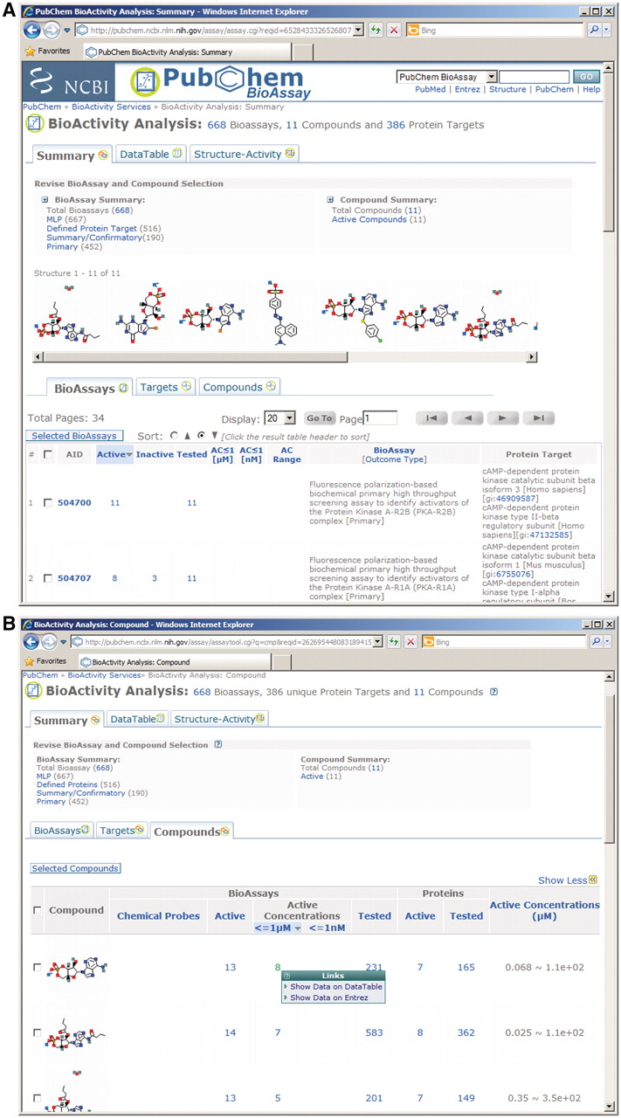
Figure 3. PubChem BioActivity Summary service. (A) assay-centric view for multiple compounds; (B) compound-centric ...
Notes:
Figure 3. PubChem BioActivity Summary service. (A) assay-centric view for multiple compounds; (B) compound-centric view; (C) target-centric view; (D) assay centric view for a single compound.
Unless provided in the caption above, the following copyright applies to the content of this slide: Published by Oxford University Press 2011.This is an Open Access article distributed under the terms of the Creative Commons Attribution Non-Commercial License (http://creativecommons.org/licenses/by-nc/3.0), which permits unrestricted non-commercial use, distribution, and reproduction in any medium, provided the original work is properly cited.

Slide 4
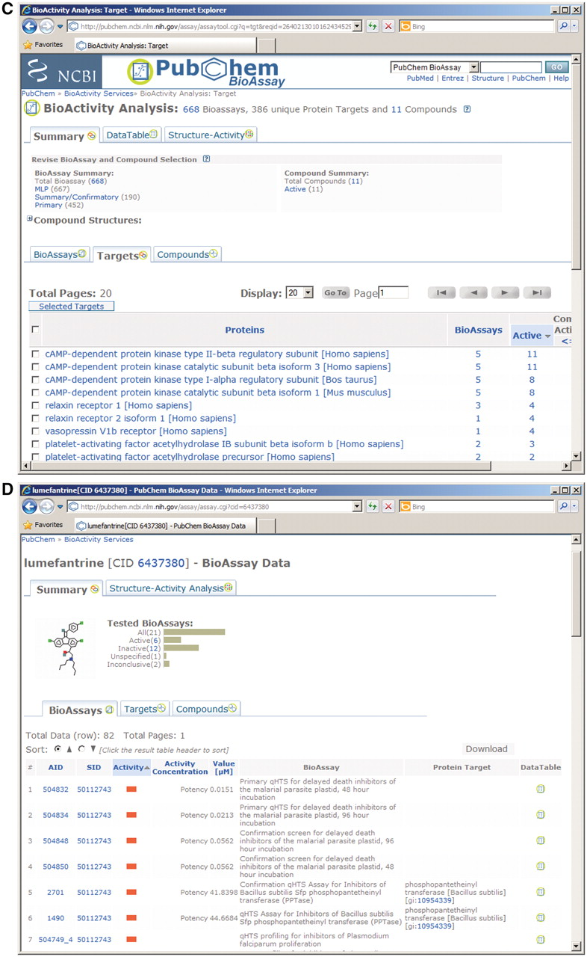
Figure 3. PubChem BioActivity Summary service. (A) assay-centric view for multiple compounds; (B) compound-centric ...
Notes:
Figure 3. PubChem BioActivity Summary service. (A) assay-centric view for multiple compounds; (B) compound-centric view; (C) target-centric view; (D) assay centric view for a single compound.
Unless provided in the caption above, the following copyright applies to the content of this slide: Published by Oxford University Press 2011.This is an Open Access article distributed under the terms of the Creative Commons Attribution Non-Commercial License (http://creativecommons.org/licenses/by-nc/3.0), which permits unrestricted non-commercial use, distribution, and reproduction in any medium, provided the original work is properly cited.

Slide 5
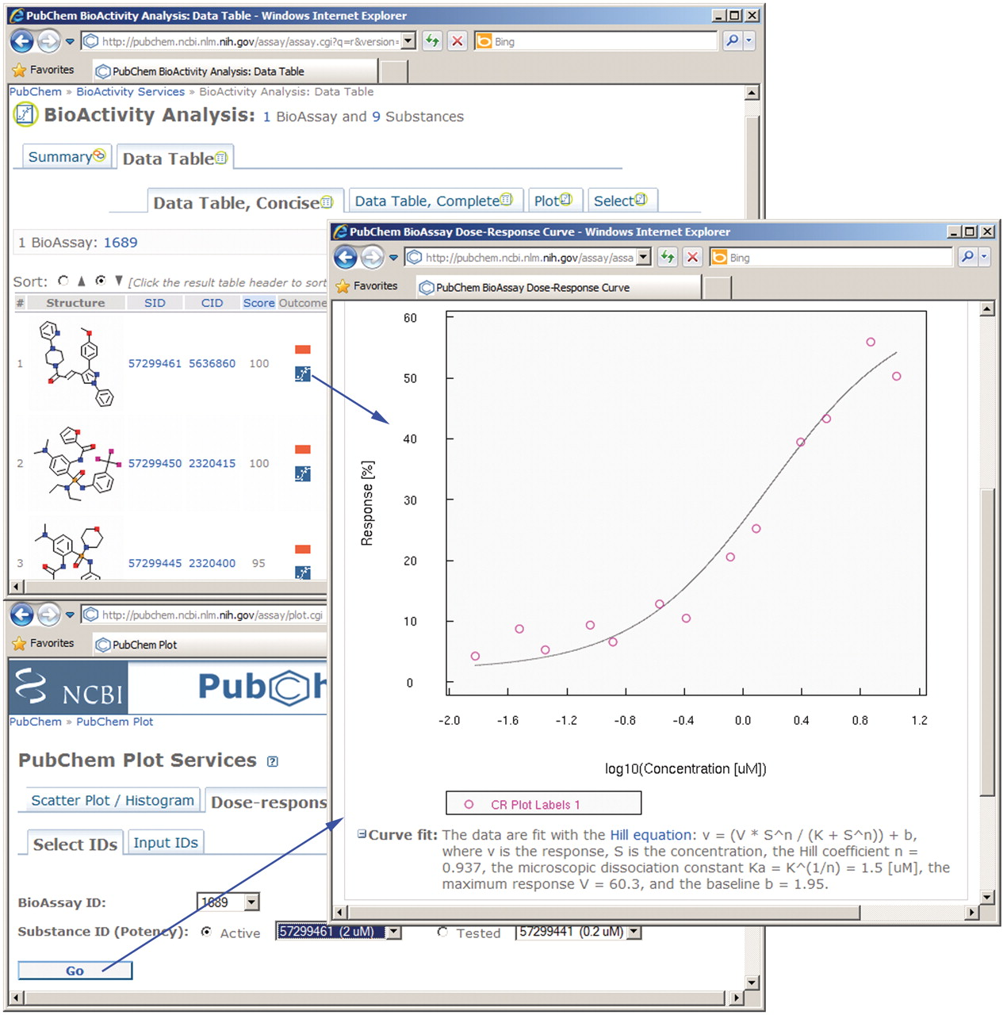
Figure 4. A new service for drawing dose–response curves.
Notes:
Figure 4. A new service for drawing dose–response curves.
Unless provided in the caption above, the following copyright applies to the content of this slide: Published by Oxford University Press 2011.This is an Open Access article distributed under the terms of the Creative Commons Attribution Non-Commercial License (http://creativecommons.org/licenses/by-nc/3.0), which permits unrestricted non-commercial use, distribution, and reproduction in any medium, provided the original work is properly cited.

Slide 6
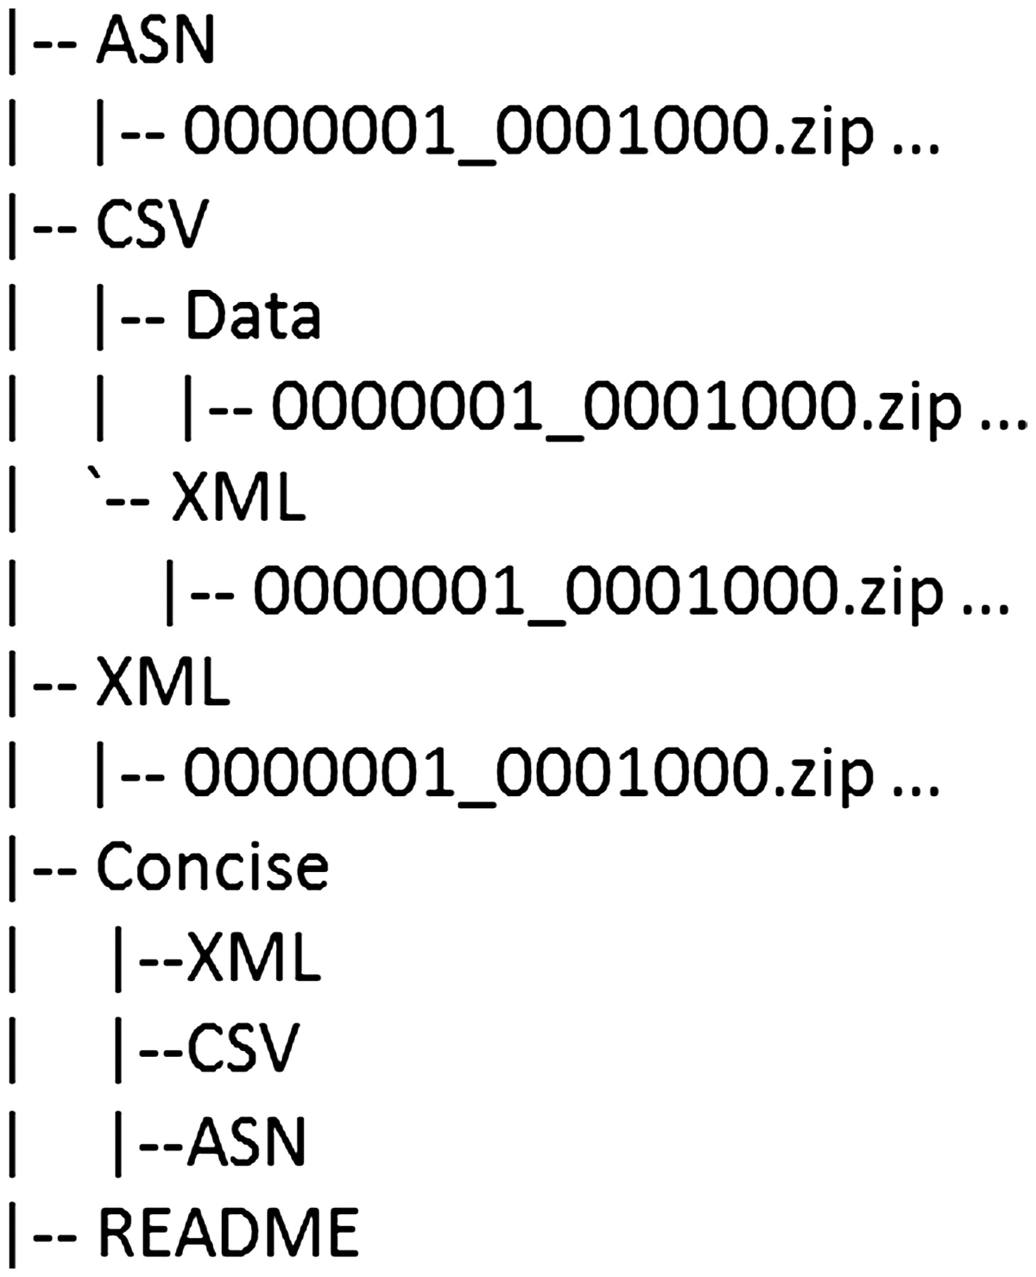
Figure 5. PubChem BioAssay FTP directory structure.
Notes:
Figure 5. PubChem BioAssay FTP directory structure.
Unless provided in the caption above, the following copyright applies to the content of this slide: Published by Oxford University Press 2011.This is an Open Access article distributed under the terms of the Creative Commons Attribution Non-Commercial License (http://creativecommons.org/licenses/by-nc/3.0), which permits unrestricted non-commercial use, distribution, and reproduction in any medium, provided the original work is properly cited.

Slide 7
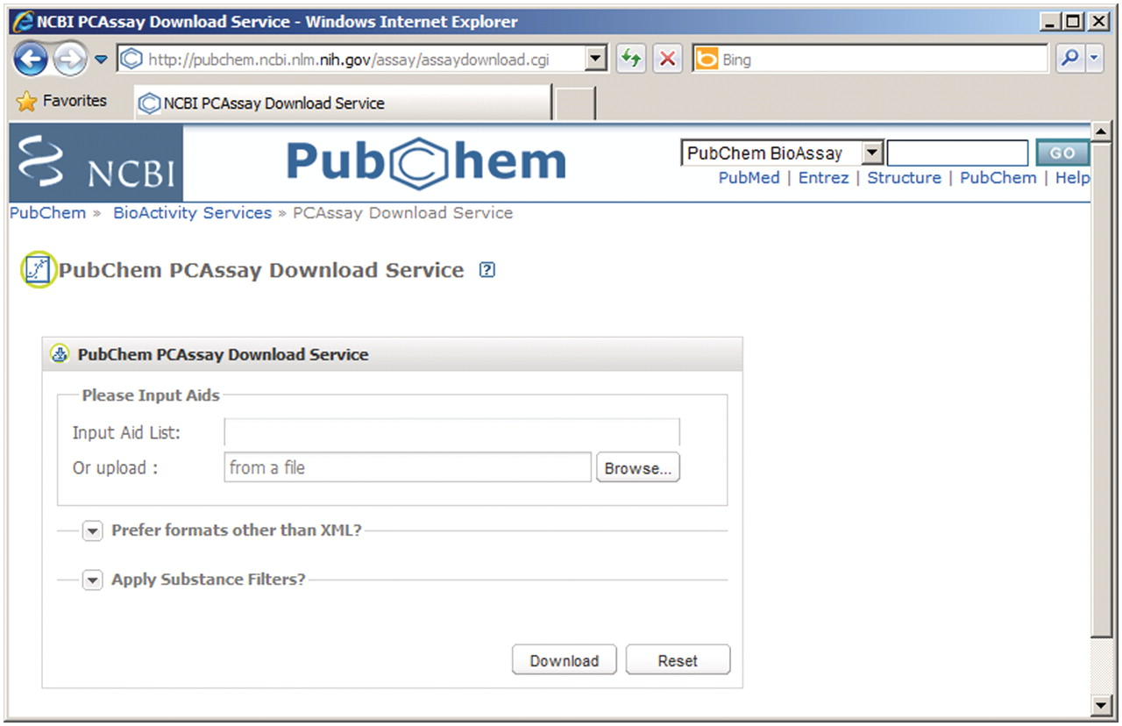
Figure 6. Web-based assay download service.
Notes:
Figure 6. Web-based assay download service.
Unless provided in the caption above, the following copyright applies to the content of this slide: Published by Oxford University Press 2011.This is an Open Access article distributed under the terms of the Creative Commons Attribution Non-Commercial License (http://creativecommons.org/licenses/by-nc/3.0), which permits unrestricted non-commercial use, distribution, and reproduction in any medium, provided the original work is properly cited.

