Slide 1
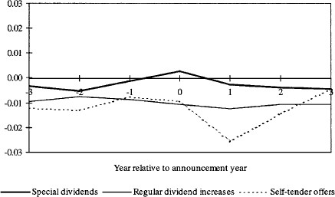
Figure 1 Mean levels of extraordinary cash flows Extraordinary cash flow is defined as sales of property, plant, and ...
Notes:
Figure 1 Mean levels of extraordinary cash flows Extraordinary cash flow is defined as sales of property, plant, and equipment minus business acquisitions scaled by total assets. Year 0 is the fiscal year of the announcement. The medians are zero for all three types and for all years.
Unless provided in the caption above, the following copyright applies to the content of this slide: © 2000 The Society for Financial Studies

Slide 2
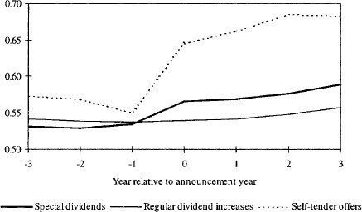
Figure 2 Mean debt ratios The debt ratio is defined as total liabilities scaled by total assets less cash and cash ...
Notes:
Figure 2 Mean debt ratios The debt ratio is defined as total liabilities scaled by total assets less cash and cash equivalents. Year 0 is the fiscal year of the announcement. Median ratios exhibit a similar pattern.
Unless provided in the caption above, the following copyright applies to the content of this slide: © 2000 The Society for Financial Studies

