Slide 1
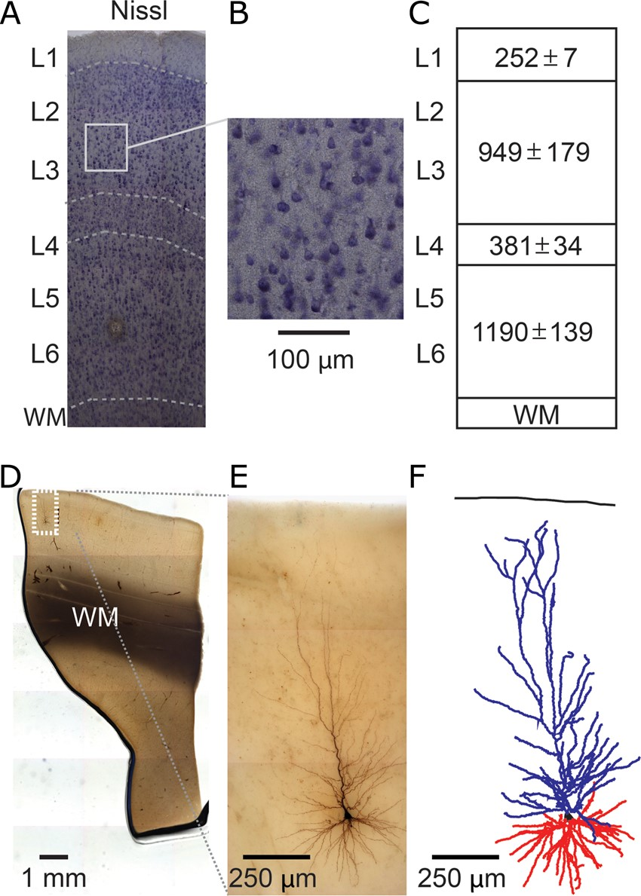
Figure 1. 3D reconstruction of single-cell dendritic morphology in human temporal cortex. (A,B) Nissl staining to ...
Notes:
Figure 1. 3D reconstruction of single-cell dendritic morphology in human temporal cortex. (A,B) Nissl staining to reveal layer boundaries (WM, white matter; L, layer). (C) Cortical layer dimensions (in µm ± standard deviation, n = 5). (D) Low-magnification view of biocytin-filled neuron. (E) High-magnification view of same neuron in D. (F) Example 3D dendritic reconstruction of neuron shown in D and E. Apical dendrite in blue, basal dendrites in red.
Unless provided in the caption above, the following copyright applies to the content of this slide: © The Author 2015. Published by Oxford University PressThis is an Open Access article distributed under the terms of the Creative Commons Attribution Non-Commercial License (http://creativecommons.org/licenses/by-nc/4.0/), which permits non-commercial re-use, distribution, and reproduction in any medium, provided the original work is properly cited. For commercial re-use, please contact journals.permissions@oup.com

Slide 2
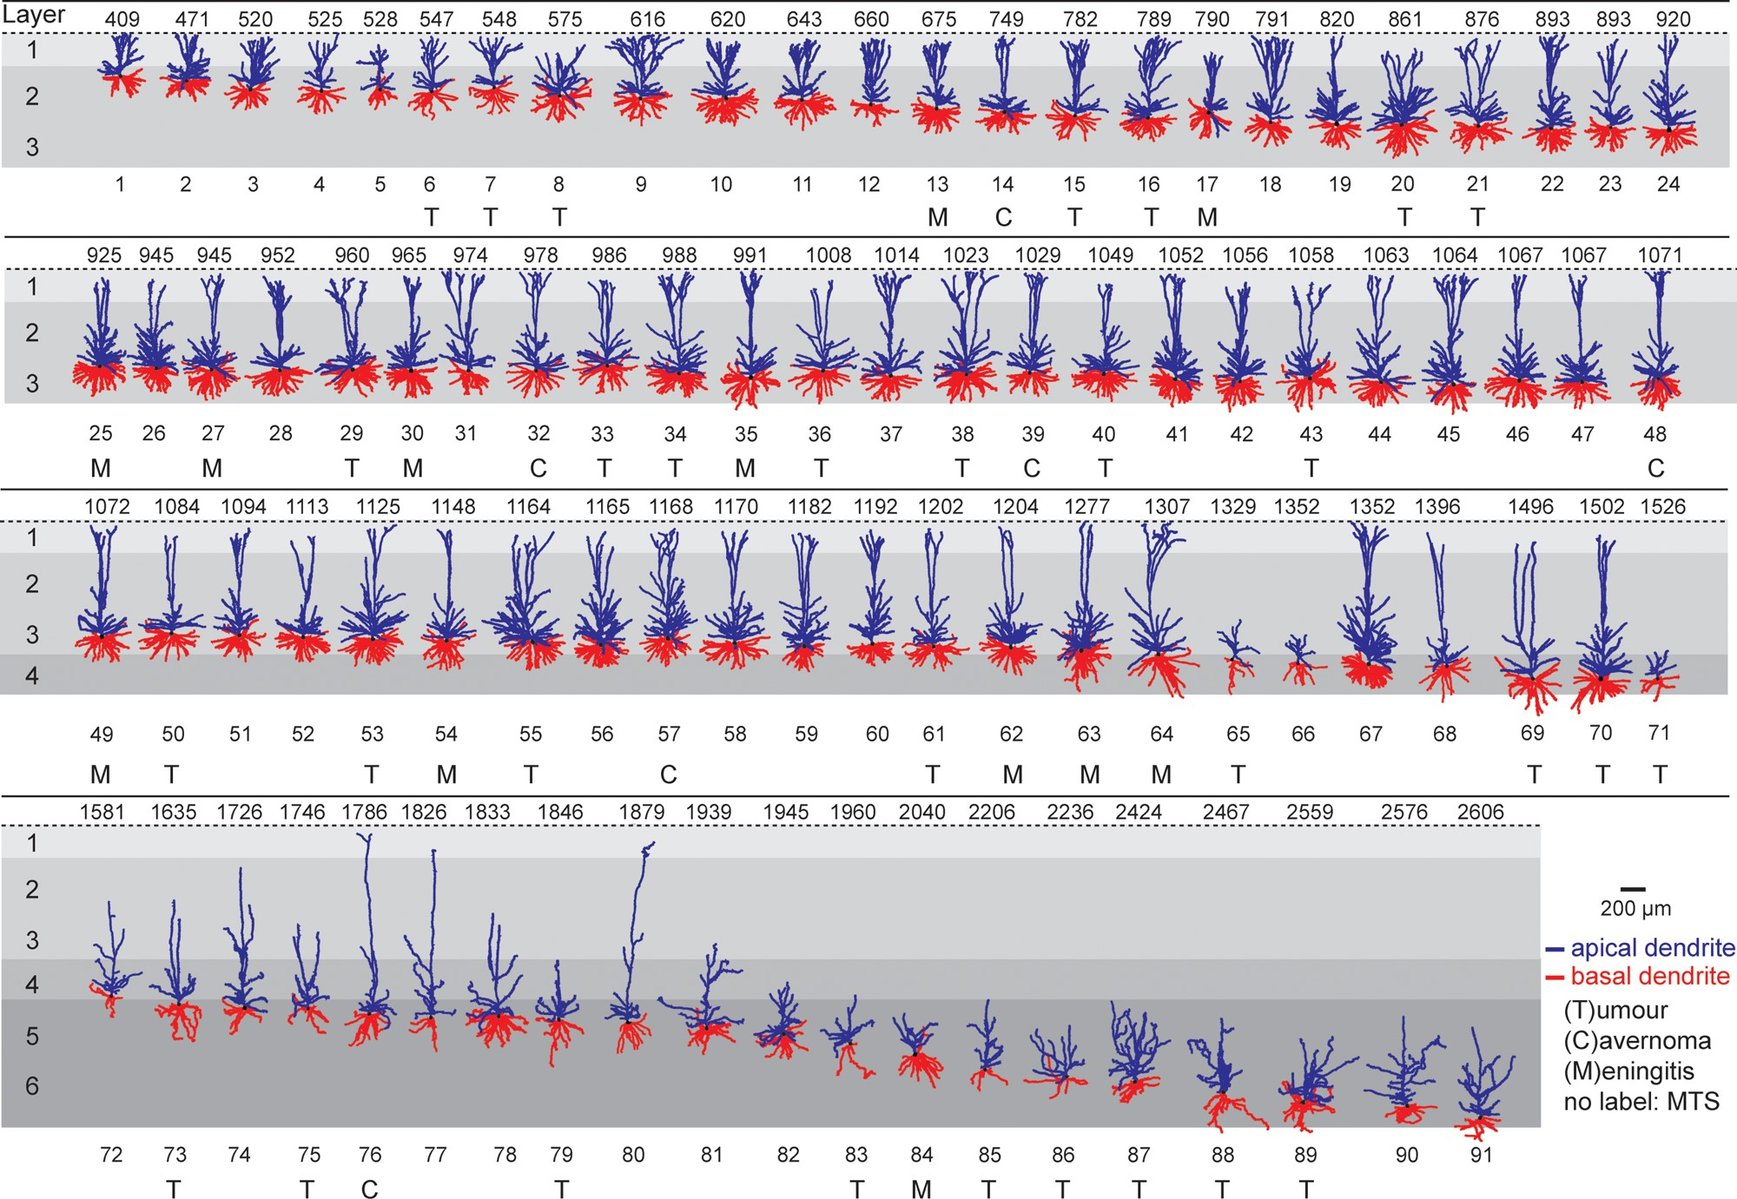
Figure 2. Dendrite gallery of human temporal cortex neurons. Representation of 91 3D reconstructed apical and basal ...
Notes:
Figure 2. Dendrite gallery of human temporal cortex neurons. Representation of 91 3D reconstructed apical and basal dendrites of human temporal cortex (Brodmann area 21) arranged along somatic depth with respect to pial surface. Capitals (T, C, M) indicate that tissue was obtained from patients with subcortical tumor, cavarnoma, or meningitis. First row indicates depth in µm. Apical dendrite in blue, basal dendrite in red. Neurons not labeled originate from patients with mesiotemporal sclerosis (MTS).
Unless provided in the caption above, the following copyright applies to the content of this slide: © The Author 2015. Published by Oxford University PressThis is an Open Access article distributed under the terms of the Creative Commons Attribution Non-Commercial License (http://creativecommons.org/licenses/by-nc/4.0/), which permits non-commercial re-use, distribution, and reproduction in any medium, provided the original work is properly cited. For commercial re-use, please contact journals.permissions@oup.com

Slide 3
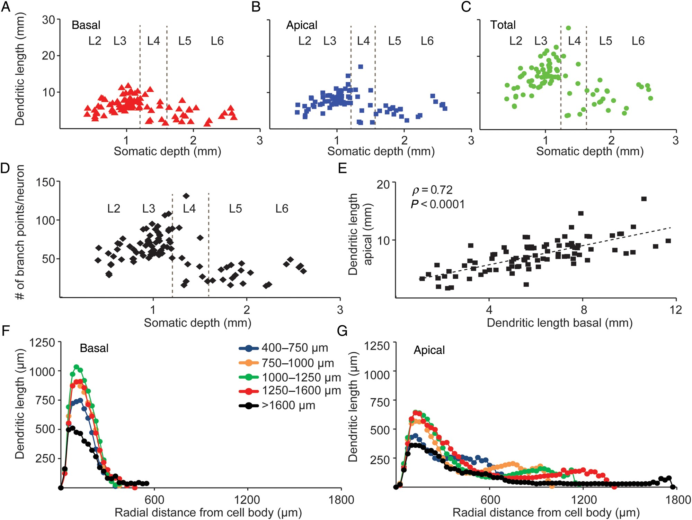
Figure 3. Layer-specific dendrite properties of human temporal cortex neurons. (A) Change in basal dendrite length of ...
Notes:
Figure 3. Layer-specific dendrite properties of human temporal cortex neurons. (A) Change in basal dendrite length of 91 human temporal cortex neurons with respect to layers and somatic depth. (B) Change in apical dendrite length with respect to layers and somatic depth. (C) Change in total dendrite length with respect to layers and somatic depth. (D) Change in number of branch points per neuron, for both apical and basal dendrites combined, with respect to layers and somatic depth. (E) Correlation between apical and basal dendrite length of 91 human temporal cortex neurons (Pearson's correlation coefficient r = 0.71, P < 0.0001). (F) Sholl analysis of 91 human temporal cortex basal dendrites, grouped into different depth bins, illustrating change in mean dendritic length with increasing radial distance from cell body. (G) Sholl analysis of apical dendrite with neurons grouped into different depth bins illustrating change in mean dendritic length with increasing radial distance from cell body.
Unless provided in the caption above, the following copyright applies to the content of this slide: © The Author 2015. Published by Oxford University PressThis is an Open Access article distributed under the terms of the Creative Commons Attribution Non-Commercial License (http://creativecommons.org/licenses/by-nc/4.0/), which permits non-commercial re-use, distribution, and reproduction in any medium, provided the original work is properly cited. For commercial re-use, please contact journals.permissions@oup.com

Slide 4
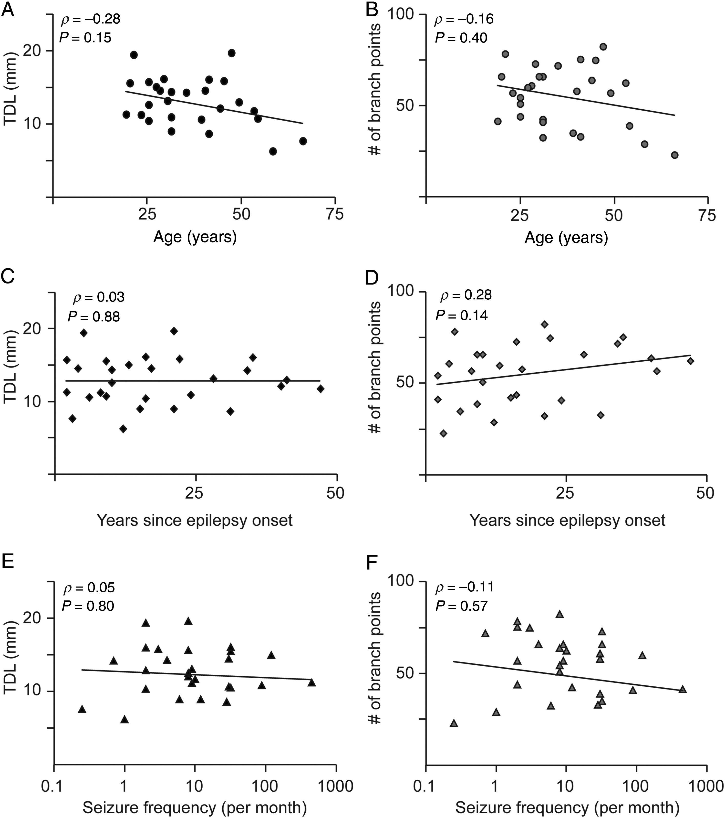
Figure 4. Disease history does not affect total dendritic length and number of branch points. (A) Correlation of total ...
Notes:
Figure 4. Disease history does not affect total dendritic length and number of branch points. (A) Correlation of total dendritic length with respect to age. Each point in the scatterplot represents the median value for a single patient (B) Correlation of number of branch points versus age. (C,D) Correlation for TDL and number of branch points, respectively, to years since epilepsy onset. (E,F) Correlation for TDL and number of branch points, respectively, to seizure frequency. Spearman's ρ and P-value are indicated within figure panels, respectively.
Unless provided in the caption above, the following copyright applies to the content of this slide: © The Author 2015. Published by Oxford University PressThis is an Open Access article distributed under the terms of the Creative Commons Attribution Non-Commercial License (http://creativecommons.org/licenses/by-nc/4.0/), which permits non-commercial re-use, distribution, and reproduction in any medium, provided the original work is properly cited. For commercial re-use, please contact journals.permissions@oup.com

Slide 5
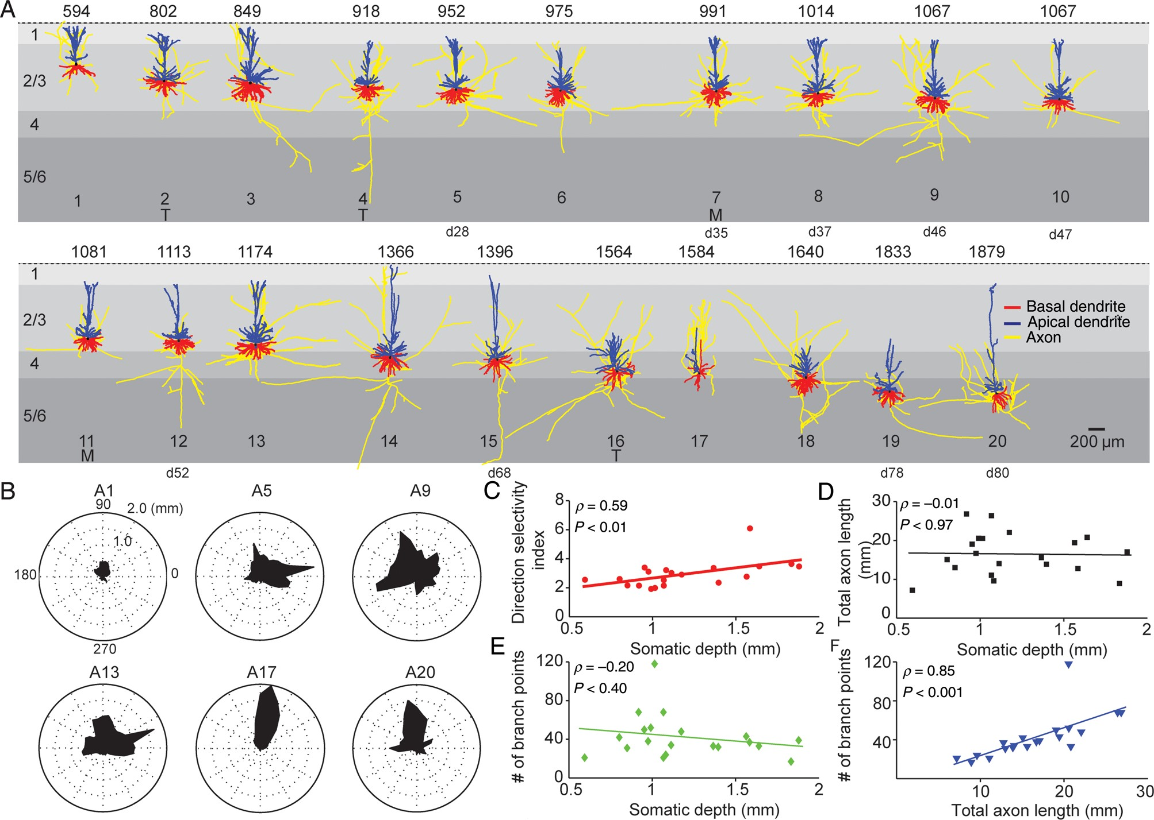
Figure 5. Axon gallery and layer-specific axonal properties of human temporal cortex neurons. (A) Representation of 20 ...
Notes:
Figure 5. Axon gallery and layer-specific axonal properties of human temporal cortex neurons. (A) Representation of 20 3D reconstructed axons with apical and basal dendrites of human temporal cortex neurons arranged with respect to somatic depth. First row indicates somatic depth in µm. Last row indicates ID of the same reconstruction in dendrite gallery if present in both. Axons in yellow, apical dendrites in blue, basal dendrites in red. Capitals (T, M) indicate that tissue was obtained from patients with subcortical tumor or meningitis. Neurons that are also present in the dendrite gallery are indicated by cell number (for instance, cell #5 in axon gallery is cell 28 in dendrite gallery). (B) Polar plots of 6 example axonal reconstructions illustrating radial orientation of axons with respect to cell body. Top row indicates ID within axon gallery. (C) Dependence of direction selectivity index of axons with respect of somatic depth. (D) Dependence of total axon length with respect to depth. (E) Dependence of number of axonal branch points with respect to depth. (F) Correlation between total axonal length and number of axonal branch points.
Unless provided in the caption above, the following copyright applies to the content of this slide: © The Author 2015. Published by Oxford University PressThis is an Open Access article distributed under the terms of the Creative Commons Attribution Non-Commercial License (http://creativecommons.org/licenses/by-nc/4.0/), which permits non-commercial re-use, distribution, and reproduction in any medium, provided the original work is properly cited. For commercial re-use, please contact journals.permissions@oup.com

Slide 6
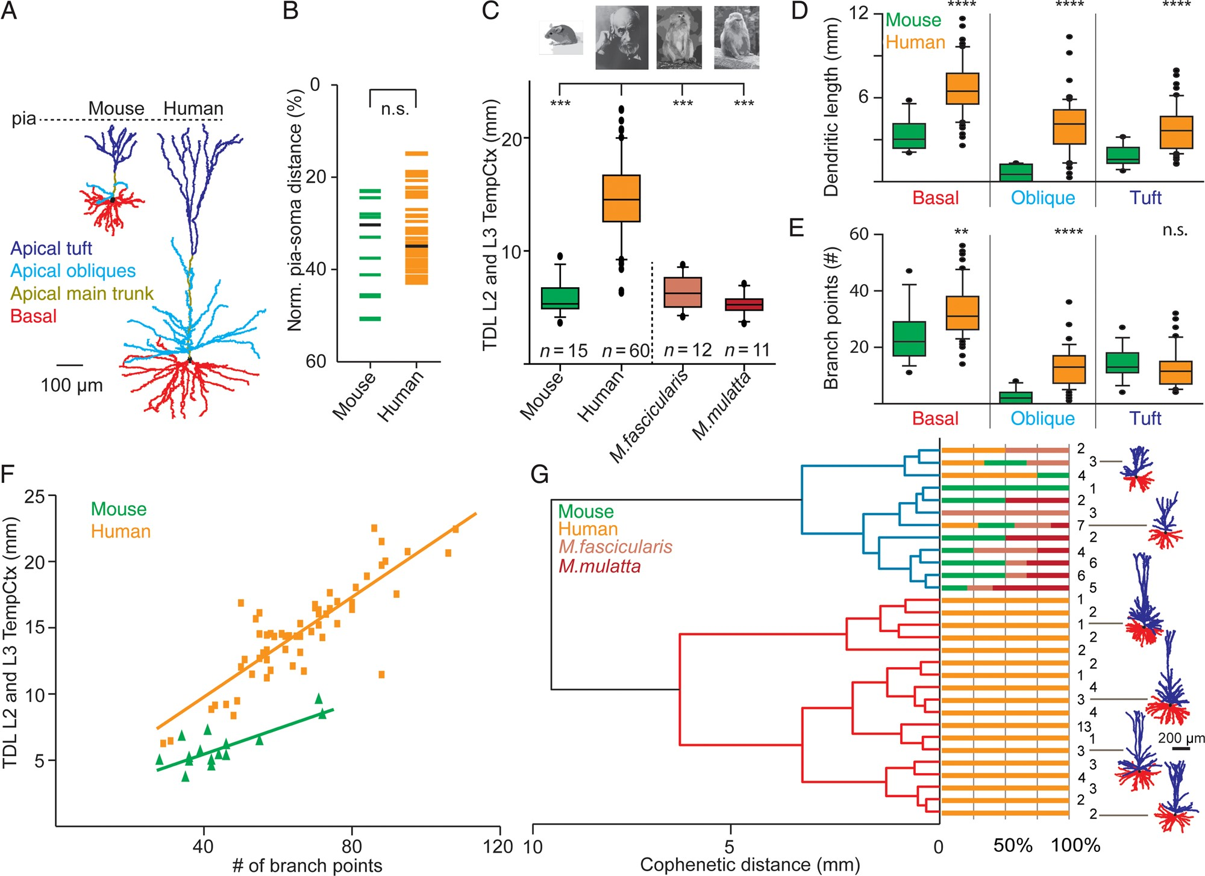
Figure 6. Comparison of dendritic complexity in human, monkey, and mouse L2 and L3 temporal cortex neurons. (A) ...
Notes:
Figure 6. Comparison of dendritic complexity in human, monkey, and mouse L2 and L3 temporal cortex neurons. (A) Representative example 3D dendritic reconstructions of one mouse and human temporal cortex neuron. Apical main trunk in dark yellow, apical oblique dendrites in light blue, apical tuft in dark blue, basal dendrites in red, respectively. (B) Normalized pia-soma depth of individual L2 and L3 neurons from mouse and human temporal cortex. (C) Comparison of total dendritic length (TDL) between L2 and L3 temporal cortex neurons of mouse, human, M. fascicularis, and M. mulatta. (D) Comparison of basal, apical oblique, and apical tuft length between mouse and human temporal cortex neurons. (E) Number of branch points for mouse and human L2 and L3 temporal cortex neurons for basal, apical oblique, and apical tuft. (F) Correlation between number of branch points and TDL of human and mouse L2 and L3 temporal cortex neurons. (G) Dendrogram based on hierarchical agglomerative clustering of mouse, human, M. fascicularis, and M. mulatta L2 and L3 temporal cortex neurons. Neurons were grouped into 2 clusters indicated by blue and red dendrograms based on TDL. Note isolation of 88% of human neurons into unique red cluster.
Unless provided in the caption above, the following copyright applies to the content of this slide: © The Author 2015. Published by Oxford University PressThis is an Open Access article distributed under the terms of the Creative Commons Attribution Non-Commercial License (http://creativecommons.org/licenses/by-nc/4.0/), which permits non-commercial re-use, distribution, and reproduction in any medium, provided the original work is properly cited. For commercial re-use, please contact journals.permissions@oup.com

Slide 7
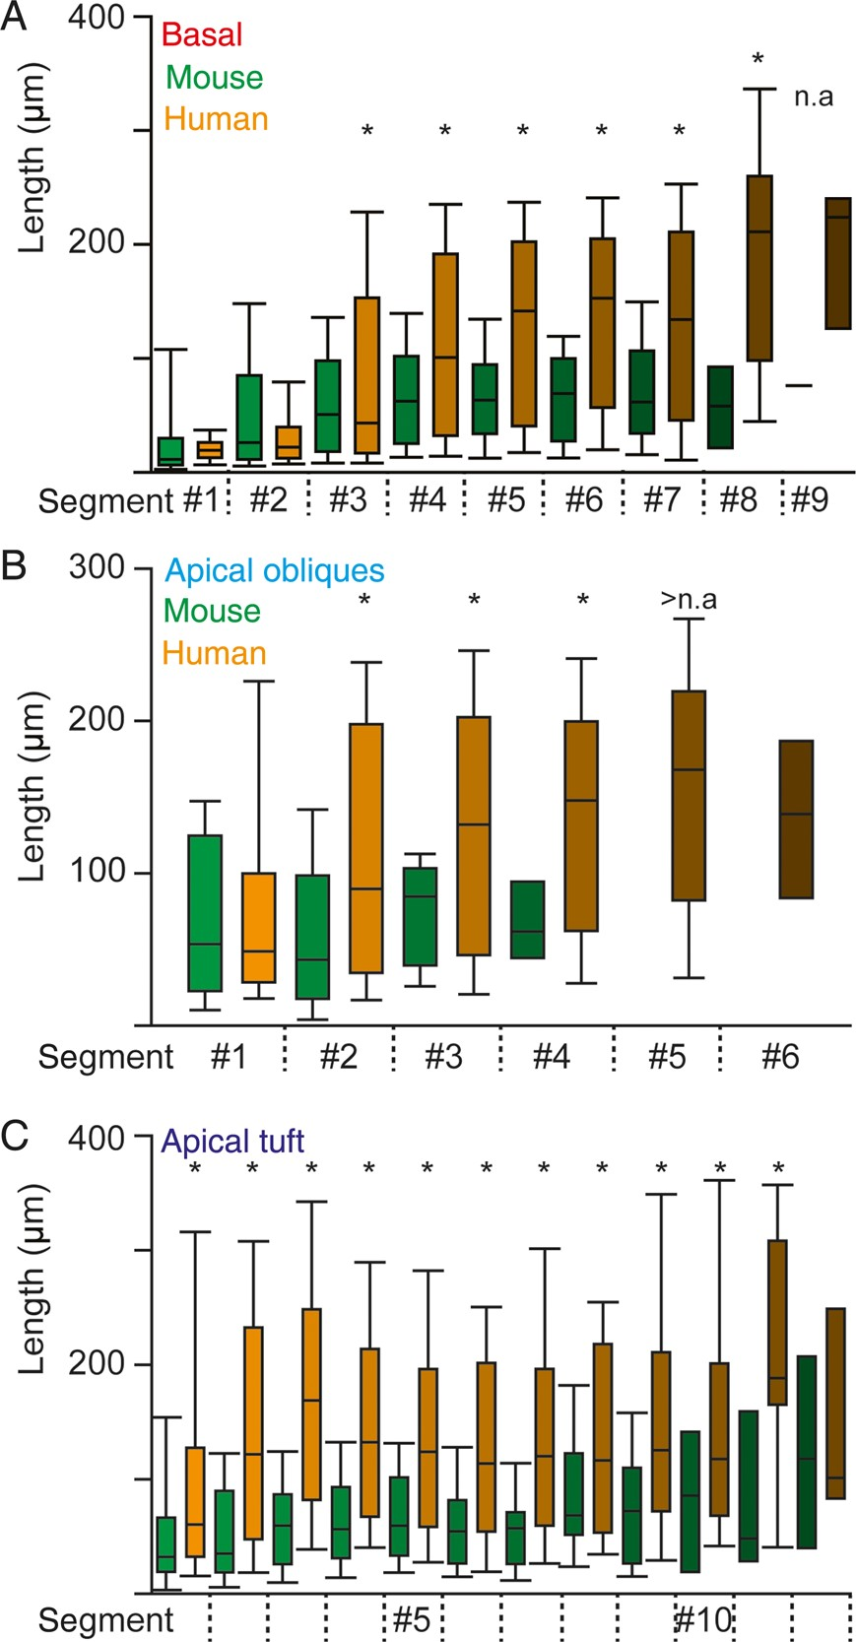
Figure 7. Elongated segments of basal, apical oblique and apical tuft dendrites in human neurons (A) Change in segment ...
Notes:
Figure 7. Elongated segments of basal, apical oblique and apical tuft dendrites in human neurons (A) Change in segment length of basal dendrites with distance from the soma of L2 and L3 neurons. Asterisks indicate statistical difference for human versus mouse (MLM statistics, see Materials and Methods) (B) Analogous to A for apical oblique dendrites. (C) Analogous to A for apical tuft dendrites.
Unless provided in the caption above, the following copyright applies to the content of this slide: © The Author 2015. Published by Oxford University PressThis is an Open Access article distributed under the terms of the Creative Commons Attribution Non-Commercial License (http://creativecommons.org/licenses/by-nc/4.0/), which permits non-commercial re-use, distribution, and reproduction in any medium, provided the original work is properly cited. For commercial re-use, please contact journals.permissions@oup.com

Slide 8
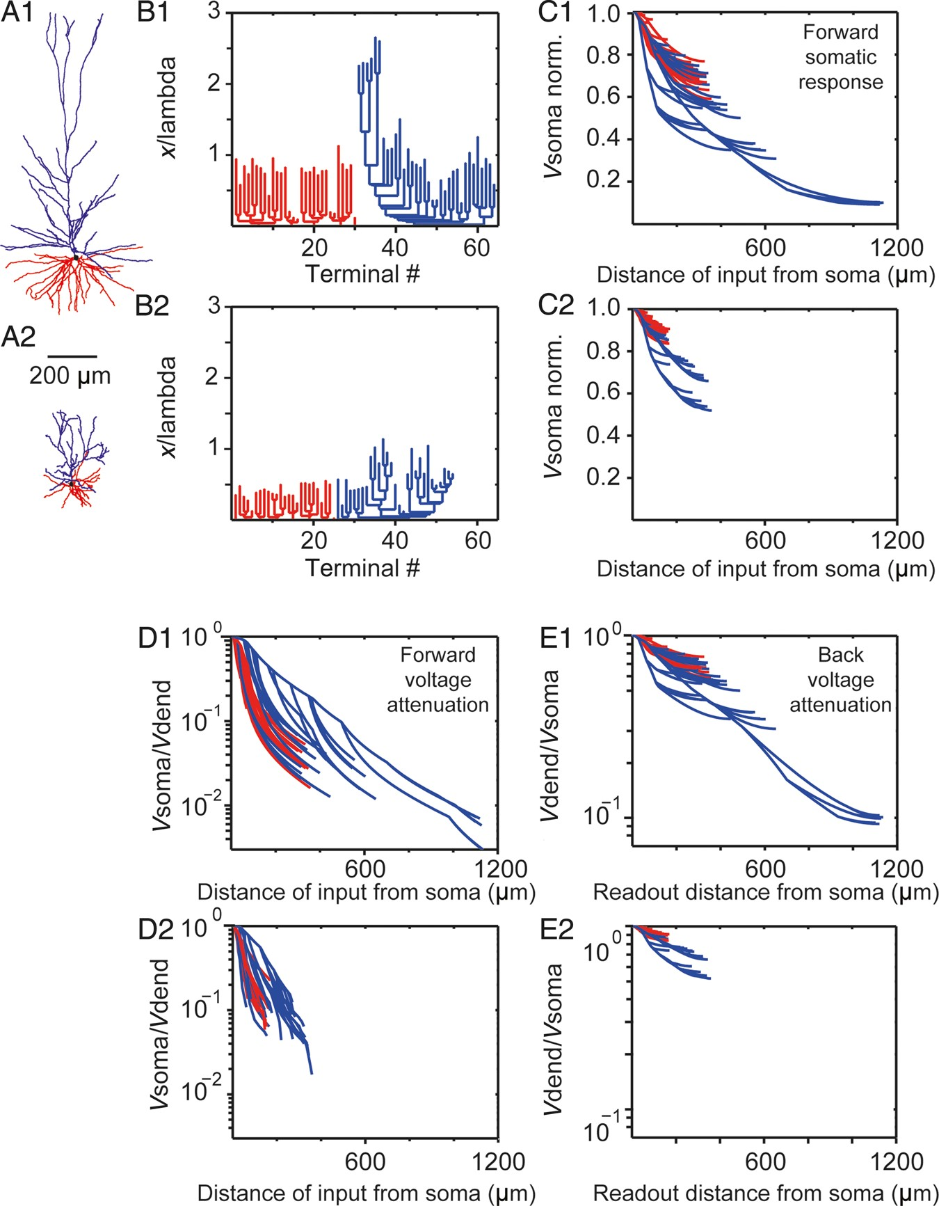
Figure 8. Electrotonic structure and voltage attenuation in human versus mouse L2 and L3 pyramidal cells. (A1, A2) ...
Notes:
Figure 8. Electrotonic structure and voltage attenuation in human versus mouse L2 and L3 pyramidal cells. (A1, A2) Morphology of human and mouse temporal cortex example neurons, respectively. Red denotes basal tree whereas blue the apical tree, respectively. (B1, B2) Dendrogram in cable units for the neurons in A1 and A2, respectively. In both cases, Rm = 15 000 Ωcm2 and Ri = 150 Ωcm. (C1, C2) Normalized soma voltage resulting from steady-state current injection in the corresponding dendritic sites for the example neurons in A1, A2, respectively. Each line represents a path from the soma to a dendritic terminal. Note the 1.5-fold increase in the average voltage attenuation for the human versus the mouse cell and the enhance attenuation from the distal apical tuft in the human neuron. (D1, D2) Steady voltage attenuation from the dendrites (Vdend) to the soma (Vsoma) for the neurons in A1, A2, respectively. Note the 2.5-fold increase in the average attenuation for the human versus the mouse neuron. (E1, E2) Steady-state voltage attenuation from the soma to the dendrites for the neurons in A1, A2, respectively.
Unless provided in the caption above, the following copyright applies to the content of this slide: © The Author 2015. Published by Oxford University PressThis is an Open Access article distributed under the terms of the Creative Commons Attribution Non-Commercial License (http://creativecommons.org/licenses/by-nc/4.0/), which permits non-commercial re-use, distribution, and reproduction in any medium, provided the original work is properly cited. For commercial re-use, please contact journals.permissions@oup.com

