Slide 1
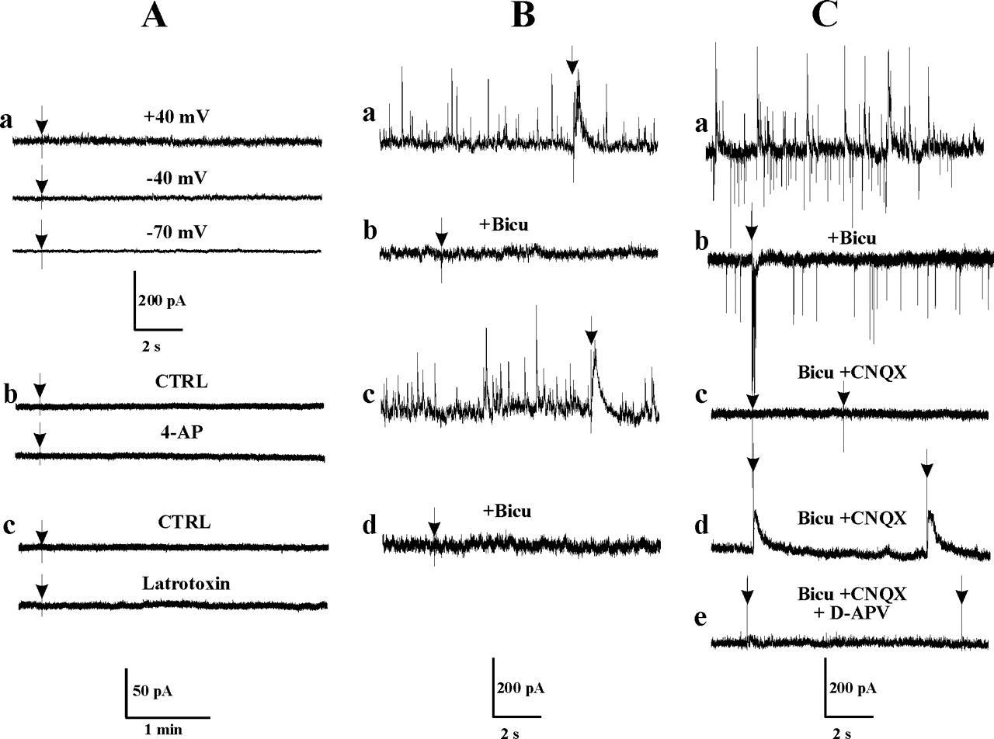
Figure 1. Functional responses of CA1 interneurons at birth. (A) Silent interneurons. (a) No spontaneous or evoked ...
Notes:
Figure 1. Functional responses of CA1 interneurons at birth. (A) Silent interneurons. (a) No spontaneous or evoked activity (arrow, 80 V, 60 μs duration) could be recorded at three different membrane potentials in some interneurons blindly patched from SR. (b) Small interneurons from SR selected under visual guidance were also found to have no spontaneous or evoked (arrow, 80 V, 60 μs) synaptic responses in control conditions (CTRL) and remain ‘silent’ even if the release of neurotransmitter is increased by 4-aminopyridine (4-AP, 100 μM, 30 min) or α-latrotoxin (0.6 nM, 1 min). (B) G interneurons. Spontaneous and evoked outward PSCs mediated by GABAA receptors were recorded in SR at –45 mV (a) and at +40 mV (c) with K-gluconate-filled electrodes. The reversal potential for GABAA currents was –61 mV. (b,d) Application of bicuculline (10 μM, 10 min) completely suppressed spontaneous and evoked (arrow, 80 V, 60 μs) GABAA responses at these two potentials. Note the absence of interictal seizures and that no NMDA response was evoked at +40 mV in these conditions. (C) GG interneurons. (a) Spontaneous and evoked GABAA (outward) and AMPA (inward) PSCs were recorded at –45 mV in K-gluconate-filled electrodes (reversal potential for GABAA currents was around –59 mV). Outward GDPs were present in this record. (b) Application of bicuculline (10 μM, 10 min) completely suppressed outward but not inward spontaneous or evoked currents and induced an interictal-like evoked response. (c) Addition of CNQX (10 μM, 10 min) to bicuculline suppressed AMPA receptor-mediated spontaneous and evoked currents at –45 mV. (d) In the presence of AMPA and GABAA receptor antagonists, large evoked and spontaneous outward currents were recorded at +40 mV. (e) These were abolished by concomitant addition of D-APV (20 μM, 10 min).
Unless provided in the caption above, the following copyright applies to the content of this slide: © Oxford University Press

Slide 2
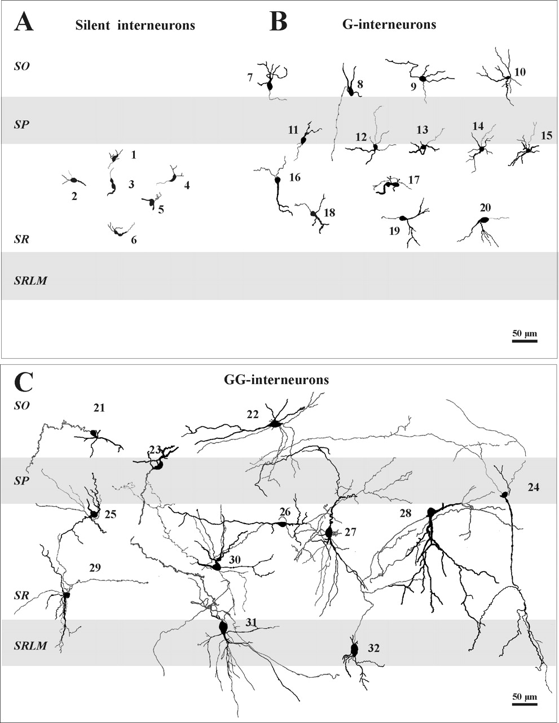
Figure 2. Morphology of interneurons at birth. (A) Silent interneurons. Six non-innervated interneurons were filled ...
Notes:
Figure 2. Morphology of interneurons at birth. (A) Silent interneurons. Six non-innervated interneurons were filled with biocytin (cells 1–6) and reconstructed. They were all located in SR. (B) G interneurons. Some of the 22 interneurons with only GABAA PSCs were reconstructed and represented in their layers. Cells 12–15 are examples of G interneurons that are located at the border with SP. They have a stellate morphology and their axons invade SP. They represented the majority of G interneurons in SR. Cell 9 may correspond to an IS-1 type of interneuron. (C) GG interneurons. Twelve of the 103 GG interneurons are represented to illustrate their morphological heterogeneity. Their size, axonal arbor and dendritic trees are different from cell to cell. Cells 22 and 29 may resemble an IS-1 interneuron. Cells 31 and 32 located in SLM may correspond to IS-2 interneurons, whereas cell 24 with a cell body in SP may correspond to the IS-3 subtype of interneuron.
Unless provided in the caption above, the following copyright applies to the content of this slide: © Oxford University Press

Slide 3
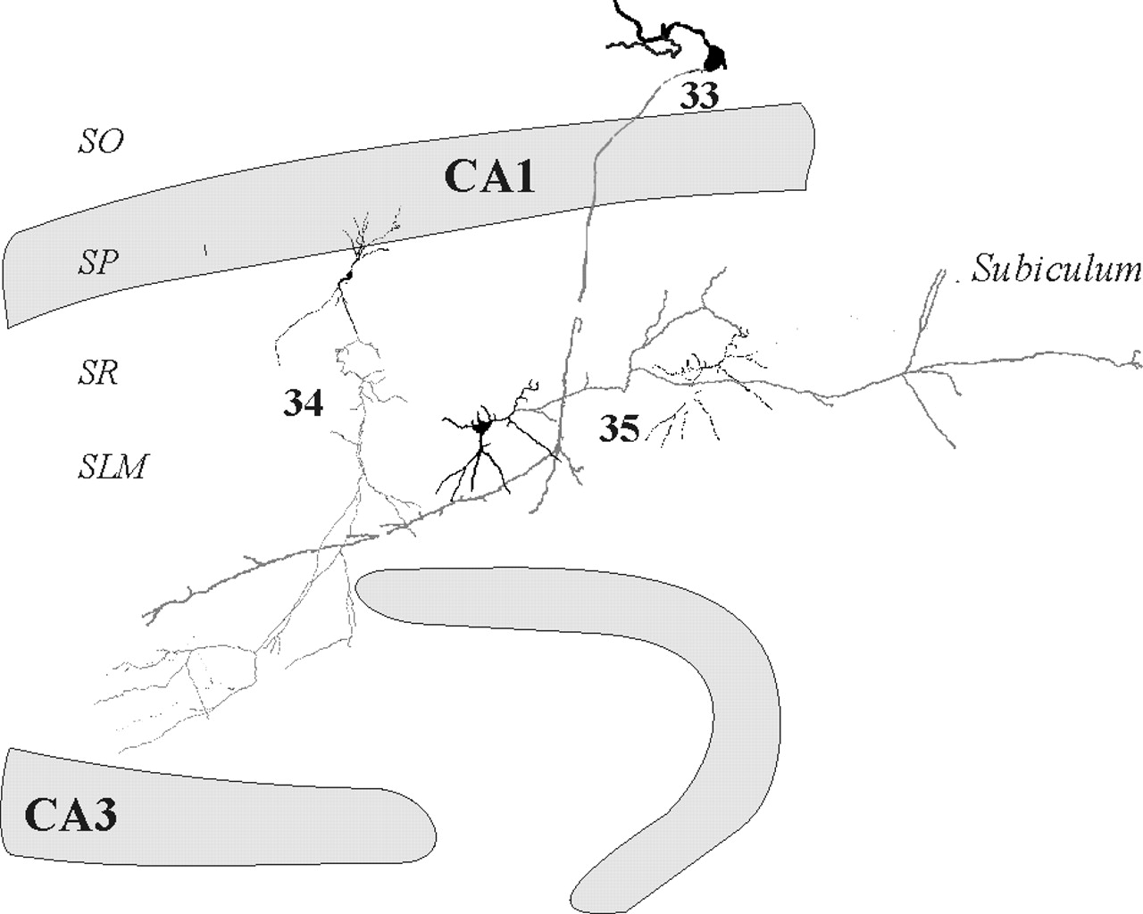
Figure 3. Interneurons projecting outside CA1. The three neurons were identified as GG interneurons at birth. Cell 33 ...
Notes:
Figure 3. Interneurons projecting outside CA1. The three neurons were identified as GG interneurons at birth. Cell 33 represents an immature O-LM cell with its axon invading SLM of CA1 and then the CA3 area. Cell 34 may correspond to a type called back-projection, with its axon crossing the fissure and extending with ramification to the CA3 area. Cell 35 sends a long and ramified axon that emerges in the subiculum area.
Unless provided in the caption above, the following copyright applies to the content of this slide: © Oxford University Press

Slide 4
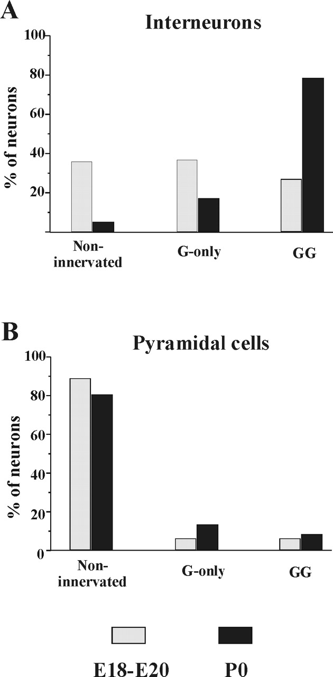
Figure 4. Relative proportions of the three types of interneurons and pyramidal cells at two developmental stages. (A) ...
Notes:
Figure 4. Relative proportions of the three types of interneurons and pyramidal cells at two developmental stages. (A) A large number (65%) of embryonic interneurons is already functional (45 cells) and this proportion greatly increases (95%) at birth (125 cells). Note that the proportion of G interneurons decreases at birth. (B) In embryonic slices, 88% of pyramidal cells (52 cells) are silent and this proportion is slightly reduced at birth [78%, 59 cells, data from Tyzio et al. (Tyzio et al., 1999)].
Unless provided in the caption above, the following copyright applies to the content of this slide: © Oxford University Press

Slide 5
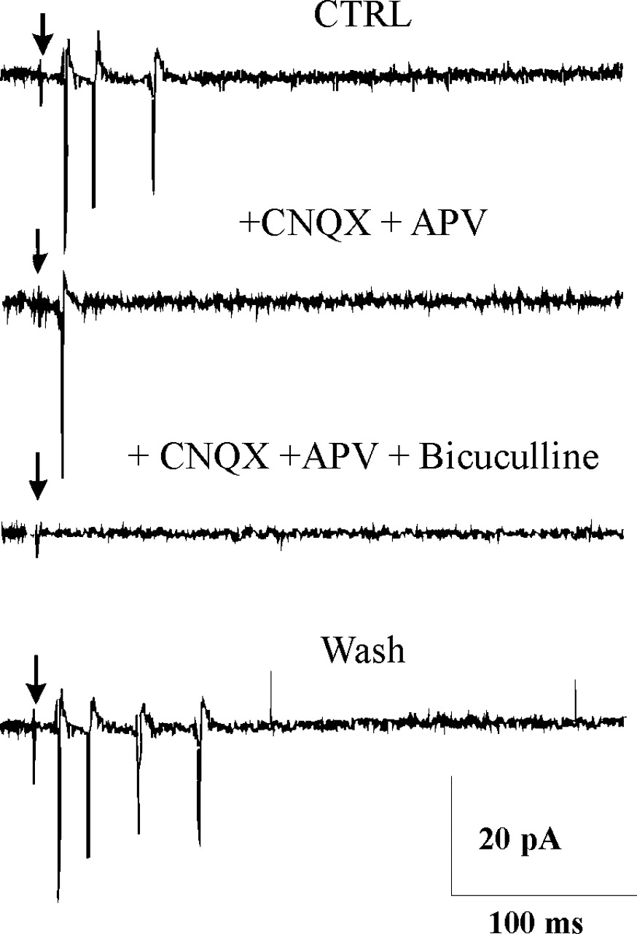
Figure 5. GABA contributes to the excitatory drive in CA1 interneurons. Traces of responses evoked in GG interneurons ...
Notes:
Figure 5. GABA contributes to the excitatory drive in CA1 interneurons. Traces of responses evoked in GG interneurons by electrical stimulation are recorded in cell-attached configuration in embryonic slices. Glutamatergic antagonists (CNQX, 20 μM; D-APV, 40 μM) reduce the number of spikes evoked in control conditions (CTRL). They are completely suppressed by further addition of bicuculline (10 μM) and are again evoked after washout of the drugs.
Unless provided in the caption above, the following copyright applies to the content of this slide: © Oxford University Press

Slide 6
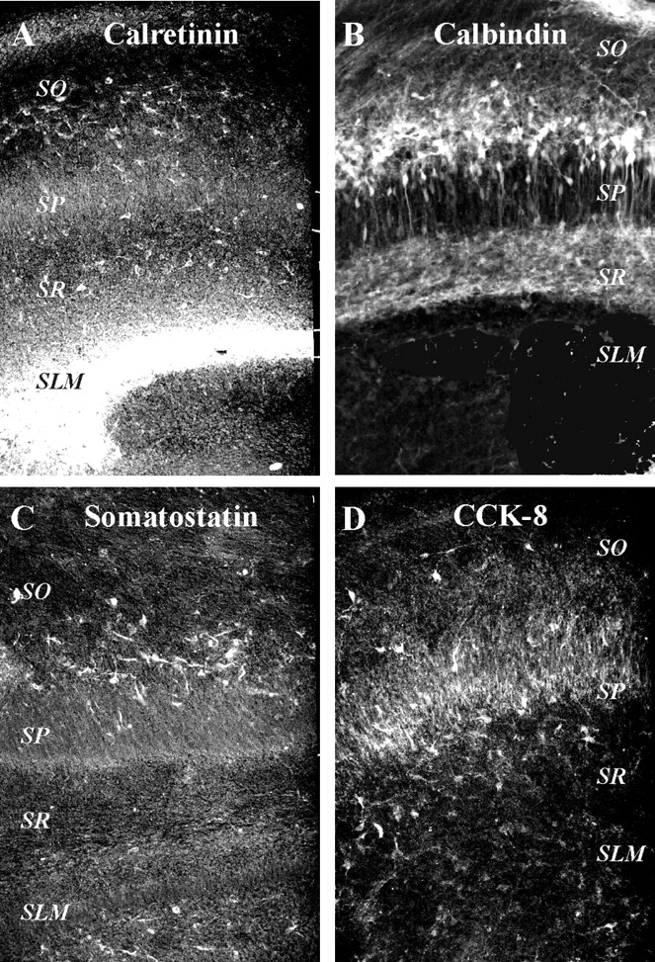
Figure 6. Immunocytochemistry in P0 slices. Adjacent hippocampal slices were incubated with polyclonal antibodies (see ...
Notes:
Figure 6. Immunocytochemistry in P0 slices. Adjacent hippocampal slices were incubated with polyclonal antibodies (see Materials and Methods). Only the CA1 region is shown (SO, stratum oriens; SP, stratum pyramidale; SR, stratum radiatum; SLM, stratum lacunosum moleculare). (A) Calretinin. The intense labelling corresponds to Cajal–Retzius cells. A less intense labelling is observed in SO and SR in cells characterized by a small dendritic tree and no specific orientation. (B) Calbindin. Immunoreactive cells are observed mainly in SO (the more intensely stained) and SR, where cell bodies and thin dendrites are labelled. A few pyramidal cells are also stained; within SP, cell bodies and the apical dendrites are lightly immunoreactive. (C) Somatostatin. Positive somata and dendritic extension are labelled in SO. In addition, few axons are observed in SLM. (D) CCK-8. Positive-cells are found in SO, SP and SR, but only cell bodies and some dendrites and not axons are labelled.
Unless provided in the caption above, the following copyright applies to the content of this slide: © Oxford University Press

Slide 7
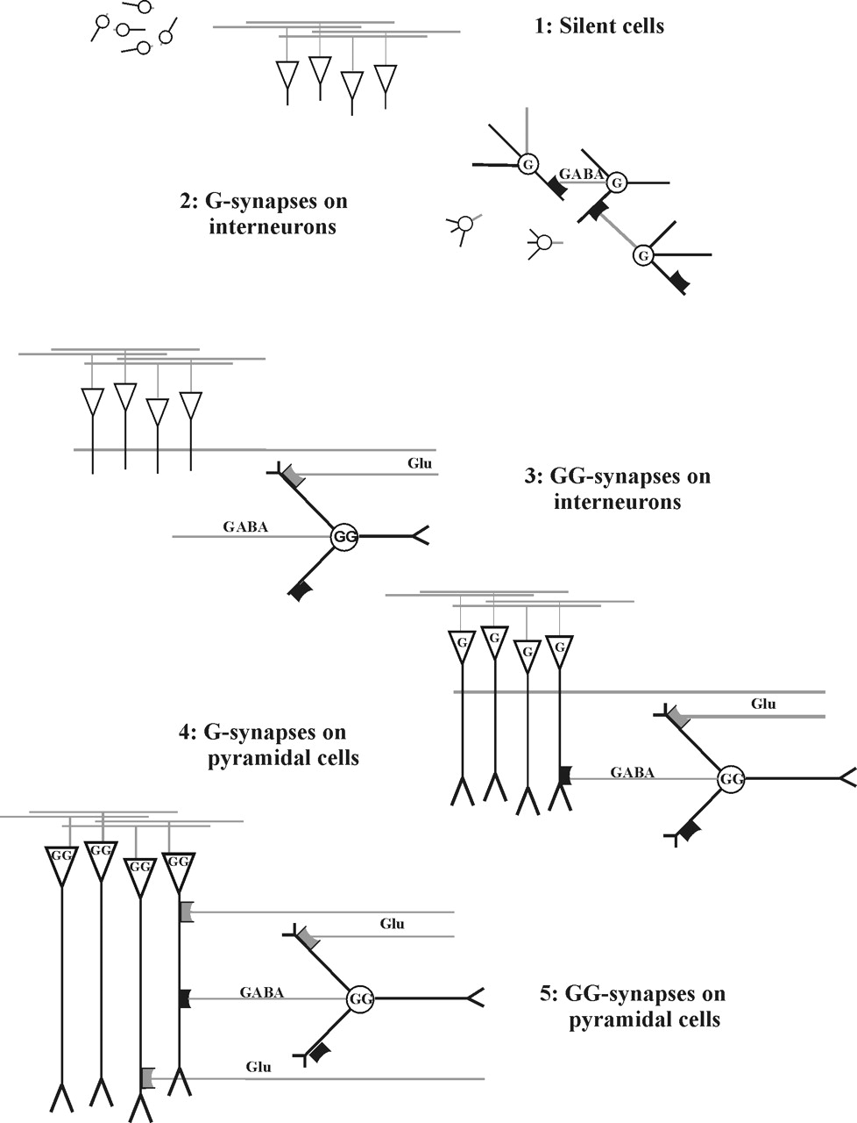
Figure 7. Sequential formation of synapses in interneurons and pyramidal cells during development. Interneurons are ...
Notes:
Figure 7. Sequential formation of synapses in interneurons and pyramidal cells during development. Interneurons are represented by a round cell body and pyramidal cells by a triangle. Step 1: both types are not yet innervated and have no functional synapses. Steps 2 and 3: interneurons, but not pyramidal cells, express sequentially GABAA (step 2) and glutamatergic (step 3) synapses; note that excitatory fibres selectively synapse with interneurons and not with the poorly developed apical dendrites of pyramidal cells. Steps 4 and 5: pyramidal neurons express sequentially GABAA (step 4) and glutamatergic (step 5) synapses on apical dendrites. Note that the apical dendrites of pyramidal cell progressively extended in SR (step 4) and SLM (step 5).
Unless provided in the caption above, the following copyright applies to the content of this slide: © Oxford University Press

