Slide 1
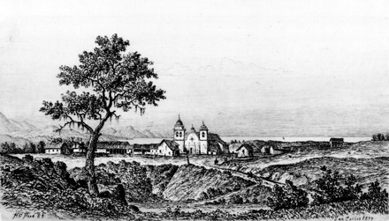
Figure 1. Carmel Mission (“View of San Carlos Borromeo Mission”) (1883), by Henry Chapman Ford. Bancroft Library, BANC ...
Notes:
Figure 1. Carmel Mission (“View of San Carlos Borromeo Mission”) (1883), by Henry Chapman Ford. Bancroft Library, BANC PIC 1963.002:0917:18-ffAL. Photo courtesy of the Bancroft Library, University of California, Berkeley. Pictures found in the Online Archive of California (OAC). http://content.cdlib.org/ark:/13030/tf5j49p2cz/?brand=oac
Unless provided in the caption above, the following copyright applies to the content of this slide: © The Author 2009. Published by Oxford University Press. All rights reserved. For permissions, please e-mail: journals.permissions@oxfordjournals.org

Slide 2
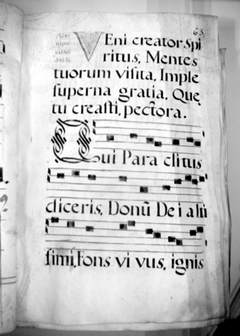
Figure 2. Veni Creator Spiritus, Carmel Mission Ms. 2, “Antiphonary,” Ms. 308.1955.46.139, fol. 4. Permission to ...
Notes:
Figure 2. Veni Creator Spiritus, Carmel Mission Ms. 2, “Antiphonary,” Ms. 308.1955.46.139, fol. 4. Permission to include image courtesy of Carmel Mission. Photo by the author.
Unless provided in the caption above, the following copyright applies to the content of this slide: © The Author 2009. Published by Oxford University Press. All rights reserved. For permissions, please e-mail: journals.permissions@oxfordjournals.org

Slide 3
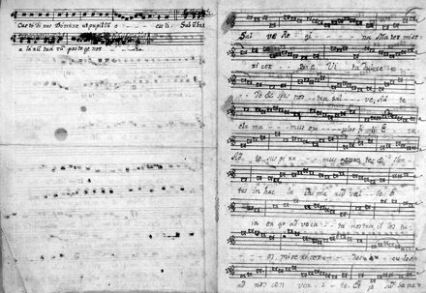
Figure 3. Salve Regina and Compline service, San Fernando Mission, Archival Center of the Archdiocese of Los Angeles, ...
Notes:
Figure 3. Salve Regina and Compline service, San Fernando Mission, Archival Center of the Archdiocese of Los Angeles, manuscript S-5. Permission to include image courtesy of the ACALA. Photo by the author.
Unless provided in the caption above, the following copyright applies to the content of this slide: © The Author 2009. Published by Oxford University Press. All rights reserved. For permissions, please e-mail: journals.permissions@oxfordjournals.org

Slide 4
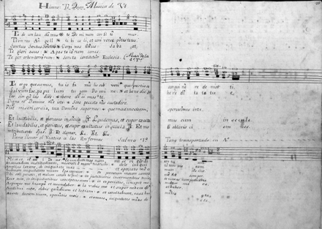
Figure 4. Te Deum (intoned in polyphony), Santa Barbara Mission Archive-Library, Document 2 (Choir Book from the San ...
Notes:
Figure 4. Te Deum (intoned in polyphony), Santa Barbara Mission Archive-Library, Document 2 (Choir Book from the San Rafael Mission), pp. 84 and 85. Permission to include image courtesy of the SBMAL. Photo by the author.
Unless provided in the caption above, the following copyright applies to the content of this slide: © The Author 2009. Published by Oxford University Press. All rights reserved. For permissions, please e-mail: journals.permissions@oxfordjournals.org

