Slide 1
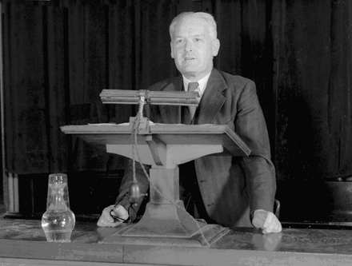
Austin Bradford Hill lecturing Picture supplied by and reproduced by kind permission of the London School of ...
Notes:
Austin Bradford Hill lecturing Picture supplied by and reproduced by kind permission of the London School of Hygiene and Tropical Medicine.
Unless provided in the caption above, the following copyright applies to the content of this slide: © International Epidemiological Association 2003

