Slide 1
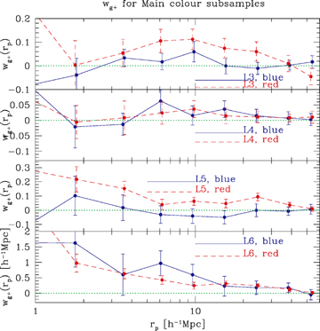
Figure 1 The GI correlation functions for the SDSS main subsamples, split into colour and luminosity bins.
Notes:
Figure 1 The GI correlation functions for the SDSS main subsamples, split into colour and luminosity bins.
Unless provided in the caption above, the following copyright applies to the content of this slide: © 2007 The Authors. Journal compilation © 2007 RAS

Slide 2
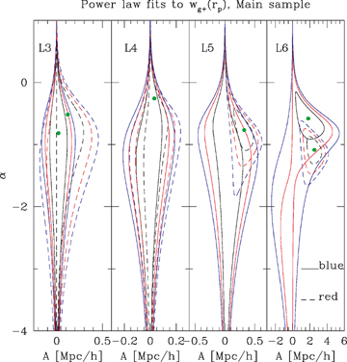
Figure 2 Confidence contours for power‐law fits to w_{g+}(r_{p}) for main sample galaxies. Contours ...
Notes:
Figure 2 Confidence contours for power‐law fits to wg+(rp) for main sample galaxies. Contours are shown for various subsets of data labelled on the plots; in each case, 1, 2 and 3σ contours are shown.
Unless provided in the caption above, the following copyright applies to the content of this slide: © 2007 The Authors. Journal compilation © 2007 RAS

Slide 3
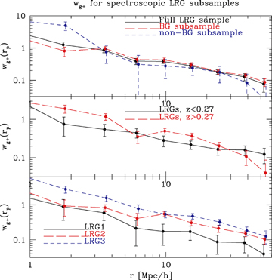
Figure 3 The density–shape correlation function w_{g+}(r_{p}) from 1 to 60 h⁻¹ Mpc with the ...
Notes:
Figure 3 The density–shape correlation function wg+(rp) from 1 to 60 h−1 Mpc with the full spectroscopic LRG sample and various subsamples as labelled on the plot. Errors are 1σ but are somewhat correlated on large scales.
Unless provided in the caption above, the following copyright applies to the content of this slide: © 2007 The Authors. Journal compilation © 2007 RAS

Slide 4
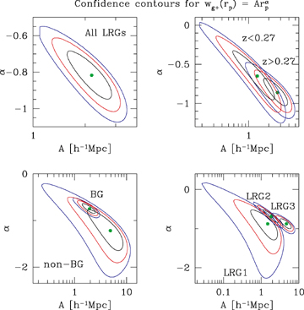
Figure 4 Confidence contours for power‐law fits to w_{g+}(r_{p}) for SDSS spectroscopic LRGs. Contours ...
Notes:
Figure 4 Confidence contours for power‐law fits to wg+(rp) for SDSS spectroscopic LRGs. Contours are shown for various subsets of data labelled on the plots; in each case, 1, 2 and 3σ contours are shown.
Unless provided in the caption above, the following copyright applies to the content of this slide: © 2007 The Authors. Journal compilation © 2007 RAS

Slide 5
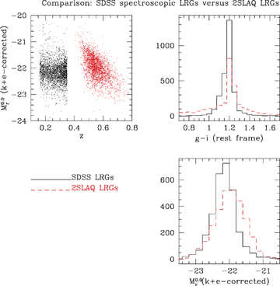
Figure 5 A comparison of the r‐band absolute magnitudes and colours of the SDSS and 2SLAQ LRG samples. The upper ...
Notes:
Figure 5 A comparison of the r‐band absolute magnitudes and colours of the SDSS and 2SLAQ LRG samples. The upper left‐hand panel shows the absolute magnitudes as a function of redshift. The upper right‐hand panel shows the distribution of g−i rest‐frame colour, and the lower right‐hand panel shows the absolute magnitude histograms over the full samples.
Unless provided in the caption above, the following copyright applies to the content of this slide: © 2007 The Authors. Journal compilation © 2007 RAS

Slide 6
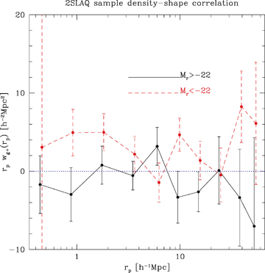
Figure 6 The galaxy density–shape correlation function r_{p}w_{g+}(r_{p}) from 1 to ...
Notes:
Figure 6 The galaxy density–shape correlation function rpwg+(rp) from 1 to 60 h−1 Mpc with the luminosity subsamples used to trace the shapes and the full 2SLAQ sample used for the galaxy density g. Errors are 1σ but are slightly correlated on large scales.
Unless provided in the caption above, the following copyright applies to the content of this slide: © 2007 The Authors. Journal compilation © 2007 RAS

Slide 7
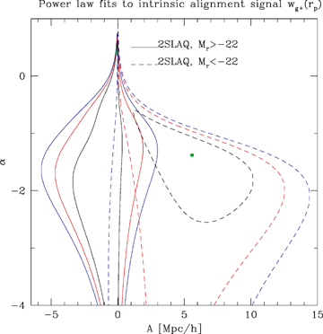
Figure 7 Confidence contours for power‐law fits to w_{g+}(r_{p}). 1, 2 and 3σ contours are shown for ...
Notes:
Figure 7 Confidence contours for power‐law fits to wg+(rp). 1, 2 and 3σ contours are shown for both luminosity subsamples.
Unless provided in the caption above, the following copyright applies to the content of this slide: © 2007 The Authors. Journal compilation © 2007 RAS

Slide 8
Figure 8 The projected galaxy–galaxy correlation functions w_{gg}(r_{p}) for the three samples and the ...
Notes:
Figure 8 The projected galaxy–galaxy correlation functions wgg(rp) for the three samples and the best‐fitting non‐linear power spectrum (using the Smith et al. 2003 mapping) to the 7.5–47 h−1 Mpc. Note that the error bars are correlated.
Unless provided in the caption above, the following copyright applies to the content of this slide: © 2007 The Authors. Journal compilation © 2007 RAS

Slide 9
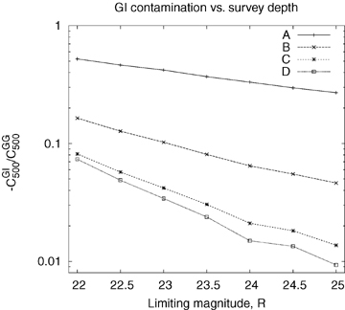
Figure 11 The GI contamination at l= 500 for the four models as a function of survey depth. We considered all galaxies ...
Notes:
Figure 11 The GI contamination at l= 500 for the four models as a function of survey depth. We considered all galaxies with R‐band magnitude less than the specified cut‐off, and z < 1.2.
Unless provided in the caption above, the following copyright applies to the content of this slide: © 2007 The Authors. Journal compilation © 2007 RAS

Slide 10
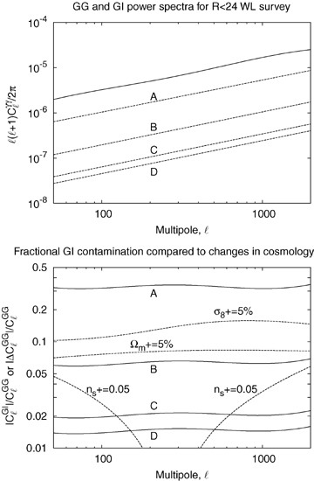
Figure 10 Upper panel: The cosmic shear power spectrum (solid line) and GI power spectra (dashed lines) for all ...
Notes:
Figure 10 Upper panel: The cosmic shear power spectrum (solid line) and GI power spectra (dashed lines) for all galaxies with R < 24. We plot the absolute value of GI since it is negative for all models. Lower panel: The fractional contamination of the power spectrum |CGIl|/CGGl (solid lines), compared to the change produced by several changes in the cosmological parameters |ΔCGGl|/CGGl (dashed lines). This ranges from ∼33 per cent for model A to ∼1.5 per cent for model D. We have plotted the range out to l= 2000 (k∼ 1 h Mpc−1 at the typical source redshift) since at smaller scales we cannot convert from wg+(rp) to wδ+(rp) (see Section 7). For the variations of cosmological parameters, Ωm is varied at fixed Ωmh2 and ns is varied at fixed σ8.
Unless provided in the caption above, the following copyright applies to the content of this slide: © 2007 The Authors. Journal compilation © 2007 RAS

Slide 11
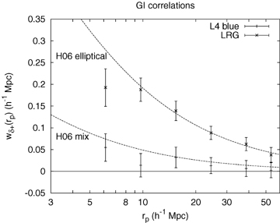
Figure 9 The GI correlation functions w_{δ+}(r_{p}) for the full SDSS LRG sample and the L4 blue ...
Notes:
Figure 9 The GI correlation functions wδ+(rp) for the full SDSS LRG sample and the L4 blue sample, with the galaxy‐to‐density conversion using biases of 1.99 and 1.12, respectively. The lines are the curves from Heymans et al. (2006b) at z= 0.27, interpreted using the procedure in Appendix B. The median redshift of the LRGs is zmed= 0.27; the L4 blue galaxies have zeff= 0.12, although we expect that evolution between 0.12 and 0.27 would make a small effect.
Unless provided in the caption above, the following copyright applies to the content of this slide: © 2007 The Authors. Journal compilation © 2007 RAS

