Slide 1
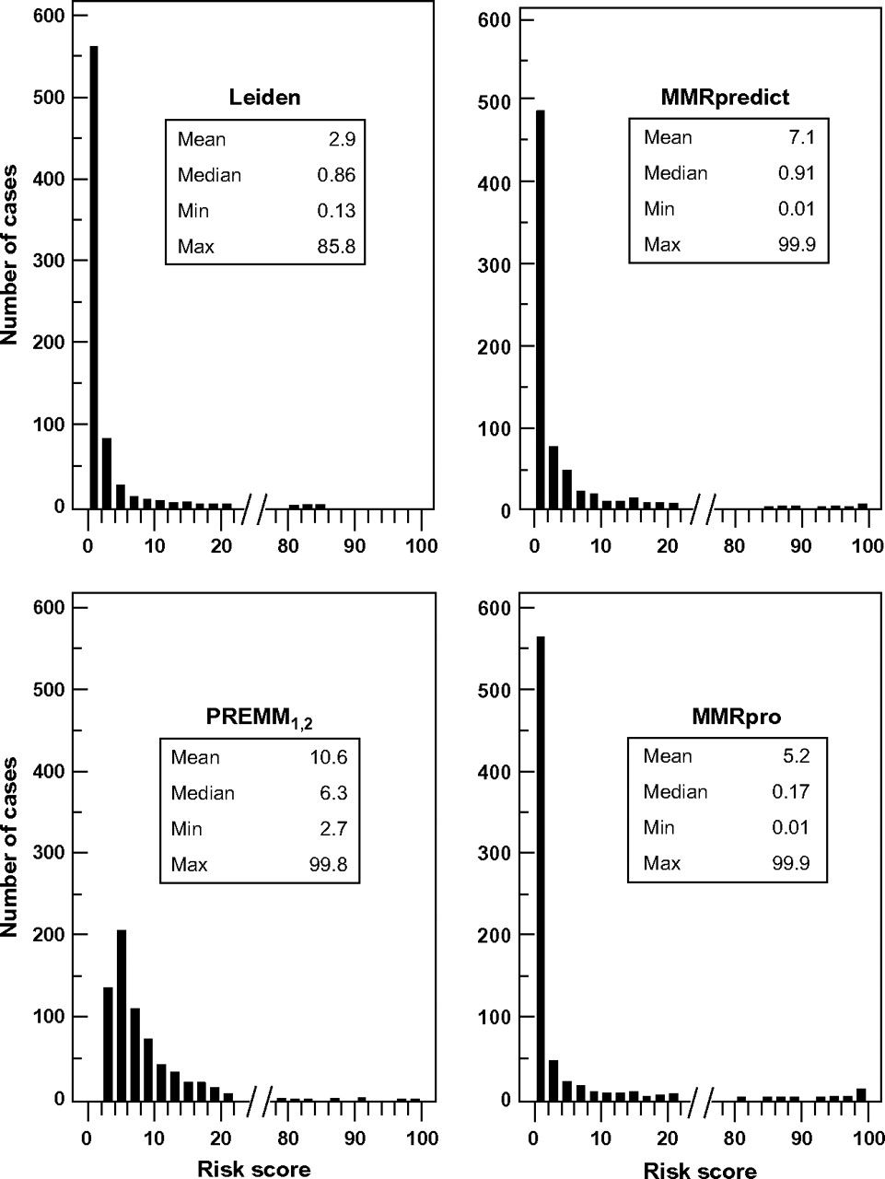
Figure 1 Distribution of risk scores for the Leiden, MMRpredict, PREMM_{1,2}, and MMRpro models. The mean, ...
Notes:
Figure 1 Distribution of risk scores for the Leiden, MMRpredict, PREMM1,2, and MMRpro models. The mean, median, minimum (Min), and maximum (Max) risk scores, expressed as percentages, for each model are shown. To reduce the size of the figures, data for risk scores between 20% and 80% have been excluded. The frequency distribution of the missing data is similar to that on either side of the break. Supplementary Figure 1, showing the complete range of data, is available online.
Unless provided in the caption above, the following copyright applies to the content of this slide: © The Author 2009. Published by Oxford University Press.

Slide 2
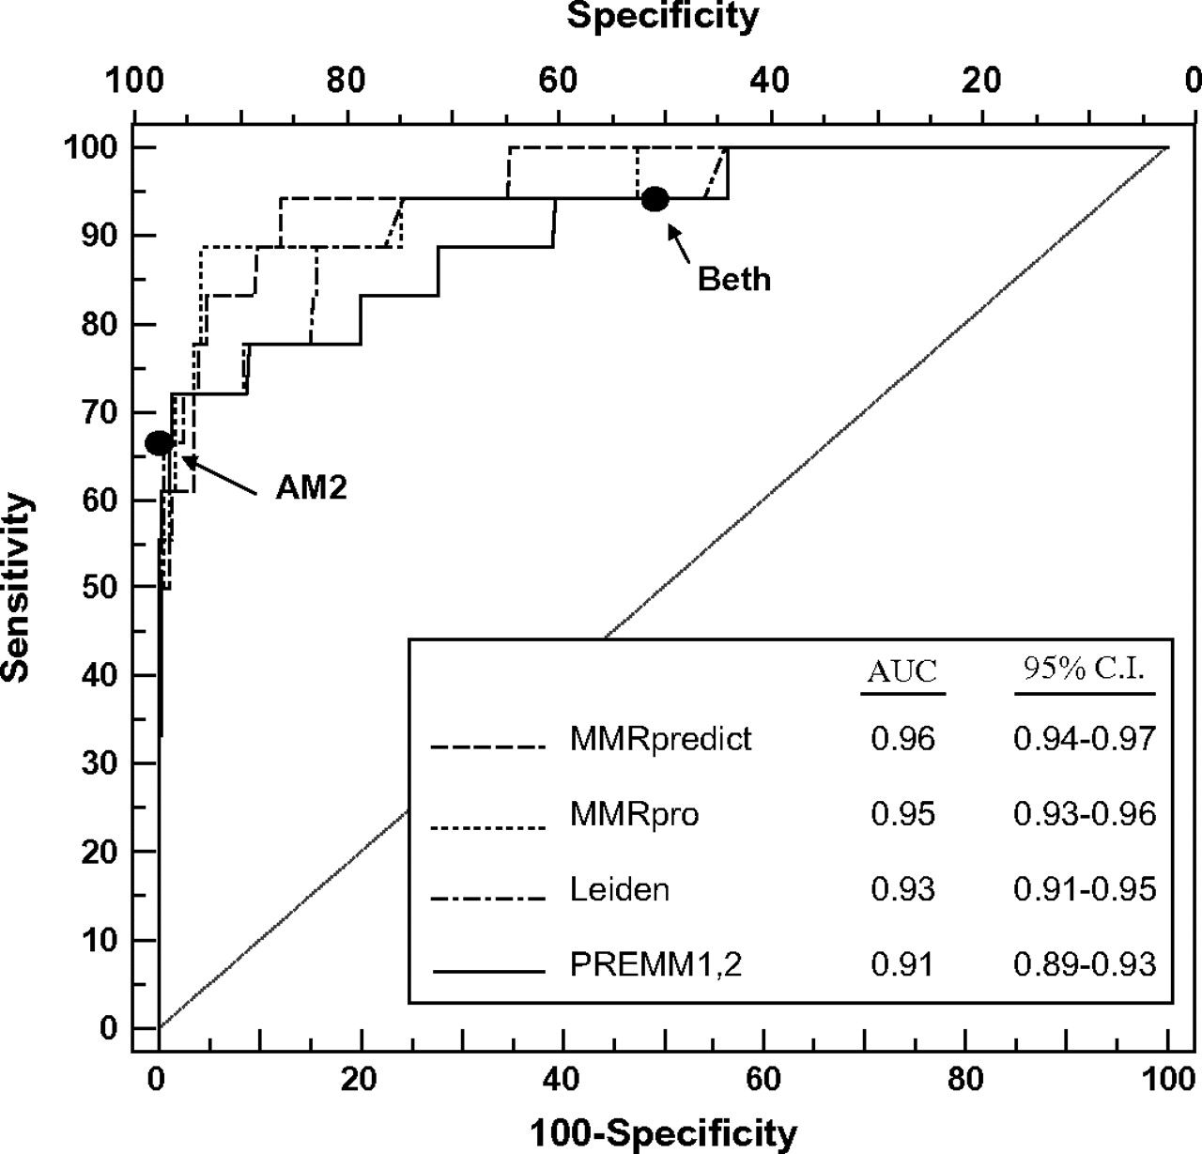
Figure 2 Receiver operating characteristics curves for the Leiden, MMRpredict, PREMM_{1,2}, and MMRpro models. ...
Notes:
Figure 2 Receiver operating characteristics curves for the Leiden, MMRpredict, PREMM1,2, and MMRpro models. Black dots = the sensitivity and specificity of the Amsterdam II criteria (AM2) and the revised Bethesda (Beth) criteria, as indicated. The diagonal line represents the so-called line of no-discrimination. AUC = area under the curve; CI = confidence interval.
Unless provided in the caption above, the following copyright applies to the content of this slide: © The Author 2009. Published by Oxford University Press.

Slide 3
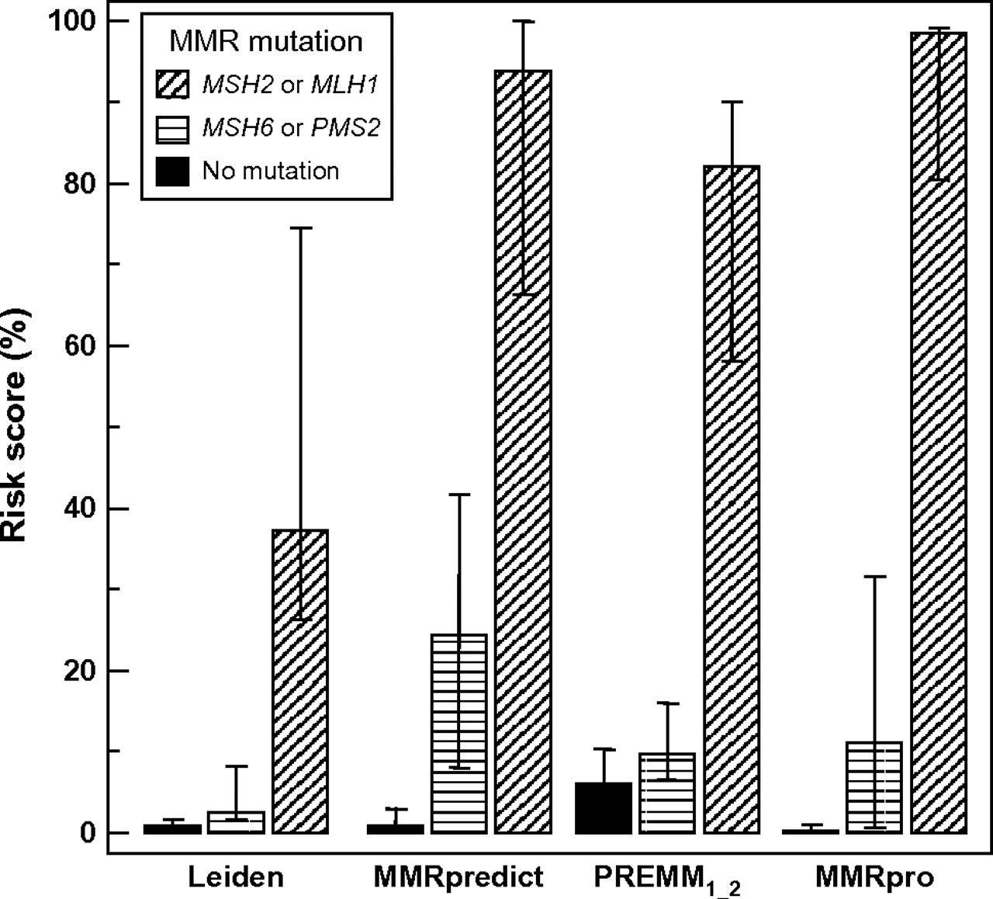
Figure 3 Median probability of the index patient carrying a DNA mismatch repair gene mutation, for the Leiden, ...
Notes:
Figure 3 Median probability of the index patient carrying a DNA mismatch repair gene mutation, for the Leiden, MMRpredict, PREMM1,2, and MMRpro models. Error bars = 25th–75th percentiles (the interquartile range).
Unless provided in the caption above, the following copyright applies to the content of this slide: © The Author 2009. Published by Oxford University Press.

Slide 4
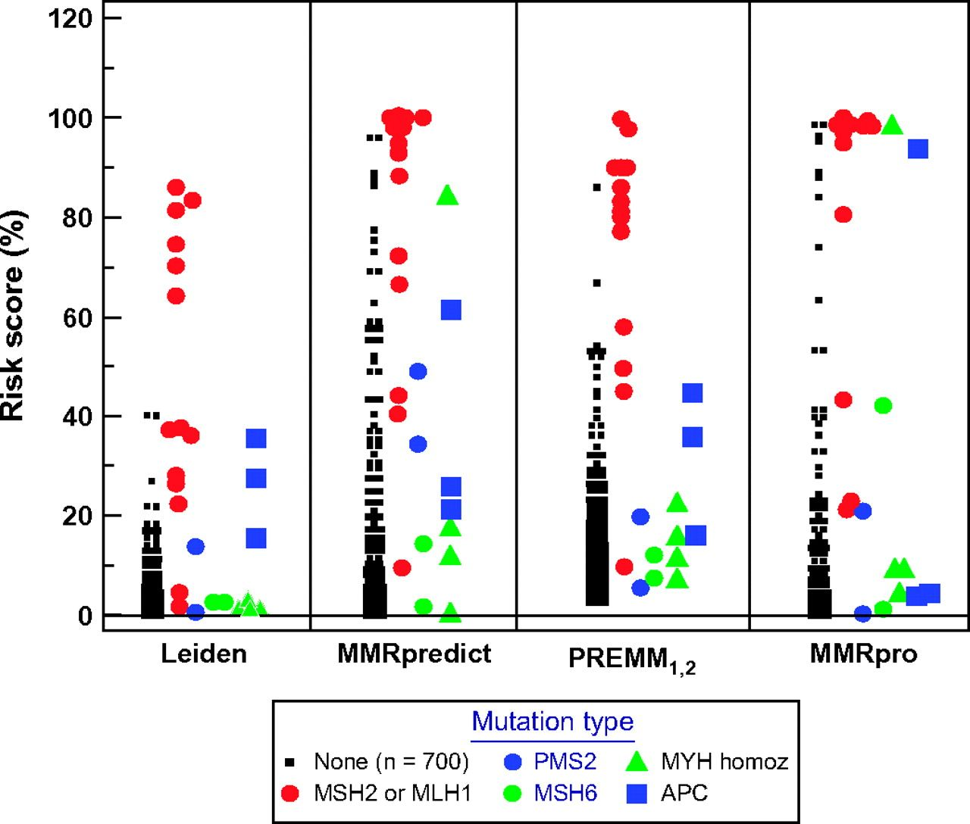
Figure 4 Distribution of individual risk scores as calculated by the Leiden, MMRpredict, PREMM_{1,2}, and ...
Notes:
Figure 4 Distribution of individual risk scores as calculated by the Leiden, MMRpredict, PREMM1,2, and MMRpro models. Each symbol represents the risk score of an individual patient.
Unless provided in the caption above, the following copyright applies to the content of this slide: © The Author 2009. Published by Oxford University Press.

Slide 5
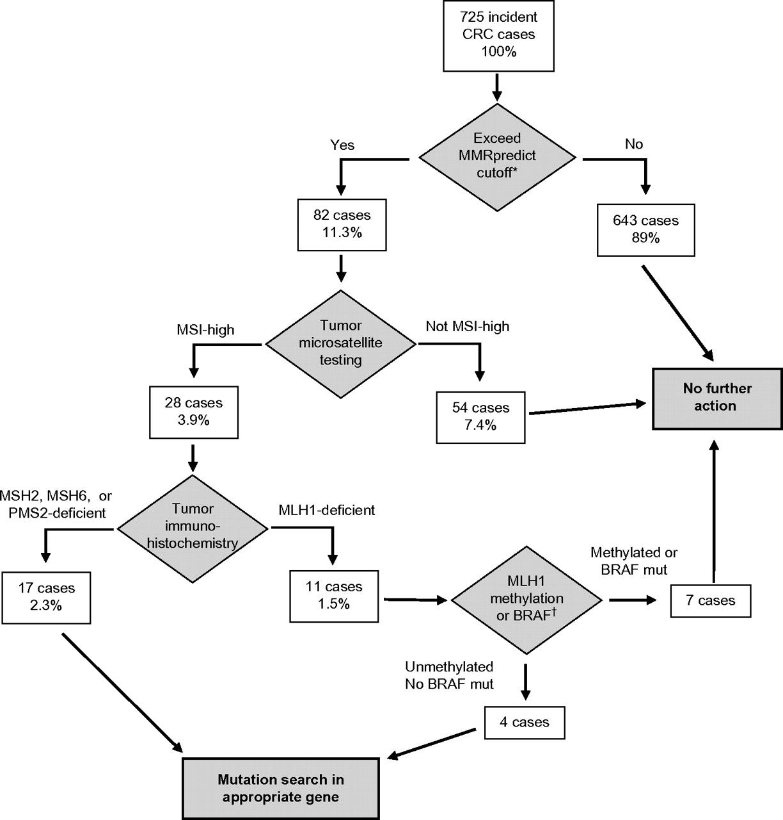
Figure 5 Flow chart for identifying Lynch syndrome mutations, including use of the MMRpredict model. MSI-high ...
Notes:
Figure 5 Flow chart for identifying Lynch syndrome mutations, including use of the MMRpredict model. MSI-high indicates that 30% or more of microsatellite loci tested were unstable. MSI = microsatellite instability; CRC = colorectal cancer. *Cutoff for the ratio of MMRpredict score to SISE coefficient > 1.66. †The tumor carried a methylated MLH1 promoter or a BRAF gene with the V600E mutation.
Unless provided in the caption above, the following copyright applies to the content of this slide: © The Author 2009. Published by Oxford University Press.

