Slide 1
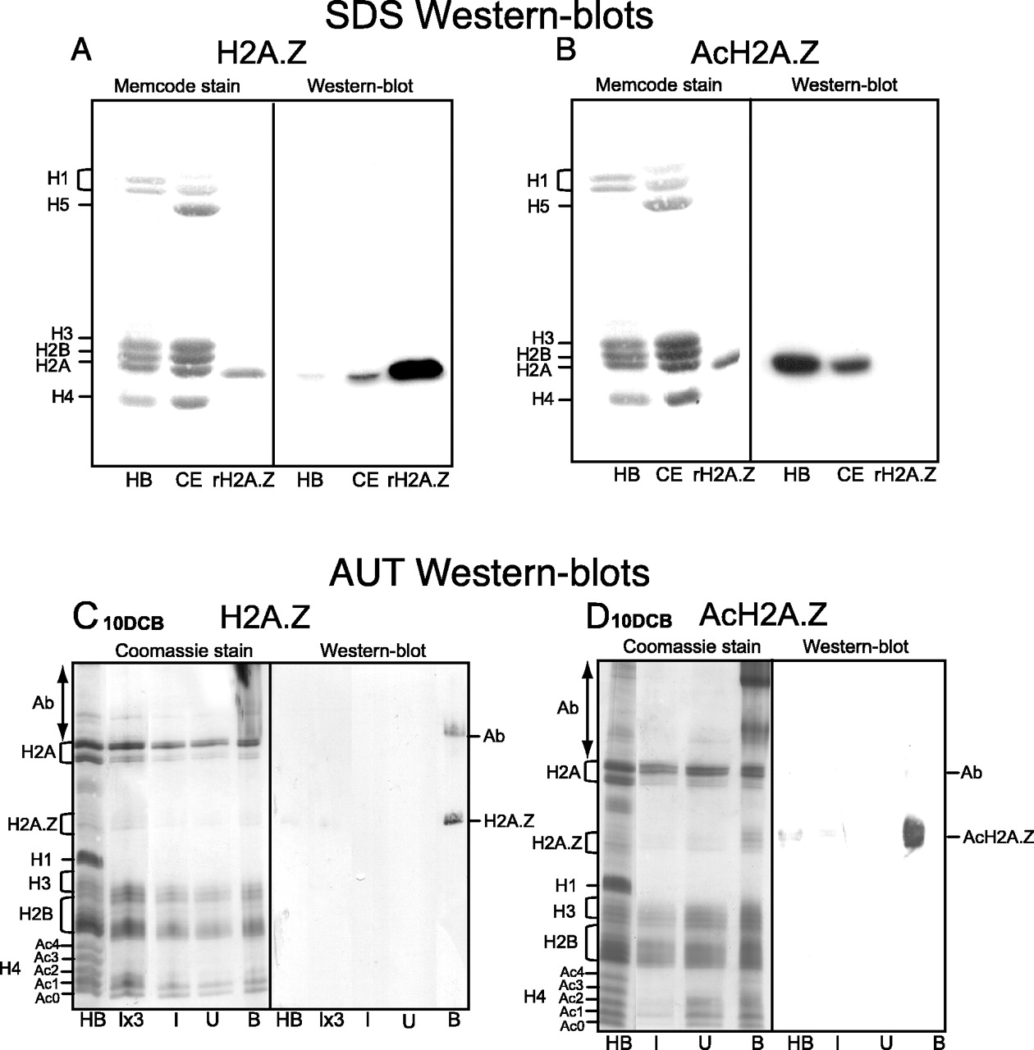
Figure 1 (A and B) Characterization of anti-H2A.Z and anti-AcH2A.Z affinity purified antibodies. HB, butyrate-treated ...
Notes:
Figure 1 (A and B) Characterization of anti-H2A.Z and anti-AcH2A.Z affinity purified antibodies. HB, butyrate-treated HeLa histones; CE, 15-day embryo chicken erythrocyte histones; rH2A.Z, recombinant H2A.Z. (C and D) Characterization of proteins from ChIPs using these affinity purified antibodies with nucleosomes from 10-day chicken brain tissue (10DCB). I, U, B: Input, Unbound, Bound histones; Ab, carry-over products of primary antibodies.
Unless provided in the caption above, the following copyright applies to the content of this slide: © The Author 2005. Published by Oxford University Press. All rights reserved The online version of this article has been published under an open access model. Users are entitled to use, reproduce, disseminate, or display the open access version of this article for non-commercial purposes provided that: the original authorship is properly and fully attributed; the Journal and Oxford University Press are attributed as the original place of publication with the correct citation details given; if an article is subsequently reproduced or disseminated not in its entirety but only in part or as a derivative work this must be clearly indicated. For commercial re-use, please contact journals.permissions@oxfordjournals.org

Slide 2
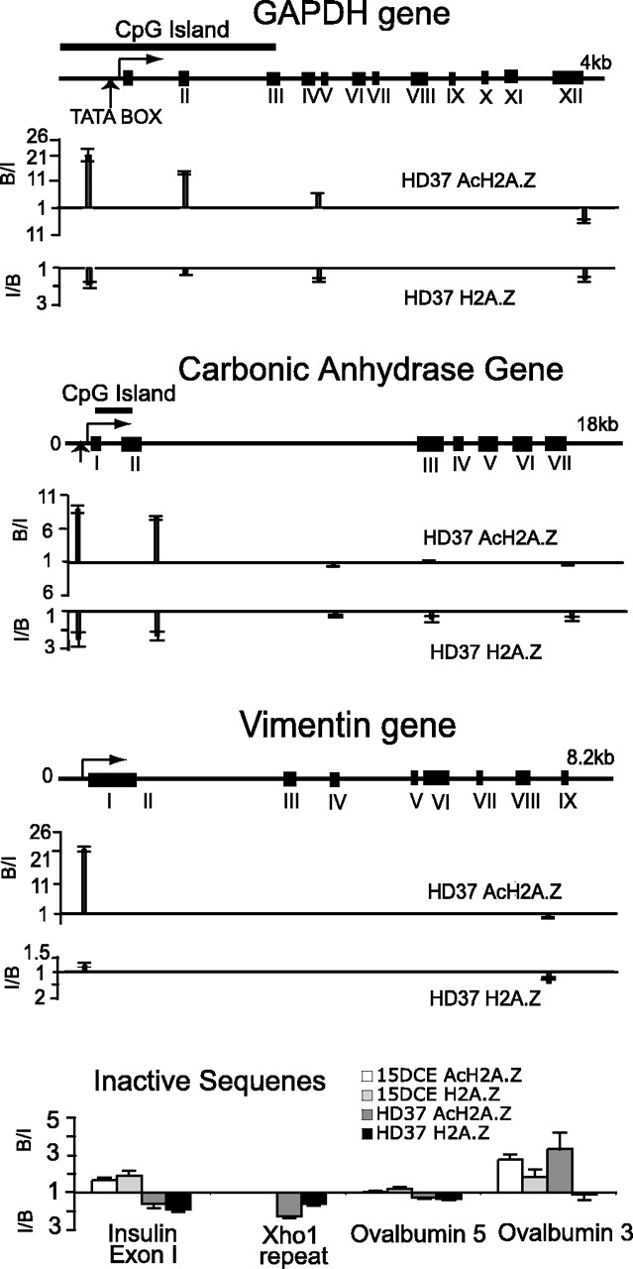
Figure 2 Distributions of H2A.Z and AcH2A.Z at two housekeeping genes, GAPDH and vimentin and the tissue-specific gene ...
Notes:
Figure 2 Distributions of H2A.Z and AcH2A.Z at two housekeeping genes, GAPDH and vimentin and the tissue-specific gene carbonic anhydrase in HD37 erythroblasts. The bottom panel shows four amplicons at inactive sequences in HD37 cells and 15DCE. B/I values (the ratio of the Bound to the Input signal for an amplicon) above the unity lines represent ‘fold enrichment’ achieved by the antibodies. I/B values are plotted below the unity lines when the Bound signal is less than that of the Input: this ratio represents ‘fold depletion’.
Unless provided in the caption above, the following copyright applies to the content of this slide: © The Author 2005. Published by Oxford University Press. All rights reserved The online version of this article has been published under an open access model. Users are entitled to use, reproduce, disseminate, or display the open access version of this article for non-commercial purposes provided that: the original authorship is properly and fully attributed; the Journal and Oxford University Press are attributed as the original place of publication with the correct citation details given; if an article is subsequently reproduced or disseminated not in its entirety but only in part or as a derivative work this must be clearly indicated. For commercial re-use, please contact journals.permissions@oxfordjournals.org

Slide 3
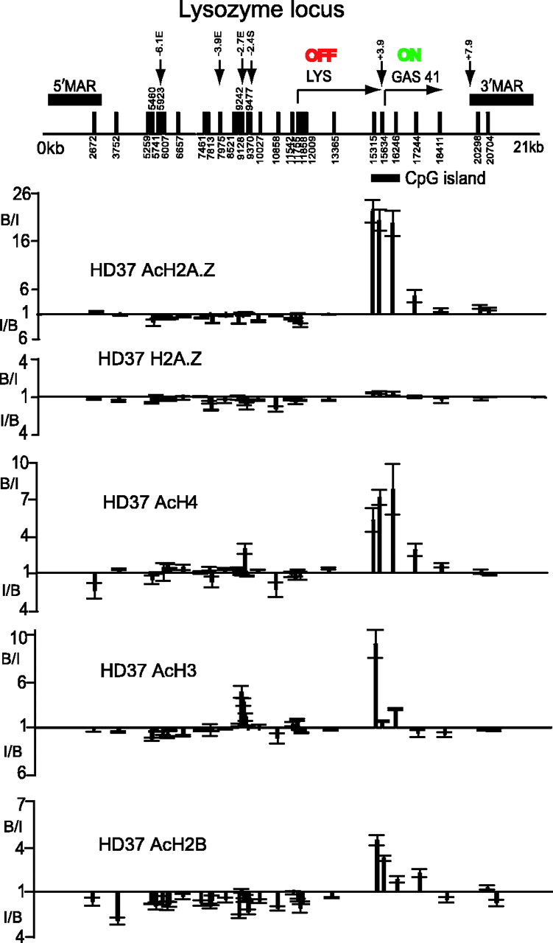
Figure 3 Distributions of H2A.Z, AcH2A.Z, AcH4, AcH3 and AcH2B at the lysozyme locus in HD37 erythroblasts. Vertical ...
Notes:
Figure 3 Distributions of H2A.Z, AcH2A.Z, AcH4, AcH3 and AcH2B at the lysozyme locus in HD37 erythroblasts. Vertical arrows = DNase I hypersensitive sites and vertical bars with numbers indicate amplicon positions. The two genes, their transcriptional status, the 5′ and 3′ matrix attachment regions (MARs) and the CpG island are indicated. B/I values (the ratio of the Bound to the Input signal for an amplicon) above the unity lines represent ‘fold enrichment’ achieved by the antibodies. I/B values are plotted below the unity lines when the Bound signal is less than that of the Input: this ratio represents ‘fold depletion’.
Unless provided in the caption above, the following copyright applies to the content of this slide: © The Author 2005. Published by Oxford University Press. All rights reserved The online version of this article has been published under an open access model. Users are entitled to use, reproduce, disseminate, or display the open access version of this article for non-commercial purposes provided that: the original authorship is properly and fully attributed; the Journal and Oxford University Press are attributed as the original place of publication with the correct citation details given; if an article is subsequently reproduced or disseminated not in its entirety but only in part or as a derivative work this must be clearly indicated. For commercial re-use, please contact journals.permissions@oxfordjournals.org

Slide 4
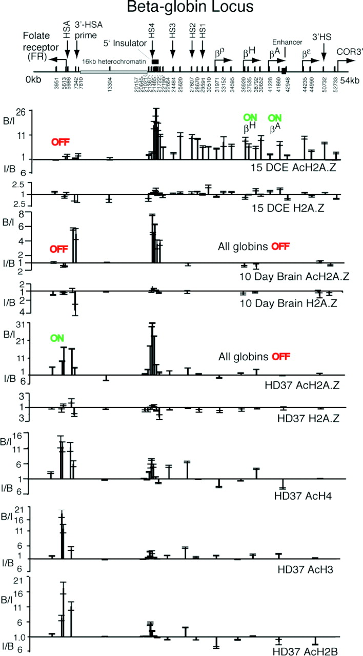
Figure 4 Distributions of H2A.Z, AcH2A.Z, AcH4, AcH3 and AcH2B at the β-globin locus/folate receptor gene in 15-day ...
Notes:
Figure 4 Distributions of H2A.Z, AcH2A.Z, AcH4, AcH3 and AcH2B at the β-globin locus/folate receptor gene in 15-day chicken embryo erythrocytes (15DCE), 10-day chicken brain tissue (10DCB) and HD37 chicken erythroblasts. Nomenclature as in Figure 3. B/I values (the ratio of the Bound to the Input signal for an amplicon) above the unity lines represent ‘fold enrichment’ achieved by the antibodies. I/B values are plotted below the unity lines when the Bound signal is less than that of the Input: this ratio represents ‘fold depletion’.
Unless provided in the caption above, the following copyright applies to the content of this slide: © The Author 2005. Published by Oxford University Press. All rights reserved The online version of this article has been published under an open access model. Users are entitled to use, reproduce, disseminate, or display the open access version of this article for non-commercial purposes provided that: the original authorship is properly and fully attributed; the Journal and Oxford University Press are attributed as the original place of publication with the correct citation details given; if an article is subsequently reproduced or disseminated not in its entirety but only in part or as a derivative work this must be clearly indicated. For commercial re-use, please contact journals.permissions@oxfordjournals.org

Slide 5
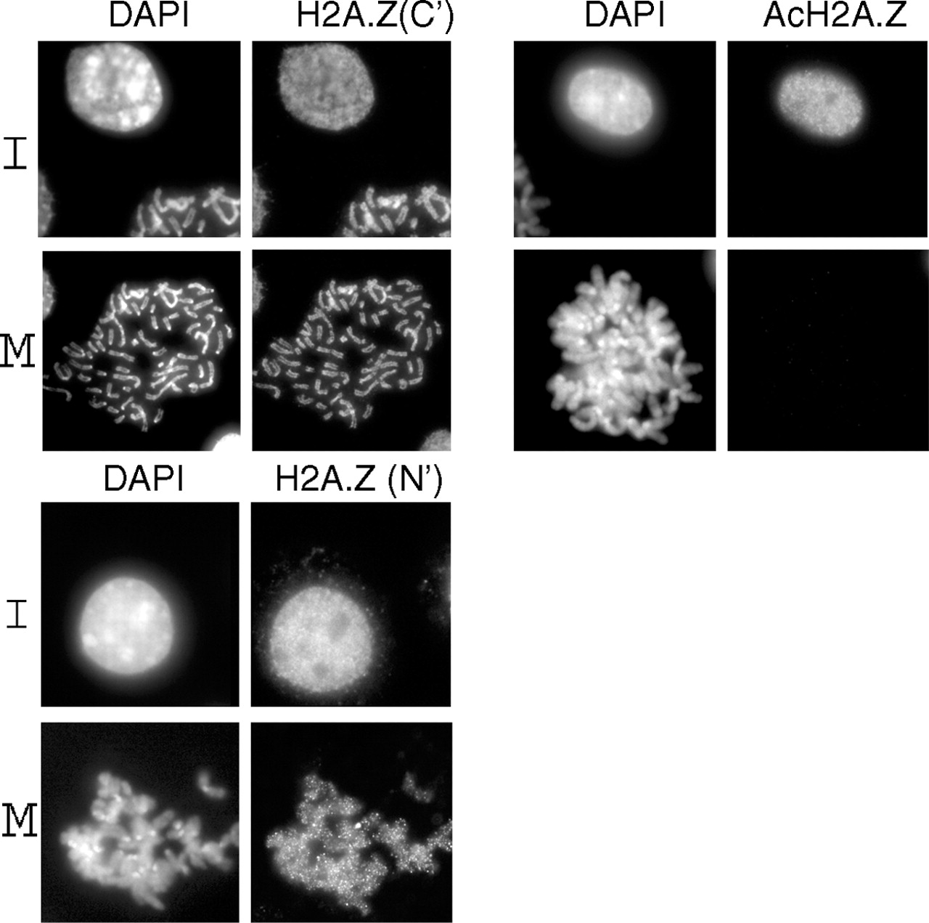
Figure 5 Mouse L929 cell nuclei stained with DAPI and three different antibodies: H2A.Z(N′) and AcH2A.Z raised to the ...
Notes:
Figure 5 Mouse L929 cell nuclei stained with DAPI and three different antibodies: H2A.Z(N′) and AcH2A.Z raised to the N-terminal tail of H2A.Z (the present antibodies) and an antibody previously raised (8) to a C-terminal epitope, H2A.Z(C′).
Unless provided in the caption above, the following copyright applies to the content of this slide: © The Author 2005. Published by Oxford University Press. All rights reserved The online version of this article has been published under an open access model. Users are entitled to use, reproduce, disseminate, or display the open access version of this article for non-commercial purposes provided that: the original authorship is properly and fully attributed; the Journal and Oxford University Press are attributed as the original place of publication with the correct citation details given; if an article is subsequently reproduced or disseminated not in its entirety but only in part or as a derivative work this must be clearly indicated. For commercial re-use, please contact journals.permissions@oxfordjournals.org

