Slide 1
Table 6 The results of virus isolation tests before and after oseltamivir therapy.
Notes:
Table 6 The results of virus isolation tests before and after oseltamivir therapy.
Unless provided in the caption above, the following copyright applies to the content of this slide: © 2006 by the Infectious Diseases Society of America

Slide 2
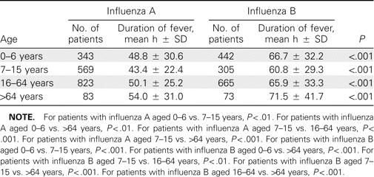
Table 5 Duration of fever for influenza A and influenza B, by patient age.
Notes:
Table 5 Duration of fever for influenza A and influenza B, by patient age.
Unless provided in the caption above, the following copyright applies to the content of this slide: © 2006 by the Infectious Diseases Society of America

Slide 3
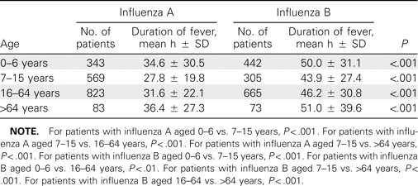
Table 4 Duration of fever after administration of the first dose of oseltamivir for influenza A or influenza B, by ...
Notes:
Table 4 Duration of fever after administration of the first dose of oseltamivir for influenza A or influenza B, by patient age.
Unless provided in the caption above, the following copyright applies to the content of this slide: © 2006 by the Infectious Diseases Society of America

Slide 4
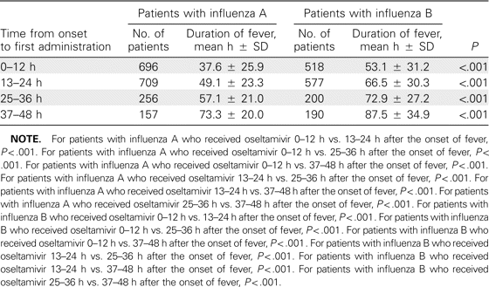
Table 3 Duration of fever for patients with influenza A and those with influenza B, by time to the first ...
Notes:
Table 3 Duration of fever for patients with influenza A and those with influenza B, by time to the first administration of oseltamivir after the onset of fever.
Unless provided in the caption above, the following copyright applies to the content of this slide: © 2006 by the Infectious Diseases Society of America

Slide 5
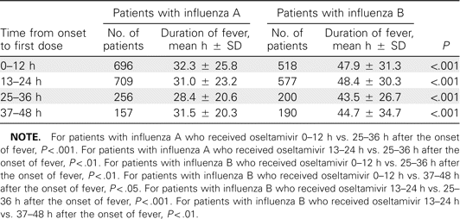
Table 2 Duration of fever after administration of the first dose of oseltamivir for patients with influenza A or ...
Notes:
Table 2 Duration of fever after administration of the first dose of oseltamivir for patients with influenza A or influenza B, by time to administration of the first dose after the onset of fever.
Unless provided in the caption above, the following copyright applies to the content of this slide: © 2006 by the Infectious Diseases Society of America

Slide 6
Table 1 Characteristics of patients in a comparison of the effectiveness of oseltamivir for the treatment of ...
Notes:
Table 1 Characteristics of patients in a comparison of the effectiveness of oseltamivir for the treatment of influenza A and influenza B.
Unless provided in the caption above, the following copyright applies to the content of this slide: © 2006 by the Infectious Diseases Society of America

