Slide 1
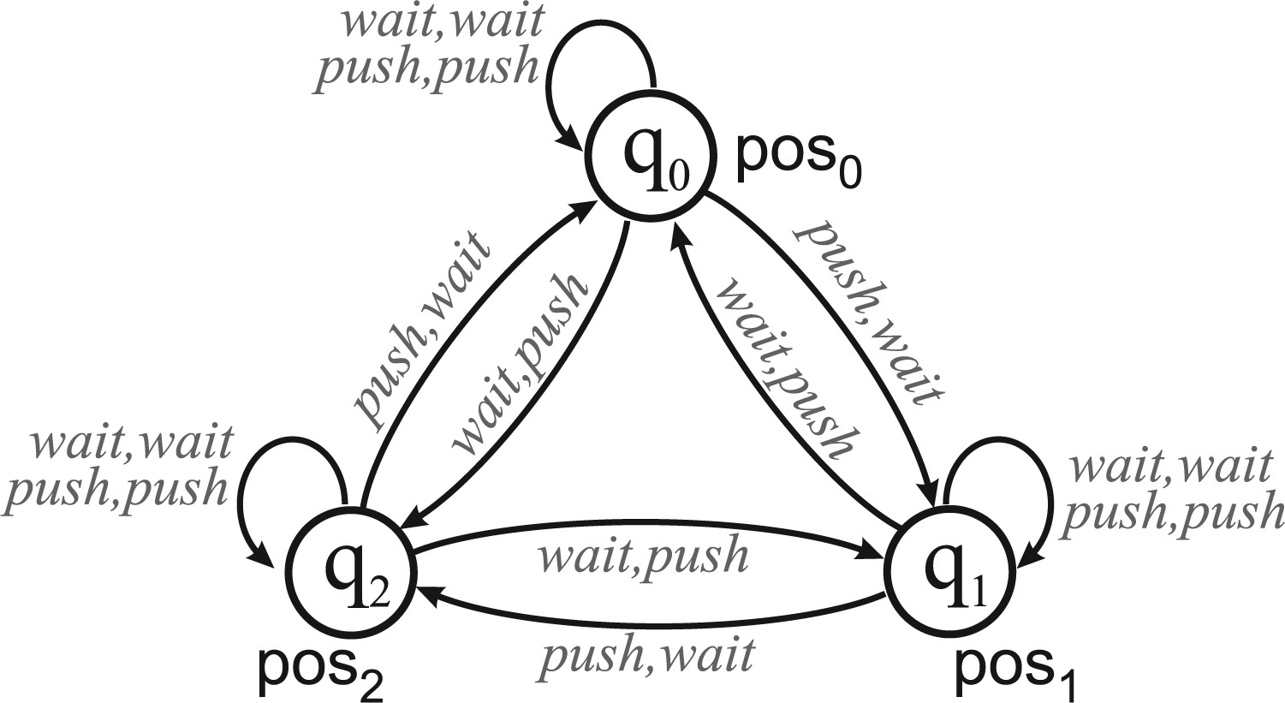
Figure 1. Robots and carriage: concurrent game structure $M_1$.
Notes:
Figure 1. Robots and carriage: concurrent game structure $M_1$.
Unless provided in the caption above, the following copyright applies to the content of this slide: © The Author, 2017. Published by Oxford University Press. All rights reserved. For Permissions, please email: journals.permissions@oup.com

Slide 2
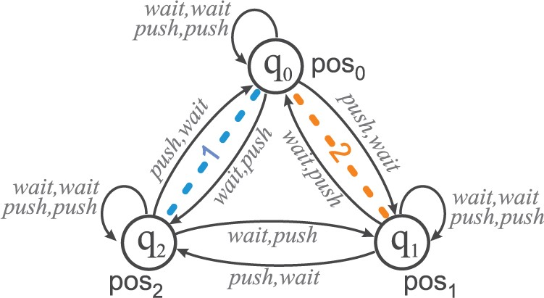
Figure 2. Robots and carriage under uncertainty: iCGS $M_2$.
Notes:
Figure 2. Robots and carriage under uncertainty: iCGS $M_2$.
Unless provided in the caption above, the following copyright applies to the content of this slide: © The Author, 2017. Published by Oxford University Press. All rights reserved. For Permissions, please email: journals.permissions@oup.com

