Slide 1
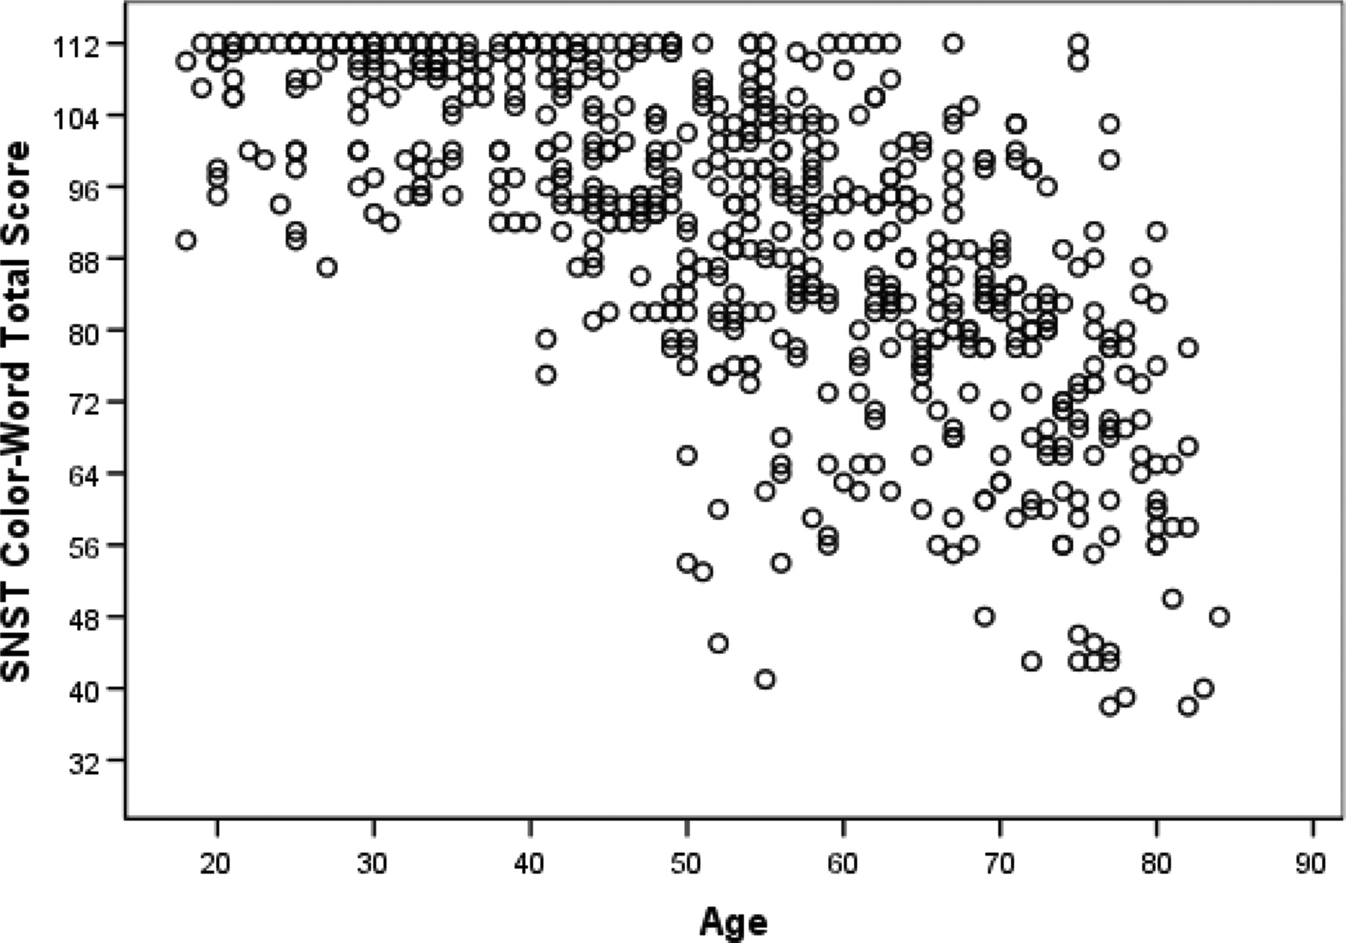
Fig. 1. Scatter plot demonstrating Stroop Neuropsychological Screening Test Color–Word total score by age.
Notes:
Fig. 1. Scatter plot demonstrating Stroop Neuropsychological Screening Test Color–Word total score by age.
Unless provided in the caption above, the following copyright applies to the content of this slide: © The Author 2009. Published by Oxford University Press on behalf of the National Academy of Neuropsychology. All rights reserved. For permissions, please e-mail: journals.permissions@oxfordjournals.org.

