Slide 1
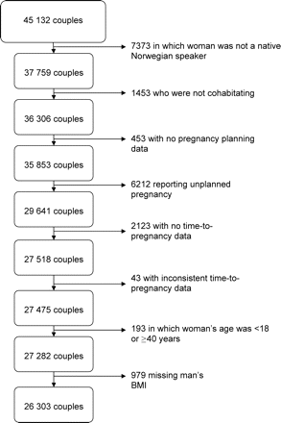
Figure 1: Flow chart of exclusions from the study sample resulting in 26 303 Norwegian couples, 1999–2005.
Notes:
Figure 1: Flow chart of exclusions from the study sample resulting in 26 303 Norwegian couples, 1999–2005. The first three exclusion categories also include some women who were missing data for that variable
Unless provided in the caption above, the following copyright applies to the content of this slide: Published by Oxford University Press on behalf of the European Society of Human Reproduction and Embryology. All rights reserved. For Permissions, please email: journals.permissions@oxfordjournals.org

Slide 2
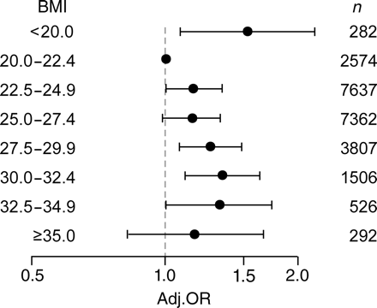
Figure 2: Adjusted OR, 95% CI and number of men by men's BMI categories among 23 986 men in Norway, 1999–2005.
Notes:
Figure 2: Adjusted OR, 95% CI and number of men by men's BMI categories among 23 986 men in Norway, 1999–2005. Model adjusted for women's BMI category (same eight categories as the men), women's and men's ages at the beginning of the pregnancy attempt, women's smoking at the beginning of pregnancy attempt, men's smoking during the first trimester of pregnancy and coital frequency. Reference BMI category is 20.0–22.49
Unless provided in the caption above, the following copyright applies to the content of this slide: Published by Oxford University Press on behalf of the European Society of Human Reproduction and Embryology. All rights reserved. For Permissions, please email: journals.permissions@oxfordjournals.org

