Slide 1
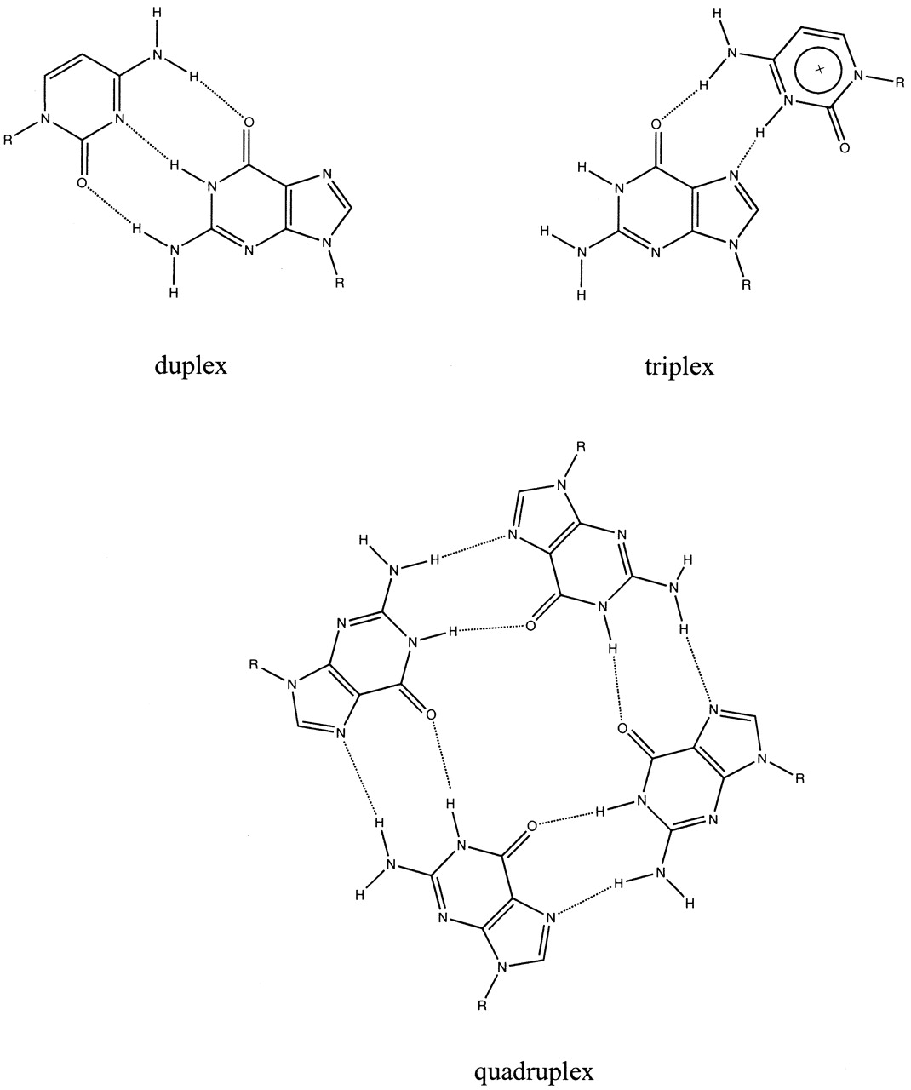
Figure 1. Schematic representations of duplex d(G·C), triplex d(G·C-C)⁺ and quadruplex ...
Notes:
Figure 1. Schematic representations of duplex d(G·C), triplex d(G·C-C)+ and quadruplex d(G)4 pairings.
Unless provided in the caption above, the following copyright applies to the content of this slide:

Slide 2
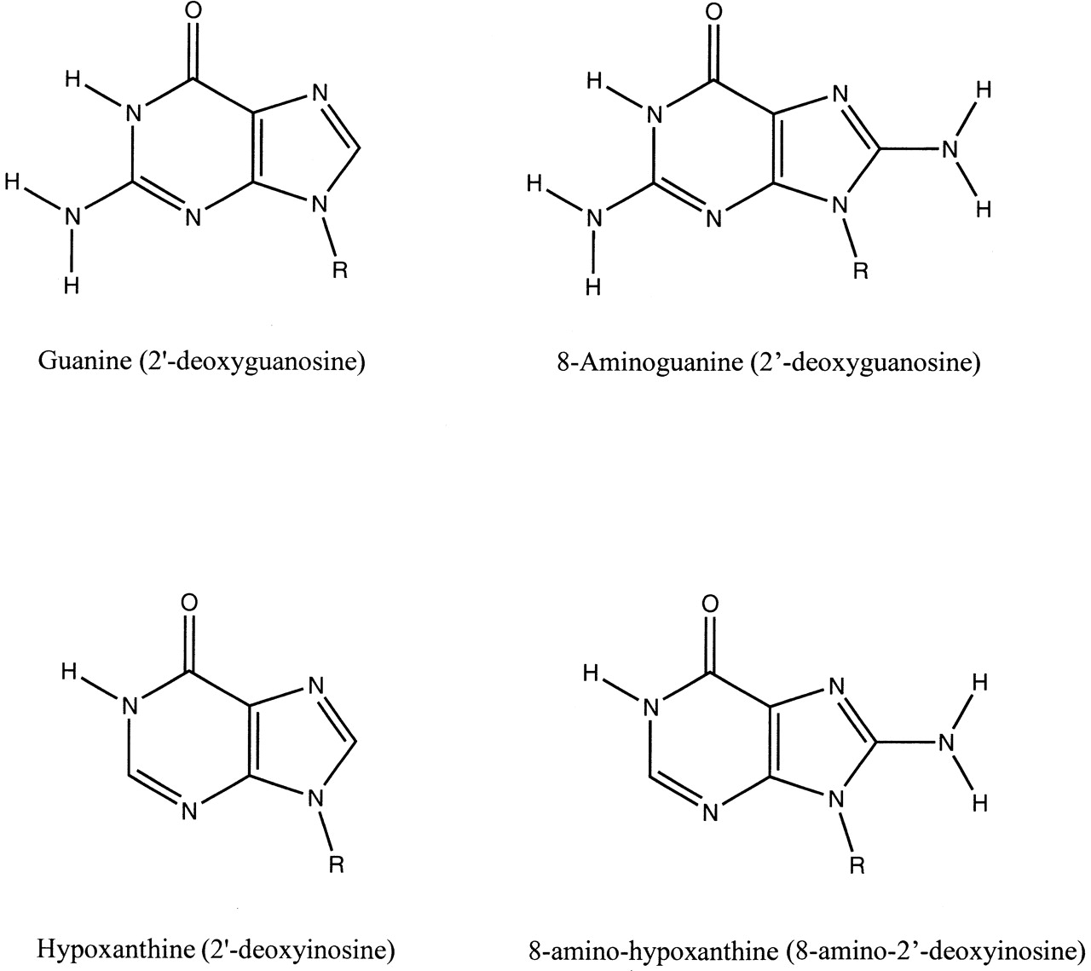
Figure 2. Schematic representation of the nucleobases and 2′-deoxynucleotides (names in parentheses) ...
Notes:
Figure 2. Schematic representation of the nucleobases and 2′-deoxynucleotides (names in parentheses) considered in this study.
Unless provided in the caption above, the following copyright applies to the content of this slide:

Slide 3
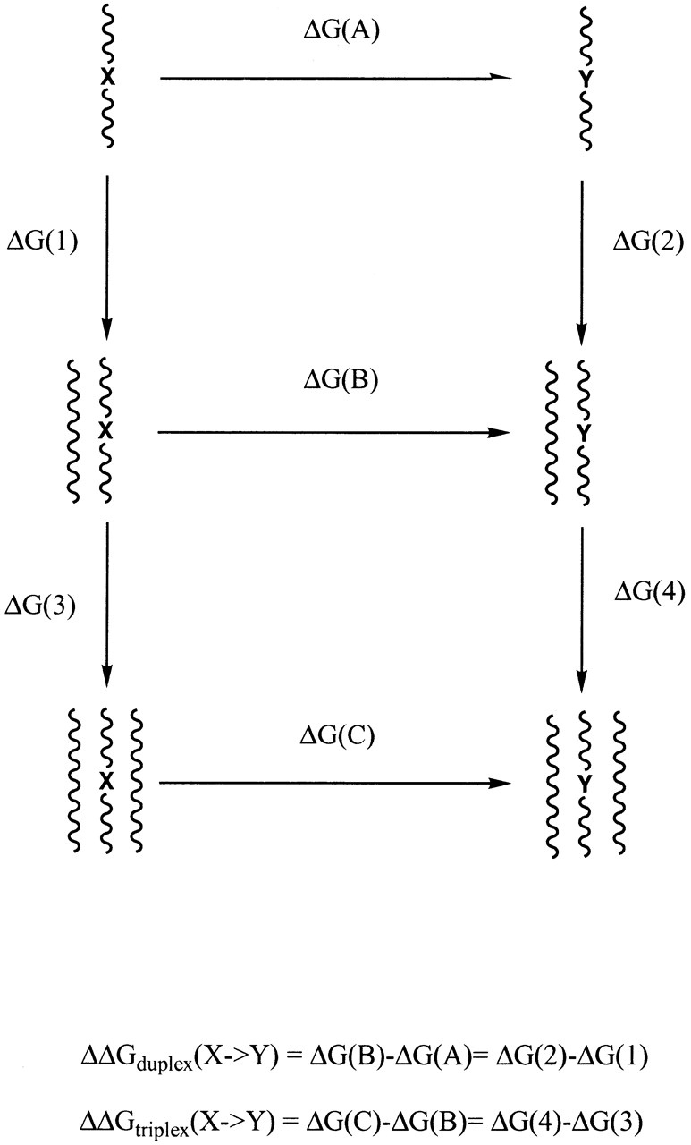
Figure 3. Thermodynamic cycle used to compute differences in the stability of duplex and triplex structures ...
Notes:
Figure 3. Thermodynamic cycle used to compute differences in the stability of duplex and triplex structures induced by the substitutions G↔I and I↔8AI.
Unless provided in the caption above, the following copyright applies to the content of this slide:

Slide 4
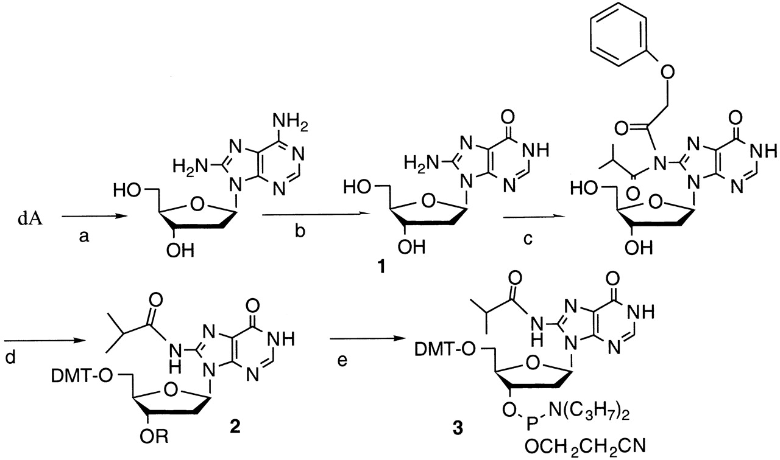
Figure 4. Preparation of the phosphoramidite of 8AI. (a) Reference (56), (b) adenosine deaminase, (c) ...
Notes:
Figure 4. Preparation of the phosphoramidite of 8AI. (a) Reference (56), (b) adenosine deaminase, (c) hexamethyldisilazane followed by phenoxyacetic anhydride in pyridine followed by isobutyryl chloride, (d) dimethoxytrityl chloride in pyridine, (e) chloro 2-cyanoethoxy diisopropylamino phosphine.
Unless provided in the caption above, the following copyright applies to the content of this slide:

Slide 5
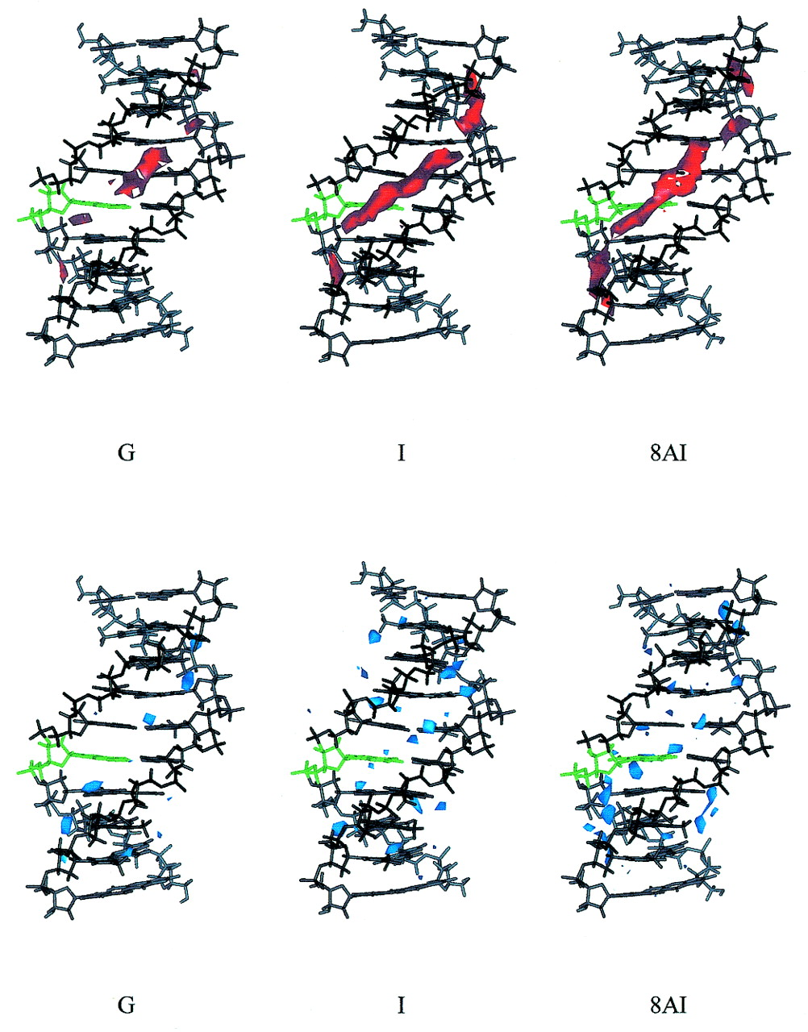
Figure 5. Classical molecular interaction potential (cMIP) (top, in red) and solvation maps (bottom, in blue) ...
Notes:
Figure 5. Classical molecular interaction potential (cMIP) (top, in red) and solvation maps (bottom, in blue) for the three duplexes of the family d(GAAGXAGGAG) considered in the study (from left to right duplexes X = G, I and 8AI). Contour levels are –5.0 kcal/mol (cMIP), and apparent density of 2.5 g/ml for solvation maps. The base X is shown in green.
Unless provided in the caption above, the following copyright applies to the content of this slide:

Slide 6
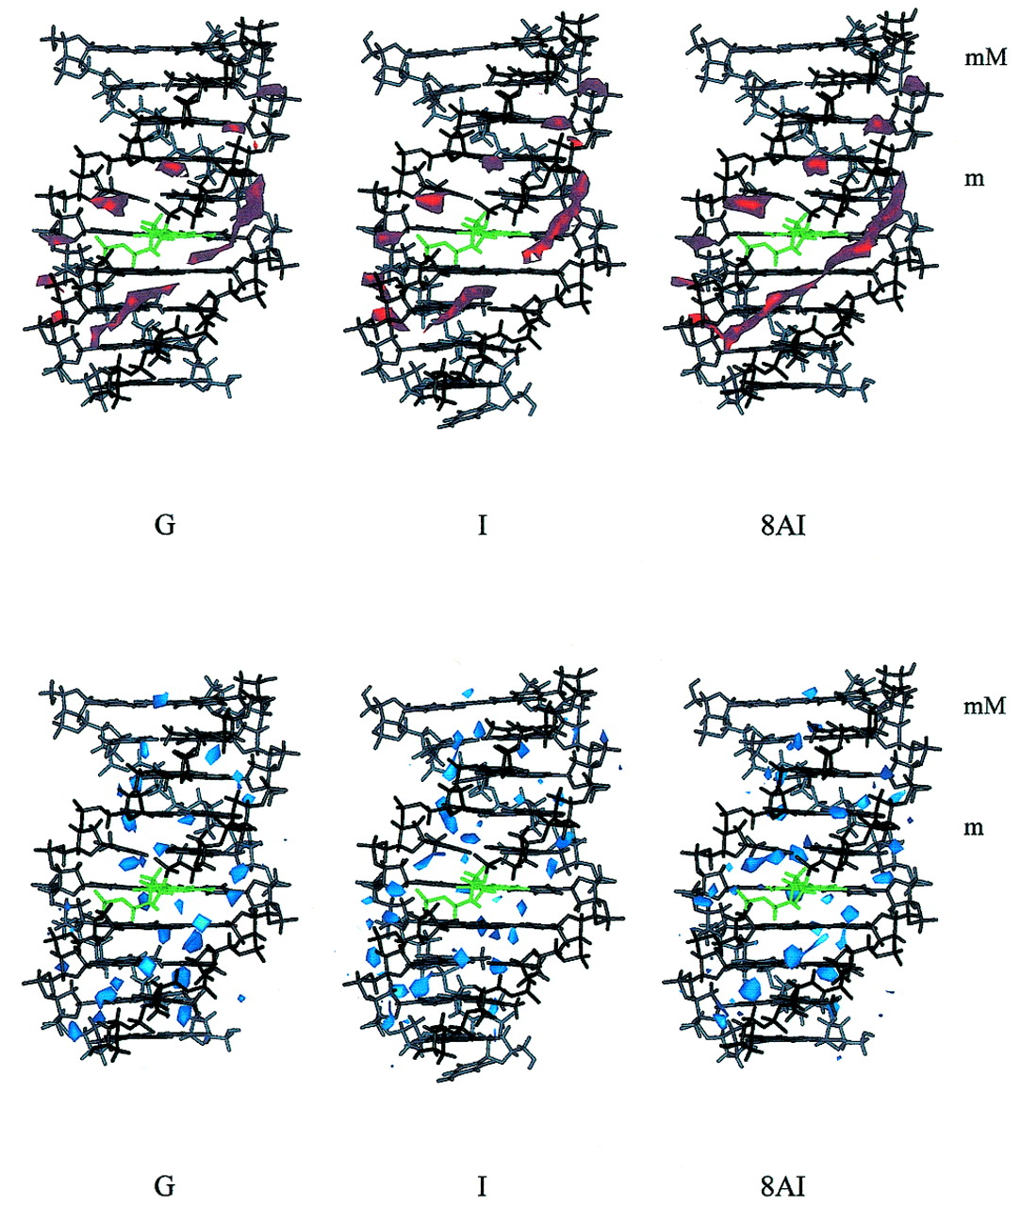
Figure 6. cMIP (top, in red) and solvation maps (bottom, in blue) for the three triplexes considered in the ...
Notes:
Figure 6. cMIP (top, in red) and solvation maps (bottom, in blue) for the three triplexes considered in the study (from left to right triplexes X = G, I and 8AI). Contour levels are –5.0 kcal/mol (cMIP), and apparent density of 3.0 g/ml for solvation maps. The base X is shown in green.
Unless provided in the caption above, the following copyright applies to the content of this slide:

Slide 7
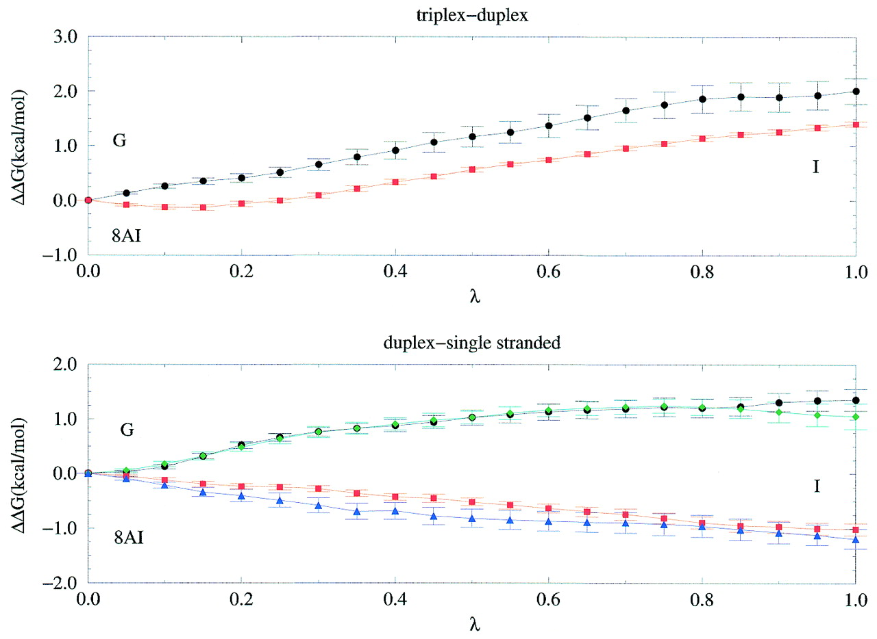
Figure 7. Difference (triplex–duplex and duplex–single-stranded) free energy profiles (in kcal/mol) obtained ...
Notes:
Figure 7. Difference (triplex–duplex and duplex–single-stranded) free energy profiles (in kcal/mol) obtained from the different mutations. Black, mutation G→I in the d(GAAGXAGGAG) duplex and triplex; green, mutation G→I in the d(GAGGXTCCAG) duplex; red, mutation 8AI→I in the d(GAAGXAGGAG) duplex and triplex; blue, mutation 8AI→I in the d(GAGGXTCCAG) duplex. Error bars are displayed.
Unless provided in the caption above, the following copyright applies to the content of this slide:

