Slide 1
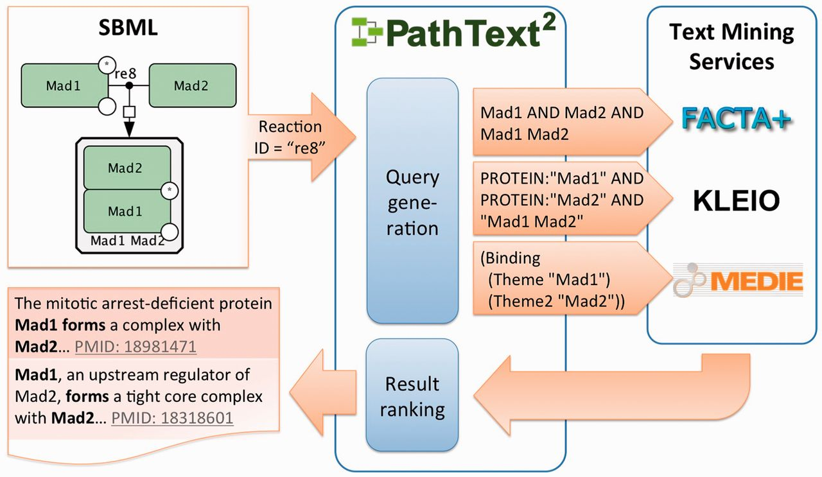
Fig. 1. Illustration of PathText 2 architecture
Notes:
Fig. 1. Illustration of PathText 2 architecture
Unless provided in the caption above, the following copyright applies to the content of this slide: © The Author 2013. Published by Oxford University Press.This is an Open Access article distributed under the terms of the Creative Commons Attribution Non-Commercial License (http://creativecommons.org/licenses/by-nc/3.0/), which permits non-commercial re-use, distribution, and reproduction in any medium, provided the original work is properly cited. For commercial re-use, please contact journals.permissions@oup.com

Slide 2
Fig. 2. Illustration of event representation
Notes:
Fig. 2. Illustration of event representation
Unless provided in the caption above, the following copyright applies to the content of this slide: © The Author 2013. Published by Oxford University Press.This is an Open Access article distributed under the terms of the Creative Commons Attribution Non-Commercial License (http://creativecommons.org/licenses/by-nc/3.0/), which permits non-commercial re-use, distribution, and reproduction in any medium, provided the original work is properly cited. For commercial re-use, please contact journals.permissions@oup.com

Slide 3
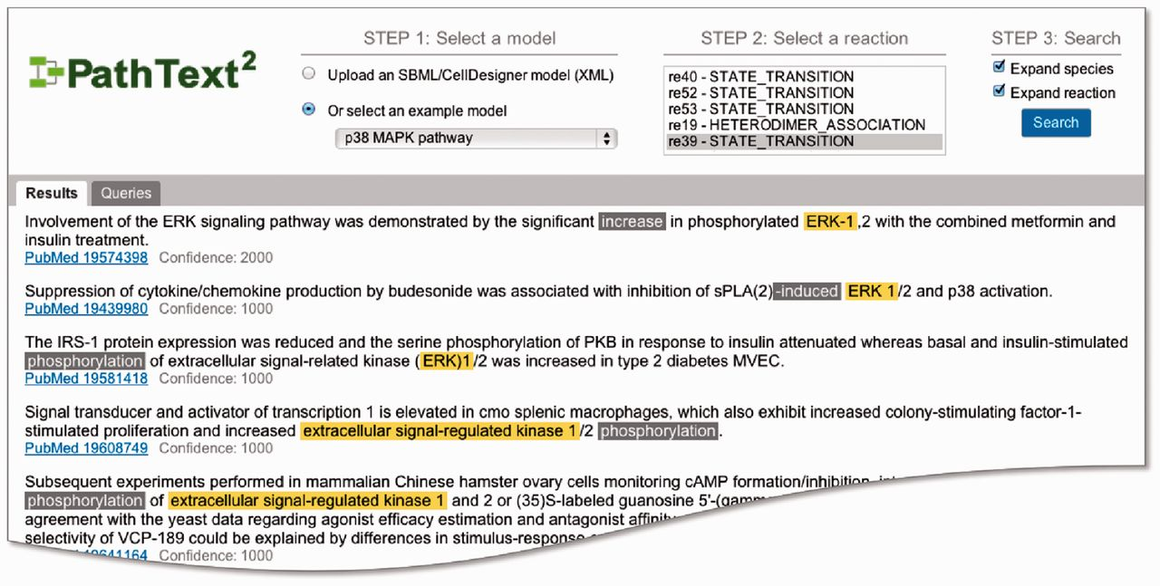
Fig. 3. Screenshot of PathText 2 web interface
Notes:
Fig. 3. Screenshot of PathText 2 web interface
Unless provided in the caption above, the following copyright applies to the content of this slide: © The Author 2013. Published by Oxford University Press.This is an Open Access article distributed under the terms of the Creative Commons Attribution Non-Commercial License (http://creativecommons.org/licenses/by-nc/3.0/), which permits non-commercial re-use, distribution, and reproduction in any medium, provided the original work is properly cited. For commercial re-use, please contact journals.permissions@oup.com

Slide 4
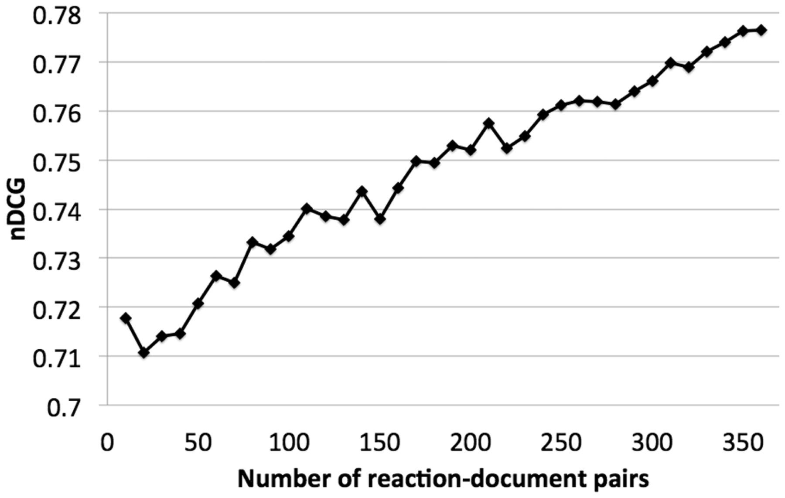
Fig. 4. Learning curve on SVM-based ranking
Notes:
Fig. 4. Learning curve on SVM-based ranking
Unless provided in the caption above, the following copyright applies to the content of this slide: © The Author 2013. Published by Oxford University Press.This is an Open Access article distributed under the terms of the Creative Commons Attribution Non-Commercial License (http://creativecommons.org/licenses/by-nc/3.0/), which permits non-commercial re-use, distribution, and reproduction in any medium, provided the original work is properly cited. For commercial re-use, please contact journals.permissions@oup.com

