Slide 1
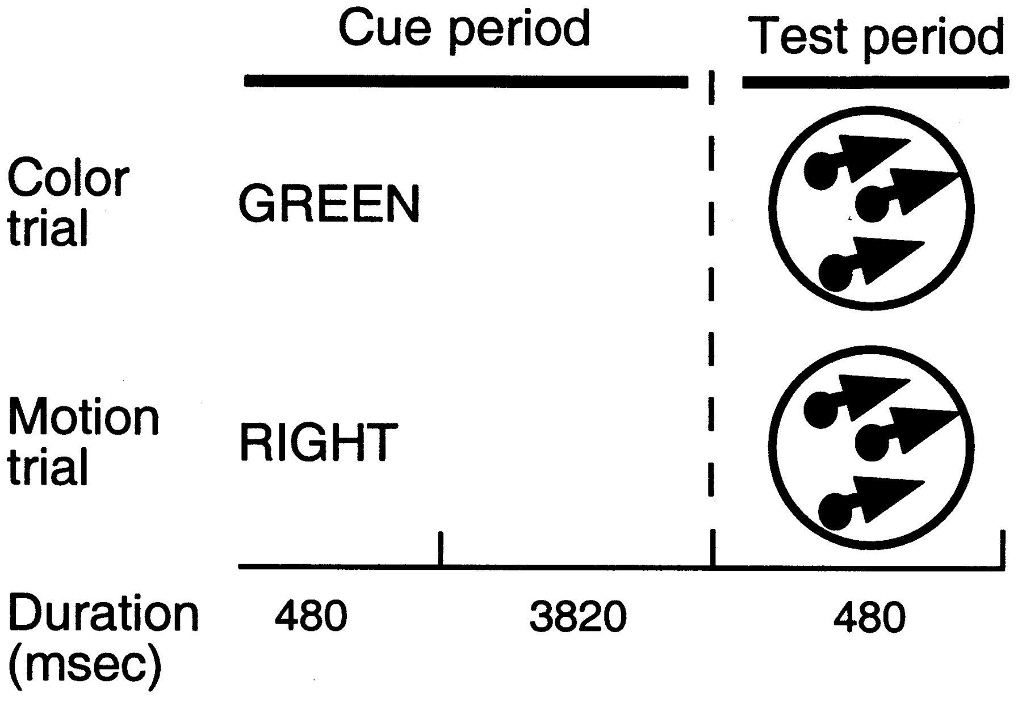
Figure 1. Examples of trials involving color and motion cues.
Notes:
Figure 1. Examples of trials involving color and motion cues.
Unless provided in the caption above, the following copyright applies to the content of this slide: © Oxford University Press

Slide 2
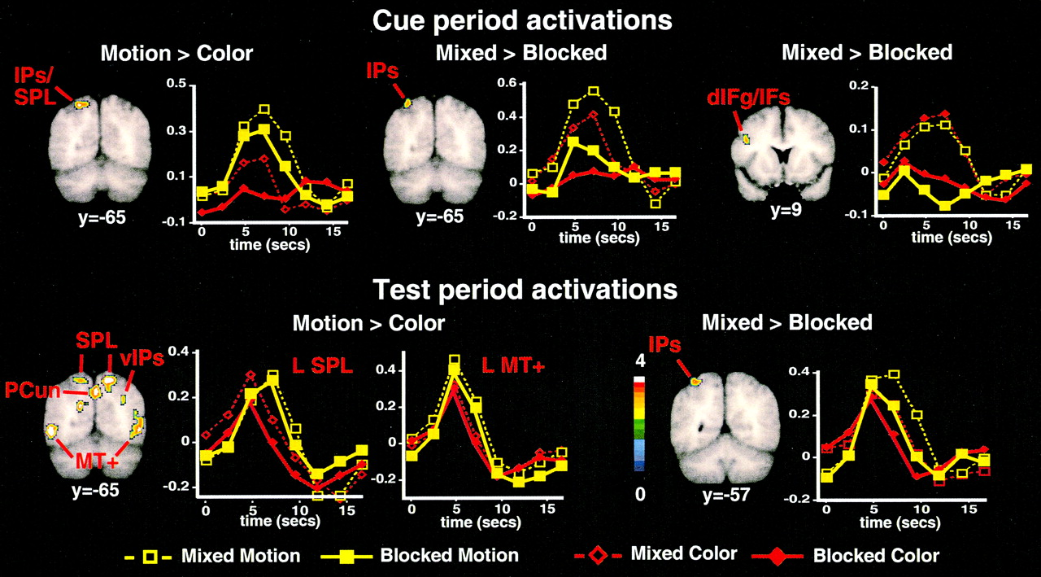
Figure 2. Statistical maps of significant voxels from voxel-wise, random-effects, multiple-comparison corrected ANOVAs ...
Notes:
Figure 2. Statistical maps of significant voxels from voxel-wise, random-effects, multiple-comparison corrected ANOVAs and the associated group mean time-course of the BOLD signal. Statistical maps are superimposed on group-averaged anatomy images. Images are displayed such that the left and right hemispheres are on the left and right side, respectively. The color scale refers to the equivalent z-score for the ANOVA, ranging from 0 (blue) to 4 or higher (white). Time-courses were determined within the ROI defined by the intersection of the voxels in the statistical map and a sphere of diameter 10mm, centered on the peak voxel for the displayed focus (see Tables 1 and 2 for coordinates). The y-axis on the graphs refers to percent signal change. Top row: Significant activations during the cue period. The left panel shows greater activity in left posterior parietal cortex following motion cues than color cues, while the middle panel shows that a similar parietal region was more activated on mixed scans than blocked scans. The right panel shows a region in left frontal cortex with greater activity on mixed than blocked scans. Bottom row: Significant activations during the test period. The left panel shows voxels with significantly greater activity for motion trials than color trials at the same coronal slice shown for the cue period. The right panel shows a left parietal region with greater activity on mixed than blocked scans. IPs = intraparietal sulcus, SPL = superior parietal lobule, IFg/IFs = inferior frontal gyrus/sulcus, PCun = precuneus. v = ventral.
Unless provided in the caption above, the following copyright applies to the content of this slide: © Oxford University Press

Slide 3
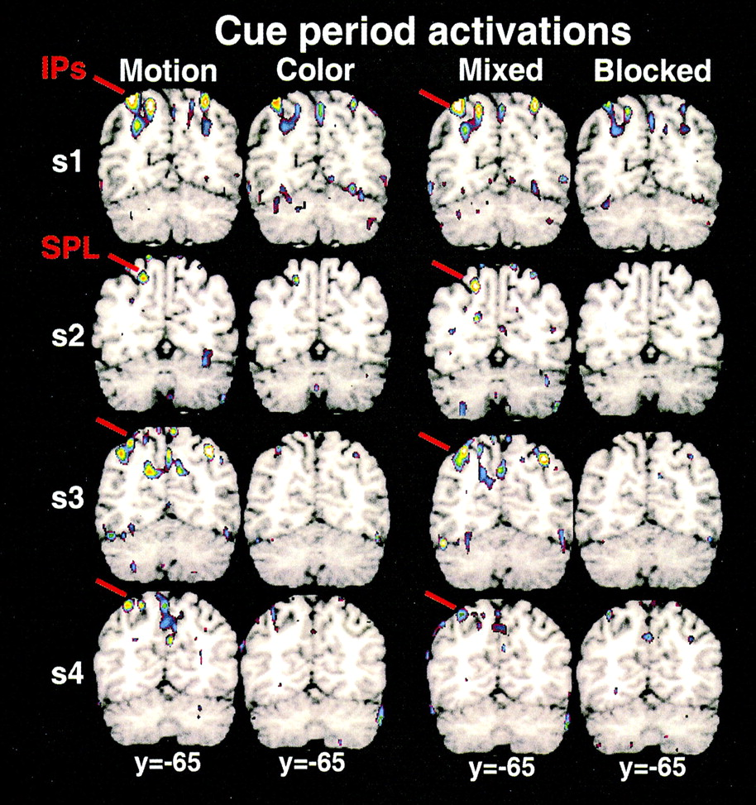
Figure 3. Individual z-maps for four subjects. Motion and color conditions were collapsed over the mixed and blocked ...
Notes:
Figure 3. Individual z-maps for four subjects. Motion and color conditions were collapsed over the mixed and blocked conditions, while mixed and blocked conditions were collapsed over the motion and color conditions.
Unless provided in the caption above, the following copyright applies to the content of this slide: © Oxford University Press

