Slide 1
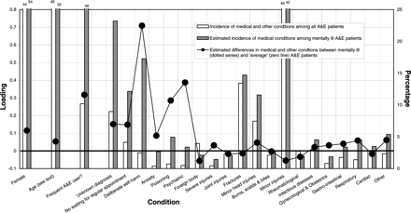
Figure 1 Main profile of mentally ill A&E patients according to their conditions. Results from non-linear canonical ...
Notes:
Figure 1 Main profile of mentally ill A&E patients according to their conditions. Results from non-linear canonical correlation
Unless provided in the caption above, the following copyright applies to the content of this slide: © The Author 2007. Published by Oxford University Press on behalf of the European Public Health Association. All rights reserved.

Slide 2
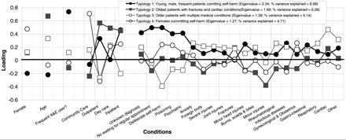
Figure 2 Typologies of mental health and A&E patients based on their medical conditions
Notes:
Figure 2 Typologies of mental health and A&E patients based on their medical conditions
Unless provided in the caption above, the following copyright applies to the content of this slide: © The Author 2007. Published by Oxford University Press on behalf of the European Public Health Association. All rights reserved.

